Slide 1
Emergency Response Planning
A Template for Public Drinking Water Systems

Slide 2
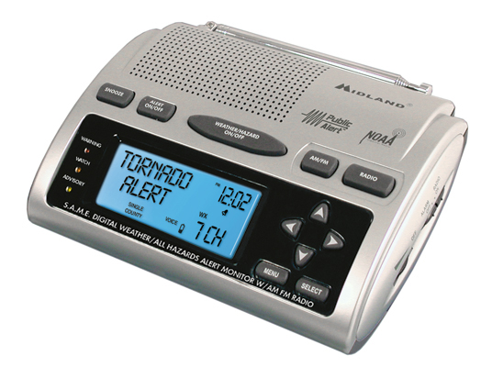
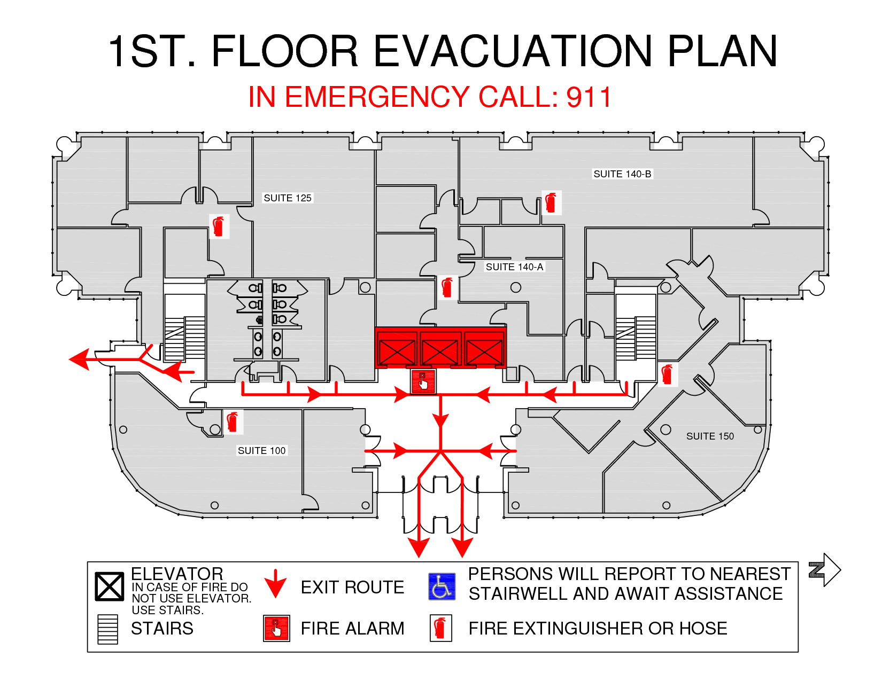
Levels of Planning
Notes:
I use this slide to have the audience think about their personal emergency planning. It seems from childhood we have participated in emergency response beginning with grade school fire and tornado drills. Back in the 1950’s there even were drills for the “BOMB.” How many of you with kids taught them how to get out of the house in case of a fire; you may have bought roll out ladders if you had a second floor. I travel a lot and in every motel I stay there is a fire evacuation map. That to is a level of planning. Maybe for a single scenario; but the most likely.

Slide 3
Everyone should have an Emergency Response Plan.
Every public water/sewer utility should have an Emergency Response Plan.
What do we need to do to create an ERP for our water system?
Notes:
Everyone in the room either has a plan for some event or has at least given it some thought. This time of year how many of you stow extra supplies in their vehicle? What organization’s creed is “Neither snow nor rain nor heat nor gloom of night stays these couriers from the swift completion of their appointed rounds.” So, during an ice storm would you rather have the sale paper or water/sewer service? As public utilities we owe it to our customers to have contingency plans. Recently, the DOW and KIA compiled an ERP template that makes the planning process a little easier.

Slide 4
Prepare
Exercise
Review
Update

Slide 5
Step 1: Prepare
Form an ERP work group at your utility. Engage the group with disaster & operational scenarios.

Slide 6
Introducing… the new easy-to-use template! DOW & KIA made this step easy for you…
Screen shot of the cover page.

Slide 7
Section 1
Internal Chain of Command
List of personnel
Order of Responsibility
Make sure to include:
Full Name & Title
All contact information

Slide 8
Section 2
Emergency Notifications
Local Resources
Other Resources
Adjacent & Interconnected Water Systems
Priority Customers
Service and Repair Contacts
Utility Public Spokesperson
Media Contacts
Notes:
I have found that calling your county EM Coordinator for a contact list makes completing the local & other resources section must easier. What is a Priority Customer? This should generate some discussion. My rule of thumb is that before I close that valve is there any customer that should be notified even in an emergency? Picture this; your watching the news and a tornado just tore through a trailer park; who is the first person that the reporter put in front of the camera? Is that your utility spokesperson? Lets face it, we all have those people in our organizations and they are good people, but in front of the camera is not where they need to be. There is room to list your primary and two alternates, so choose wisely.

Slide 9
Section 2
Continued

Slide 11
Section 3
Basic System Information
System Demand and Capacity
Location of Pertinent Information
Treatment Plant
Disinfection Chemicals
Treatment Chemicals
Source Information
Finished Water Storage
Pumps & Motors
Standby Power Requirements
Notes:
Section 3 can be very time intensive especially if you have treatment and distribution. Many of the items in this section require GPS coordinates. The easiest way to obtain this information is to contact your Area Development District. They will typically send you a spreadsheet listing all of your infrastructure information with GPS coordinates. This is a good section to expend your discussion on generators.

Slide 12
Section 3
Continued

Slide 13
Section 3
Continued

Slide 14
Section 3
Continued

Slide 15
Section 3
Continued

Slide 16
Section 4
Specific Emergency Preparedness
Preparation:
Includes info on how to avoid the emergency or how to get ready for oncoming emergency.
Impact:
Includes all parts of the Utility that will be affected by the emergency and how damage can be minimized.
Recovery:
Prioritized list of tasks to get Utility back to normal operations.
Notes:
To me this is the most important section in the entire template. It is not designed to write a long narrative, but rather a bullet list of things to do. The easiest way to start is to begin with a scenario that you have experienced. If you are like most you have had this experience more that once. Note: If you are making this a three hour session this is the point where you take a break to set up the white board then facilitate a scenario plan.

Slide 17
Section 5
Training and Exercise Record
Date of training/exercise
Description
Participants
Notes:
The best reason to train: You don’t want to be in the middle of a disaster to figure out your plan of action. There are many opportunities to train for emergency response through your local and state EM Coordinators. But you can pick a day and exercise a portion of your plan. For instance, for those with running SCADA; try operating without it. Try running a portion of your system on as few generators as possible especially where you have to leapfrog between pump or lift stations. Training in a controlled safe environment is better than waiting for the disaster to learn the hard and dangerous way.

Slide 18
Section 6
Plan Approval Documentation
Prepared by:
Name
Title/Organization
Date
Officially reviewed, approved and signed by:
Name
Signature
Date

Slide 19
Appendices
Additional Chemical Information
Additional Source Information
Additional Finished Water Storage Information
Additional Pump Information
Additional Control Valve Information
Additional Standby Power Information
KY Specific Emergency Response Example
Key Messages
Schematic of Treatment Plant

Slide 20
Step 2: Exercise
With all involved utility employees, exercise at least one scenario of the ERP annually.
Document each exercise in Section 5 of the ERP.

Slide 21
Step 3: Review
Meet as a group, at least annually, to review the contents of your ERP and discuss the results of your ERP Exercise.

Slide 22
Step 4: Update
With your ERP work group, update the ERP as needed with each annual review.
Document the revisions in the table at the bottom of the cover page.

Slide 23
The ERP template can be found…
On the Capacity Development website:
http://water.ky.gov/DrinkingWater/Pages/CapDev.aspx
On the Kentucky Rural Water Association website:
http://www.krwa.org/announcements/is-your-emergency-response-plan-up-to-date/
On the KYWARN website:
http://www.kywarn.org/news-events/

Slide 24
ERP Recommendations
Keep contact list current
Maintain accurate pump & motor inventories
Know your power requirements
Install switch gear at locations with mobile power needs
Use the scenarios for team building
Keep ERP’s in all service vehicles
Practice the most common scenarios annually.
Participate in local, state & federal EM events.

Slide 25
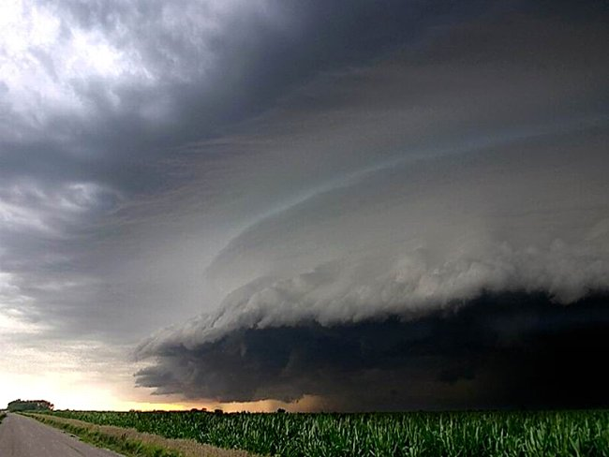
KYWARN
Mutual Aid Response Network
For Water and Wastewater Systems

Slide 27
Other Groups Involved
American Water Works Association
National Rural Water Association
Water Environment Federation
Water and Wastewater Utilities
Association of State Drinking Water Administrators
State Environmental Protection Departments
Local Emergency Management Agencies

Slide 28
Who and What is a WARN
Water/Wastewater Agency Response Network
Simply an Agreement between two Utilities
Statewide Resources from all other Utilities and other
United by a Common Enemy
Natural Disasters
Manmade Disasters
Utilities Organized within a State
Private
Public

Slide 29
What a WARN is Not
Not a Corporation
Not Federal Government (FEMA)
Not State Government
Not Connected to any Funding Source
Not Required for any Utility to Participate

Slide 30
What is a KYWARN Event
A declaration of an emergency issued by a community’s authorized official or alternate
Natural Disasters
Manmade Disasters
Operational Disaster

Slide 31
What is an Emergency
Any occurrence that is, or is likely to be, beyond the control of the services, personnel, equipment, or facilities of a Party’s utility. Emergencies are generally unforeseen events.
Participation in KYWARN does not create any duty to respond to a request for assistance.
When a Member receives a request for assistance, the Authorized Official shall have absolute discretion as to the availability of resources. An Authorized Member’s decisions on the availability of resources shall be final.

Slide 32
How Does My Utility Participate?
Participation in KYWARN is voluntary and membership is free.
To participate in KYWARN, simply fill out the Membership Information Form and submit to KYWARN along with the Mutual Aid Agreement.
The governing entity must adopt the Mutual Aid Agreement.
KYWARN also recommends that a sample equipment schedule of fees be adopted by your governing entity.
In the event of a KYWARN response, if a schedule of charges is not agreed upon, the default will be FEMA rate of reimbursement.

Slide 33
Comments and Questions

