Slide 1

Workforce Planning:
DO YOU HAVE ENOUGH OPERATORS?
Provided by the
Kentucky Operator Certification Program
Department for Environmental Protection
Notes:
Good afternoon. Introduce yourself.
Today I am going to cover some statistics related to the world of drinking water and wastewater specific to Kentucky. This information can be beneficial for some trend analysis to determine a water utilities future needs and the difficulty addressing these needs.

Slide 2
WHAT WE WILL COVER
01
02
03
04
05
06
Why certified operators
What it takes to be an operator
New regulatory changes
The national picture
Kentucky specific numbers and issues
Steps of succession planning
Notes:
Here are 6 main topics I will cover related to water operators.
Why have certified operators
What is takes to be a certified operator
New regulatory changes and how they will affect utilities
The current national certified operator condition
Data specific to Kentucky water operators
Steps for succession planning

Slide 3
Things to know
Water and Wastewater facilities require certified operators
Applicants may need 1 – 7 years of experience
It takes time to certify operators
Certified operators may be hard to find
You need to think ahead
Notes:
In Kentucky, all drinking and wastewater systems are required to have certified operators. It may take as little as 1 year to get an operator certified for small systems, and as much as 7 years for larger systems.
To become a certified water operator in Kentucky it takes experience and the ability to pass a written exam. Because of the demanding nature of the profession and the work experience requirements, it takes time to certify operators.
Not to mention, there is not a surplus of operators waiting to find work, they are often hard to find.
It is imperative that managers and owners of the utilities plan ahead to ensure compliance with operator staffing for their water utilities.

Slide 4


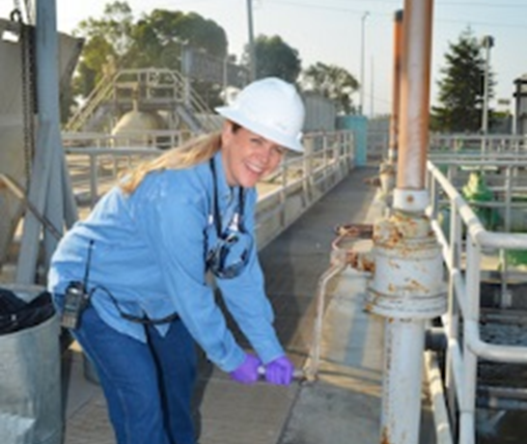

Why do we certify
Operators
Certified operators are crucial to ensure adequate and safe drinking water and that wastewater is treated properly.
Ongoing training is necessary to stay up to date as new regulations and technologies emerge.
Training reinforces and advances an operator’s knowledge, skills and abilities. It also expands an understanding of emerging technologies and best practices.
Notes:
Certified operators are crucial to ensure adequate and safe drinking water and that wastewater is treated properly.
Ongoing training is necessary to stay up to date as new regulations and technologies emerge.
Training reinforces and advances an operator’s knowledge, skills and abilities. It also expands an understanding of emerging technologies and best practices.

Slide 5

What does being certified mean?
Operators have met the basic knowledge requirements needed for their certification level.

Slide 6

What it doesn’t mean?
An operator can run a plant by themselves. Will depend on their skill level.
An operator knows how to operate every type of treatment plant.
An operator is familiar with all treatment systems.
Notes:
The education component to certify operators requires them to have a fundamental understanding of the industry as a whole. Operators who pass the exam should definitely understand how their plant works.
They should also understand an recognize other types of plants and how they function. Their ability to be left alone or in charge of a treatment plant will depend on their skill level. This skill level is often developed with time and experience. This is why there is an experience metric required for an operator to become certified.

Slide 7



Relevant Work Experience
Certification in Kentucky
Education - substitution available
Test - 70% or above
Notes:
Speaking of experience and academic requirements. Regulations give the Operator Certification Branch some leeway for applying work experience that is not actual operations but is similar enough to provide exposure to the water industry. (A good example would be this, a retired plumber could count some of their experience towards the experience requirement)
Regulations do allow for academic substitutions as well. This was inserted into the regulations to help expedite the certification process due to the time required to gain experience
All operators much pass a certification exam for the license they seek. A Class 1 licenses is the lowest license Kentucky issues and is the easiest to pass. A Class 4 is the highest license and is the most difficult to pass.

Slide 8
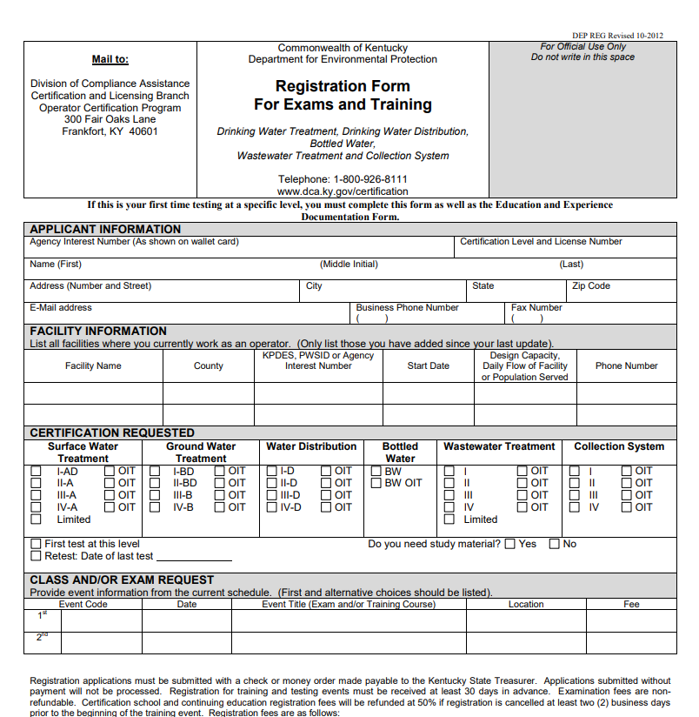
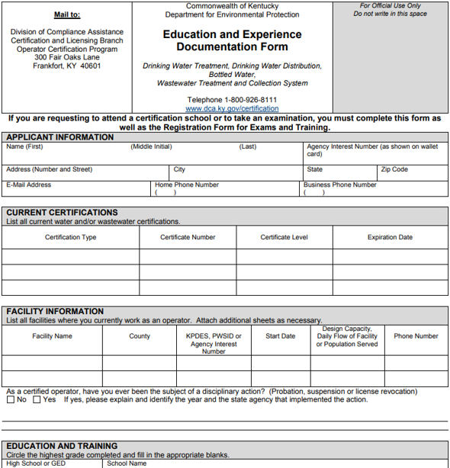
Certification
Registration Form for Exams and Training Kentucky One Stop
Education and Experience Documentation Form
Notes:
To register an employee for the certification exam they need to go to the Division for Compliance Assistance web site and navigate the links until they get to the training and exam page. Here you see an example of the online form that the applicant will fill out.

Slide 9
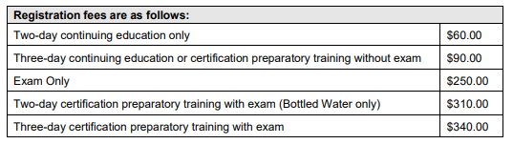
Certification Fees
Note: if application is rejected exam fees are non-refundable
If in doubt call us
All paper applications have an additional $50 paper application fee
Notes:
In 2019 the regulations changed and the price of the exams and trainings went up significantly. These are non-refundable fees. If an operator fails the exam, they don’t get to apply the money to another exam. We do make special reparations on a case by case basis for illness since COVID seems to be a permanent part of humanity.

Slide 10
Relevant Work Experience
01
Operator experience must be relevant to the classification. It can’t be managerial and it has to be operational in nature.
02
Does not necessarily have to be at a facility as long as it is relevant and related.
03
Whatever the experience, be clear and detailed on the form.
If operator holds multiple certifications, describe the percentage of time worked at each certification.
03
Notes:
Acceptable operator experience has to be related to the hands-on component of water treatment operations. Management of a system is not operations of a system.
However, the experience does not have to be working in the facility as long as it is related. This is evaluated on a case by case basis
List all the job duties in detail. Break the work history apart when job duties or job titles change
When an operator has multiple licenses they must identify the amount of time spent performing each duties for each. For example: Identify the amount of time spent performing distribution duties and collection duties from May 2015 through January 2022

Slide 11
Water Treatment Operator Certification Requirements
DW Limited
Minimal level of education is not required. Minimal level of experience is not required.
DW Treatment
Class I-AD
High school diploma or GED is required. One (1) year of experience running a class I-AD or higher public water system.
DW Treatment
Class II-A
High school diploma or GED is required. Two (2) years of experience running a public water treatment plant, with six (6) months of that experience in a class II-A, III-A or IV-A treatment plant.
DW Treatment
Class III-A
High school diploma or GED is required. Three (3) years of experience running a public water treatment plant, with one (1) year of that experience in a class II-A, III-A or IV-A treatment plant.
DW Treatment
Class IV-A
Baccalaureate degree in engineering, science, or equivalent from an accredited college or university. One (1) year of experience operating a class III-A or IV-A water treatment plant.
Notes:
The “A” designation indicates the raw water supply is a surface water source or is a ground water under the influence of surface water
Drinking water Limited licenses are for schools and are not very common.
A Drinking Water Class 4 requires a Bachelor degree in STEM with one year of operational experience in a class 3 or 4 system
Or 5 years of work experience with only a HS diploma.

Slide 12
Water Treatment Operator Certification Requirements
DW Treatment
Class I-BD
High school diploma or GED is required. One (1) year of experience running a class I-BD or higher public water system.
DW Treatment
Class II-BD
High school diploma or GED is required. Two (2) years of experience running a public water treatment plant, with six (6) months of that experience in a class II-A, II-BD or higher treatment plant.
DW Treatment
Class III-B
High school diploma or GED is required. Three (3) years of experience running a public water treatment plant, with one (1) year of that experience in a class II-A, II-BD, III-A, III-B, IV-A or IV-B water treatment plant.
DW Treatment
Class IV-B
Baccalaureate degree in engineering, science, or equivalent from an accredited college or university. One (1) year of experience operating a class III-A, III-B, IV-A or IV-B water treatment plant.
Notes:
The “B” designation indicates the source water is a groundwater source.
A Drinking Water Class 4 requires a Bachelor degree with one year of operational experience in a class 3 or 4 system
Or 5 years of work experience with only a HS diploma.

Slide 13
Water Distribution Operator Certification Requirements
DW Distribution
Class I-D
High school diploma or GED is required. One (1) year of experience running a distribution system.
DW Distribution
Class II-D
High school diploma or GED is required. Two (2) years of experience running a distribution system, with six (6) months of that experience in a class II-D, III-D or IV-D distribution system.
DW Distribution
Class III-D
High school diploma or GED is required. Three (3) years of experience operating a distribution system, with one (1) year of that experience in a class II-D, III-D or IV-D distribution system.
DW Distribution
Class IV-D
Baccalaureate degree in engineering, science, or equivalent from an accredited college or university. One (1) year of experience operating a class III-D or IV-D distribution system.
Notes:
A Drinking Water Class 4 requires a Bachelor degree with one year of operational experience in a class 3 or 4 system
Or 5 years of work experience with only a HS diploma.

Slide 14
Wastewater Treatment Operator Certification Requirements
WW Limited
Minimal level of education is not required. Minimal level of experience is not required.
WW Treatment
Class I
High school diploma or GED is required. One (1) year of experience running a WW treatment plant.
WW Treatment
Class II
High school diploma or GED is required. Two (2) years of experience running a WW treatment plant.
WW Treatment
Class III
High school diploma or GED is required. Three (3) years of experience running a WW treatment plant, with one (1) year of that experience in a WW treatment plant with a design capacity greater than 50,000 gallons per day.
WW Treatment
Class IV
Baccalaureate degree in engineering, science, or equivalent from an accredited college or university. At least three (3) years of acceptable operation of a WW treatment plant. Two (2) years of the required experience shall be in a WW treatment plant with a design capacity greater than (2) million gallons per day. At least one (1) year of primary responsibility in a WW treatment plant with a design capacity greater than two (2) million gallons per day.
Notes:
WW Limited is for schools and is also dependent on the size of the WW treatment plant.
It is hard to read because there is a lot of information. A Wastewater Class 4 requires a STEM Bachelor degree with 3 years of operational experience in a system with a design capacity of 2 millions gpd or greater
AND must have 2 years of primary responsibility in a wastewater system with a design capacity of 2 millions gpd or greater
Without a STEM degree the applicant will need a HS Diploma or GED plus 7 years experience.

Slide 15
Wastewater Collection Operator Certification Requirements
WW Collection
Class I
High school diploma or GED is required. One (1) year of acceptable operation of a WW collection system shall be required.
WW Collection
Class II
High school diploma or GED is required. Two (2) years of acceptable operation of a WW collection system shall be required.
WW Collection
Class III
High school diploma or GED is required. Three (3) years of experience running a WW collection system with one (1) year of that experience in a WW collection system with a design capacity greater than 50,000 gallons per day.
WW Collection
Class IV
Baccalaureate degree in engineering, science, or equivalent from an accredited college or university. At least three (3) years of acceptable operation of a WW collection system. Two (2) years of the required experience shall be in a WW collection system with a design capacity greater than two (2) million gallons per day.
Notes:
A Wastewater Class 4 requires a STEM Bachelor degree with 3 years of operational experience in a system with a design capacity of 2 millions gpd or greater
AND must have 2 years of primary responsibility in a wastewater system with a design capacity of 2 millions gpd or greater
Without a STEM degree the applicant will need a HS Diploma or GED plus 7 years experience.

Slide 16




Educational Substitution
Education
In an approved field can be substituted for up to 50% of the required experience.
STEM Associates
Degree
Can substitute for 2 years of experience.
STEM Baccalaureate
Degree
Can substitute up to 4 years of experience.
Transcripts
If a degree was not completed, submit transcripts for class by class review.
Notes:
Education can be used to substitute for experience. A STEM associates degree can provide up to 2 years of experience. A STEM Baccalaureate degree can provide up to 4 years experience.
If an applicant has some college classes or a Non-STEM degree, they can submit their transcripts and get partial substitutions for work experience.
It is important to note: Except for the Class 4 license. All academic substitutions can only count up to 50% of the required work. An applicant must work 50% of the required work experience.

Slide 17
Agricultural
Geoscience
Applied Geography
Bioengineering
Horticulture
Plant and Soil Science
Mathematics
Approved STEM Degrees
Biology
Chemistry
Microbiology
Natural Resources and Environmental Science
Engineering
Environmental Heath
Physics
Public Health
Geology
Water Resource Management
Baccalaureate Degrees which meets the education requirements established in 401 KAR 11:030 and 401 KAR 11:040. Additional degrees may be considered on a case-by-case basis.
Notes:
In 2019 the regulations expanded the courses that were considered to fall within the STEM degree criteria. Here you can see some of the academic disciplines. An extended list of approved degrees can be found on DCA’s webpage

Slide 18


Experience
Substitutions
I year of operational experience = I year of education (no degree)
Partial experience substitution for work in maintenance, lab analysis or other work related to the collection, treatment or distribution of drinking water or wastewater.
Notes:
For applicants who do not have any college education
1 year of operational experience is equal to 1 year of education
Partial work experience substitutions can be granted for work related to water operations.

Slide 19
01
Operators renew license every 2 years
Drinking water – even numbered years....
Wastewater – odd numbered years..…..
Must attend Continuing Education Courses
Reinforces and advances technical knowledge, skills, and …....abilities
Expands an understanding of emerging technologies ………...and best practices
Renewal
03
02
Online renewal form
Notes:
The renewal periods for operators are on 2 year cycles.
Drinking water operators must renew on even years (2022, 2024, 2026…..)
Wastewater operators must renew on odd years (2023, 2025, 2027….)
Operators must have already completed their continuing education requirements before applying for their license renewal

Slide 20
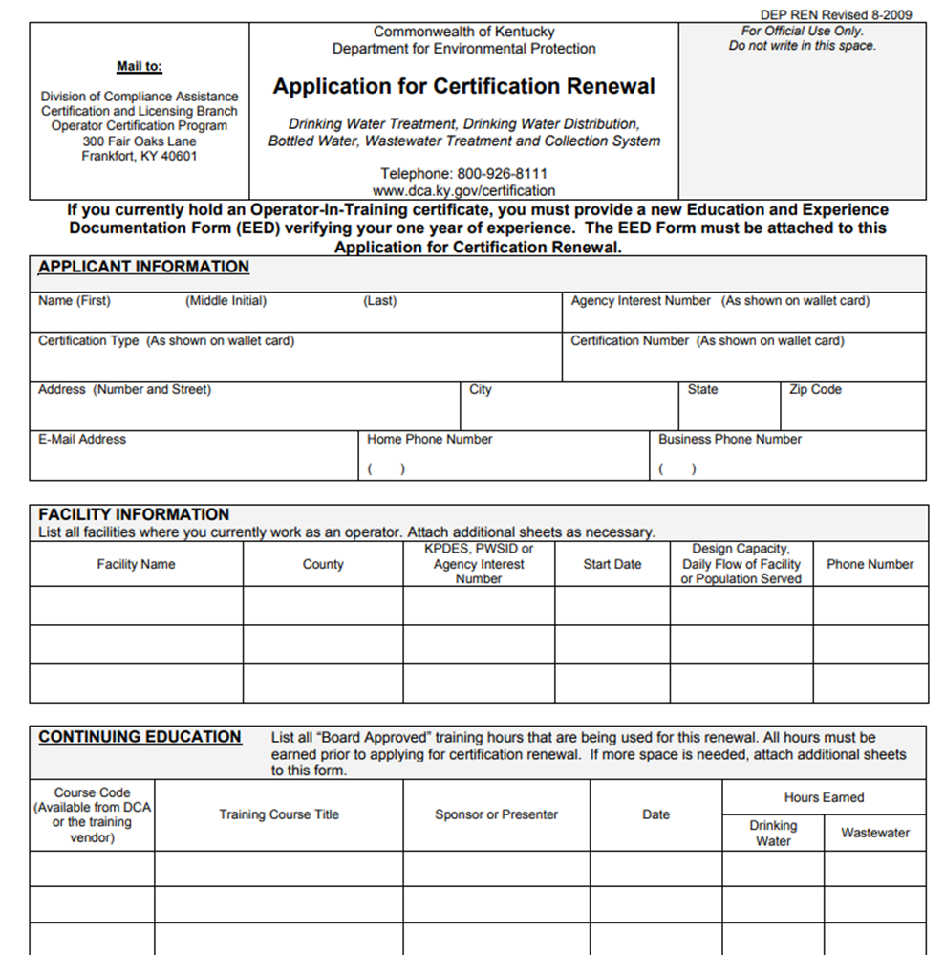
Renewal Requirements
$200 online renewal fee
$250 hard-copy renewal
Renewal Form
Notes:
The fee for renewing an operators license is $200 on line or $250 if they send in a paper copy.

Slide 21
What is expected of an operator?
Notes:
Expectations of the operators include:
Being responsible,
Capable of performing the skills necessary for the job
Ethical in their decision making and representation of data and operations

Slide 22
Responsibilities
To safeguard the life, health and welfare of the public and the environment and to establish and maintain a high standard of integrity in the certified operator profession
401 KAR 11:020
Notes:
To safeguard the life, health and welfare of the public and the environment and to establish and maintain a high standard of integrity in the certified operator profession
401 KAR 11:020. This comes straight from the regulations

Slide 23
Mathematical, mechanical and science skills
Engage in logical processes for trouble-shooting
Calibrate, repair, and troubleshoot treatment systems
Collect field and facility samples
Maintain treatment systems (piping, pumps, valves and tanks)
Skills and Duties
Maintain records and observations; and report problems in the system
Prepare chemical treatments for plant systems
Operate instruments and meters for treatment systems
Communicate issues clearly
Be committed to safety, practices and standards
Notes:
Possessing and maintaining the skills to perform the duties of an operator. This includes record keeping, performing the necessary math to operate their system safely, communication with other operators and the public, technical abilities to operate their systems specific processes.

Slide 24
Operator Ethics
DEP places a strong emphasis on certified operator performance and ethics.
Certified operators are held accountable for their actions at their facilities.
Notice of Violations (NOVs)
Operator Disciplinary Actions
Notes:
Certified operators are being held more accountable for their actions and this can been seen in three areas. Recent regulation changes, NOVs and Operator Disciplinary Actions.

Slide 25
Code of
Conduct
Professionalism develops integrity with stakeholders
Unethical behavior damages public trust and confidence in how operators do their jobs
Notes:
There is an expectation that operators follow some code of conduct. Though it is not the regulatory agency’s responsibility to establish this code, the state government does have regulations that set a minimum standard. Purposeful neglect or willful ignorance of regulations that does or can harm the environment or the public are dealt with by the water boards. Often the end result is a permanent revocation of the operators license.

Slide 26
protect the health, welfare and safety of the public and the environment
A Certified Operator Shall:
401 KAR Chapter 11
Use reasonable care and judgment in performance of duties
If an operator’s judgment is overruled by an employer and the safety, health and welfare of the public or environment are endangered, the operator shall inform the employer of potential consequences
Be truthful and complete in applications, reports, statements and testimony provided to the cabinet
Ensure the integrity of the samples collected, prepares or analyzes so that the results shall be a true representation of water quality
Notes:
protect the health, welfare and safety of the public and the environment
Use reasonable care and judgment in performance of duties
If an operator’s judgment is overruled by an employer and the safety, health and welfare of the public or environment are endangered, the operator shall inform the employer of potential consequences
Be truthful and complete in applications, reports, statements and testimony provided to the cabinet
Ensure the integrity of the samples collected, prepares or analyzes so that the results shall be a true representation of water quality

Slide 27
Other Requirements
While on duty, a certified operator shall carry the cabinet-issued wallet card showing the operator’s current certification status.
If information related to the operator's employment or mailing address changes from that provided in the application for certification, the certified operator shall provide written notification to the cabinet within thirty (30) days.
Notes:
Certified operators shall carry their cabinet issued wallet license with them while on duty
Operators shall update their official contact information or change of employment within 30 days.

Slide 28
Disciplinary Action
Reasons For Taking Action:
Willfully or negligently caused or violated requirements of KRS Chapters 223 or 224
Example: Willfully or negligently falsified, failed to maintain, or submit records required by Chapter 5 or 8
Notes:
I briefly mentioned earlier in the conversation about the Code of conduct. Operators can will have disciplinary actions taken against them for violating the requirements of the KRS Chapter 223 and 224. These include things ( and are not limited to these) such as failure to maintain proper record keeping or falsifying documents such as monitoring reports and licensure applications.

Slide 29
Consequences
Probation not to exceed 1 year
Suspension of license not to exceed 4 years
Disciplinary actions may include, but are not limited to:
Revocation of license
A combination of the action above
Civil or criminal penalties
Notes:
Consequences:
Probation not to exceed 1 year
Suspension of license not to exceed 4 years
Revocation of license (permanently)
Criminal and civil penalties
Or a combination of these

Slide 30
Disciplinary Review Procedure
01
02
03
04
05
Complaint/referral is received by the certification program (from inspectors, public, other operators, etc.)
Department staff may issue LOW or NOV
The complaint and supporting documentation is sent to the certification board for review. If charges are considered a “criminal” case, it is referred to Office of Inspector General.
The certification board will request to have the certified operator to appear before board to discuss the actions that resulted in the referral
When the review is complete, the agency reviews evidence presented and the board’s recommendation
06
07
08
09
10
Cabinet initiates the action recommended by the board or notifies the board why an alternative action was taken
If action is taken, the certified operator and their employer(s) are notified of the action, reasons for action and length of action.
During probation or suspension the board and/or cabinet will monitor your performance and work activities.
At the end of action, the agency will determine if all remedial measures were met and may confer with the board to determine whether the action should be lifted or whether additional action is required.
An operator who considers him/herself aggrieved by a disciplinary action may file a petition for hearing with the Cabinet pursuant to KRS 224.10-420(2).
Notes:
Investigations on operators begin with a complaint or a referral from the Division of Water (or other agency)
Referrals often come in the form of a NOV = Notice of Violation or a LOW = Letter of Warning
An investigation is performed by the Operator Certification Branch. This information is sent to the board for review. The board reviews the information and makes a recommendation to the cabinet
The cabinet usually follows the boards recommendation. If action is taken against the license the operator can appeal the decision and petition to have a hearing with the Cabinet.

Slide 31
Operator Disciplinary Action
Allegation - Failure to use reasonable care and judgment in the course of employment as a certified operator, failure to apply ability in the performance of duties, and willfully violated the requirements of KRS Chapter 223 and 224 and 401 KAR Chapter 8. Operator failed to submit MORs over an extended period of time and to maintain any other documentation related to chlorine residuals.
Final Action – license terminated. Operator not eligible for certification for a period of 5 years and at that point would be required to meet with the certification board to demonstrate an understanding of his responsibilities as an operator and exhibits a willingness to perform those duties before being approved to take the examination.
Operator failed to submit MORs over an extended period of time and to maintain any other documentation related to chlorine residuals.

Slide 32
Operator Disciplinary Action
Action – Suspend operator’s Class III Wastewater Treatment certification for 2 years; operator shall attend 24 hours of board-approved training on activated sludge, regulatory and permit requirements in which at least half of the 24 hours of training must be on activated sludge; the required 24 hours of supplemental training shall not be applied toward certification renewal; and at the end of the suspension period, the operator shall appear before the Kentucky board of Certification of Wastewater System Operators to demonstrate his competency as a certified operator.
Operator was responsible for multiple wastewater treatment plants. Multiple NOVs were issued for improper O & M. The plants were continuing to discharge unacceptable effluent. Several instances of plant upsets, line breaks, bypasses, etc. were not reported as required. Lagoons were not being properly maintained.
Allegation - Failure to use reasonable care and judgment in the performance of operational duties.

Slide 33
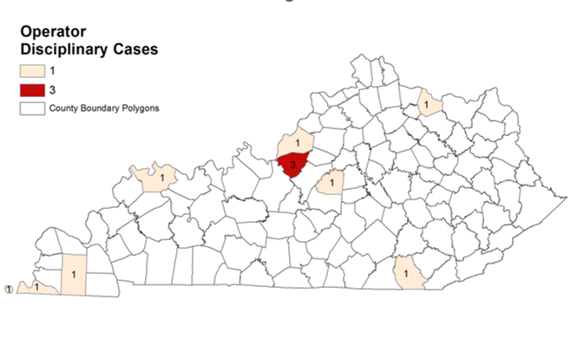
2020-2025
Notes:
This maps shows locations identified by DOW staff and inspections that don’t have enough operators for coverage of vacations or illness, or they are facilities with an approved alternative staffing plan. This map has more counties listed in 2022 than it did in 2020.

Slide 34
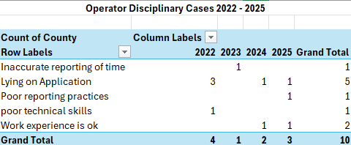
Reasons for Operator Disciplinary Cases 2022- 2025

Slide 35
Responsibility:
Responsibility for the water system goes beyond just the operators.
They are only as effective as their leadership!

Slide 36

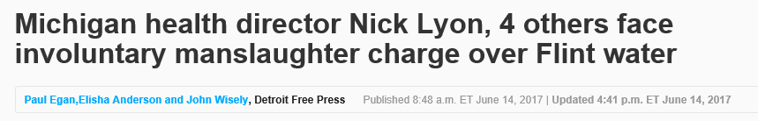
Notes:
An actual head line related to the possible criminal and civil side of negligence as an operator and utility manager.

Slide 37
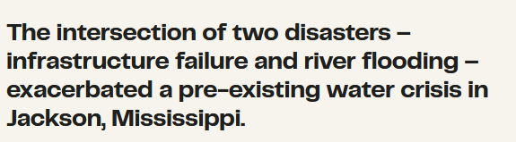

Slide 38
Jackson Mississippi – A multi-party problem
Background:
2010 winter storm caused water main breaks and widespread outages.
This caused city hospitals to rely on privately-owned well capacity as an emergency response.
In the aftermath of the 2010 storm city officials tried to issue bonds and local sales tax options to fund and fix system, funding efforts were blocked or reduced in size by state officials.
2012 Jackson failed EPA inspection for SDWA standards.
November 2012 Jackson settled; requirement was to improve maintenance of system.
2016 a sizable leak was reported.
By 2023 the leak was still present and had created a crater next to a golf course.
February 2021 another winter storm shut down the O. B. Curtis Water Treatment Plant.

Slide 39
Jackson Mississippi – A multi-party problem
Background:
This left residents without potable water for a month.
For sewer issues City leaders asked state officials for $47 million to make sewer repairs but only received $3 million.
July 2021 the City and the EPA agreed on a repair plan, but the infrastructure continued to deteriorate with low water pressure and open sewage in the streets.
A private contractor failed to send thousands of resident’s water bills; the Governor allowed a partial amnesty where customers did not have to pay further hindering the city finances.
By December 2021, the EPA allocated $74.9 million from the Infrastructure Investment and jobs act to Mississippi, at this point the repair bill was estimated at $2 billion.

Slide 40
Jackson Mississippi – A multi-party problem
Problems accumulate:
From 2017 to 2021 Jackson recorded annual average of 55 breaks / 100 miles of water line (safe rate is 15).
EPA completed a report and identified issues with understaffing, high employee turnover, malfunctioning water meters, inability to properly issue bills to customers, and 50% of water supplied did not result in revenue.
By the time of the 2022 water crisis the city had $191 million in outstanding revenue bond debt and bonds had been downgraded and rated as junk status.

Slide 41
Jackson Mississippi – A multi-party problem
Problems accumulate:
Due to funding and staff issues the city did not record water pressure, flush regularly, maintain and exercise valves and hydrants, and did not cycle water in the tanks to maintain chlorine levels.
Ultimately the city was forced to switch to backup pumps putting the city on a permanent boil water advisory
The city was last entertaining hiring or creating an independent water utility for the city.

Slide 42
The Roll of Public Officials
Get to know your systems
Read your permit
Get to know your operators - encourage communications
Get to know state regulators and field office staff
Will you need to replace infrastructure
What are the financial needs of the system in the future
What are the employments needs at the plant - operations and management
Notes:
The roll of public officials is to know their systems. Work with engineers and operators to know what infrastructure they have and what they need. Read your permits. Know what you financial needs are (which is different than having the money for your financial needs). Encourage open communication. Get to know the regulators and field staff.

Slide 43
Questions about
Certification

Slide 44
Operator Recruitment and Succession Planning
Notes:
Moving along. I have talked about the operator certification process. I have touched on items such as the why operators need to be certified, requirements for certification, the different classes of certification and operator ethics.
Why is this important. Because operators quit and they retire. It takes time to retrain operators and not everyone who wants to be an operator will make a good operator or can pass them examinations.

Slide 45

As of January 2024
153k drinking water and 16k wastewater facilities in the US
A majority served fewer than 10k people
478,700 people employed by utilities (operators, administration, customer service, electricians, etc.)
No matter what the size the facility, location or occupation held, we all have one problem.

Slide 46
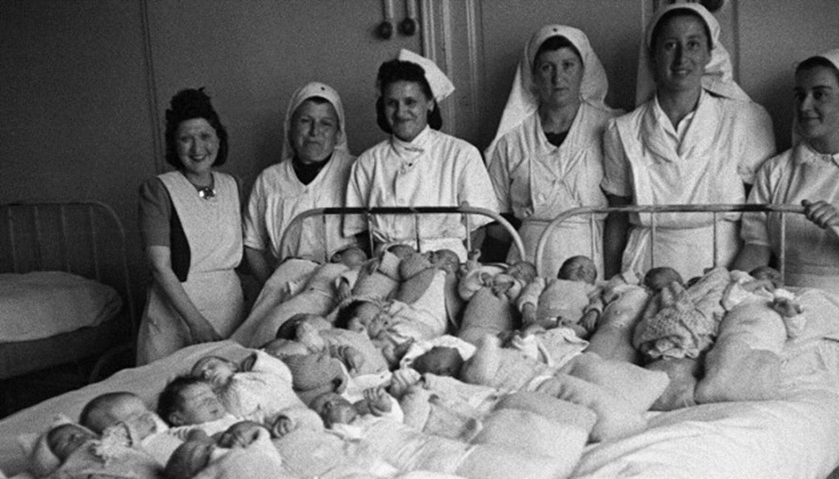
Notes:
The Baby Boomers are retiring!

Slide 47
KY – TN Clean Water Professionals Survey:
A survey was performed in 2022 by the Clean Water Professionals of Kentucky and Tennessee.
The survey was a Kentucky survey for drinking water and wastewater operators and managers.
There were 413 respondents total spread across the state and identified by Area Development District.

Slide 48
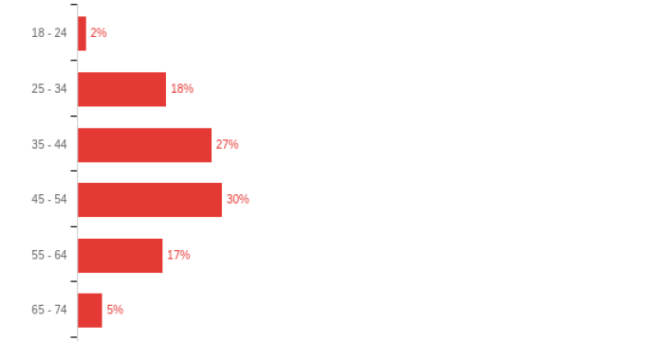
KY – TN Clean Water Professionals Survey:
Age Distribution of Operators

Slide 49
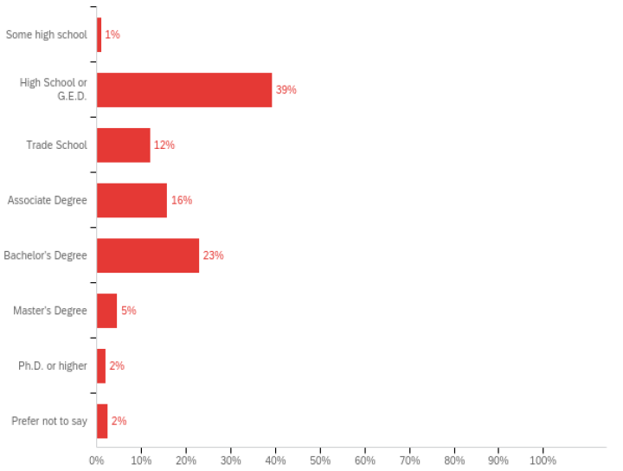
KY – TN Clean Water Professionals Survey:
Education Level Completed

Slide 50
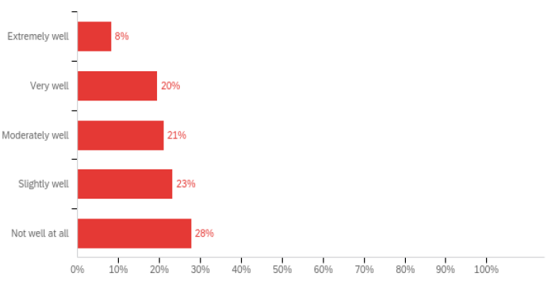
KY – TN Clean Water Professionals Survey:
Utility Decision Makers Understanding of Operations

Slide 51
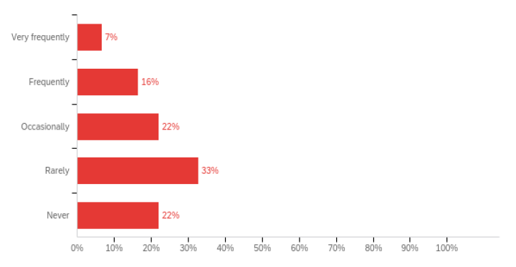
KY – TN Clean Water Professionals Survey:
Utility Decision Makers Communication with Operators

Slide 52
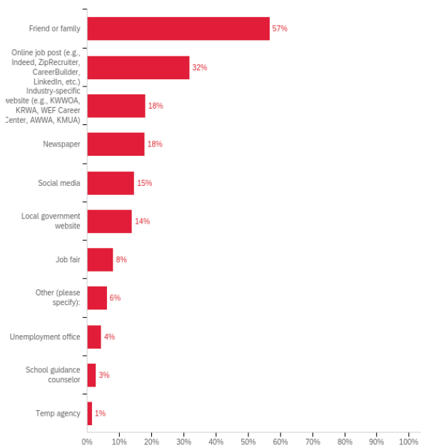
KY – TN Clean Water Professionals Survey:
Resources Used to Find Work in Water Sector

Slide 53
Sampled water facilities across the nation
January 2024 Bureau of Labor Statistics Report
Small utilities served 30,000 or less
Looked at workforce needs in water/wastewater vs overall workforce across occupations
Notes:
In 2020 the BLS published their 2018 data looked at the water and wastewater needs of large and small systems.

Slide 54
Operators Vs. Other Occupations 2024
In 2024 Current Population Survey (BLS):
23.5% of water operators were 55 and over
23.3% of the total US work population was 55 and over
In 2024 median age in water occupations was 43.5
Median age in all other occupations was 42.2
Notes:
In 2022 BLS published the 2018 data. 31.1% of operators were 55 and over. 23.5% of the US population was 55 and over. This is 7.8% difference. The median age in the water industry was 45. It was 42 for other occupations.

Slide 55
Some operators kept working to make up for lost wages
As economy expands more workers will retire
There will be increased competition for young talent in trade
Water industry must be competitive with construction and other trades
Recession Then and Now
Notes:
This data indicates that operators continue to work but retirement is looming. As the older operators leave there will be competition to recruit young and capable operators. Utilities well be competing with other trades as well. Don’t forget, it often takes years to certify an operator.

Slide 56
Outlook for Industry Jobs
BLS projects - annual average of -8,700 job openings nationwide for water operators from 2024 to 2034
Annual replacement need of -7% vs +5% for other occupations
It predicts an overall decline in employment in the industry due to automation
Automation decline will likely be in larger systems, not small, rural systems
Notes:
BLS projects an average of 10,800 jobs nations wide over the next 10 years. The annual replacement need of operators will be 8.2%, while it is expected to be 10.9% for other occupations. This means water utilities will be in competition with other trades.
It is anticipated that there will be an overall decline in employment due to automation but this will benefit larger systems more than smaller systems

Slide 57
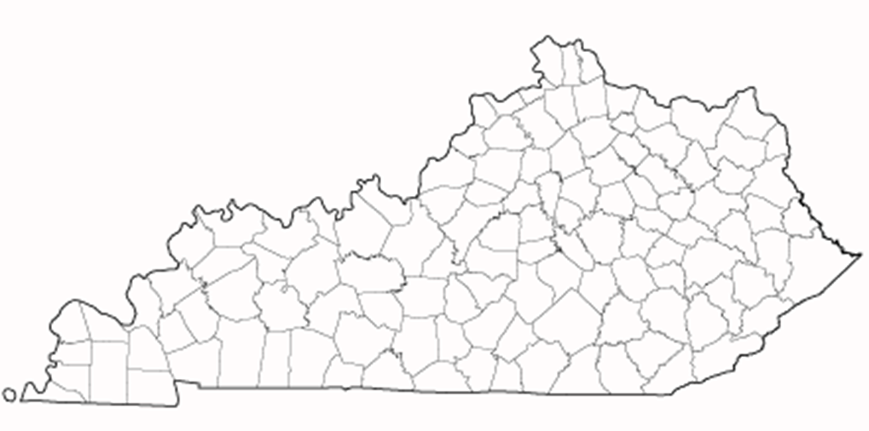
Kentucky Statistics
Notes:
There are more specific statistics related to Kentucky.

Slide 58
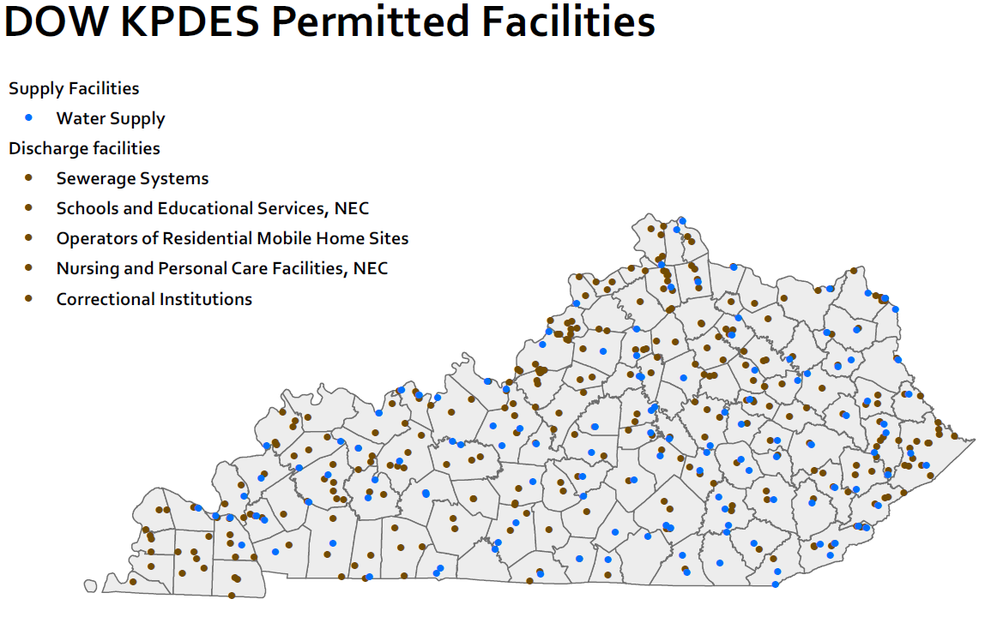
Facilities
Notes:
To examine the operator situation and needs we can start by looking at the facilities requiring these operators.
From our internal database we have pulled a listing of water supply facilities and water discharge facilities. Supply facilities are in Blue and discharge are in brown.
Each dot indicates a location that needs one or more certified operators.

Slide 59
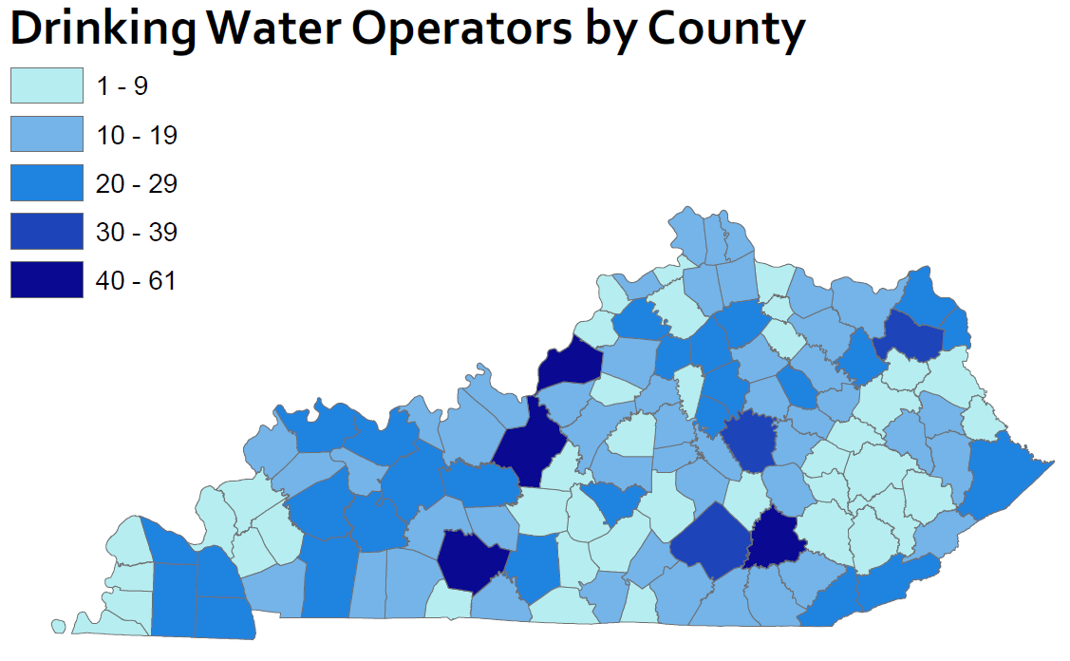
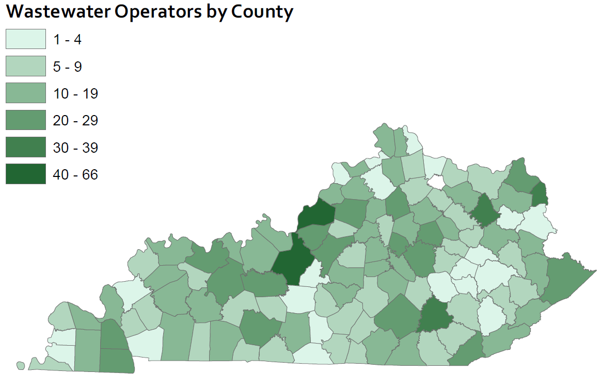
Operator Availability
Notes:
These maps show wastewater and drinking water availability. This location is based on where the operator lives, not where they work. Generally the darker areas of each of the maps indicate there are larger communities and facilities that require more operators. We don’t have enough operators currently. Many facilities (both the darker and lighter shades) are having a hard time hiring individuals. And we know that this is not a Kentucky Specific issue.

Slide 60
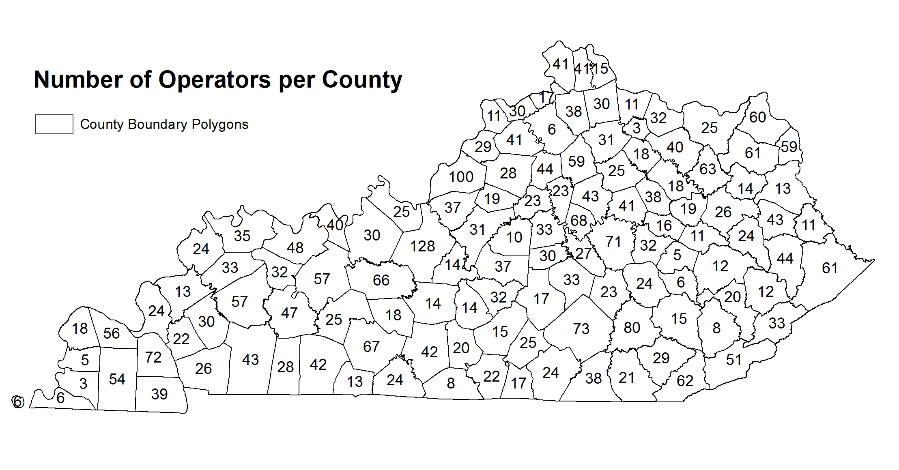

Slide 61
Succession Planning
01
02
03
04
05
Identify Succession Requirements
Track Relevant Talent Pools
Develop and Retain Talent
Forecast Succession Planning Impact
Evaluate and Refine Succession Planning
Notes:
Succession planning is a process. Utilities have to identify their succession requirements. What? How many? When? They must tap into pools of possible talent and figure out how to retain them, especially since there will be a time investment to get them certified. Constantly review the existing succession plan to see if it is adequate for the utilities upcoming needs.

Slide 62
1. Identify Requirements
Know the regulations and time frames for certifying operators
Certified operators must have a high school diploma or GED and pass the Kentucky certification exam.
Water operator certification – must have 1-5 years of experience depending on class of facility
Wastewater operator certification – must have 1-7 years of experience depending on the class of facility
Education substitutions based on science degrees or coursework
Notes:
Know the regulations and time frames. Know the minimum requirements for operators (HS Diploma or GED)
Know how long you have before you go from a proactive to reactive situation. It will take 1 to 5 years to get a drinking treatment or distribution employee certified to the appropriate level.
It will take 1 to 7 years for the wastewater operator to become certified.

Slide 63

2. Track Relevant Talent Pools
Notes:
To be successful you have to think like an advertiser. Who do you want to hire? Where are they? How would you reach them?
Not enough Generation Xers to fill positions so you have to look at the millennial and possibly the Generation Z generations.

Slide 64



Think like a Marketer
People leaving the military have a host of skills including water treatment experience.
Based on your requirements, who will fit the bill?
Where do they get their information? How can you reach them?
Don’t forget some target populations.
People in the prison population are often certified as operators. They leave with a valuable skill set and it offers them a second chance.
Notes:
Ask yourself, who has the discipline, integrity and dedication to operator the utility? Where do they get their information? What organizations can you tap into to spread the word?

Slide 65








Where could you find interested candidates?
Notes:
Exploring the idea of outside organizations may include private organizations, public groups, digital platforms and statewide publications.

Slide 66
3. Develop and Retain Talent
Set salaries to keep top talent.
Make a plan for their career path.
Notes:
Bureau of Labor Statistics shows that Kentucky is behind the national average on salaries. It will take adequate pay to encourage new operators to make the profession a career.

Slide 67
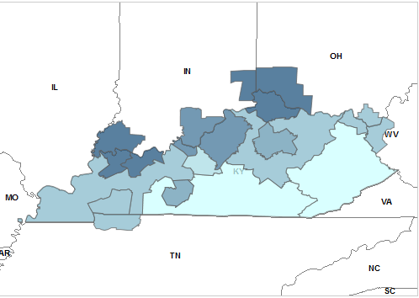
Annual: $57,510 - $77,890
Hourly: $27.64 - $37.45
Annual: $53,570 - $57,100
Hourly: $25,75 - $27.45
Annual: $47,390 - $53,560
Hourly: $22.78 - $25.75
Annual: $26,700 - $47,320
Hourly: $12.84 - $22.75
National Average:
Annual: $55,690
Hourly: $26.78
National Median:
Annual: $51,600
Hourly: $24.81
Notes:
National Mean Wage: Kentucky Mean Wage:
Annual: $52,320 Annual: $40,830
Hourly: $25.15 Hourly: $19.63
All of KY under the national median!

Slide 68
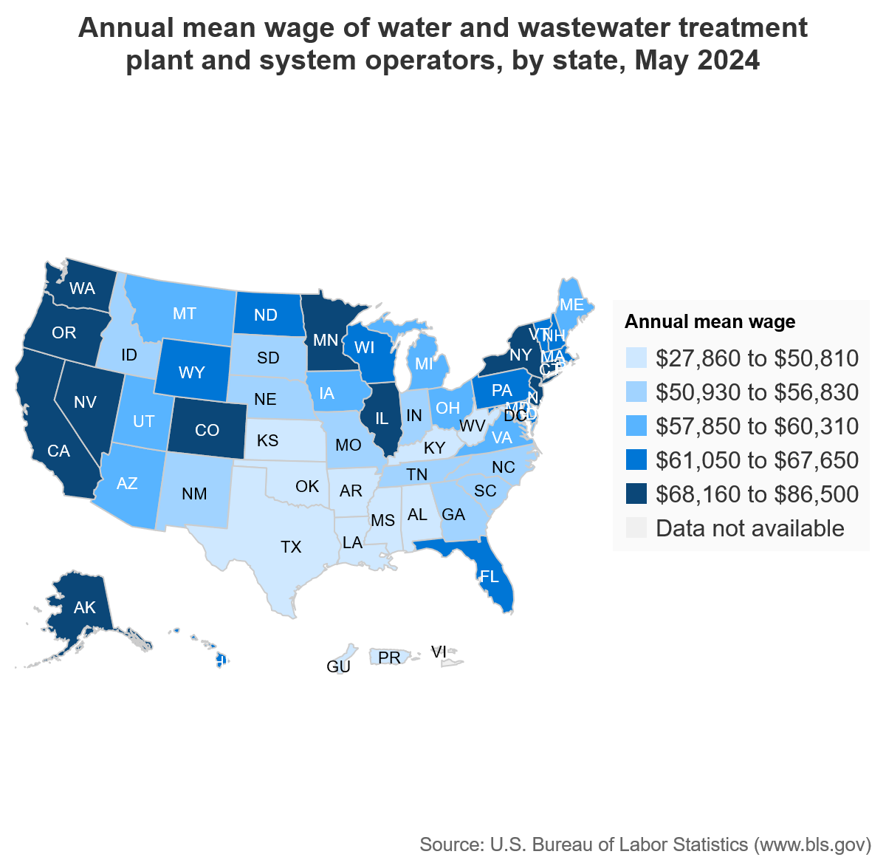
National Mean Wage:
Annual: $60,620
Hourly: $29.15
Kentucky Mean Wage:
Annual: $48.910
Hourly: $23.98
Notes:
National estimates for Water and Wastewater Treatment Plant and System Operators: https://www.bls.gov/oes/current/oes518031.htm#nat
Employment estimate and mean wage estimates for Water and Wastewater Treatment Plant and System Operators:
Employment: 121,150
Employment RSE: 1.3%
Mean hourly wage: $25.15
Mean annual wage: $52,320
Wage RSE: 0.5%
Percentile wage estimates for Water and Wastewater Treatment Plant and System Operators:
Percentile 10% 25% 50%(Median) 75% 90%
Hourly Wage $14.46 $18.14 $23.02 $29.20 $37.10
Annual Wage $30,070 $37,720 $47,880 $60,740 $77,170

Slide 69
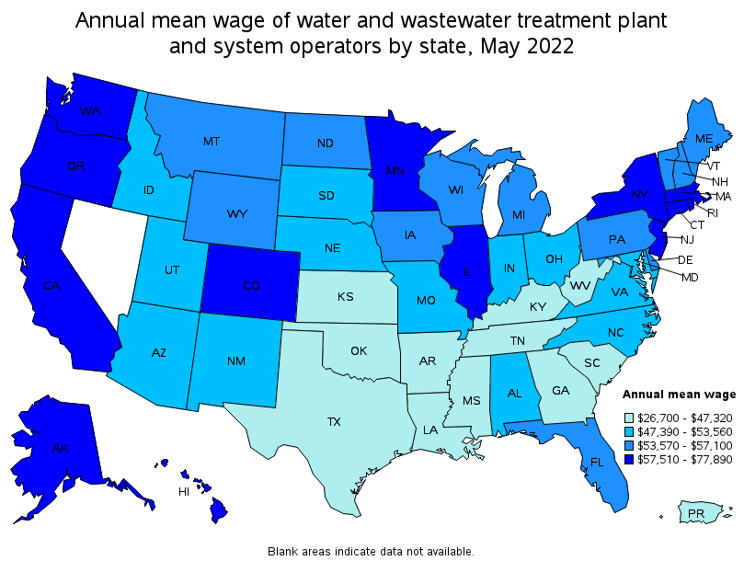
National Mean Wage:
Annual: $55,690
Hourly: $26.78
Kentucky Mean Wage:
Annual: $37,010
Hourly: $17.79
Notes:
National estimates for Water and Wastewater Treatment Plant and System Operators: https://www.bls.gov/oes/current/oes518031.htm#nat
Employment estimate and mean wage estimates for Water and Wastewater Treatment Plant and System Operators:
Employment: 121,150
Employment RSE: 1.3%
Mean hourly wage: $25.15
Mean annual wage: $52,320
Wage RSE: 0.5%
Percentile wage estimates for Water and Wastewater Treatment Plant and System Operators:
Percentile 10% 25% 50%(Median) 75% 90%
Hourly Wage $14.46 $18.14 $23.02 $29.20 $37.10
Annual Wage $30,070 $37,720 $47,880 $60,740 $77,170

Slide 70
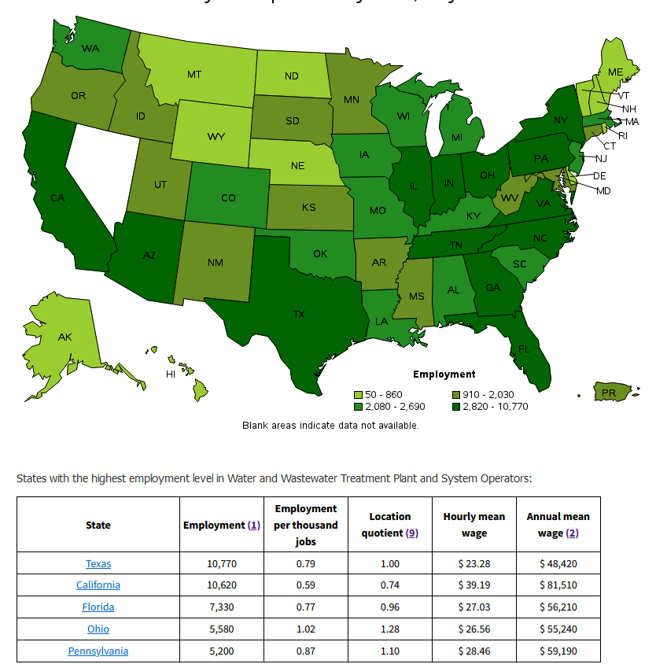
BLS Labor Force Operator Statistics
The green color map shows the approximate number of operators per state.

Slide 71
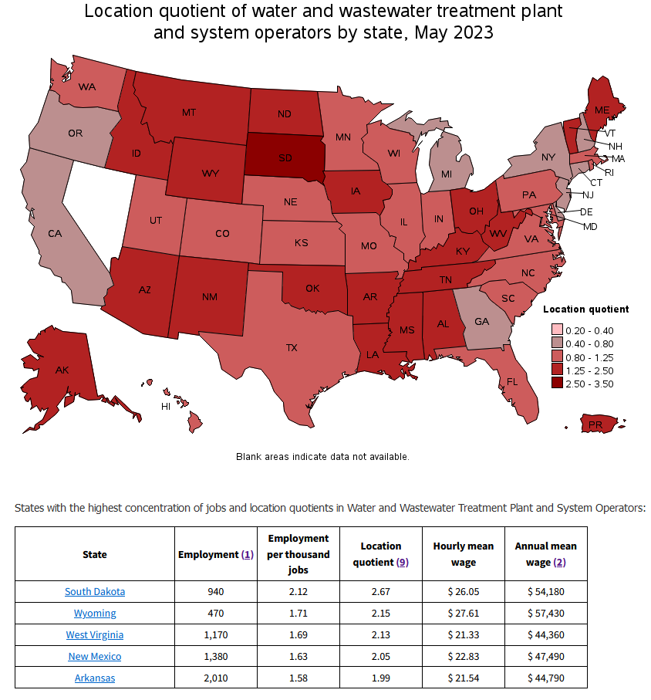
BLS Labor Force Operator Statistics
The red map shows the location quotient. Greater than 1 indicates a higher concentration of operators than the national average

Slide 72
Do you know when your staff are eligible to retire?
Are you prepared if someone leaves?
How much advance notice would you need?
4. Forecast Succession Planning Impact
Notes:
Utility managers and owners must prepare for unexpected departures. Such as, an operator quits with no notice. Is current staffing prepared to absorb the extra work? How long will it take to retrain a replacement?

Slide 73
Annually review your staffing plan.
5. Evaluate and Refine Succession Planning
5. Evaluate and Refine Succession Planning
Review your plan if anyone leaves.

Slide 74
On the job training – start hiring now
How Do We Get Them Certified Faster?
Education
Apprenticeships
Notes:
To speed the process along. Operators can participate in the apprentice program or the Operator In Training program.
If an operator doesn’t have the required college degree but does have college credits they can send in a copy of their transcripts in with their application. The trainers will review the transcript and apply any classes that are in the required fields to their education/experience.

Slide 75
Education
Online Training
California State University, Sacramento
College Courses
Notes:
A popular course with the operators is the California State Sacramento courses. If an operator were to take one 9 hour course then Kentucky recognizes that as 6 months of education. Per regulation we can substitute up to 50% of the required experience with education. Example: A class one operator must have a HS diploma and 1 year of ‘hands on’ working experience. That operator can take one Sacramento course, work 6 months and have met the requirements for a class 1 operator.
What makes Sacramento courses count for 6 months of experience? It is an actual college course with actual college credit. This is how we are able to calculate the 6 months of education.
90 hour course = 18 college credit hours
18 x .033 (per regulation) = .594 months (we round to 6 months)

Slide 76
CSUS Water & Wastewater
CSUS courses are college courses
Can be applied as an education substitution
Water & Wastewater courses are interchangeable
9 CEU course may substitute 6 months of experience
90 contact hours = 9 CEU
Can be applied as CEU’s for operators
All classes are performed online
Notes:
The roll of public officials is to know their systems. Work with engineers and operators to know what infrastructure they have and what they need. Read your permits. Know what you financial needs are (which is different than having the money for your financial needs). Encourage open communication. Get to know the regulators and field staff.

Slide 77

Established an apprenticeship program
Kentucky Rural Water
Approved through the state
Can be customized
Built into regulation to allow substitution

Slide 78
What is a registered Apprenticeship?
Allows employers to design a training program tailored to the company’s needs.
Apprentices EARN while they LEARN in a 2 year program.
Employee training model that combines at least 2,000 hours of on-the-job learning with 144 hours per year of related technical instruction.
Program completion results in highly skilled workers who receive a certificate from the federal Department of Labor.
Started Fall of 2019
Notes:
A quick summary of the apprentice program allows employers to design training programs for the participant. They work and earn money as an apprentice. The program consists of 4000 hours of on the job training with 288 clock hours of technical instruction. The person who completes the program is a skilled worker and receives a certificate from the department of labor.

Slide 79


Visit: krwa.org/apprenticeship for more information.
Notes:
Kentucky Rural Water Association is the only Cabinet approve provider to offer an apprentice program for Kentucky for individuals who want to become certified operators. Contact KRWA for more information on who is eligible and how to get started.

Slide 80
Operator In Training (OIT)
Test prior to getting work experience
Enables system to identify and retain talent
College Courses still apply to substitution

Slide 81
OIT needs a mentor with current license
OIT must hold a current license when seeking the next higher license
Operator In Training Opportunity
Education and work substitution can still apply
OIT tests first then works required experience
OIT must apply for certification when eligible
Education can include College degrees and Sacramento College water courses

Slide 82


Who to Contact
Department for Environmental Protection
Certification and Licensing Branch
Jessica Wilhoite
Jessica.Wilhoite@ky.gov
502-782-6477
BJ Bland
Byron.Bland@ky.gov
502-782-6556
ENVHelp@ky.gov
502-564-3170

