Slide 1



Water Loss Surcharge
Any views expressed in this presentation are those of the presenter and do not reflect official positions of the PSC

Slide 2

We were ordered to collect a water loss surcharge, NOW WHAT??

Slide 3
The Order Says…….
1) Within 120 days of the date of service of this Order, the utility should file with the Commission a qualified infrastructure improvement plan (QIIP), including a comprehensive unaccounted-for water loss reduction plan that establishes priorities and a time schedule for eliminating each source of unaccounted-for water loss and provides a detailed spending plan for the proceeds of a surcharge.

Slide 4
What’s a QIIP?
What is the utility’s plan for updating and improving infrastructure?
Segment by segment or area by area?
Could address anything from meters to water lines to pump stations to water treatment plants
Zone meters
Investments in leak detecting equipment

Slide 5
Do we have to have an engineer to do it?
No but is the plan detailed?
Is there trained staff who can create a plan?
Does anyone have time to create the plan?
Anyone who works in a system everyday can cite to issues in the system start there. The issues you can readily identity are usually the most urgent.
Age of the system, think of it as a math problem. Age + leak amount = priority/need number

Slide 6
How do we create a timeline?
Another math equation: Need + cost= priority placement
What can we afford right now?
What are easy things to do?
What money can we get?
Grants and loans (plus surcharge funds adds up)

Slide 7
What’s a “detailed spending plan”?
Calculate the expense of the top five projects
If the district wants to purchase leak detection equipment, get estimates, estimated times of delivery
If the district wants to hire leak detecting and repair employees, what should you do? Consider full-time vs. part-time, salary and benefits.
If the district wants to replace meters or buy zone meters, get estimates and do your research!! What is the useful life, will it work with the present system? Where should the zone meters go?
ASK for permission to use surcharge funds prior to spending money and have a plan in place for when the surcharge expires.

Slide 8
What do we do if we don’t know what to do?
ASK YOUR ATTORNEY
We can’t give legal advice, but we can send you in the right direction. For example, ask at Rural Water conventions, ask at trainings, who has been here before, what was expected

Slide 9
The Order Also Says…..
2) The Utility should deposit surcharge collections in a separate interest-bearing account.
3) On the 15th day of each month for 48 months from the date of service of this Order or until all surcharge proceeds are expended, _________________ should file with the Commission a monthly activity report that includes a statement of monthly surcharge billings and collections using the format in the Surcharge Reporting form, a monthly surcharge bank statement, a list of each payment from the account, its payee, and a description of the purpose, and invoices supporting each payment.

Slide 10
4) On the 15th day of each month for 48 months from the date of service of this Order or until all surcharge proceeds are expended, the utility should file a monthly water loss report with the Commission.
5) The utility should not use any surcharge proceeds for reimbursement of unaccounted-for water loss reduction expenses without prior Commission authorization.

Slide 11
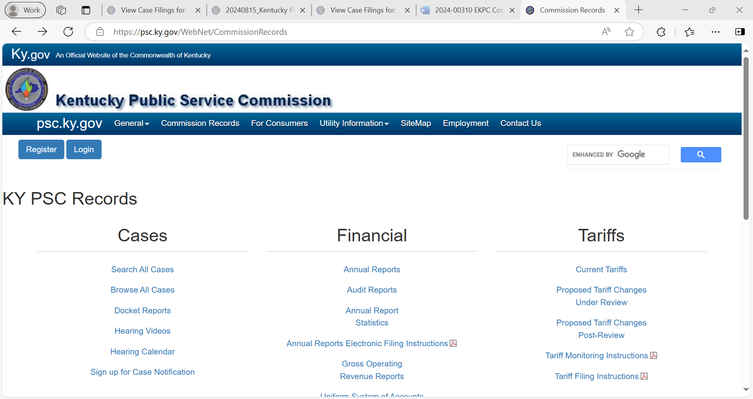

Slide 12
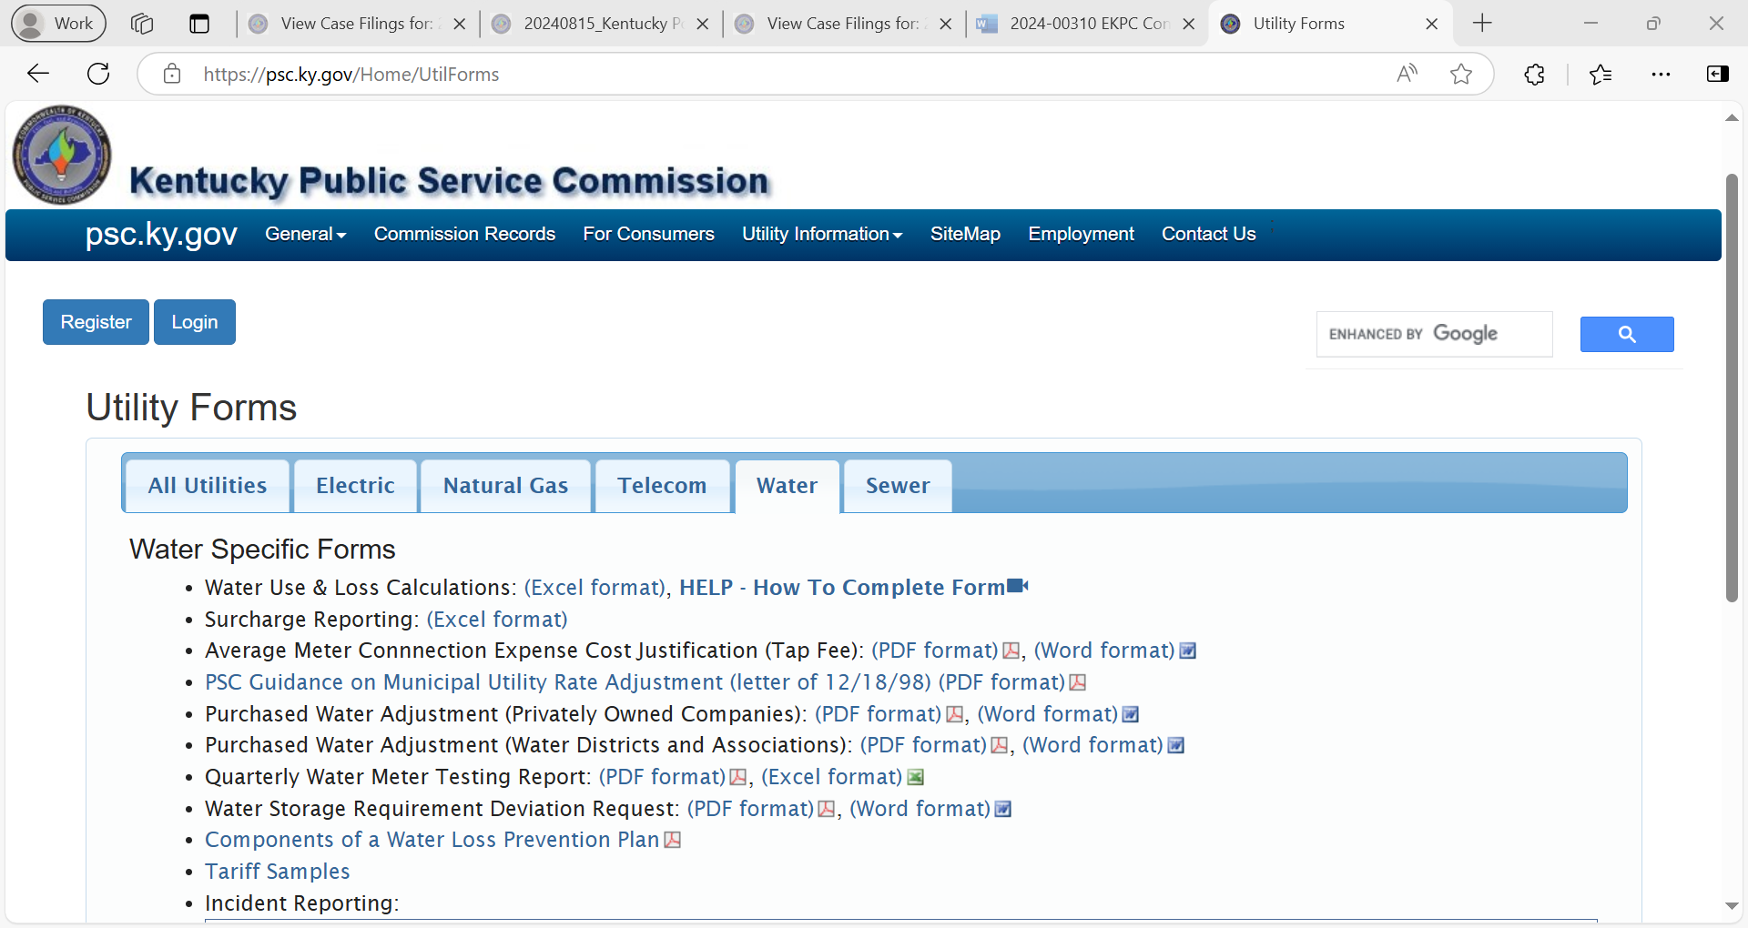

Slide 13
6) The Utility should file requests to use surcharge proceeds into the record of this proceeding.
The request should include a complete description of the equipment, project, or service for which approval is sought; bids, invoices, or price quotes as applicable; and a statement describing how the proposed purchase, project, or service is related to the qualified infrastructure improvement plan and the goal of reducing unaccounted-for water loss.

Slide 14
Make this a separate filing/Motion – Clearly mark it as a request to use surcharge funds
Have everything on this list, so make a checklist – have we included all of this….?
If you do not have everything, don’t file it. Wait until you do or thoroughly explain why you don’t or can’t.
If it is not in the QIIP, then there must be substantial information related to need… a major leak, a weather event that caused an issue. Make sure you have included an explanation.

Slide 15
The Utility should consider all surcharge collections as contributions and shall account for them in the manner that the Uniform System of Accounts for Class A and B Water Districts and Associations prescribes.
If you don’t know, ASK YOUR ACCOUNTANT

Slide 16
The Utility should debit monthly billings for the surcharge to customers’ accounts receivable and credit the contribution account.
9) When the Utility collects the surcharge from the customers, it should debit special funds and credit the customer account.

Slide 17
10) For the purpose of evaluating whether adjustments in the surcharge are required, the Utility should file an annual report of surcharge activity and water loss improvement progress no later than ___________ of each year. The report should be based on the preceding year ended _______________ with reported surcharge billings and expenditures reflecting the amounts reported for surcharge activity in the financial and statistical Annual Report filed with the Commission and the district’s audited financial statements. Cumulative surcharge billings and expenditures over the life of the surcharge shall also be included, a schedule of the estimated and actual progress of the water loss detection and repair program. This report shall include encumbered amounts of future surcharge proceeds.

Slide 18
11) The Utility failure to comply with any conditions attached to its assessment of the surcharge will result in termination of the surcharge and the refund of all surcharge proceeds previously collected

Slide 19
Tariff Language
Water loss surcharge must be included in your tariff.
The surcharge per meter and the length of time the surcharge will be charged
Districts have varied on where they have added it in the tariff as far as the general rate page or the nonrecurring charges

Slide 20
If you have questions, please ask
There are three attorneys, two financial analysis persons and two inspectors who monitor filings in these cases.
We can’t speak for the Commission but can be a resource.

Slide 21
Thank You!

