Slide 1


Water Loss Calculation / Forms
Any views expressed in this presentation are those of the presenter and do not reflect official positions of the PSC

Slide 2

Today’s Agenda
Excess Water Loss - Kentucky Law
Definitions
The Math
Regulatory Consequences of Excess Water Loss
Forms
Component Lines
Error Checking / Issues
Water Loss Percentage
Annual Reporting

Slide 3
Ratemaking Consequences of Excessive Water Loss
807 KAR 5:066 Section 6 (3)
Unaccounted for water loss. Except for purchased water rate adjustments for water districts and water associations, and rate adjustments pursuant to KRS 278.023(4), for rate making purposes a utility's water loss shall not exceed fifteen (15) percent of total water produced and purchased, excluding water used by a utility in its own operations.
Upon application by a utility in a rate case filing or by separate filing, or upon motion by the commission, an alternative level of reasonable water loss may be established by the commission. A utility proposing an alternative level shall have the burden of demonstrating that the alternative level is more reasonable than the level prescribed in this section.

Slide 4
What Is Water Loss?
Unaccounted-for water loss is "the difference of the total amount of water produced and purchased and the sum of water sold, water used for fire protection purposes¹, and water used in treatment and distribution operations (e.g., backwashing filters, line flushing).“² Generally speaking, the unaccounted-for water loss is the result of line breaks and leaks, inaccurate meters, tank overflows, excavation damages, and theft.³
¹ When provided without charge pursuant to the utility's tariff.
² Application of Cannonsburg Water District for (1) Approval of Emergency Rate Relief and (2) Approval of the Increase in Nonrecurring Charges, Case No. 2011-00217 (Ky. PSC Feb. 27, 2012), Order at 5 n.12.
³ See, e.g. , Application of Ledbetter Water District for an Alternative Rate Adjustment, Case No. 2018-0011 7 (Ky. PSC Sept. 10, 2018), Order at 3 (excessive water loss caused by large leak); Electronic Application of Hardin County Water District No. 2 for a Declaratory Order that Sample Testing Satisfies the Testing Requirements of 807 KAR 5:066, Section 16(1) or, in the Alternative, for an Order Granting a Deviation [There]From, Case No. 2016-00432 (Ky. PSC March 22, 2018), Order at 7-8 n.28 (noting potential loss from defective meters); Electronic Application of McCreary County Water District for Authorization to Execute Lease-Purchase Agreement and Related Relief, Case No. 2018-00038 (Ky. PSC June 28, 2018), Order at 5 (granting Certificate of Pubic Convenience and Necessity (CPCN) based, in part, on project "reduce[ing] unaccounted-for water loss because of quicker detection of water leaks, meter tampering, and theft"); Application of Cumberland Falls Highway Water District for Approval of Financing and Issuance of a Certificate of Convenience and Necessity, Case No. 2017-00268 (Ky. PSC Aug. 14, 2017). Order at 2 (approving CPCN based, in part, on finding that project will lower water loss by replacing leak-prone lines); Application of Mountain Water District for an Adjustment of Water and Sewer Rates, Case No. 2014-00342 (Ky. PSC Oct. 9, 2015), Order at 11 (noting utility representation that excessive water loss was attributable to "inaccurate meters, theft of service, and infrastructure failure"); Alternative Rate Filing of Eastern Rockcastle Water Association, Inc., Case No. 2014-00385 (Ky. PSC May 15, 2015), Order at 6-7 (noting loss from inaccurate meter); Application of Hardin County Water District No. 1 to Modify Water Utility Tariff of Master Meters for Billing Multi-Unit Residential Properties, Case No. 2009-0011 3 (Ky. PSC Oct. 22, 2010), Order at 2 (noting that stolen water contributes to water loss); Hardin County Water District No. 1 's Proposed Tariff Allowing the Use of Master Meters in Manufactured Housing Communities, Case No. 2007- 00461 (Ky. PSC Aug. 14, 2008), Order at 2 (same).

Slide 5
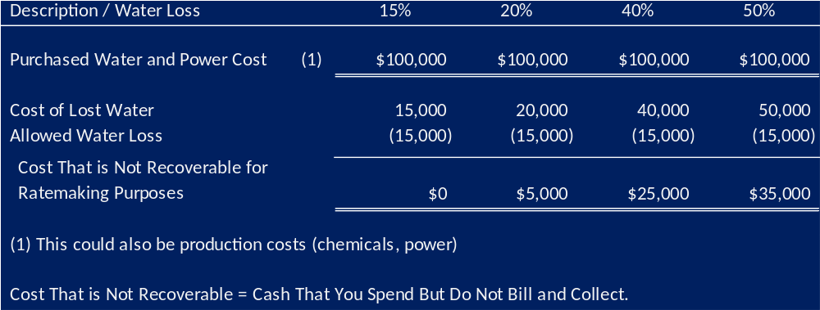
Ratemaking Consequences of Excessive Water Loss – The Math

Slide 6
Commission Orders
The Commission is placing greater emphasis on monitoring utilities that consistently exceed the fifteen (15) percent water loss threshold and strongly encourages Subject Utility to pursue reasonable actions to reduce its water loss. Failure by Subject utility to make significant progress towards reducing water loss may cause the Commission to pursue additional action with the utility.

Slide 7
Water Loss
Excessive water loss will be a primary focus of PSC interactions with water utilities
PSC’s position is that excessive water loss poses a threat to the utility’s financial and operational stability & viability
Point of emphasis at PSC training seminars
Water loss exceeding 15% will be cited as a deficiency by water system inspectors
Rate cases, purchased water adjustments,
CPCNs and water financing cases will all include language on water loss in excess of 15%
A utility’s inability or continued inaction to reduce water loss will lead to greater PSC attention

Slide 8
Water Loss
Annual Reports are being reviewed to identify utilities with water loss in excess of 15%
Deficient utilities will:
Be cited with 5:066, Section 7 – Standards of Construction
Receive letter with estimate of $ costs, copying water commissioners and where applicable, the County Judge Executive/Magistrates
Listed on PSC website with $ impact

Slide 9
Water Loss Over 15% - Regulatory Consequences
Commission Orders for ARFs, full rate cases, purchased water adjustments, CPCNs and water financing cases will all include language on water loss when in excess of 15%
A utility’s inability or continued inaction to reduce water loss will lead to greater PSC attention
Surcharge, Qualified Infrastructure Investment Plan, compliance monitoring, restrictions,

Slide 10
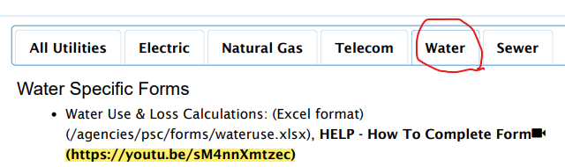
YouTube Instructional Tutorial
An approximate 15 minute instructional video is available at the link below
PSC Water Loss Calculation video March 2020 – YouTube

Slide 11
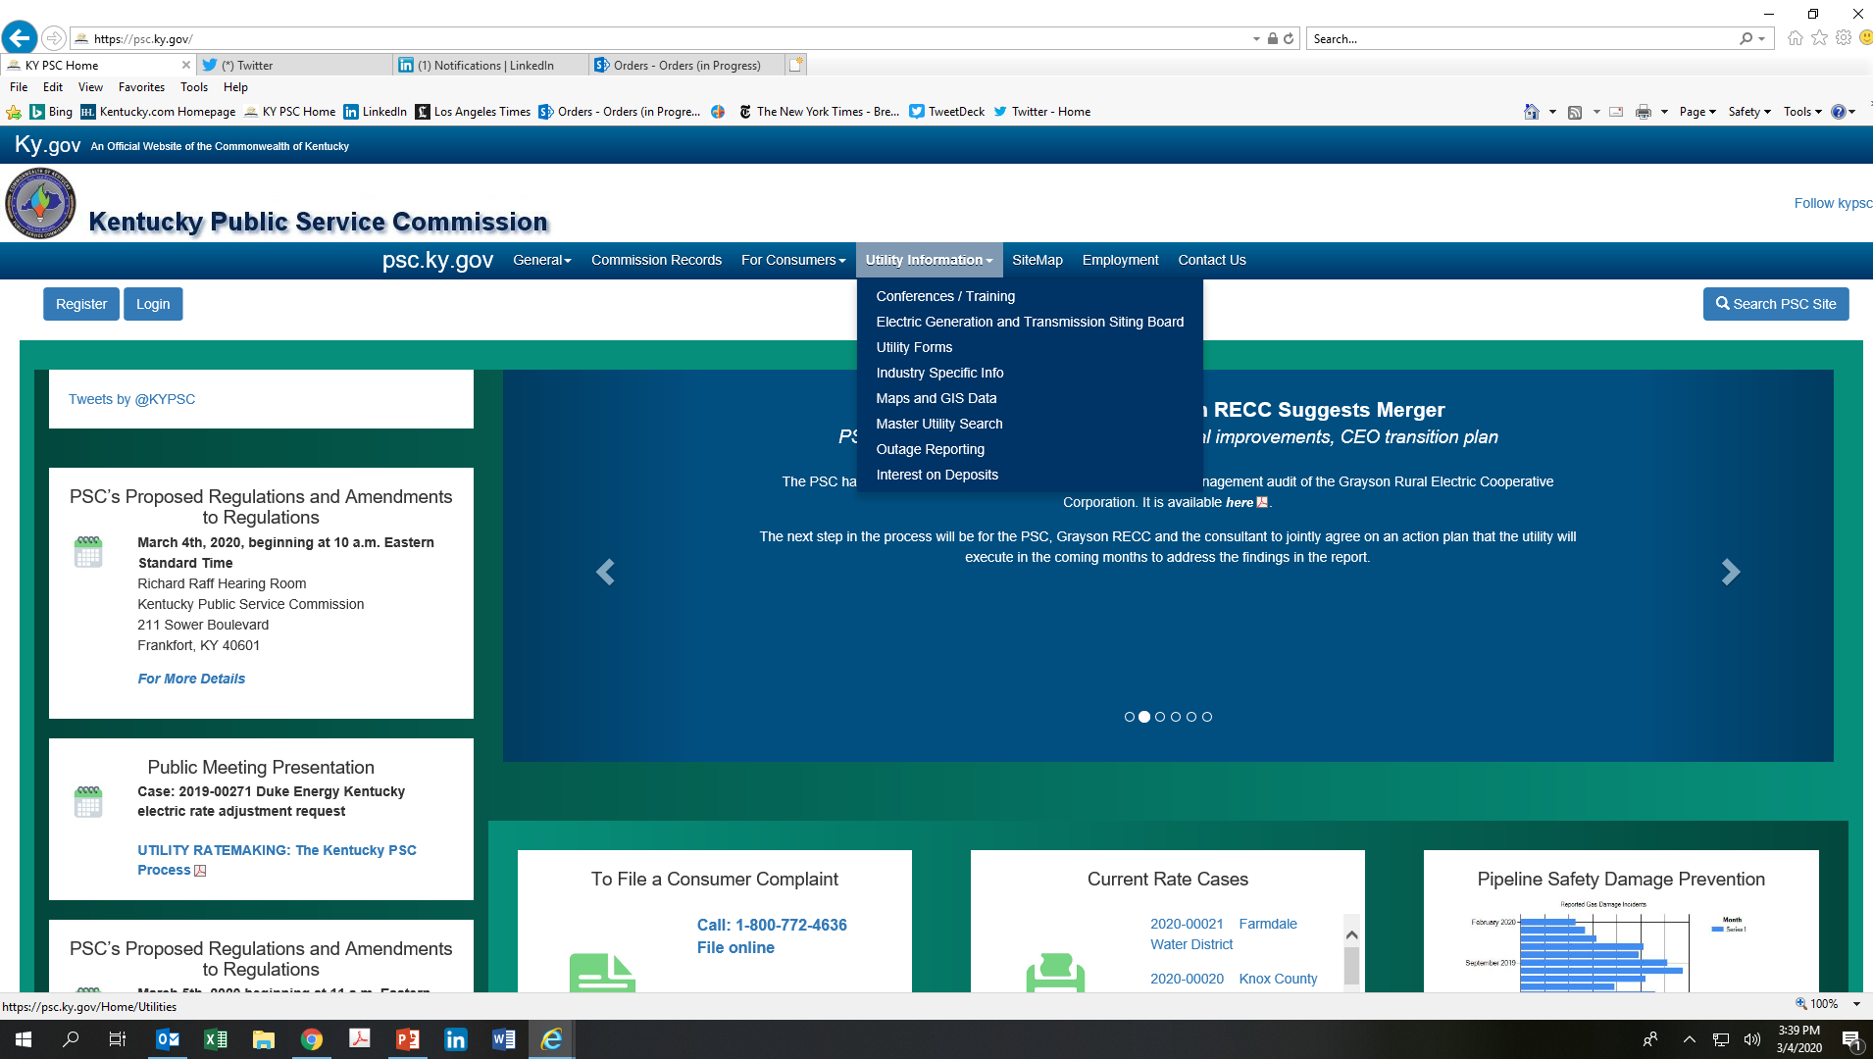
Navigation

Slide 12
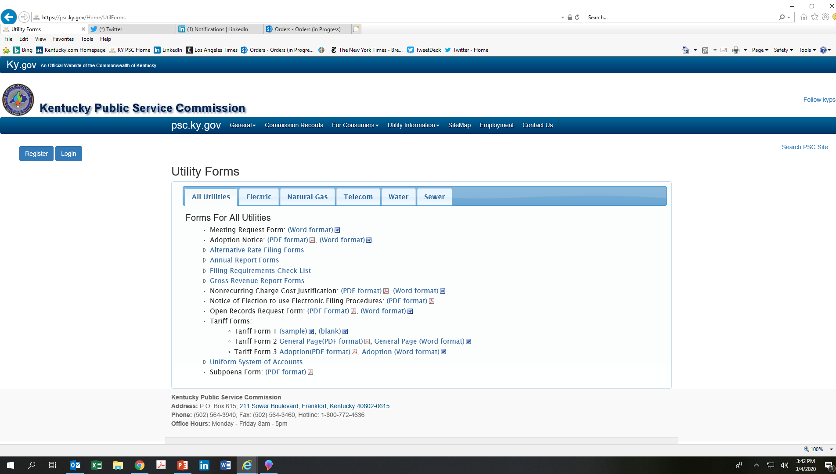
Navigation

Slide 13
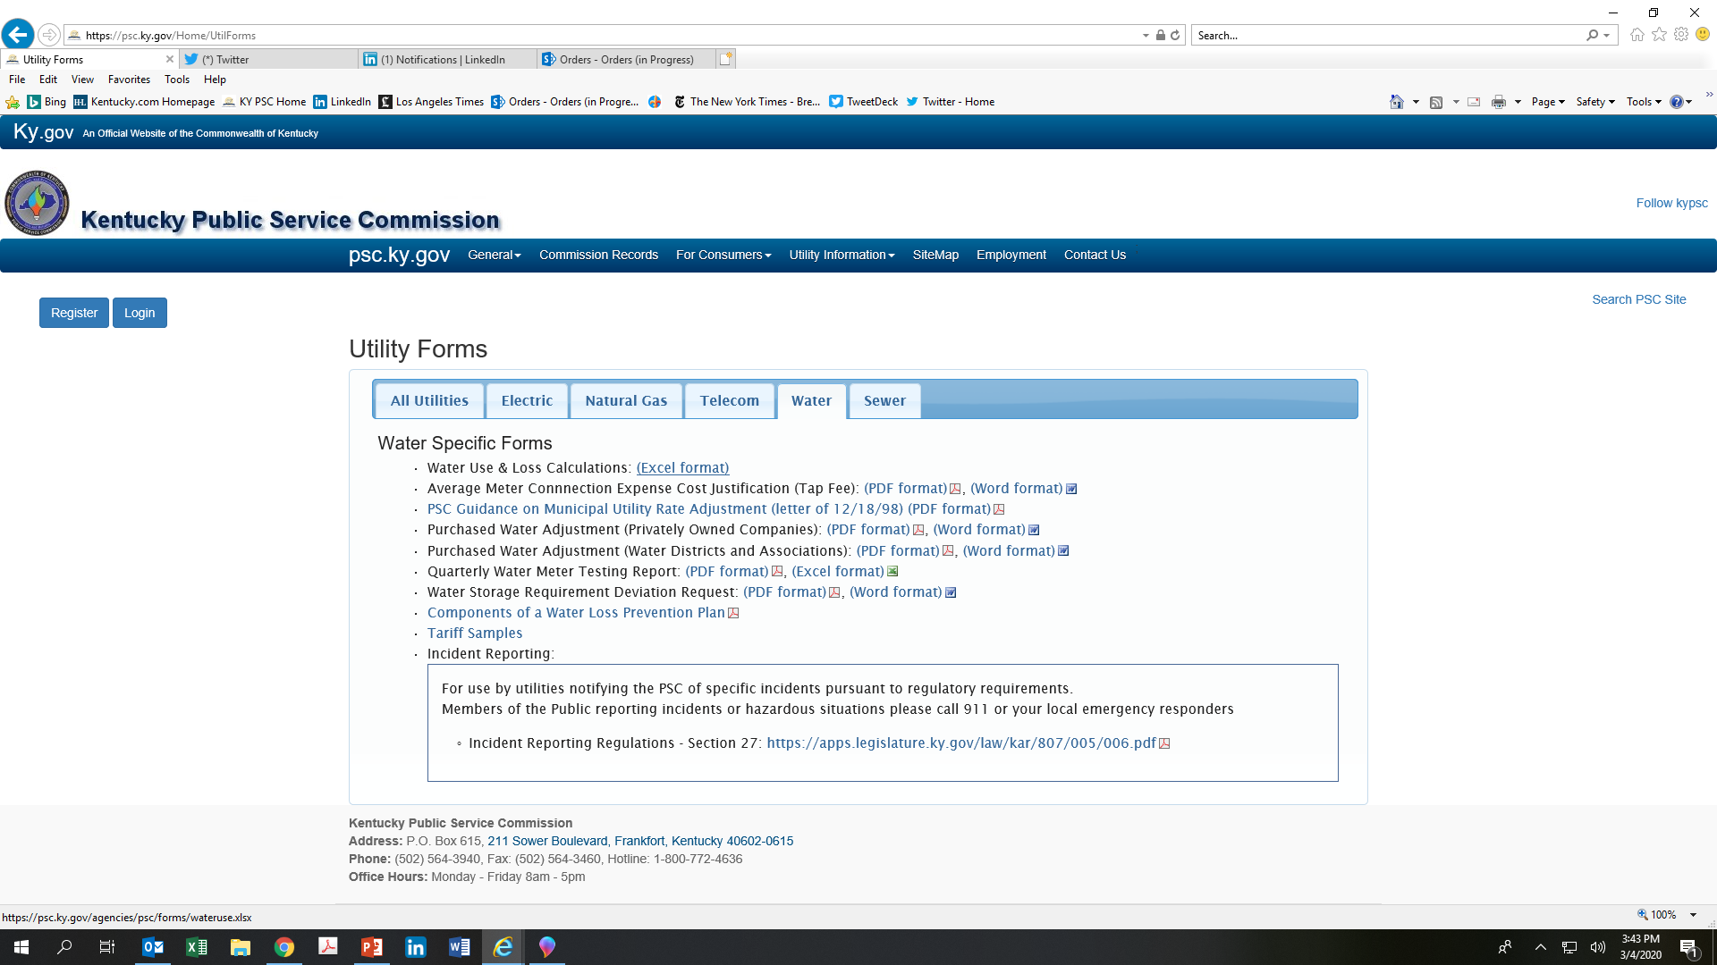
Navigation

Slide 14
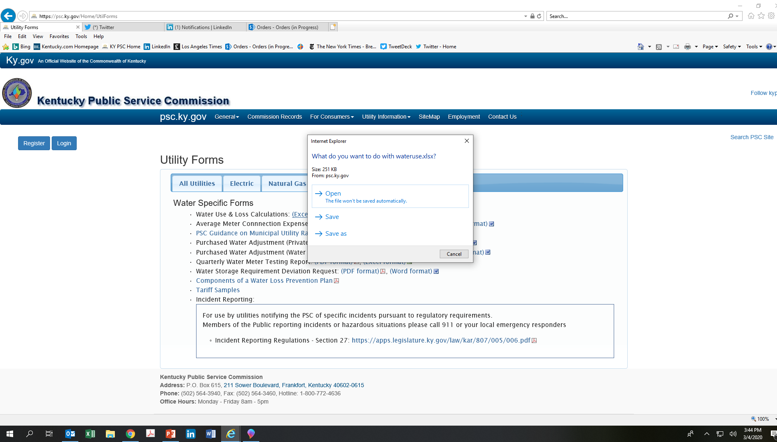
Navigation

Slide 15
Getting Started
Find the spreadsheet on the PSC website:
Go here: https://psc.ky.gov/Home/UtilForms
Go to the “Water” tab
Spreadsheet is first on the list
Click on the link
Download and save to your computer

Slide 16
About the Form
Excel spreadsheet
First tab is instructions
Tabs for each month’s calculations
Final tab is for annual (year-end) calculation – the spreadsheet is set up to calculate this automatically from the monthly inputs

Slide 17
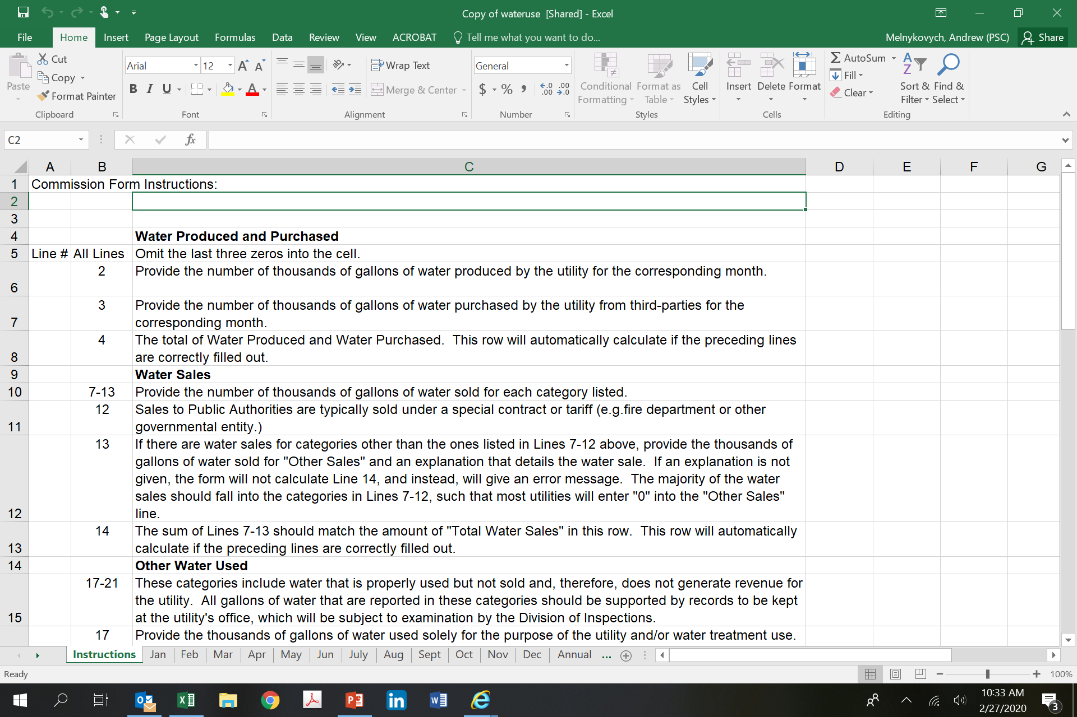
About the Form
IT WILL LOOK LIKE THIS
Instruction tab
Monthly input tabs
Yearly total tab

Slide 18
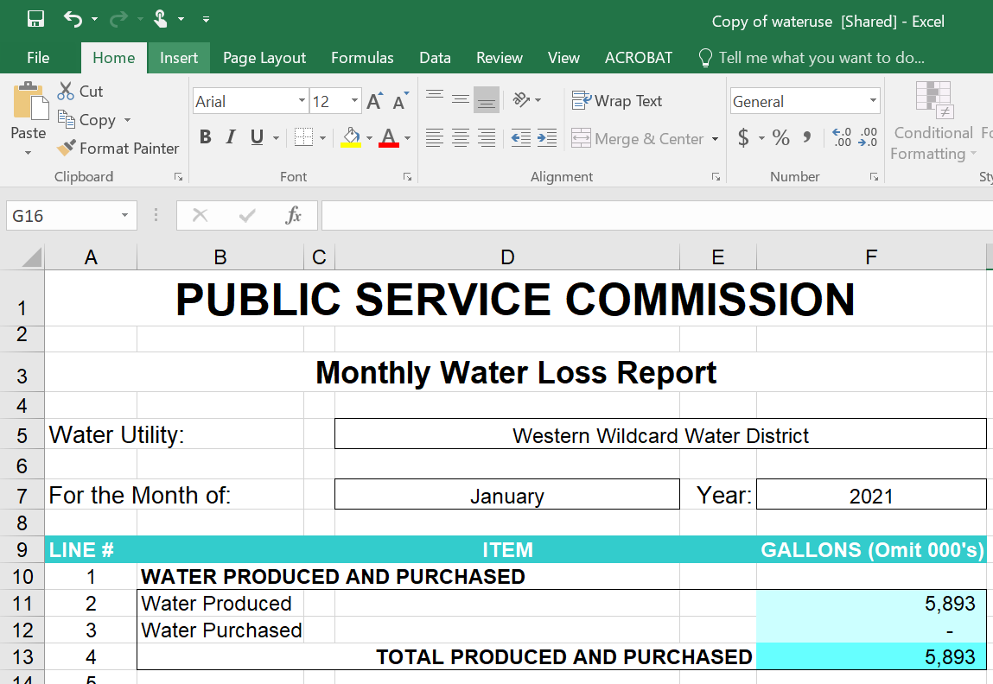
About the Form (continued)
Fill in the name of your utility and the year.
Fill in the amount of water produced during the month, in thousands of gallons. This means omitting the last three numbers and rounding to the nearest thousand gallons. So 5,893,437 gallons of water produced would be entered as 5,893.

Slide 19
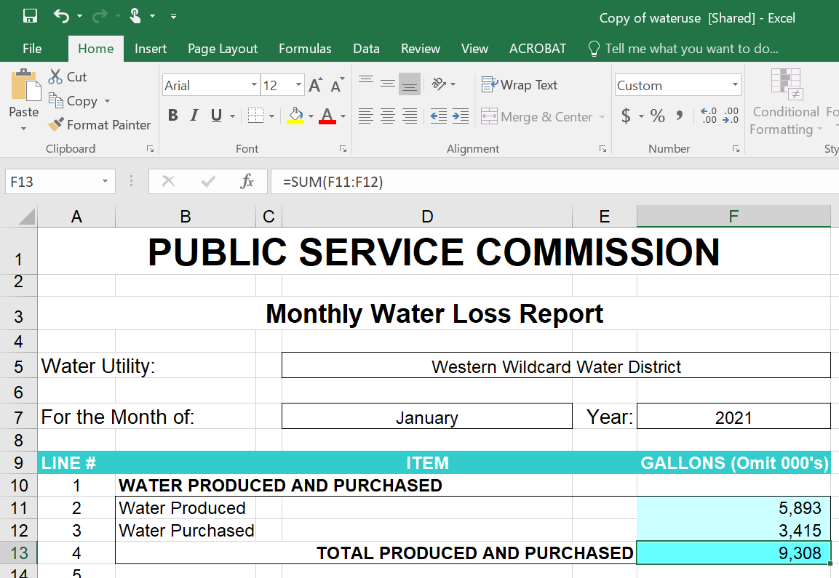
About the Form (Water Produced and Purchased)
Next, fill in the amount of water purchased during the month, in thousands of gallons. Use the same rounding rule. The spreadsheet will automatically total the amounts of water produced and purchased.

Slide 20
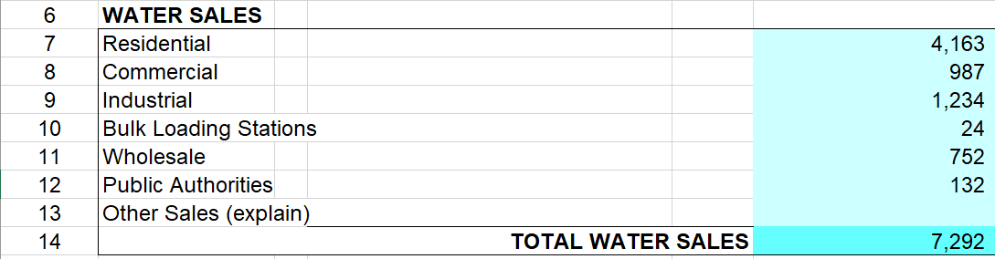
About the Form (Water Sales)
Fill in the amount of water SOLD to each of the various rate classes, in thousands of gallons for each. This is the amount of water BILLED FOR, even if the payment has not yet been made.
THIS IS REVENUE WATER ONLY –DO NOT INCLUDE WATER PROVIDED AT NO CHARGE.
Sales to Public Authorities, such as fire departments or government agencies, are typically sold under a special contract or tariff.
The spreadsheet will calculate a running total as each line is entered.

Slide 21
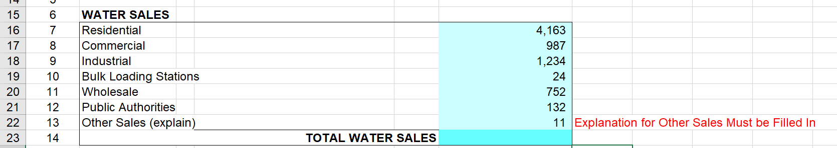
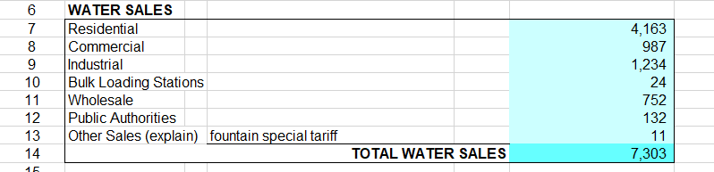
About the Form (Other Sales)
If there are sales for other uses, these should be entered on line 13, and an explanation provided in the highlighted box. If an explanation is not provided, an error message will be generated, and no further entries can be made or a total calculated until the explanation is filled in.
Once the explanation is provided, the total for water sales will be filled in automatically.

Slide 22
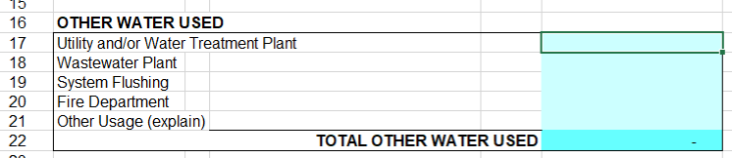
About the Form (Other Water Used)
OTHER WATER USED includes water that is used for proper and approved purposes, but that does not generate revenue. Usage figures in this category must be supported by records that are kept at the utility's office and which must be available for review by the Division of Inspections.

Slide 23
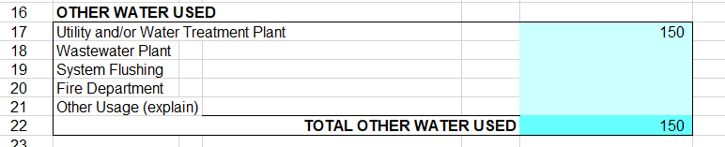
About the Form (Other Water Used – Line 17)
Line 17 should state the quantity of water used, in thousands of gallons of water, solely for the use of the utility, including use at the water treatment plant. This would include usage for purposes such as backwashing the filtration system at the water treatment plant. As with the rest of the spreadsheet, the figures in this section, if filled out correctly, will total automatically.

Slide 24
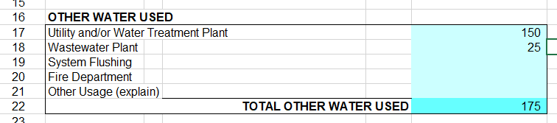
About the Form (Other Water Used – Line 18)
Line 18 is for non-revenue usage at wastewater treatment facilities. (If the utility bills a wastewater treatment operator for water usage, it should be included in the previous section.) Uses include functions such as washing down or cleaning a wastewater facility.

Slide 25
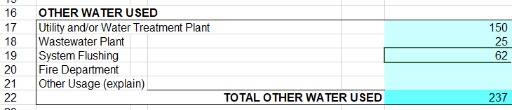
About the Form (Other Water Used – Line 19)
System flushing accounts for water used to clean the distribution system and maintain disinfectant (chlorine) residuals, as well as flushing lines to protect against total trihalomethanes (TTHM) and halieutic acids (HAA).

Slide 26
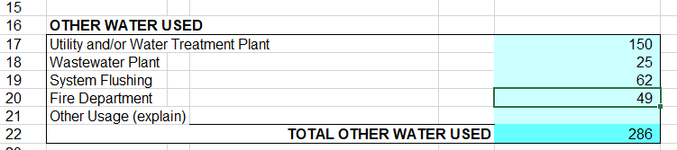
About the Form (Other Water Used – Line 20)
Fire department usage on line 20 is to include all water provided to fire departments at no cost, whether for training, firefighting or other uses. Water sold to fire departments should be included with Sales to Public Authorities. If a utility allows a fire department to use water at no charge, it must require the fire department to submit quarterly reports documenting the water usage. (KRS 278.170(3) and 807 KAR 5:095, Section 9(1)) Furthermore, the utility is required to include in its tariff a provision that imposes a penalty on a fire department that fails to report its water usage. (807 KAR 5:095, Section 9(2))

Slide 27
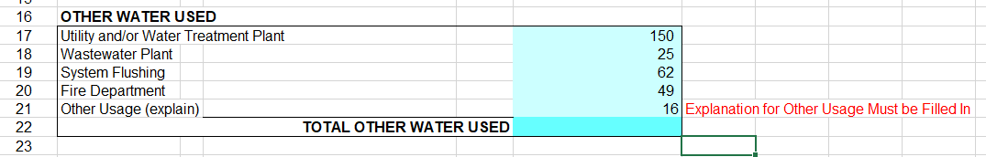
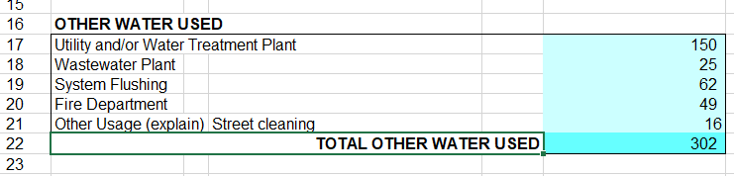
About the Form (Other Water Used – Line 21)
As with water sales, authorized non-revenue usage that does not fall into one of the main categories must be accompanied by an explanation. Without an explanation, the spreadsheet will not provide a total for the OTHER WATER USED category. Providing an explanation permits a total to be calculated.

Slide 28
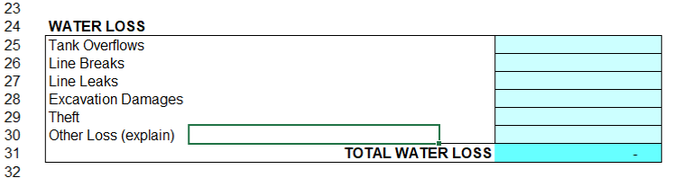
About the Form (Water Loss)
The last section of data to enter is water loss. This includes all water that is not billed, not used in the transmission or production of water or not used for other authorized and proper purposes. As with the other sections of the form, this section totals automatically.

Slide 29
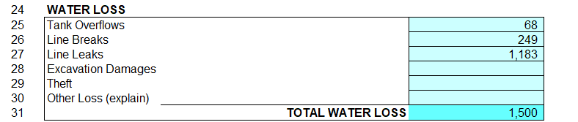
About the Form (Water Loss – Line Descriptions)
The first three categories of water loss are:
Water loss through overfilling or overflow of water storage tanks
Line breaks – these do not include those that are the immediate result of excavation activity
Line leaks – ongoing loss from smaller leaks
If actual numbers cannot be determined, provide best estimates and retain supporting documentation.

Slide 30
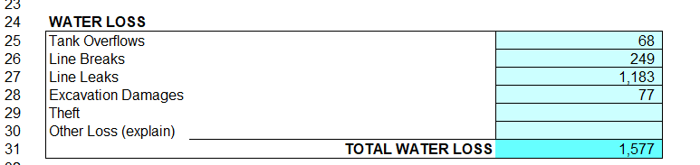
About the Form (Water Loss - Excavation Damage)
Excavation damage should list water lost as the result of excavation damage to a water line for which the utility was not reimbursed (for example, if the utility itself did the damage). If the responsible party was billed and paid for the lost water, the loss should be recorded in water sales under Other Sales, with an explanation provided.

Slide 31
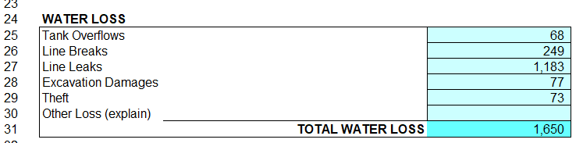
About the Form (Water Loss - Theft)
Water lost through theft, for which no cost recovery was made from the customer, is to be listed on line 29. If the amount cannot be determined precisely, it can be estimated using average monthly usage for each customer class. If the cost of water stolen is recovered from a customer, it should be included in water sold for that class of customer.

Slide 32
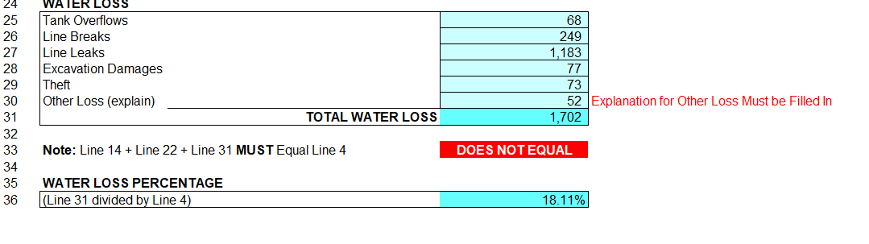
About the Form (Water Loss – Other Loss)
Line 30 should be used to list other water losses, such as those due to tank leaks or malfunctioning meters. Loss that cannot be determined or attributed to other causes should be listed here. The losses on line 30 should account for only a small portion of the overall loss.
Other water losses must be explained. If an explanation is not provided, an error message will appear and section will not total.

Slide 33
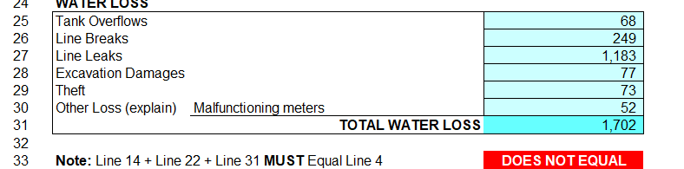
About the Form (Math Check)
The amount of water produced and purchased must equal the amount of all water sold, non-revenue water consumed, and water lost. If the totals do not match exactly, a red warning will appear on Line 33, indicating that the numbers need to be corrected.

Slide 34
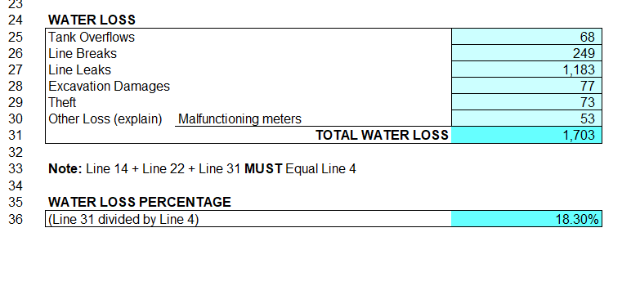
About the Form (Water Loss Percentage)
Once the totals add up correctly, the spreadsheet will calculate the water loss percentage for the month.

Slide 35
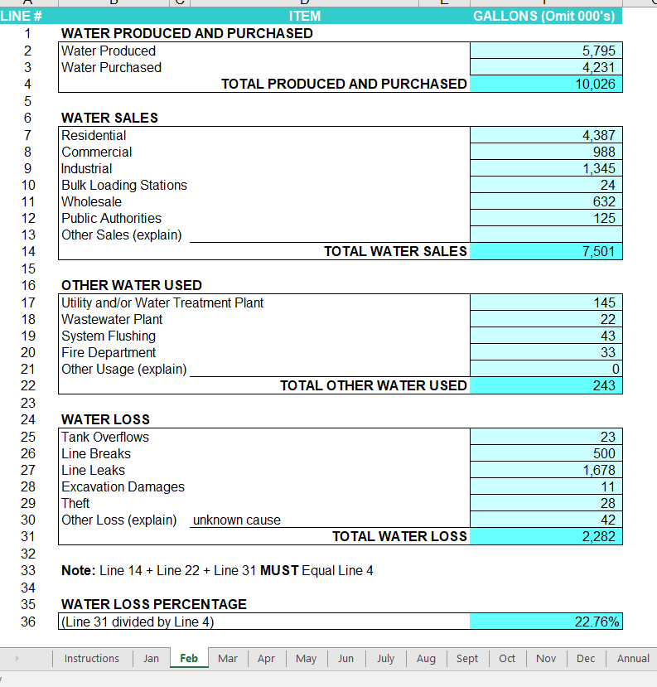
About the Form (Water Loss Monthly Forms)
Calculate each successive month in the same way.

Slide 36
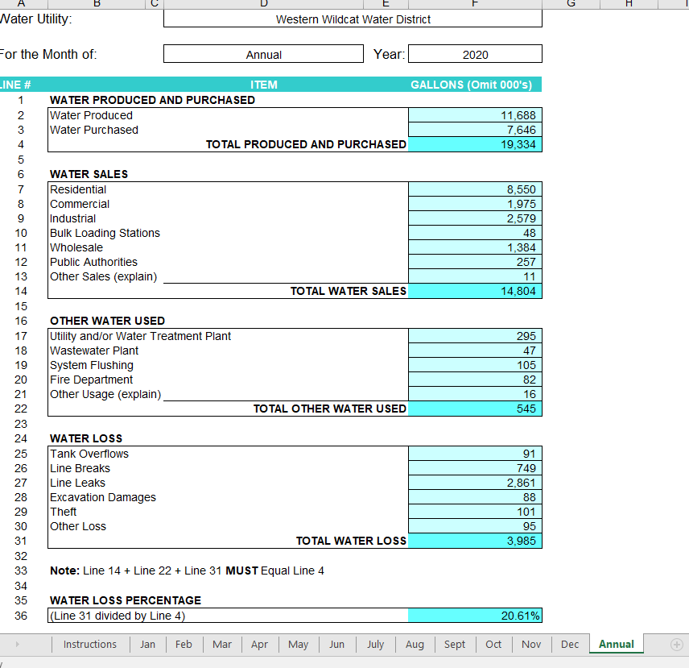
About the Form (continued)
As each month is completed, the spreadsheet will calculate a running average for the year. It can be found in the Annual tab. Once the December figures are entered, the spreadsheet will calculate the annual water loss.

Slide 37
THANK YOU
For information or assistance, call the PSC at:
502-564-3940

