Slide 1

Sustainable Infrastructure
through
Preventative Maintenance
Roy Gray
Kim Padgett
Regional logo here
Notes:
Add regional logo in picture frame at lower left

Slide 2
NOT an employee of PSC

Slide 4

Acknowledgement
This project has been funded wholly or in part by the United States Department of Agriculture/Rural Development (USDA/RD) under a training and technical assistance agreement to Rural Community Assistance Partnership. The contents of this document do not necessarily reflect the views and policies of the USDA/RD, nor does the USDA/RD endorse trade names or recommend the use of commercial products mentioned in this document.
This content does not necessarily reflect the views and policies of State Primacy, RCAP, or RCAP Regions.

Slide 5
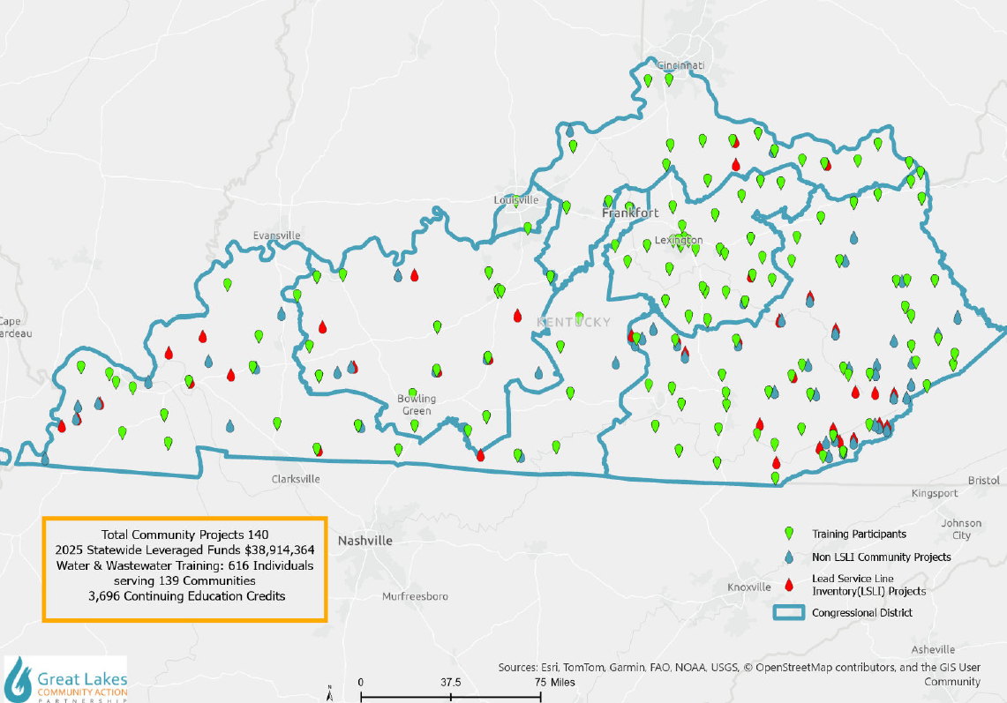
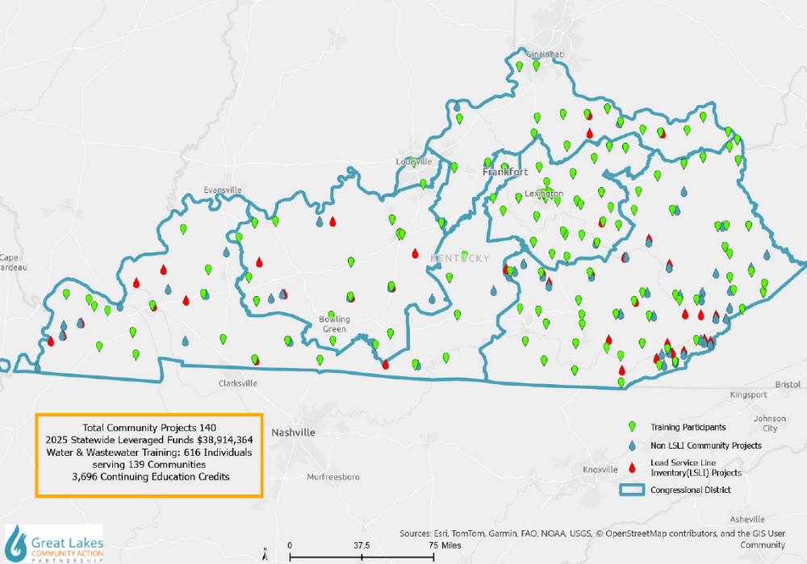
Kentucky Projects and Training 2025
Notes:
Projects and Training for 2025

Slide 6
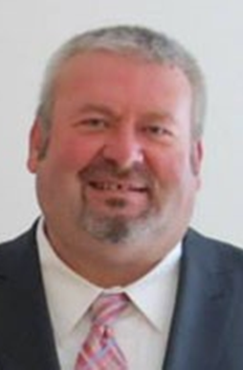
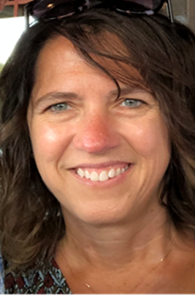

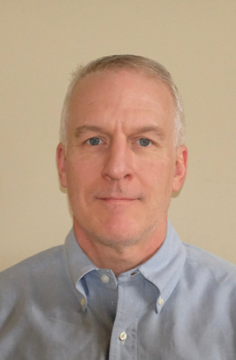

GLCAP-KY

Slide 7

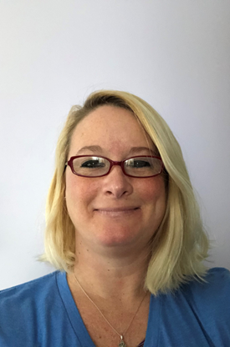
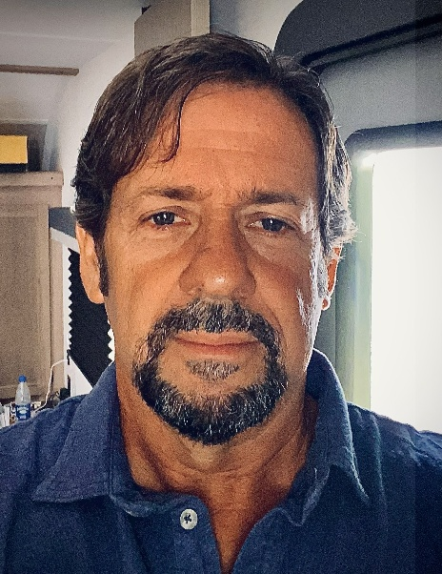

GLCAP-KY

Slide 8
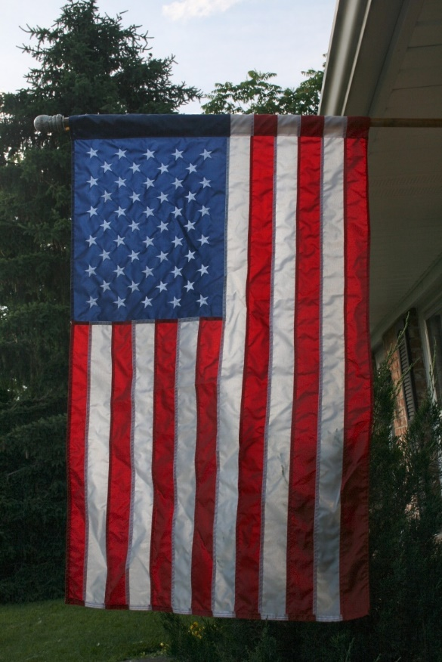
Thank YOU

Slide 9

Objectives
Identify key assets in your utility.
Compare cost effectiveness of preventative maintenance and asset management to replacement.
Communicate the value of water and wastewater services to community.
Awareness of public facing resources on the internet.

Slide 10
Exercise
Sketch your water system.

Slide 11
Water System Assets
Water Source: Intake
Water Storage Tanks
Water Treatment Plant
Hydrants
Trucks
Meters
Valves
Lines
Computer
Billing Software
Paying Customers
Employees
Certified operators
Well informed board members
Notes:
So for each of these assets that we have identified, does your system have a written preventative maintenance program (also known as an asset management plan)?
(If they say that they do, have them fully describe the program in place for a chosen asset. Chances are NO utility will have a complete preventative maintenance program in place for EVERY asset.)

Slide 12
Wastewater System Assets
WWTP
Lift Stations
Manholes
Pumps
Collection Lines
Force Mains
Grinder Pumps
Paying Customers
Employees
Influent Bar Screen
Channel Grit Chamber
Sedimentation Tank
Trickling Filter
Sludge Filter Press
WWTP Operators
WW Collection Operators
Well Informed Board Members

Slide 13

Drinking Water Advisory Council-Operator Survey
What did we learn?
Class IV Operators Email: 66%
Aging Infrastructure: 73%
Difficulty hiring/retaining skilled staff: 64%
Operator Wages: $13-$52/hr
Enjoy their jobs
Recruited from systems

Slide 14
Barriers to Hiring Operators
Rate of Pay: 74%
Lack of Qualified Applicants
Available shifts
Financial limitations at the utility
Certification process and requirements
Other:
  Over regulation
  Pay does not match level of responsibility
  Management not understanding regulatory requirements
  Lack of Benefits

Slide 15
Benefits
Paid sick and vacation days
Paid holidays
Health insurance
Retirement benefits
Paid time and travel to trainings
Reimbursement for certification fees and licenses
Overtime
Life & disability insurance
Annual raises

Slide 16

Asset Management
vs.
Preventative Maintenance

Slide 17
Asset Management/Preventative Maintenance
A planning process that ensures that entities get the most value from each asset and have the financial resources to rehabilitate and replace them when necessary.
Not a new concept… Preventative Maintenance Program that is fully supported… FINANCIALLY SUPPORTED… by the board and local elected officials!

Slide 18
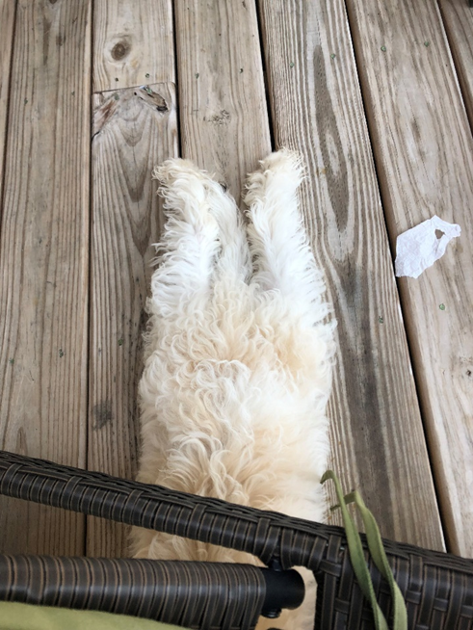
Asset Management is not regulated in Kentucky.
Yet…..

Slide 19
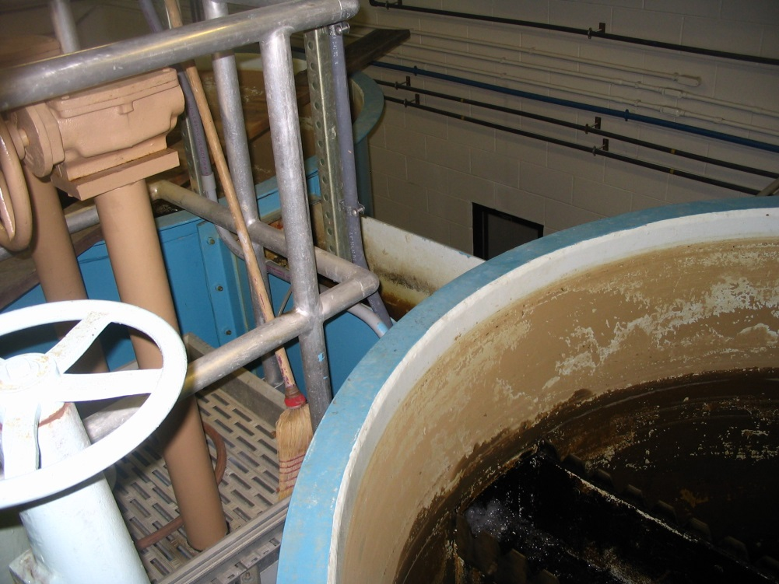
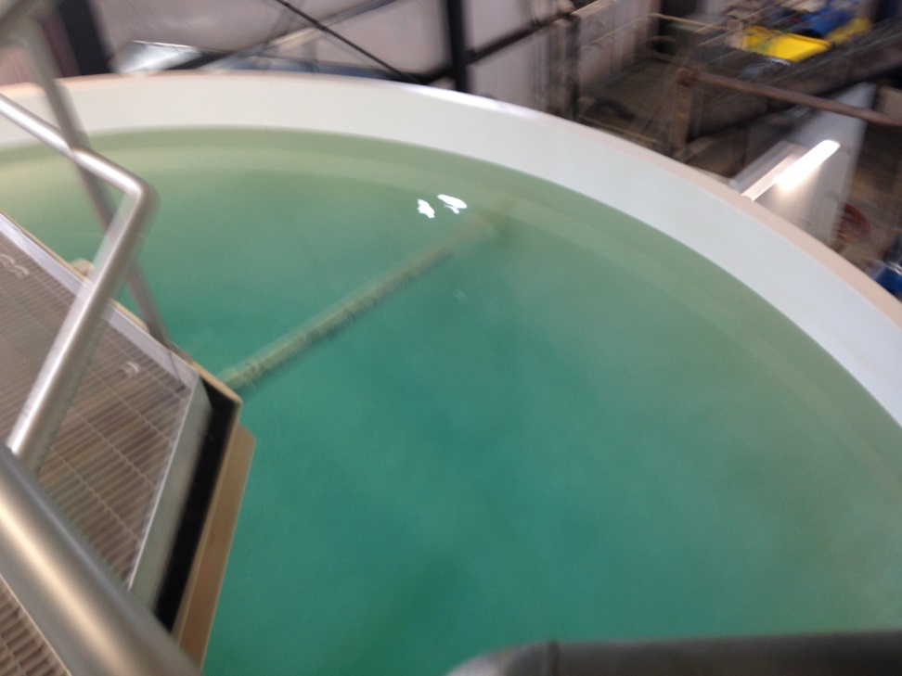
Asset Management - Preventative Maintenance
Notes:
Which system do you think has a written preventative maintenance program or asset management program in place?

Slide 20
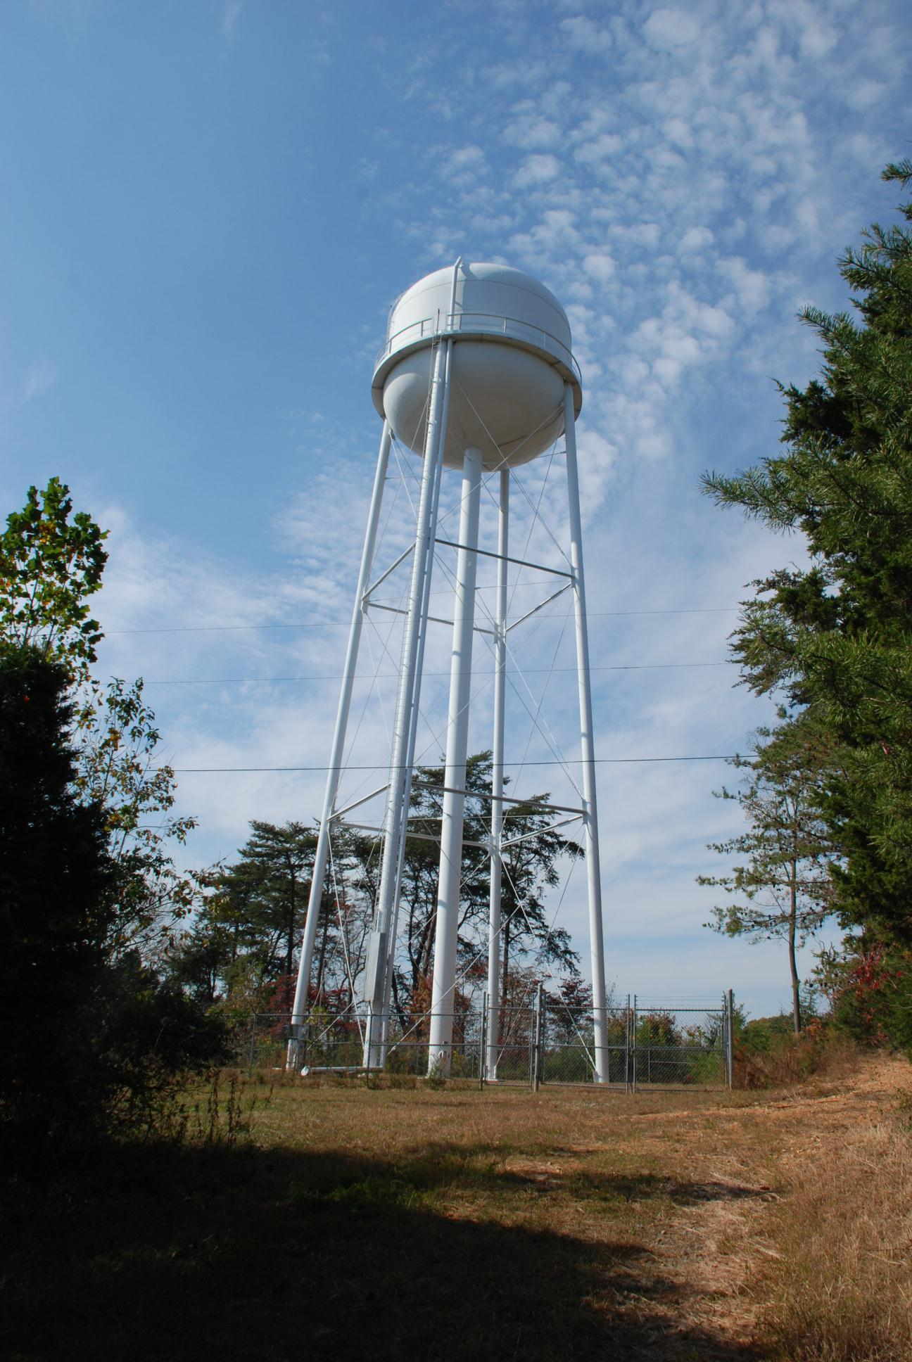
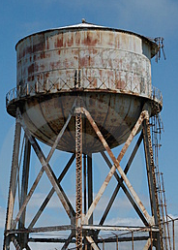
Asset Management - Preventative Maintenance
Notes:
Which system do you think has a written preventative maintenance program or asset management program in place?

Slide 21
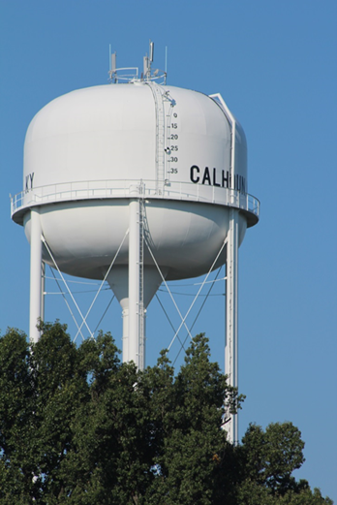

Water Storage Tanks
Inspection
Maintenance
Repair
Replace

Slide 22
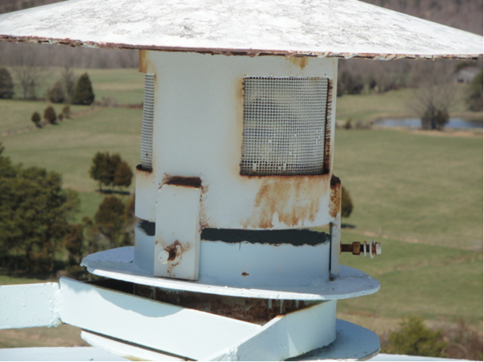
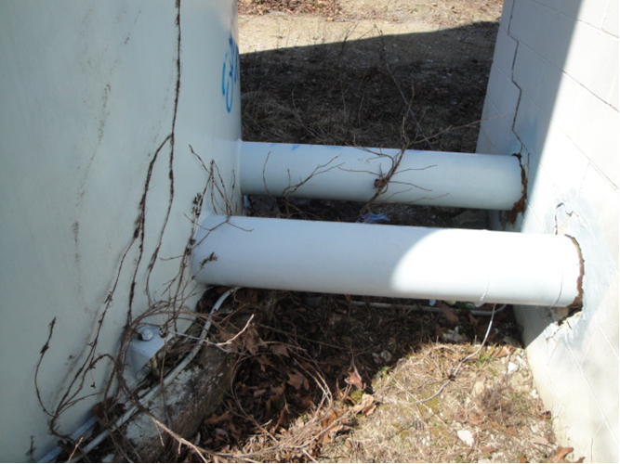
Water Storage Tanks

Slide 23
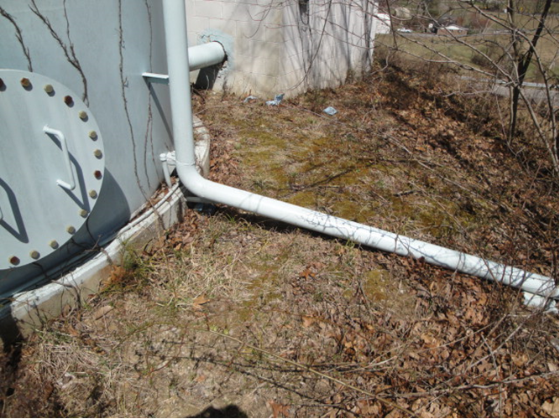
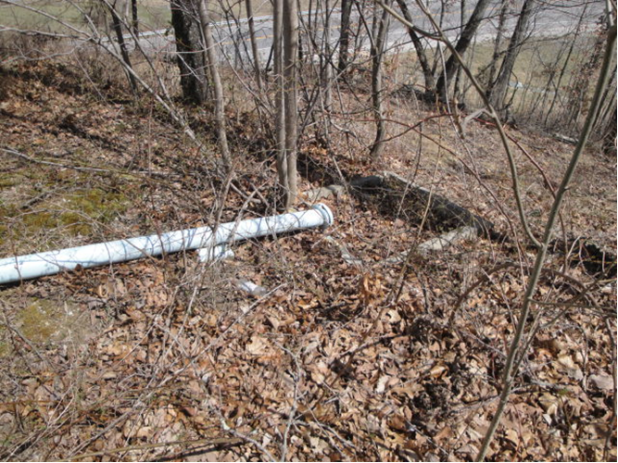
Water Storage Tanks

Slide 24
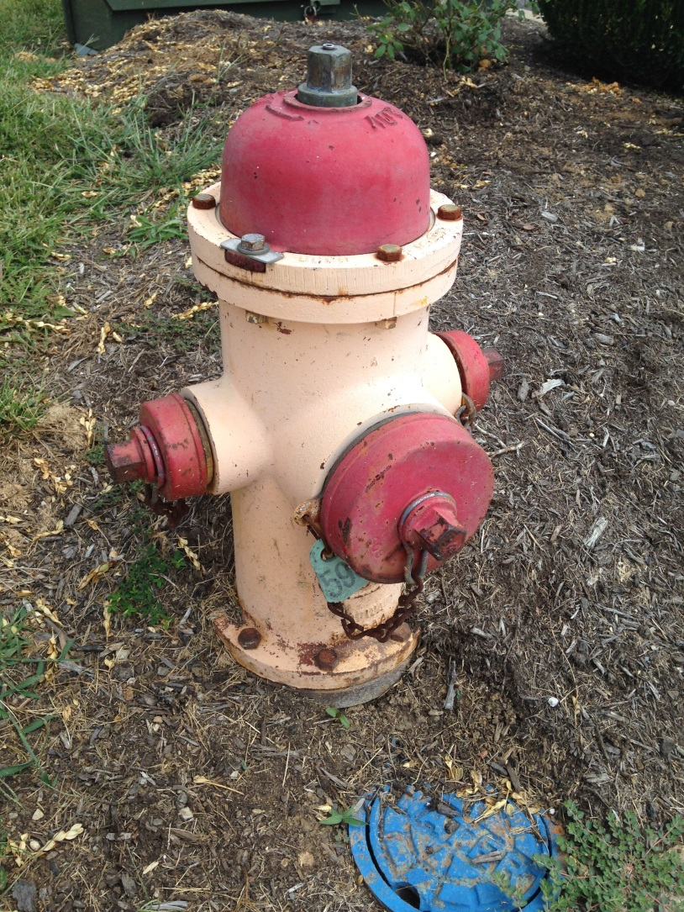
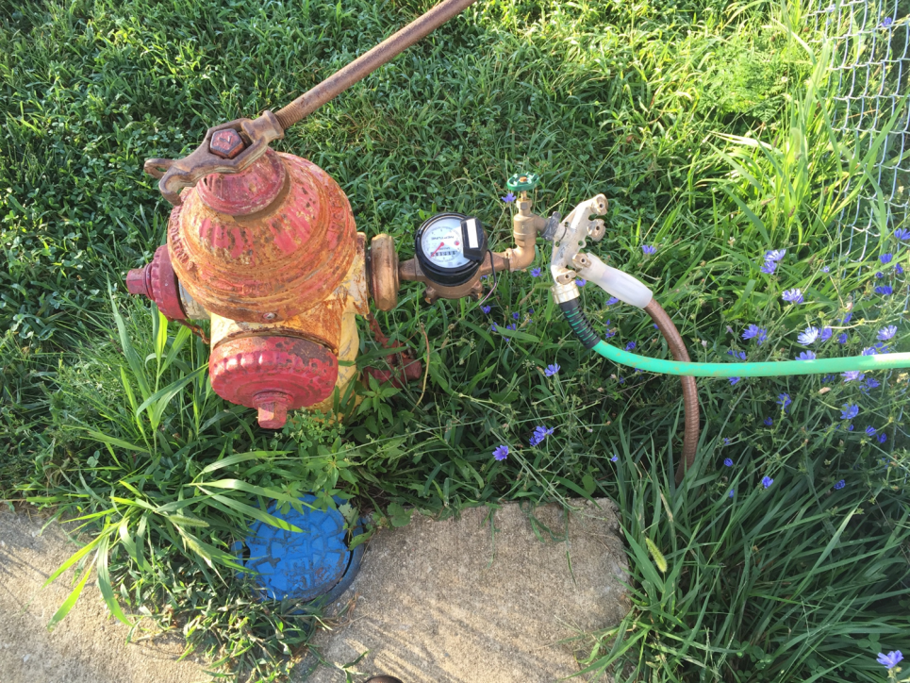
Hydrants
Inspection
Maintenance
Repair
Replace

Slide 25
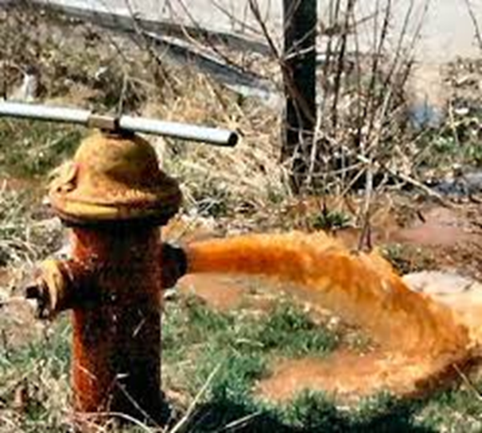
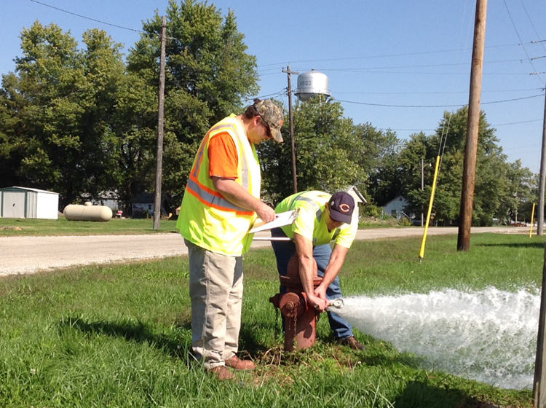
Hydrant Maintenance & Flushing

Slide 26
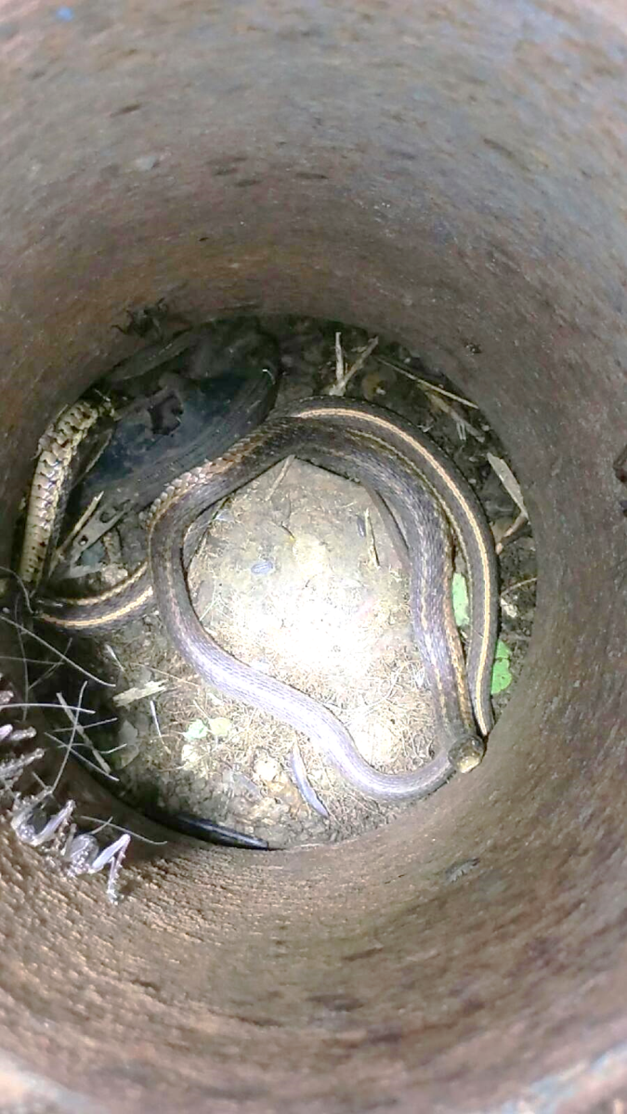
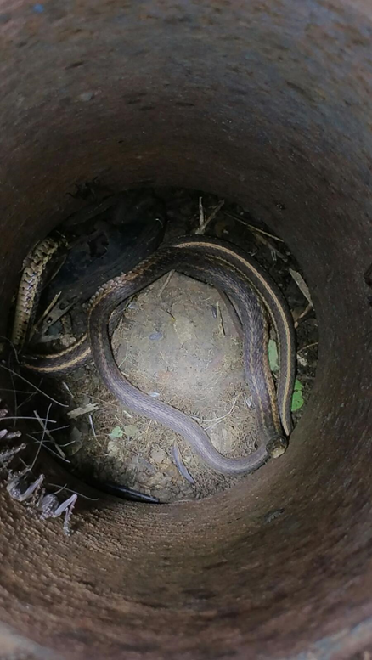
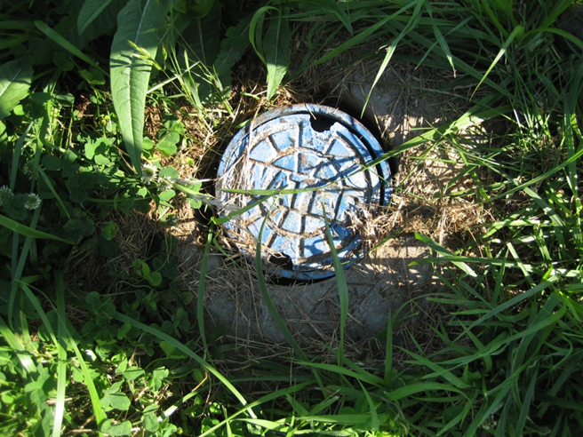
Valves
Inspection
Maintenance
Repair
Replace
Notes:
Please give credit to Michael of Versailles for the snake photo. After they opened the cover and saw the snakes, they put the cover back on. Actually there were four different snakes in the valve box; the 4th is difficult to see. No telling when/if they had last seen light.
Why are valves important?
Valves are critical in ensuring the reliability of distribution system and addressing emergencies
Main break must be isolated
Speed of shut off important in limiting damage.
Valves not used over a period of time can deteriorate-Negatively affecting water quality
Corrosion
Sediment deposit
“Distribution system valves are the least appreciated but most important component for providing reliability.”
“A valve that doesn’t work is – just a piece of pipe.”

Slide 27
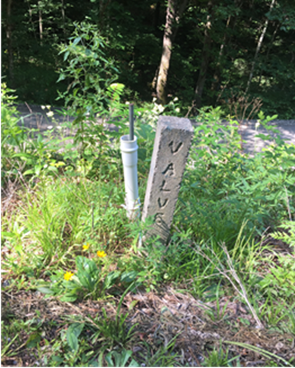
Valves

Slide 28
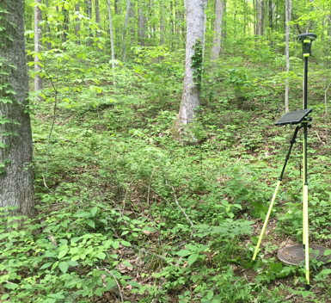
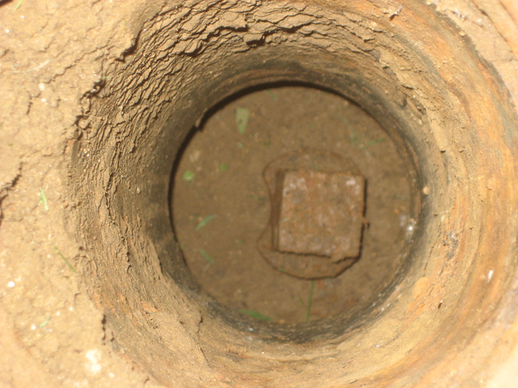
Valves
Notes:
“Most water systems would be hard pressed to say that they know where all their valves are.”
“A valve that doesn’t work is – just a piece of pipe.”

Slide 29
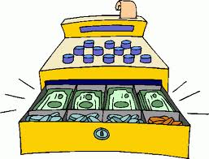
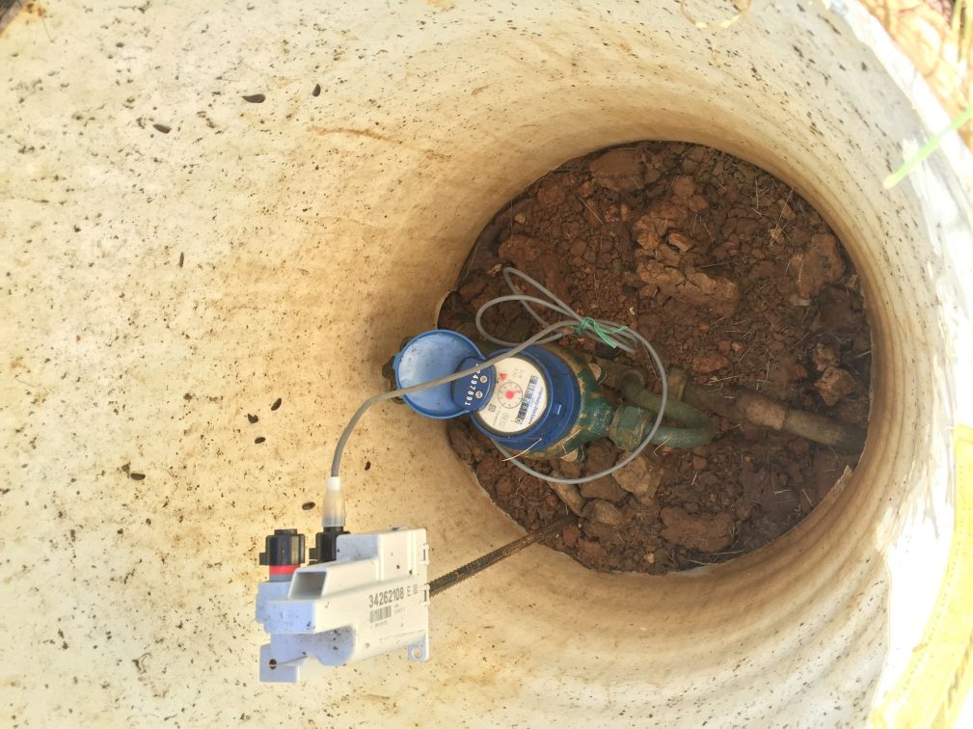
Meters
Inspection
Repair
Replace
Notes:
Your meters determine your revenue. An inaccurate meter means higher water loss but more importantly lost revenue.

Slide 30
Periodic Tests – 807 KAR 5:066 Sec. 16
Size of Meter Inches | Interval Between Tests Years
5/8 | 10
5/8 x 3/4 | 10
3/4 | 10
1 | 10
1 1/4 | 4
1 1/2 | 4
2 | 4
3 | 2
4 and larger | 1
Notes:
For PSC regulated water systems, regulation 807 KAR 5:066 Section 16 states that each utility shall test periodically all water meters so that no meter will remain in service without test for a period longer than specified in the above table.

Slide 31
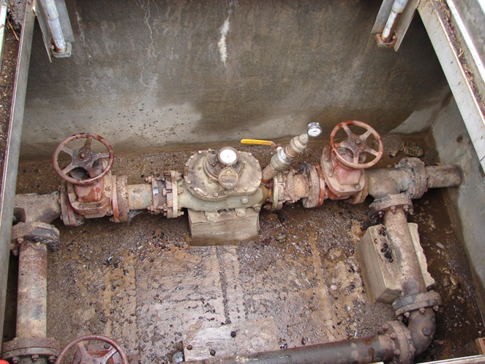
Master Meters

Slide 32
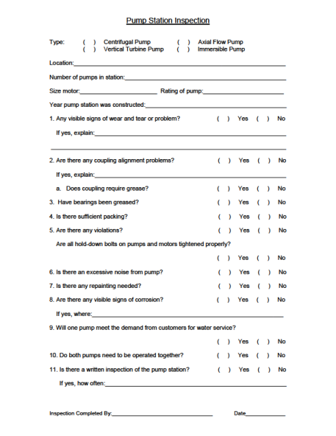
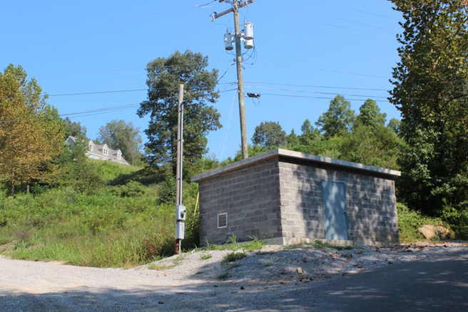
Pump Stations
Notes:
Check on the condition control panels, temperatures, condition of the interior of the building (are the walls wet, have they been sweating, is the concrete in good condition or is it crumbling).
Is the building secure?
If there are windows, are they in good repair? Are they broken?
What condition are the vents? Are they rusted? Are they open and functioning?
Check on the condition of the pumps (vibration, heat, seal, etc) and controls to ensure the pumps are operating properly. Check to make sure the pump operating times are equalized (that the pumps automatically switch over.) If this is done manually, make the appropriate switch over. Check and record the meter readings and pressure gauge readings on suction and discharge sides of pumps.
For those of you who have PRVs (Pressure Reducing Valves), keep the same inspection and maintenance schedule. DAILY You need to read these pressures daily.

Slide 33
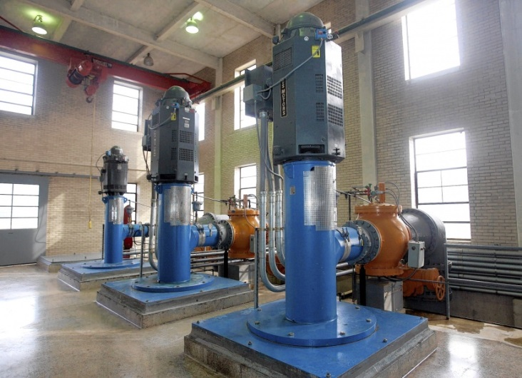
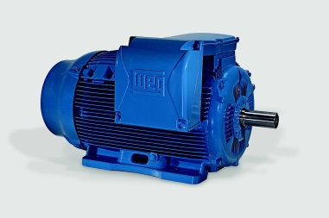
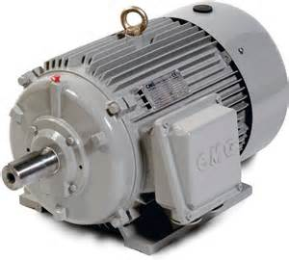
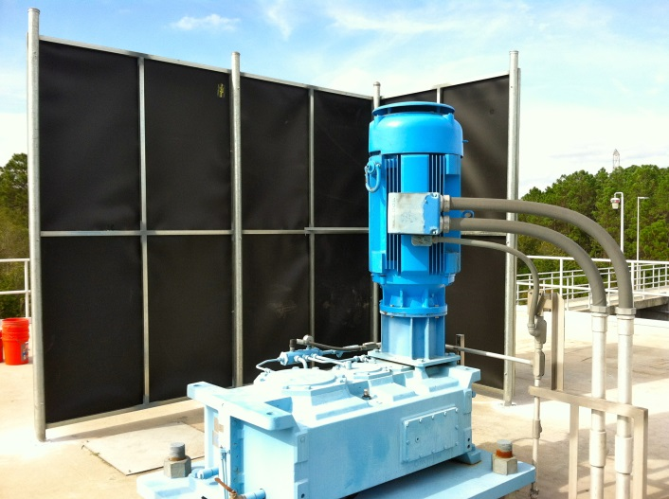
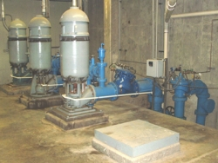
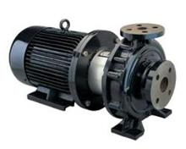
Motors and Pumps
Inspection
Repair
Maintenance
Replace
Notes:
Edit this slide as appropriate (replace words in brackets).

Slide 34

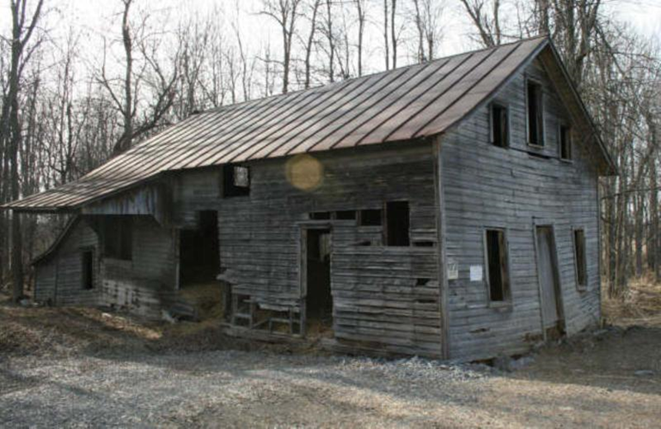
Do you maintain your system?

Slide 35
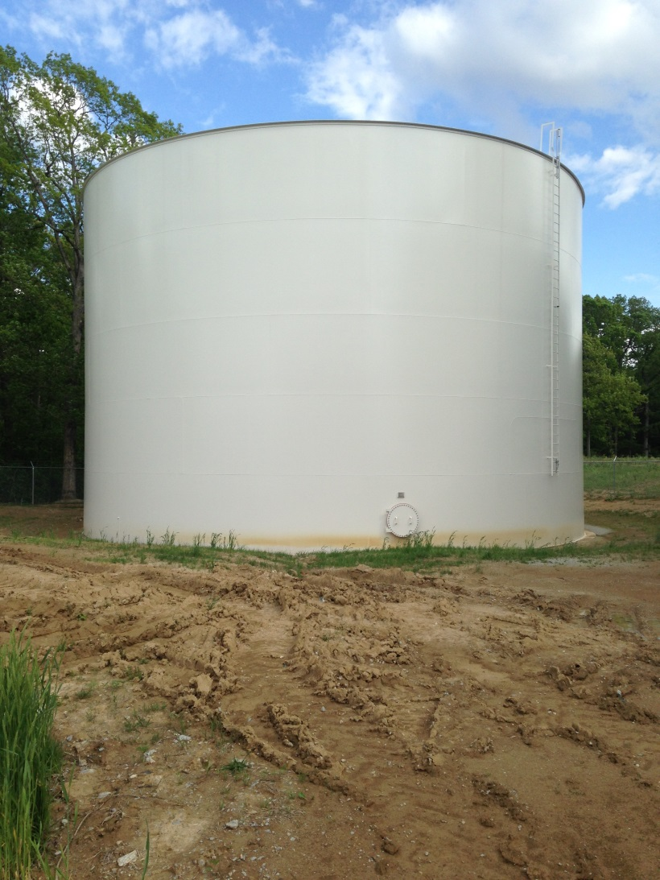
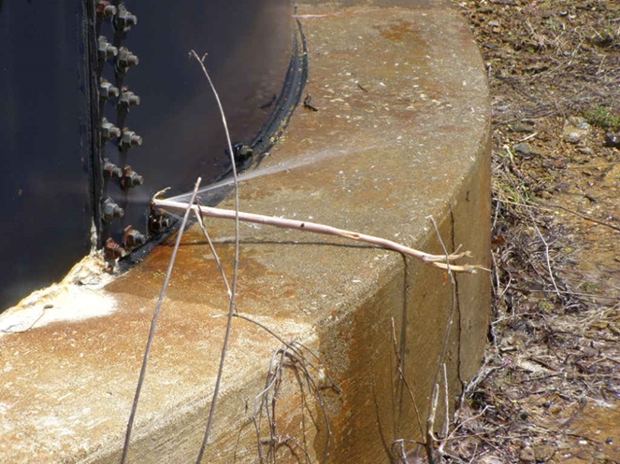
Do you maintain your system?

Slide 36
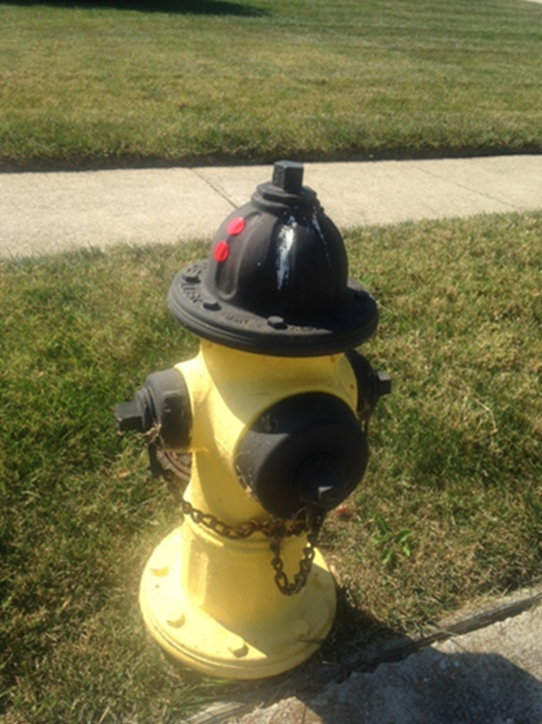
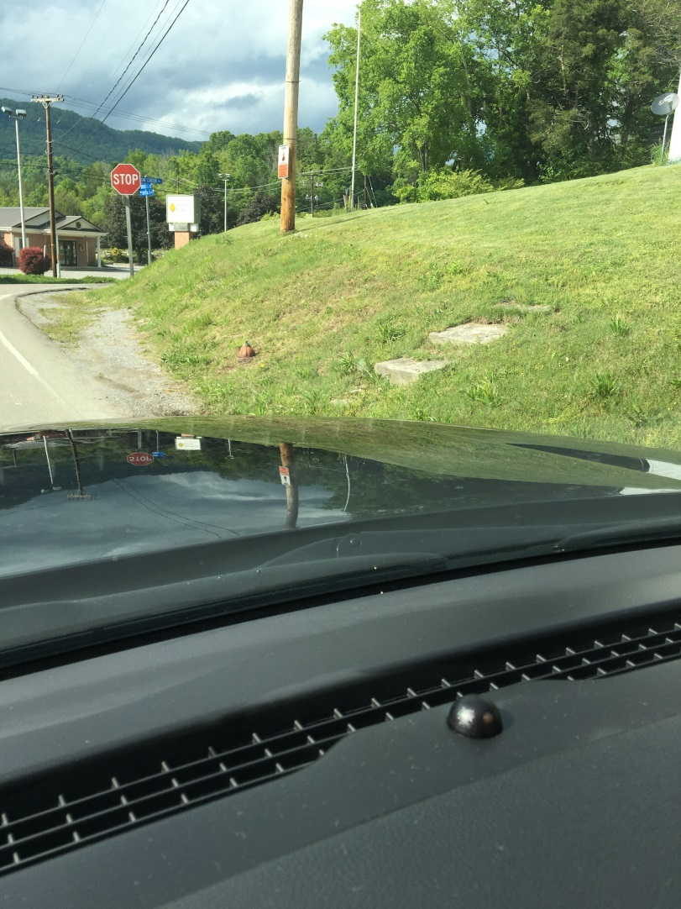
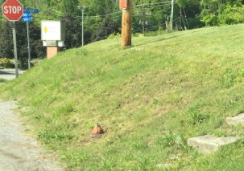
Do you maintain your system?

Slide 37
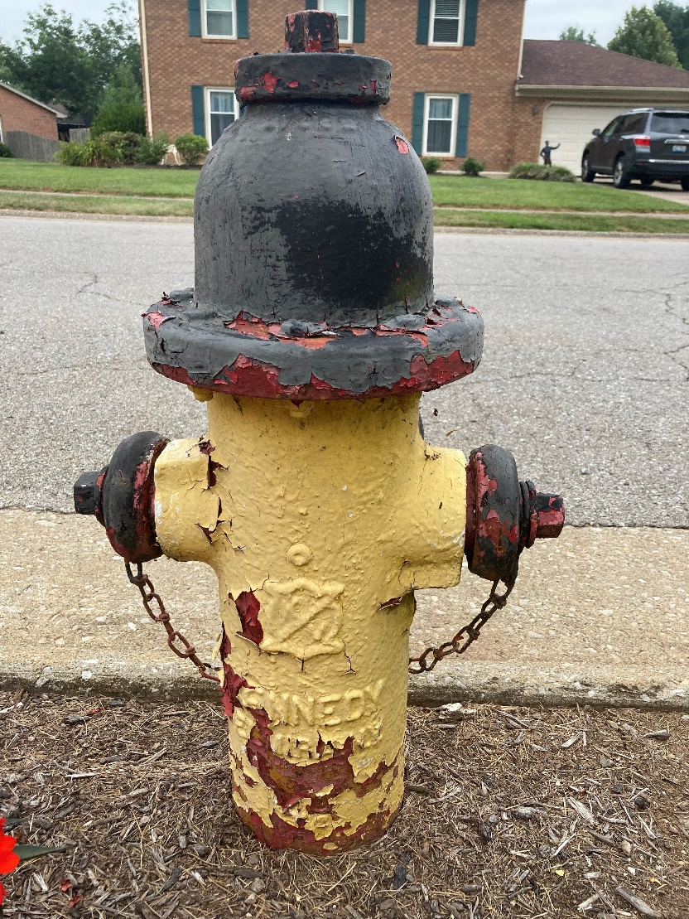
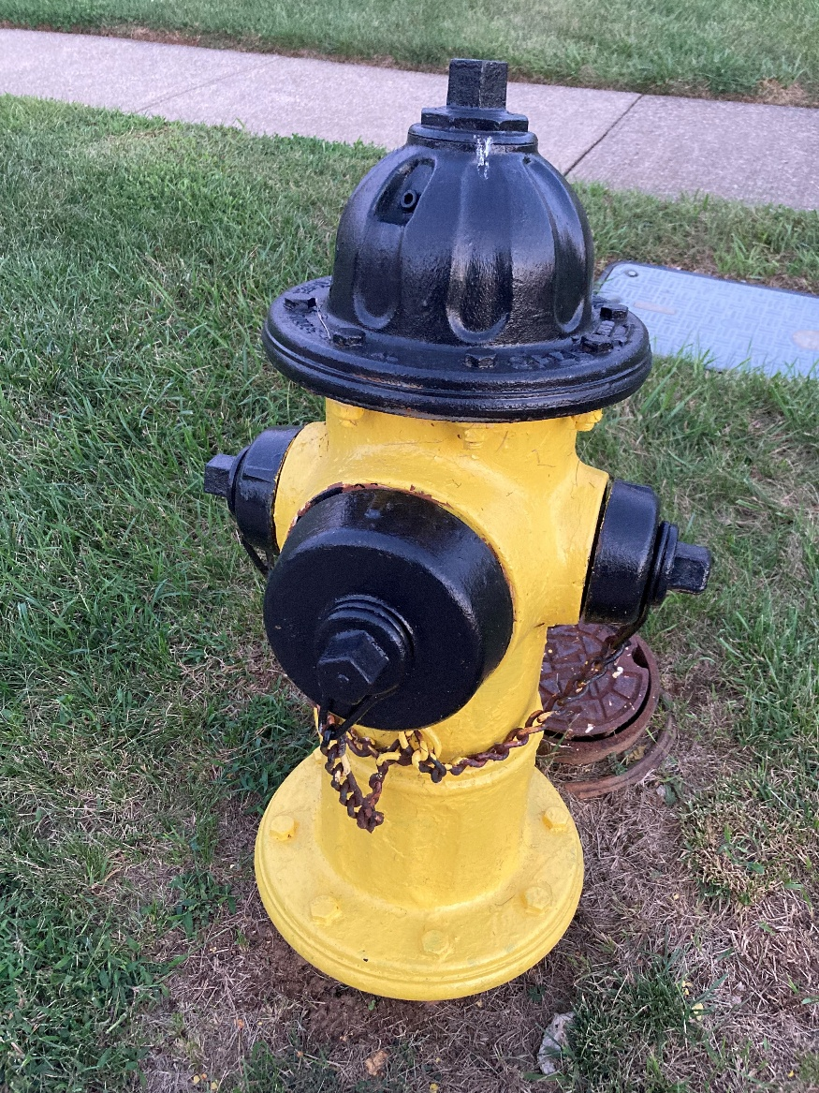
Do you maintain your system?

Slide 38
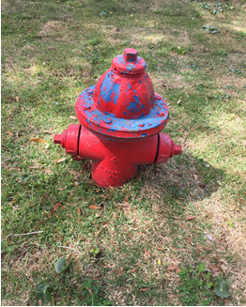
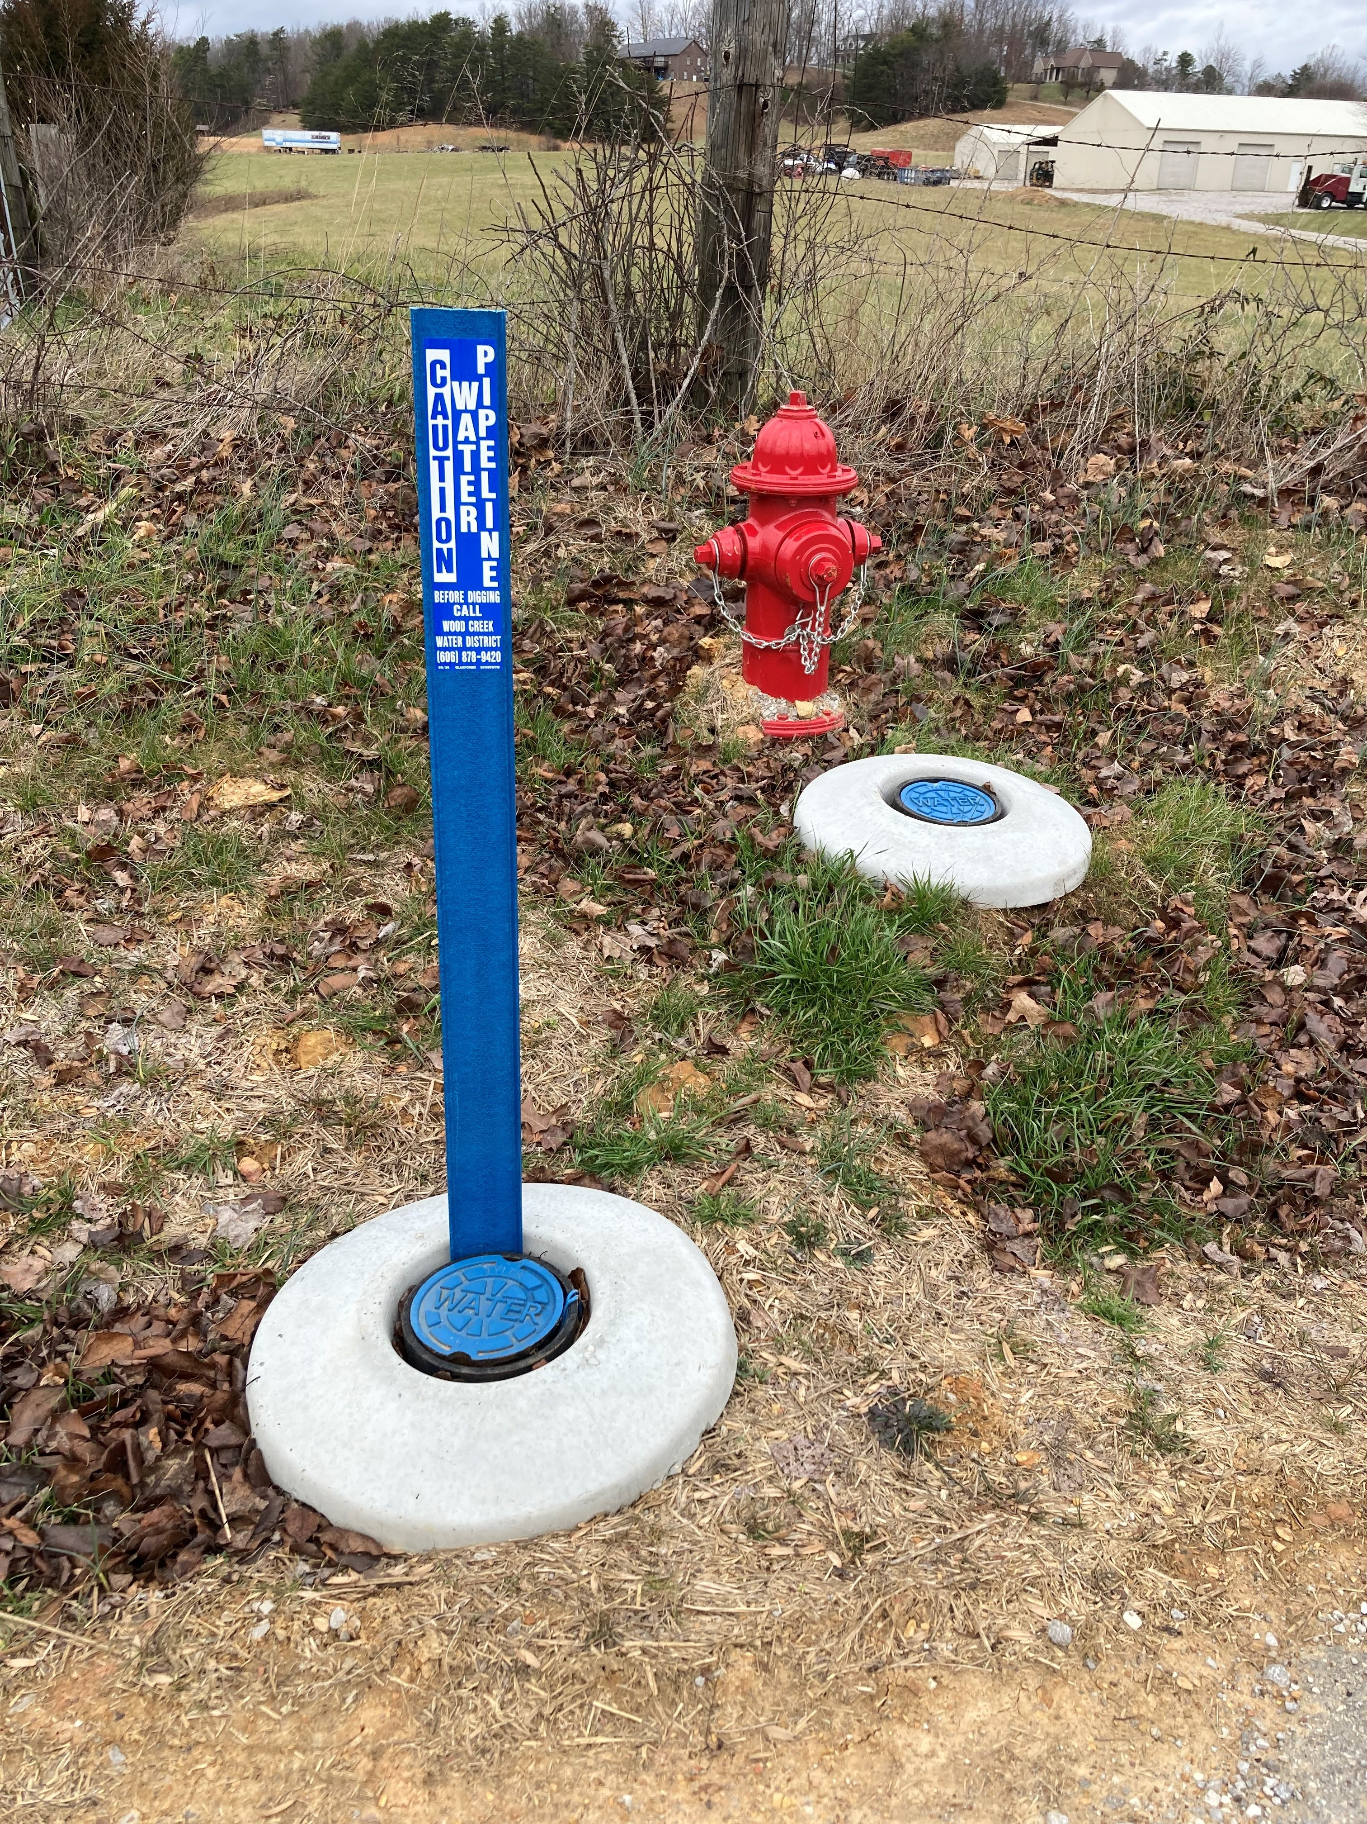
Do you budget maintenance expenses?

Slide 39
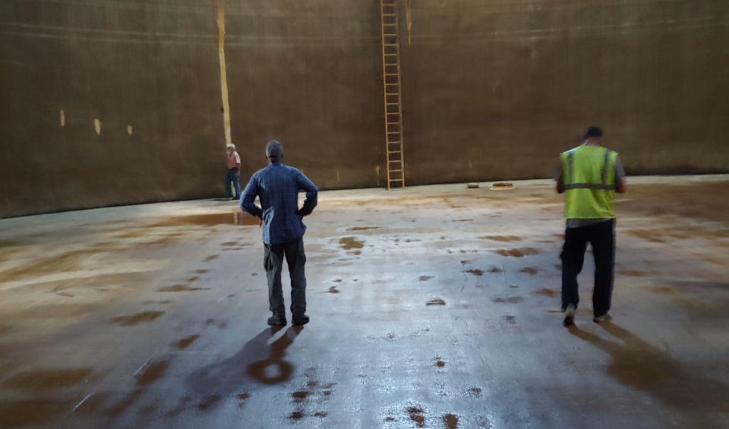
Do you maintain your system?

Slide 40



Scenario #1
Maintenance: NONE
Useful Life: 50,000 Miles
Cost per Mile: $0.71
Scenario #2
Maintenance: BASIC
Useful Life: 150,000 Miles
Cost per Mile: $0.24
Scenario #3
Maintenance: PREVENTIVE
Useful Life: 200,000 Miles
Cost per Mile: $0.18
Base Price:
$35,400
Notes:
Let’s talk about an asset that every utility has in their system. A truck! The current base price on this F150 quadcab XLT is $35,400. If we do zero maintenance on it, we can probably get 50,000 miles. Maybe a little more. But at 50,000 miles, the cost per mile is $0.71. If we do basic maintenance on the truck, surely we can get 150,000 miles. So the cost per mile is $0.24. However, if we stick to preventative maintenance…$0.18/mile.
Surely, we do not operate our vehicles at work or at home on a RUN to FAIL philosophy.
So why would we (and why do we) operate our water assets in that way?

Slide 41
Cost Comparison
Truck Preventative Maintenance Costs VS Repair Costs VS Replacement
Item | Prevent. Maint. Cost (Average) | Item | Repair Cost (Average)
Transmission Flush | $125 - $250 | Replace Transmission | $1,800 - $4,200
Tire Alignment | $100 - $150 | Replace Tires (4) | $1,000 - $2,000
Spark Plugs | $150 - $200 | Replace Catalytic Converter | $ 500 - $1,500
Timing Belt | $500 - $950 | Replace Engine | $3,000 - $6,500
Truck Replacement
$35,400
Notes:
Less frequent but necessary maintenance items.
Timing belt and tensioners – Every 100,000 miles, approximately $700-$1000
Transmission Service w/Filter – Every 75,000 miles, approximately $250-$400
Replace shocks and struts – Every 100,000 miles, approximately $500-$750
Water pump replacement – Every 75,000 – 100,000 miles, approximately $300-$500
Tune-up – Every 75,000 – 100,000 miles, approximately $400-$600
More frequent but necessary maintenance item.
Oil and filter – Every 5,000 mile, approximately $75-$100
Replace drive belts – Every 2-3 years, approximately $100-$200
Rotate and balance tires – Once a year, approximately $100-$150
Air Conditioning cabin filter – Every 2-3 years, approximately $75-$100
Coolant replacement – Every 2 years, approximately $75-$100
Brake fluid flush – Every 2-3 years, approximately $200-$250

Slide 42

Cost Comparison
Water Storage Tank (500,000 Gallons)
Inspection | Maintenance: Paint with minor repairs | Repairs
$1,200 | $15,000-$17,000 (20 years: $56,000) | $400,000
Replacement:
$800,000-$1,500,000

Slide 43


Useful Life of Lines

Slide 44

Waterlines

Slide 45


Waterlines
Notes:
In this particular case in southeastern Kentucky, a small water system was rapidly approaching receivership. They weren’t producing enough revenue to make debt service requirements (aka…their loans). The board members decided to negotiate with RD, PSC, and primacy. RD found a neighboring larger system who was willing to “purchase” the smaller system and noted the extraordinary amount of water loss. They applied for and received CDAP funds for a water loss control program. During this time, look what was discovered.
When uncovered, the pipe on the left was in a graveled ditch and looked fine. HOWEVER, when taken out of the ditch, look what was found. The missing “triangular” piece was not in the ditch. The contractor knowingly placed a broken pipe in place! The system had been losing water before being placed in operation.

Slide 46


Water Loss
What is your system’s average monthly water loss?
How much does it cost?
Notes:
Do you know what your system’s average monthly non revenue water is? Let’s start with your systems average water loss. (Record on easel the water loss numbers shared. Include one of RCAP’s systems water loss of 65%)
I am not just including the amount of water in actual leaks…I am also wanting to include water that you are not collecting revenue for as depicted in this second picture. (share the illegal tap picture that has the “pig” and the water meter)
How much does non revenue water (lost and stolen) cost you?
Let do some arithemetic…
Either refer to chart with loss amounts from the beginning of the presentation or ask for an acceptable number… Do arithmetic on chart or write it and ask someone with a smart phone to calculate it for you but write it on the chart nonetheless.
If we use 15% which has been designated to be the industry standard (which is why PSC pushes 15%)….
365 days x .15 = 54.75 days
Use an amount higher, say 65 % 365 x 0.65 = 237 days of the year you are using chemicals, using energy that you don’t need to, paying a higher electric bill that you don’t need to, sending water through lines that you don’t need to….

Slide 47
Water Loss of 15%
365 days in a year X 0.15 =
54.75 days
365 days in a year X 0.65 =
237.25 days

Slide 48
Which is more cost effective:
  Allow leaks/stolen water or I & I to continue?
  Budget staff time to locate and repair?
  Replace all lines?

Slide 49

Notes:
Aero validity in this information, simply a compilation of self reported, inconsistent data

Slide 50

Notes:
The software, and the process. Move away from % UFW and start to track in terms of Volume, Value and Validity

Slide 51
New Challenge for Industry
Transition from building and operating new infrastructure projects to managing assets
  Developing long-term funding strategies for the maintenance, renewal and augmentation of public infrastructure.
Asset Management/Preventative Maintenance is important because it provides… Sustained Long-term Performance.
Notes:
You have been building new facilities as needed for capacity or new treatment regulations. You have been operating your facility to the best of your ability.
But, have you been maintaining your facilities? Have you been putting back funds to replace your facilities? Do you have a plan?

Slide 52


Communicating the Value of Water and Wastewater Systems to the Community
Notes:
What is the real value of your water?
What is the value of the water system?
What is the value of both to your community?

Slide 53

Water Is Free !
Notes:
You can catch all that you want!

Slide 54


But if you want it delivered in your home safe to drink 24/7,
It’s going to cost you!

Slide 55

Safe, Reliable, Convenient = $$
You are paying for the processing, packaging, and delivery of the product.

Slide 56


Packaging & Convenience
$0.77 /gallon
$0.01 / gallon
Notes:
Paying for Convenience

Slide 57

Let’s Put It In Perspective!
 | Machine | Hauled | PWS
Toilet - 5 gallons per flush | $1.25 | $0.30 | $0.05
Dishwasher - 15 gallons/use | $3.75 | $0.90 | $0.15
Washing Machine - 55 gallons/use | $13.75 | $ 3.30 | $ 0.55
Avg HH use-70 gallons/day/person | $17.50 | $ 4.20 | $ 0.70
Assumptions:
- 1 gallon of water costs $0.25 from a machine
- Compare to $.06 per gallon for hauled water delivered at $60.00/1000 gallons
- Compare this to $.01 per gallon if your rates were $10.00 /1000 gallons
Cost per person drinking an average of ½ gallon of water per day =
$0.12 $0.025 $0.005
Notes:
Affordability? It costs ½ of a cent a day for your drinking water.
The rest of your water bill is for using water;
Carrying away waste
Washing clothes and living environment
Washing self instead of the river
Industrial and commercial use.

Slide 58



Let’s Put It In Perspective!
$ 3.49/Gallon
$ 5.98/Gallon
$ 0.01/Gallon

Slide 59

Monthly Utility Costs
What can we live without?
Notes:
Why is the most important utility we use the cheapest?

Slide 60
Value of Water or Sewer Utilities
1,500 connections * $10,000/connections =
$15,000,000.
This is the physical value NOT the economic or social value for the source, treatment, storage, and distribution.
Do the customers know the value of their utility?
Do you know the value of your utility?
Notes:
Let’s take a community of just under 4,000 residents. Using a national average ball park, rule of thumb, of $10,000 per service
1500 services * $10,000.00 per service equals a value of that water system at $15,000,000.
This is just the structural value. Not social, health, or economic value.

Slide 61


Is preventative maintenance essential to your system’s sustainability?

Slide 62

Water Resource Information System (WRIS)
https://kia.ky.gov/WRIS/Pages/WRIS-Portal.aspx

Slide 63

Water Resource Information System (WRIS)
https://kia.ky.gov/WRIS/Pages/WRIS-Portal.aspx

Slide 64

System Data

Slide 65

System Data – Search by County

Slide 66

System Data – Operation & Management
Notes:
System contact information.

Slide 67

System Data – Owner Entity

Slide 68

System Data – Fiscal Attributes
Notes:
Some useful information on this page includes: Number of employees, cost for 4,000 gallons of water, and number of connections.

Slide 69

System Data – Planning
Notes:
Page includes water loss data (should check accuracy for your system) and water supply information.

Slide 70

System Data – Asset Management

Slide 71

System Data – Maintenance

Slide 72

Projects
Notes:
Here you can see a list of the recent projects submitted through the ADD. We can see project costs, whether it was funded, partially funded, or not funded, if they were under an Agreed Order, and more. If we click on a specific project (next slide).

Slide 73

Projects
Notes:
You have opened a project and you will have a few choices for reviewing the information put in per project. The Narrative, applicant info, who is administering the project, what the budget and schedule are, what the projected impacts will be, components of the project (this needs to match your narrative), is sustainable infrastructure part of the project (this gains extra points), an audit on project activity, and the map of the project area (again all components should be mapped).

Slide 74

Projects
Notes:
You have opened a project and you will have a few choices for reviewing the information put in per project. The Narrative, applicant info, who is administering the project, what the budget and schedule are, what the projected impacts will be, components of the project (this needs to match your narrative), is sustainable infrastructure part of the project (this gains extra points), an audit on project activity, and the map of the project area (again all components should be mapped).

Slide 75

Map

Slide 76

System Data

Slide 77

Cleaner Water Funds

Slide 78

System Data

Slide 79


Slide 80
Exercise
Go to the KIA WRIS portal, System Data page, find your system and determine how many water tanks are listed for your utility.
Notes:
Have attendees use their phones to look up information about their system.
(Go around the room to ensure everyone understands the assignment and is participating. After approximately 5 minutes, have a representative from each system report out.)

Slide 81
Water Resource Information System (WRIS)
https://kia.ky.gov/WRIS/Pages/WRIS-Portal.aspx

Slide 82

Water & Wastewater Funding Needs
Notes:
State wide funding needs.

Slide 83

WRIS Projects by Region – Northern KY ADD
Notes:
Funding needs for Pennyrile ADD area.

Slide 84

WRIS Projects by Region – Pennyrile ADD
Notes:
Funding needs for Pennyrile ADD area.

Slide 85

WRIS Projects by Region – Green River ADD
Notes:
Funding needs for Pennyrile ADD area.

Slide 86

WRIS Projects by Region – FIVCO ADD
Notes:
Funding needs for Pennyrile ADD area.

Slide 87

WRIS Projects by Region – Cumberland Valley ADD
Notes:
Funding needs for Pennyrile ADD area.

Slide 88

WRIS Projects by Region – Kentucky River ADD
Notes:
Funding needs for the Purchase ADD area.

Slide 89

WRIS Projects by Region – Bluegrass ADD
Notes:
Funding needs for the Purchase ADD area.

Slide 90

Kentucky Infrastructure Authority (KIA)
Notes:
The Kentucky Infrastructure Authority (KIA), under the Office of the Governor and administratively attached to the Department for Local Government (DLG), provides financial help in the way of grant and loan assistance to communities for water and wastewater needs.​

Slide 91

Kentucky Infrastructure Authority (KIA)
Notes:
The Kentucky Infrastructure Authority (KIA), under the Office of the Governor and administratively attached to the Department for Local Government (DLG), provides financial help in the way of grant and loan assistance to communities for water and wastewater needs.​ 200 applications; only made it to number 25.

Slide 92


Kentucky Infrastructure Authority (KIA)

Slide 93


Kentucky Public Service Commission https://psc.ky.gov/
Click hamburger stack to
access menu.

Slide 94


Kentucky Public Service Commission

Slide 95


Kentucky Public Service Commission

Slide 96


Kentucky Public Service Commission

Slide 97
Exercise
Go to the PSC website, find your system’s tariff and determine what your utility charges for a new residential meter tap-on/connection.
Notes:
Have attendees use their phones to look up information about their system.
(Go around the room to ensure everyone understands the assignment and is participating. After approximately 5 minutes, have a representative from each system report out.)

Slide 98

Drinking Water Watch
https://dep.gateway.ky.gov/DWW/
Notes:
Safe Drinking Water Information System (SDWIS) – federal database for all drinking water data. This is the public facing portion of it. The Drinking Water Branch- Compliance Section enters all information into the database. So, they are the only ones to contact if there are known issues with the data entered.

Slide 99


Slide 100


Slide 101
Drinking Water Watch
https://dep.gateway.ky.gov/DWW/
Notes:
Safe Drinking Water Information System (SDWIS) – federal database for all drinking water data. This is the public facing portion of it. The Drinking Water Branch- Compliance Section enters all information into the database. So, they are the only ones to contact if there are known issues with the data entered.

Slide 102


Slide 103


Slide 104


Slide 105



Slide 106


Slide 107


Slide 108


Slide 109


Slide 110


Slide 111


Slide 112

These Are Not Burnside’s violations

Slide 113



Slide 114
Department For Environmental Protection
Protecting Kentucky's Environment
Kentucky's remarkable natural resources have helped shape our economy, culture and history. These resources also provide us with the responsibility of good stewardship. Kentucky’s residents and businesses must work together to preserve the resource quality and diversity that make Kentucky a great place to live, work and play.
The Kentucky Department for Environmental Protection has been given the duty to lead this effort to protect and enhance Kentucky’s environment. The department invites you to join us in this effort. By working together, we will successfully keep Kentucky's environment as one of our greatest treasures.
The department's mission is to protect and enhance Kentucky's environment. This mission is important because it has a direct impact on Kentucky's public health, our citizens' safety and the quality of Kentucky's valuable natural resources and environment.​

Slide 115



Department For Environmental Protection
Divisions
Air Quality
Waste Management
Water
Enforcement
Compliance Assistance
Notes:
Although Air Quality, Waste Management, and Enforcement are important divisions and at times can be involved in water and wastewater operations, especially Waste Management and Enforcement, we will not be going over those departments. We will be focusing on Division of Water and Compliance Assistance.

Slide 116



Department For Environmental Protection

Slide 117
Compliance Assistance
The Compliance Assistance program provides services to improve regulatory compliance, achieve exceptional performance and enhance the quality of Kentucky’s environment and communities.
Environmental Compliance Assistance Program
Operator Certification Program
Brownfield Redevelopment Program

Slide 118

Compliance Assistance
Notes:
On the Compliance Assistance homepage on the right side of the page under Quick Links is the shortcut to Program Resources

Slide 119

Compliance Assistance – Program Resources
Notes:
On the Compliance Assistance homepage on the right side of the page under Quick Links is the shortcut to Program Resources.
Permits at a Glance – is a fact sheet describing all types of permitting under each division (Air, Waste Management, Water, and Assistance and Resources.
Compliance Library – is a listing of all fact sheets related to compliance topics.
DEP Forms Library – is an interactive search site where you can look up the most up to date form that you may need.
Subscribe to Online Media – is a page highlighting media resources created by different departments.

Slide 120



Resources

Slide 121
Compliance Assistance
Notes:
On the Compliance Assistance homepage on the right side of the page under Quick Links is the shortcut to Program Resources

Slide 122

Compliance Assistance – Operator Certification
The Certification and Licensing Branch is home to the solid waste, drinking water and wastewater certification programs.

Slide 123


Compliance Assistance – Operator Certification

Slide 124

Compliance Assistance – Operator Certification

Slide 125

Department For Environmental Protection

Slide 126
Division of Water
The mission of the Division of Water is to manage, protect and enhance the quality and quantity of the Commonwealth's water resources for present and future generations through voluntary, regulatory and educational programs.

Slide 127

Division of Water

Slide 128
Division of Water
Broken down into 13 groups:
Compliance and Inspections
Permits, Certificates and Approvals
Submittals and Reporting
Community Outreach/Involvement
Drinking Water
Flooding and Drought
Funding

Slide 129
Division of Water
Broken down into 13 groups (cont.):
GIS and Maps
Monitoring and Assessments
Planning and Protection
Quality Assurance and Standard Operating Procedures
Regulations and Standards
Reports and Publications
Notes:
Considering time restraints we only be covering a select few of these groups and subgroups within them.

Slide 130



Division of Water

Slide 131

Division of Water – Compliance and Inspections
Performs a number of critical
functions to help prevent and
address problems with water
pollution.

Slide 132
Division of Water – Compliance and Inspections
CMOM
“CMOM” stands for Capacity, Management, Operation, and Maintenance. A CMOM program is a framework of self-assessment and practices that help a sewer system manage, operate, and maintain their collection systems; investigate and provide adequate collection system and treatment plant capacities; and respond to and prevent unauthorized discharges such as sanitary sewer overflows (SSOs) and other non-compliance.
Info available in this section:
CMOM Self-Assessment
CMOM Plan of Action
Modifications of CMOM Programs and Documentation
Notes:
The goals of a comprehensive CMOM program are:
To better manage, operate, and maintain the collection system;
Investigate capacity constrained areas of the collection system and treatment plant;
Proactively prevent or minimize unauthorized discharges;
Respond to overflow events and other non-compliance; and
Proactively prevent or minimize the potential for the release of pollutants from associated activities through treatment plant site runoff, spillage or leaks, sludge or waste disposal, or drainage from storage areas.
Specific CMOM programs may address budgeting, staffing, training, public education, inventory, preventive maintenance and cleaning, rehabilitation, overflow response, fats, oils and grease, backup power, root control, and system capacity. POTWs can conduct a self-assessment to determine which specific CMOM programs are appropriate for their sewer system, and determine the status of programs that may already exist or will need to be developed.

Slide 133

Division of Water – Compliance and Inspections
Combined Sewer Systems and CSOs
Field Operations
Municipal Separate Storm Sewer Systems (MS4s)
Pretreatment

Slide 134

Division of Water

Slide 135



Division of Water – Drinking Water

Slide 136

Drinking Water – Check Your Pipes KY
Notes:
Has information for utilities and for consumers.

Slide 137

Drinking Water – Check Your Pipes KY
Link to website geared toward the public explaining lead in drinking water and how they can help the utility complete the service line inventory and better protect themselves from lead.
Video demonstrating the different types of
service line and how to identify it.
Social media posts and info that
utilities can use on their own
social media page.
Post card and door hanger examples

Slide 138


Division of Water – Drinking Water

Slide 139



Drinking Water – Information For Water Treatment Professionals

Slide 140




Drinking Water – Information For Water Treatment Professionals - Compliance

Slide 141

Drinking Water – Information For Water Treatment Professionals – Compliance – Lead Rule Revisions

Slide 142

Drinking Water – Information For Water Treatment Professionals – Compliance – Public Notification

Slide 143

Division of Water

Slide 144

Division of Water – Funding

Slide 145

Division of Water – Funding - Funding Resources

Slide 146

Division of Water – Cont.

Slide 147


Email:
Roy Gray
rlgray@glcap.org
Kimberly Padgett
khpadgett@glcap.org

Slide 148

Time for a Break

