Slide 1



PSC REGULATORY REQUIREMENTS
Kentucky Public Service Commission
Water Training Seminar
Any views expressed in this presentation are those of the presenter and do not reflect official positions of the PSC

Slide 2
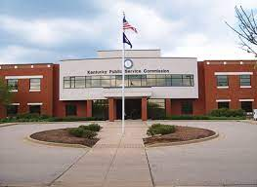
Agenda
Overview statutes and regulations for
    Rates
    Service
    Construction – Certificate of Public Convenience and Necessity
    Financing or Issuing Debt

Slide 3

THE BUCK STOPS WITH YOU
Why attend commissioner training?
KRS 74.020: water district is administered by board of commissioners who manage the affairs of the district
KRS 74.070: duties and powers
Commissioners are responsible for ensuring that the water district complies with the laws of the Commonwealth and Commission regulations

Slide 4
PSC
Chair, Angie Hatton
Vice-Chair, Mary Pat Regan
Commissioner – Andrew W. Wood
Commissioner – Barry Mayfield
4-member independent administrative agency (will eventually be 5)
Quasi-legislative and quasi-judicial duties
Regulate utility rates and service

Slide 5

PSC Statutory Authority
KRS 278.040
Exclusive jurisdiction over regulation of utility rates and service
Adopt reasonable regulations to implement KRS Chapter 278
Investigate utility methods and practices
Require utilities to conform with laws of the state

Slide 6
Examples of PSC Regulatory Responsibility
Rate increase or reduction
Meter accuracy
Consumer complaints
Compliance with service and safety regulations
Management audits
Construction and operation of utility facilities
Issuance of debt by a utility

Slide 7
Rates
KRS 278.010(12)
Any individual or joint fare, toll, charge, rental, or other compensation for service rendered or to be rendered by any utility, and any rule, regulation, practice, act, requirement, or privilege in any way relating to such fare, toll, charge, rental, or other compensation, and any schedule or tariff or part of a schedule or tariff thereof.

Slide 8

Rates
Methods for Setting and Adjusting Rates
General Rate Adjustment
Alternative Rate Adjustment
Purchase Water Adjustment
KRS 278.023, RD rate requirement
Non-recurring charges
Tariff Filings

Slide 9
Rates
Methods for Setting and Adjusting Rates
Not all methods for setting rates are equal
General Rate Adjustment
  Filing requirements found in 807 KAR 5:001, Section 16
  Available to all utilities
  Must be filed by an attorney
Alternative Rate Adjustment
  Filing requirements found in 807 KAR 5:076, Section 4
  Available to utilities with gross annual revenue of ≤ $5,000,000 in the immediate past calendar year
  Must have filed annual reports in both of the last two years
  Does not require an attorney, unless a hearing is scheduled

Slide 10
Rate Adjustments
807 KAR 5:001: Procedural rules for proceedings
  Section 16: General Adjustment of Existing Rates
    Application not deemed filed until meets all requirements
  Section 17: Notice of General Rate Adjustment

Slide 11
Rates: Alternative Rate Filing
807 KAR 5:076
Purpose: Simplified and Less Expensive Procedure
Utilities need only file Simplified Application Form With PSC
Eligibility:
  Utilities with Gross Annual Revenues ≤ $5,000,000

Slide 12
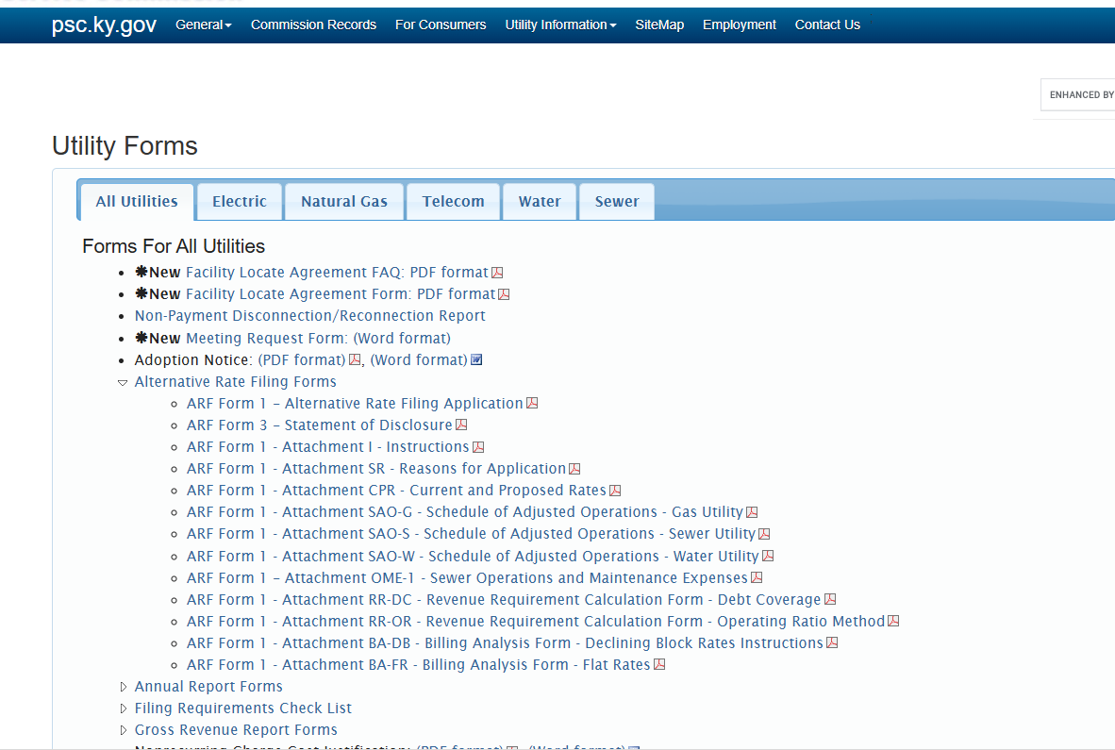
Rates: Alternative Rate Filing

Slide 13
Rates: Alternative Rate Filing
807 KAR 5:076
  Section 3: Record upon which decision made
  Section 4: Application
  Section 5: Notice to customers
  Section 6: Notice to Commission
  Section 7: Effective Date of Proposed Rates

Slide 14
Rates: Alternative Rate Filing
807 KAR 5:076
  Section 13: Role of non-attorneys
    Authorized water district personnel may:
      file application
      responses to requests for information
      appear at conferences
    BUT Attorney must represent at hearing (if held)

Slide 15
Rates continued
KRS 278.023 Rate Adjustment
Rates adjusted in connection with USDA/RD financing of improvement project
Rates determined by USDA/RD, Commission must accept rates
Commission conducts no independent review
Depreciation is not accounted for in USDA/RD loans approval the same as in a General Rate Case or an Alternative Rate filing before the Commission.
Filed by an attorney
Purchased Water Rate Adjustment
Rates charged to utility customers increased when wholesale water rates increase. Pursuant to KRS 278.015(2)
Often called a “pass through” increase
Filed by the utility

Slide 16
Rates: Purchased Water Adjustment
KRS 278.015(2)
  Adjust rates to reflect wholesale supplier increase
807 KAR 5:068
  File application within 20 days of adjustment
  Notice to customers
  File revised tariff sheet within 20 days of Commission order approving proposed rates

Slide 17
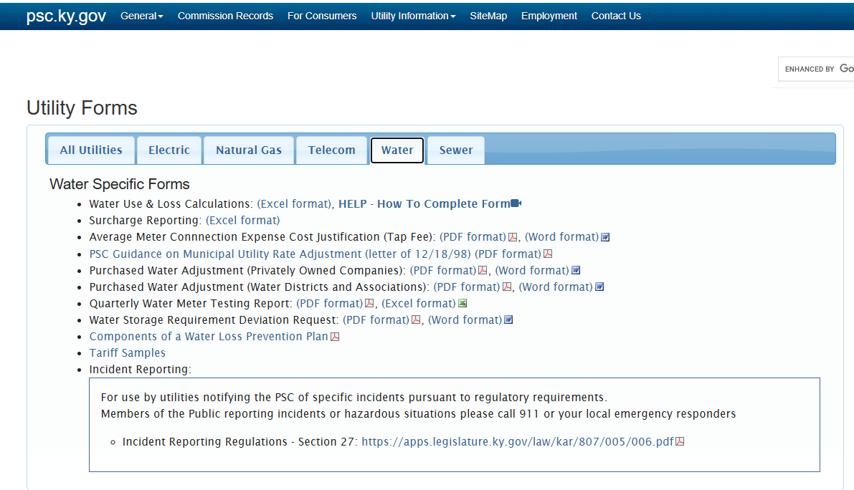
Rates: Purchased Water Adjustment

Slide 18
Rates: Tariffs
KRS 278.160: utility must file and adhere to tariff
KRS 278.170: no rate or service discrimination, but reduced rates in response to an emergency possible.
KRS 278.180: rate changes
807 KAR 5:001: rules of procedures for proceedings
807 KAR 5:006: general procedures for providing service
807 KAR 5:011: tariff regulations

Slide 19
Rates: Tariffs
KRS 278.160(1): Rates must be filed with PSC
    Utility must file tariff with PSC showing
      Schedule of rates for each class of customers
      Terms and conditions under which service is provided to customers
KRS 278.160(2): Filed Rate Doctrine:
  Utility cannot charge or collect greater or less compensation for service rendered than its filed tariff
  Customer cannot receive service that differs from the tariff

Slide 20
Rates: Tariffs
KRS 278.170
  No unreasonable preference between customers
  KRS 278.170(2) permits a utility to provide reduced rate service for the purpose of providing relief in the case of flood, epidemic, pestilence or other calamity. Notice must be given to the Commission and the Commission must approve before the lower rate can go into effect, except in a declared emergency, in which case the Commission shall be notified within 5 days after service rendered.

Slide 21
Rates: Tariffs
807 KAR 5:006: General rules for providing service
  Section 5: substantial service changes
  Section 6: special requirements require PSC approval
  Section 7: Meter readings and billing
  Section 8: Deposits
  Section 9: Nonrecurring charges
  Section 11: Bill Adjustment
  Section 15: Refusal or Termination of Service

Slide 22
Rates: Tariffs
  If it isn’t in your tariff, you can’t do it
  If it is in your tariff, you must do it

Slide 23
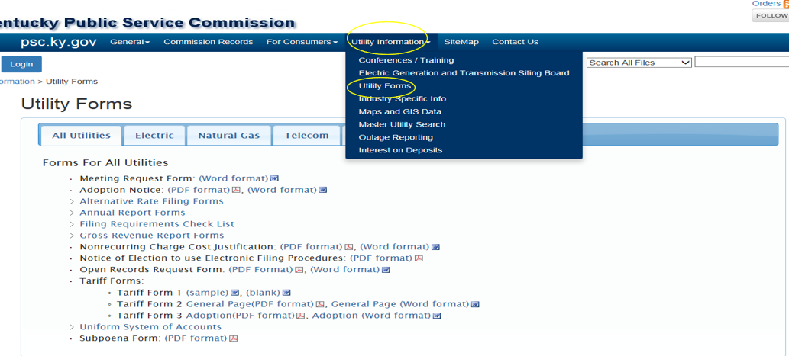
Rates: Tariffs

Slide 24
Rates: Tariffs
KRS 278.180: Change in Rates
  30 days notice to Commission
  File revised tariff sheets
  State proposed changes
  State time changed rates go into effect

Slide 25
Rates: Tariffs
807 KAR 5:011: filing requirements for tariffs
  Customer Notice
    Billing insert
    Newspaper of general circulation
    Newsletter distributed to all customers
    Public posting in utility premises and web site
  Proposed rates become effective on date stated if:
    Proper notice to public
    Tariff sheet complies with 807 KAR 5:011
    Commission does not suspend proposed rates per KRS 278.190

Slide 26
Rates: Nonrecurring charges
807 KAR 5:011 Section 10
  Documentation
    Cost justification
    Public notice
    Statement why revisions were not included in most recent rate case and should not be deferred until next general rate case
  Only enough revenue to pay expenses incurred

Slide 27
Service
807 KAR 5:006: general rules for providing service
Section 10: Customer complaints
Section 11: Bill adjustment and monitoring usage
Section 14: Customer Relations
Sections 17 – 19: Meter Testing
Section 26: Inspection of Systems
Section 27: Reporting Accidents
  WITHIN 2 HOURS CALL OR EMAIL THE PSC
  CALL 502-782-7904 OR EMAIL PSC.Water.Notice@ky.gov

Slide 28
Service
807 KAR 5:066: general rules for water utilities
Section 2: Information provided to customers
Section 3: Water quality
Section 4: Continuity of service
Section 5: Water pressure
Section 7: Construction standards
Section 11: Extension of service
Section 12: Service Connections
Section 15: Meter accuracy requirements

Slide 29
Construction
KRS 278.020
Certificate of Public Convenience and Necessity
Utility cannot construct any plant, equipment, property or facility until obtain obtained certificate from the Public Service that public convenience and necessity requires the construction
Exception: extensions in the ordinary course of business
When in doubt consult the utility’s attorney!

Slide 30
Construction
What is an extension in the ordinary course of business?
Extension that does not
Create wasteful duplication
Conflict with existing service
Involve sufficient capital outlay to materially affect utility’s current financial condition
Result in increased charges to customers
When in doubt, consult the utility’s attorney
807 KAR 5:001 Section 15(3)

Slide 31
Construction
PSC Considerations for issuing CPCN
Need for the Project
Reasonable Least Cost Option
  Reviews Other Alternatives
  Cost/Benefit Analysis

Slide 32
Financing
KRS 278.300 – no utility can borrow funds without Commission approval
  Exception: does not apply to notes/loans with terms of 2 years or less
  Commission has 60 days to act once application filed
      May be continued for good cause
  Standard: Proper purpose/Effect on Utility’s Financial Integrity

Slide 33
Financing
What is evidence of indebtedness?
Note
Bond
Installment Purchase Contract
Lease
Water Purchase Agreement (Maybe)
Assumption of Other’s Obligations/Debt

Slide 34
Questions?

