Slide 1



Ratemaking Basics
Any views expressed in this presentation are those of the presenter and do not reflect official positions of the PSC

Slide 2
Today’s Agenda
Alternative Rate Filing (ARF) and methods for establishing a utility’s revenue requirement (including changes to non-recurring charges)
Recurring problems with rate adjustment filings
Ratemaking consequences of excessive water loss
Purchased water adjustment (PWA) applications

Slide 3
Alternative Rate Filing (ARF) 807 KAR 5:076
Why? Maintain sound finances, smaller increases more frequently less painful than large increases, better planning / capital equipment replacement execution means better service, less day-to-day headaches
Eligibility - Applicant had $5,000,000 or less in gross annual revenues in its immediate past calendar year of operation
No Limitations on frequency of filings

Slide 4
Alternative Rate Filing (ARF) – Process Overview
Typical Process Flow (not all inclusive)
Each Utility Filing Includes a “Read First” Letter
Notice of Intent (NOI)
Application
Deficiency or No Deficiency Letter
Procedural Schedule, First Data Request (DR)
Utility Responds to DR1 (approx. 30 days)
Second Data Request (DR2), Utility responds (14 days)
Staff Report
Utility Response to Staff Report (14 days)
Final Order (FO)
Other Possible Events
Surcharge Authorized in FO = Surcharge Monitoring Case
Possible Statute Violations Identified in Staff Report = Investigation
Other Issues That Warrant Investigation
Hearing

Slide 5
Alternative Rate Filing (ARF) – Smoother Sailing
Support schedules tie to Test Year and Pro-Forma amounts or show reconciling difference (test year)
Documentation quality
Check that numbers foot
Clarity of responses to data requests
Show calculations in excel, not hard entered numbers
Save yourself the many data requests (DR) and send these items with application. Then the second DR will be more targeted
Test year and current year to date general ledger and trial balance (Excel format)
Prior year, test year, current year Board minutes
Commission appointment and salary documentation and training records
Rate calculation Excel workbook that shows details of each proposed adjustment
Refer to Case No. 2022-00400 Dec. 22, 2022 Order beginning at page 8 of 13 for an example of what could be sent with application to save time.

Slide 6
Alternative Rate Filing (ARF) – Billing Analysis
Billing Analysis for ABC Water District
REVENUE BY RATE INCREMENT
 |  | BILLS | GALLONS | RATE | REVENUE
FIRST | 2,000 | 38,461 | 64,172,975 | $14.42 | $554,607.62
NEXT | 3,000 |  | 54,682,577 | 4.70 | 257,008.11
NEXT | 5,000 |  | 28,459,203 | 4.06 | 115,544.36
All Over | 10,000 |  | 62,942,971 | 3.42 | 215,264.96
 | TOTAL | 38,461 | 210,257,727 |  | $1,142,425.06

Slide 7
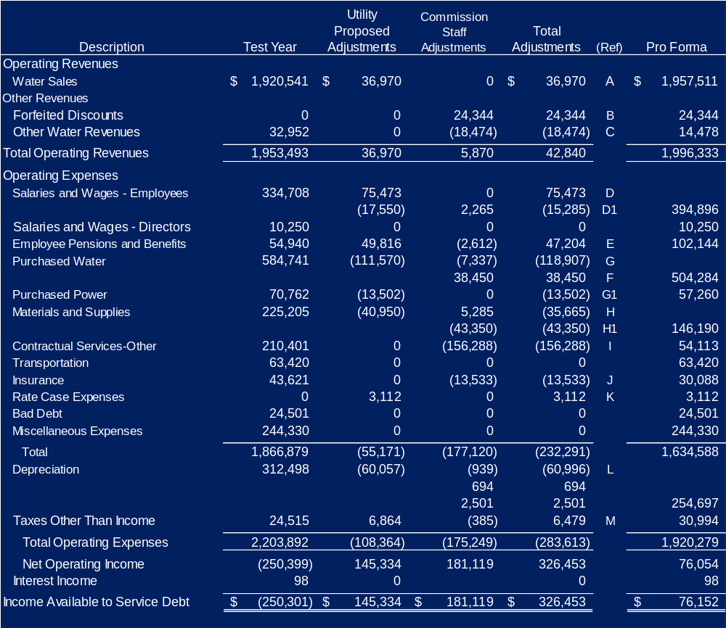
Alternative Rate Filing (ARF) – Overview of the Math

Slide 8
Methods for Establishing a Utility’s Revenue Requirement
Debt Coverage Ratio
Operating Ratio

Slide 9
Debt Service Coverage
Creditors require that utility borrowers assess rates that produce revenues that exceed cash related expenses by a specific margin.
Bond resolutions between Rural Development and a Water District generally require that a District’s “annual net revenues (defined as gross revenues less operating expenses)…are equal to not less than 120 percent of the average annual debt service requirements for principal and interest…”
Other lenders may require a Debt Service Coverage (“DSC”) ratio that is different than 120 percent.

Slide 10
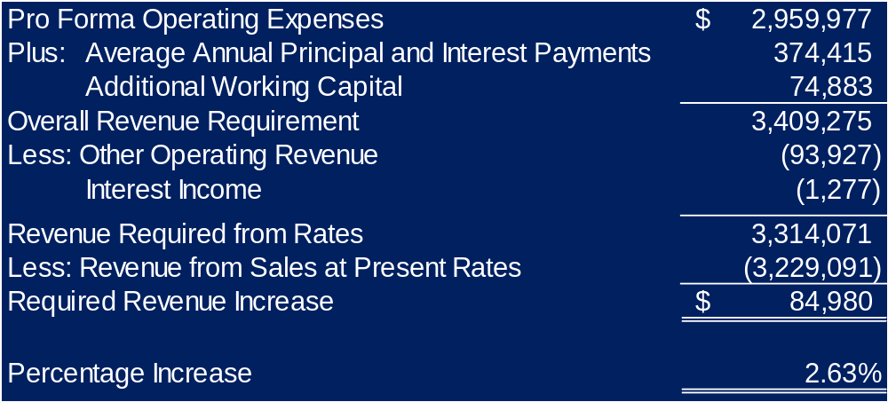
Debt Service Coverage (DSC) (continued)

Slide 11
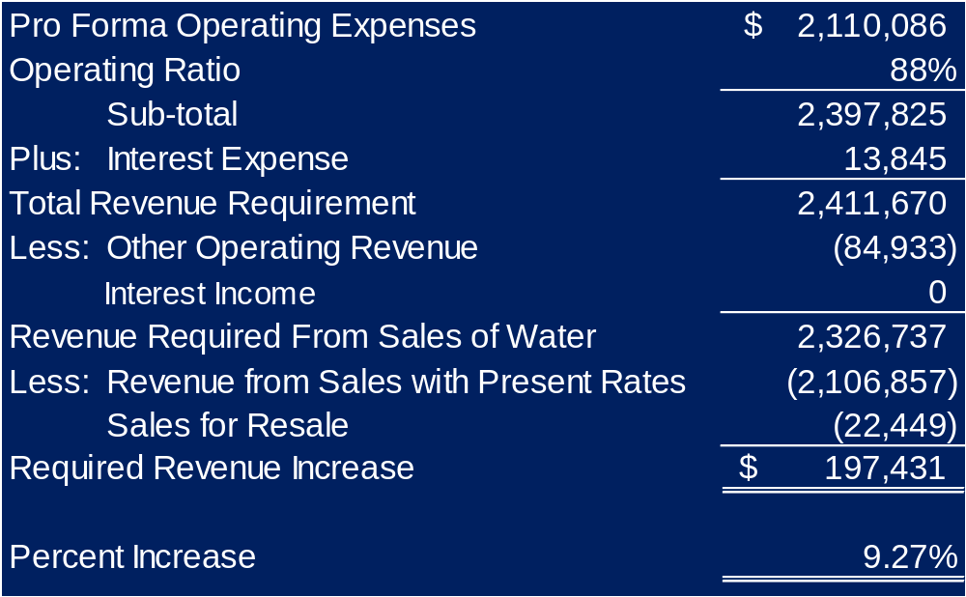
Operating Ratio (OR) (continued)

Slide 12
Tariffs
KRS 278.160(2) states that “[n]o utility shall charge, demand, collect, or receive from any person a greater or less compensation for any service rendered or to be rendered than that prescribed in its filed schedules, and no person shall receive any service from any utility for a compensation greater or less than that prescribed in such schedules.”
807 KAR 5:011 Section 1(9) "Tariff" means the schedules of a utility's rates, charges, regulations, rules, tolls, terms, and conditions of service over which the commission has jurisdiction.

Slide 13
Tariffs – Volumetric Rates
Commission Orders and Tariffs state rates per gallon *
$3.25 per 1,000 gallons is now $0.00325 per gallon
Utility must support exceptions (bulk, coin operated)
Wholesale rates may either be per gallon or per thousand gallons.
* Rates will be established as per 100 cubic feet (cf) if applicable

Slide 14
Tariffs - Non-Recurring Charges (NRC)
807 KAR 5:011 Section 1(4) "Nonrecurring charge" means a charge or fee assessed to a customer to recover the specific cost of an activity, which:
    (a) Is due to a specific request for a service activity for which, once the activity is completed, additional charges are not incurred; and
    (b) Is limited to recovery of an amount no greater than the cost of the specific service.
Cost Justification forms are available on the PSC website

Slide 15
Tariffs - Non-Recurring Charges (NRC)
Revisions - 807 KAR 5:011 Section 10. Non-Recurring Charges. This section discusses revisions to NRCs.
Types of Charges - 807 KAR 5:006 Section 9. Item 3.
  a) Turn-on charge
  b) Reconnect charge
  c) Termination or field collection charge
  d) Special meter reading charge
  Meter resetting charge
  f) Meter test charge
  g) Returned payment charge
  Late payment charge
  Tap fees

Slide 16
Recurring Problems With Rate Adjustment Filings
Authorized debt (KRS 278.300)
Commissioner compensation, training, appointment documentation (KRS 74.020)
Commissioner benefits (cites on slide).
Adjustments for pension and OPEB costs in excess of KPPA established contribution rate
Depreciation / NARUC

Slide 17
Recurring Problems With Rate Adjustment Filings - Unauthorized Debt
KRS 278.300(1) “No utility shall issue any securities or evidences of indebtedness…until it has been authorized so to do by order of the commission.”
KRS 278.300(8) “This section does not apply to notes issued by a utility, for proper purposes and not in violation of law, that are payable at periods of not more than two years from the date thereof, or to like notes, payable at a period of not more than two years from date thereof, that are issued to pay or refund in whole or in part any such notes, or to renewals of such notes from time to time, not exceeding in the aggregate six years from the date of the issue of the original notes so renewed or refunded.”
There may be situations where short term debt makes sense but in general don’t go there.
KRS 278.990(1). Any officer, agent, or employee of a utility, as defined in KRS 278.010, and any other person who willfully violates any of the provisions of this chapter or any regulation promulgated pursuant to this chapter, or fails to obey any order of the commission from which all rights of appeal have been exhausted, or who procures, aids, or abets a violation by any utility, shall be subject to either a civil penalty to be assessed by the commission not to exceed two thousand five hundred dollars ($2,500) for each offense or a criminal penalty of imprisonment for not more than six (6) months, or both.

Slide 18
Recurring Problems With Rate Adjustment Filings - Commissioner Compensation and Training
KRS 74.020(6) “Each commissioner shall receive an annual salary of not more than thirty-six hundred dollars ($3,600), which shall be paid out of the water district fund, except that beginning January 1, 1999, and subject to subsection (9) of this section, each commissioner who completes during an educational year a minimum of six (6) instructional hours of water district management training approved by the Public Service Commission may receive an annual salary of not more than six thousand dollars ($6,000) to be paid out of the water district fund. An educational year shall begin on January 1 and end on the following December 31. In the case of single-county districts, which shall be deemed to include districts described in subsection (1)(c) of this section, the salary shall be fixed by the county judges/executive with the approval of the fiscal court; in multicounty districts, it shall be fixed by the agreement between the county judges/executive with the approval of their fiscal courts. In fixing and approving the salary of the commissioners, the county judge/executive and the fiscal court shall take into consideration the financial condition of the district and its ability to meet its obligations as they mature.”

Slide 19
Recurring Problems With Rate Adjustment Filings - Commissioner Appointment and Salary Documentation
Appointment Documentation: Fiscal Court Minutes – work with your fiscal court to get them to document appointment, start and end terms, and annual compensation.
Annual Compensation - if you are paid on a per occurrence basis, there is risk that you will be paid over the permitted amounts.

Slide 20
Recurring Problems With Rate Adjustment Filings - Commissioner Benefits
Commissioners cannot vote to give themselves benefits.
Case No. 2019-00268, Application of Knott County Water and Sewer District for an Alternative Rate Adjustment (Ky. PSC Jan. 31, 2020).
“Since water district commissioners are vested with all relevant powers to manage and oversee water districts,42 except for the power to fix their salary authorized by KRS 74.020(6), which is assigned to the county judge executive and fiscal court,43 a water district would be unable to provide its commissioners health insurance and other similar benefits without an official action by the water district commissioners.44 Thus, by prohibiting water district commissions from participating in official actions that directly benefit themselves financially, the General Assembly effectively prohibited water districts from receiving additional benefits to compensate them for their work on the board, which further indicates the General Assembly’s intent to limit the total compensation of water district commissions to amounts specifically authorized by statute. The Commission finds that the General Assembly intended to limit the water districts’ total compensation to commissioners for their service on a water district’s board to amounts specifically authorized by KRS Chapter 74. Therefore, the Commission finds that Knott District may not offer benefits to the Commissioners on the Knott District Board of Commissioners pursuant to KRS Chapter 74 and should cease doing so immediately.”

Slide 21
Recurring Problems With Rate Adjustment Filings - Commissioner Benefits (continued)
KRS 74.020(6).
KRS 74.020(1) (“A water district shall be administered by a board of commissioners which shall control and manage the affairs of the district.”); KRS 74.070 (“All corporate powers of the water district shall be exercised by, or under the authority of, its commission.”) See also KRS 65A.080(1) (requiring the governing body of each “special purpose government entity” to adopt a budget and prohibiting any “special purpose government entity” from expending funds in a manner inconsistent with their budget and any amendment thereto.).
KRS 74.020(6) presumably gives the county judge executive and fiscal court the authority to fix the salary of the water district commissioners to avoid just this issue. Further, while KRS 74.050 authorizes the water district board to establish the additional compensation, if any, to be paid to the treasurer of the board, the treasurer could avoid violating the prohibition against taking official actions that benefit him financially by properly recusing himself from such an action. Conversely, there would be no viable way for water district commissioners to provide themselves insurance benefits without involving themselves in the decision to do so.

Slide 22
Recurring Problems With Rate Adjustment Filings - Adjustments for Pension and Post Employment Benefits Other Than Pensions (OPEB) Costs in Excess of Kentucky Public Pension Authority (KPPA) Established Contribution Rate
Prior to the implementation of GASB 68 (Accounting and Financial Reporting for Pensions) and GASB 74 (Financial Reporting for Postemployment Benefit Plans Other Than Pension Plans) as Amended Districts were not required to report a liability on its financial statements for their proportionate share of the County Employees’ Retirement Systems (CERS) Net Pension and post-retirement benefits other than pension (OPEB) liabilities. The District’s expense was equal to its contributions.

Slide 23
Recurring Problems With Rate Adjustment Filings - Adjustments for Pension and Post Employment Benefits Other Than Pensions (OPEB) Costs in Excess of Kentucky Public Pension Authority (KPPA) Established Contribution Rate (continued) - TODAY
Annual pension expense reflects employer’s contributions plus or minus its change in liability.
Expense that is recorded may exceed or be less than the amount of contributions that were required to be made.
The difference between the required contribution and the recorded expense is excluded for ratemaking purposes.
Ratepayers should not bear the burden of an accounting expense that does not represent the actual cost of funding pensions and benefits. The contribution rate is established by the Kentucky Public Pensions Authority.

Slide 24
Recurring Problems With Rate Adjustment Filings - Adjustments for Pension and Post Employment Benefits Other Than Pensions (OPEB) Costs in Excess of Kentucky Public Pension Authority (KPPA) Established Contribution Rate (continued)
Example 1: You recorded $125,000 in expense but your contributions were $100,000 and the net pension liability increased by $25,000. The additional $25,000 is excluded from expenses for ratemaking purposes.
Example 2: You recorded $75,000 in expense but your contributions were $100,000 and the net pension liability decreased by $25,000. The $25,000 decrease in liability is added back to expenses for ratemaking purposes.
We have mostly seen increases in net pension and OPEB liabilities since implementation meaning amounts are reduced from expenses for ratemaking purposes.

Slide 25
Recurring Problems With Rate Adjustment Filings - Depreciation / NARUC
Depreciation is the periodic allocation of the cost of a tangible long-lived asset over its estimated useful life.
Periodic Allocation: Accounting Instruction 33 of the Uniform Systems of Accounts (USoA) for Water Districts and Water Associations requires the use of straight-line depreciation.
Estimated Useful Life: Commission follows 1979 National Association of Regulatory Utility Commissioners (NARUC) titled Depreciation Practices for Small Water Utilities (NARUC Study).

Slide 26
Recurring Problems With Rate Adjustment Filings - Court Precedent for Recovery of Depreciation
The Kentucky Supreme Court has held that the Commission must permit a water district to recover its depreciation expense through its rates for service to provide internal funds for renewing and replacing assets. See Public Serv. Comm’n of Kentucky v. Dewitt Water Dist., 720 S.W.2d 725, 728 (Ky. 1986). Although a water district’s lenders require that a small portion of the depreciation funds be deposited annually into a debt reserve/depreciation fund until the account’s balance accumulates to a required threshold, neither the Commission nor the Court requires that revenues collected for depreciation be accounted for separately from the water district’s general funds or that depreciation funds be used only for asset renewal and replacement.

Slide 27
Recurring Problems With Rate Adjustment Filings - Depreciation / NARUC
Depreciation estimated useful lives should be consistent from utility to utility and rate payers should not be required to pay to recover the utility’s investment in capital faster (or slower) than the standard rate range.
The Commission relies on the National Association of Regulatory Utility Commissioners’ (NARUC) 1979 publication entitled Depreciation Practices for Small Water Utilities (NARUC Study). To evaluate the reasonableness of the depreciation practices of small water utilities, the Commission has historically relied upon NARUC Study. When no evidence exists to support a specific life that is outside the NARUC ranges, the Commission has historically used the midpoint of the NARUC ranges to depreciate the utility plant.

Slide 28
Ratemaking Consequences of Excessive Water Loss
There is a separate presentation on water loss reporting. The next slides are limited to the law and calculations for ratemaking purposes.
Unaccounted for Water Loss 807 KAR 5:066 Section 6 (3)
The Math – Cost of Excess Water Loss

Slide 29
Ratemaking Consequences of Excessive Water Loss
807 KAR 5:066 Section 6 (3) (continued)
Unaccounted for water loss. Except for purchased water rate adjustments for water districts and water associations, and rate adjustments pursuant to KRS 278.023(4), for rate making purposes a utility's water loss shall not exceed fifteen (15) percent of total water produced and purchased, excluding water used by a utility in its own operations.
Upon application by a utility in a rate case filing or by separate filing, or upon motion by the commission, an alternative level of reasonable water loss may be established by the commission. A utility proposing an alternative level shall have the burden of demonstrating that the alternative level is more reasonable than the level prescribed in this section.

Slide 30
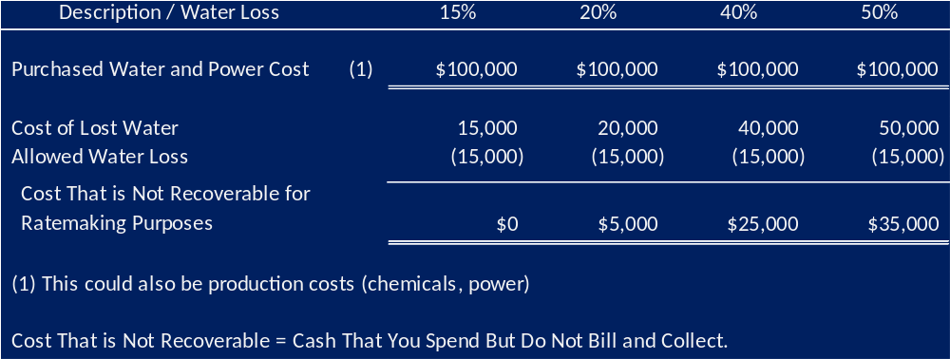
Ratemaking Consequences of Excessive Water Loss – The Math

Slide 31
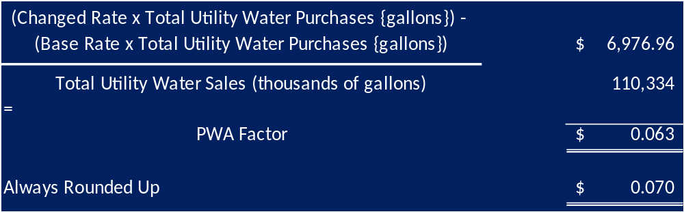
Purchased Water Adjustment (PWA) Applications
Section807 KAR 5:068. Purchased water adjustment for water districts and water associations.
3. Purchased Water Adjustment Factor.
New tariff to reflect adjustment.

Slide 32
Forms
http://www.psc.ky.gov/
Utility Information
  Utility Forms
    NRC Cost Justification
    Water specific Forms
    Average meter connection Cost Justification
    PWA Forms
    ARF Forms
    Filing requirements check list

Slide 33
QUESTIONS?

Slide 34
Thank You!

