Slide 1



Kentucky Underground Facilities Damage Prevention Act Remedial Training
Any views expressed in this presentation are those of the presenter and do not reflect official positions of the PSC

Slide 2
Kentucky Underground Facilities Damage Prevention Act
The views expressed in this presentation are those of the Commission’s Division of Inspections (DOI). This presentation is intended to convey DOI’s interpretation of the Underground Facilities Damage Prevention Act of 1994 as amended and explain DOI’s investigation process.
The views expressed in this presentation do not reflect the official position of the Kentucky Public Service Commission.
This presentation is intended for educational purposes only and should not be considered legal advice.

Slide 3



The Act
Underground Facility Damage Prevention Act of 1994
  Effective January 1, 1995
  KRS 367.4901 through 367.4917
Amended in 2018 to give PSC enforcement authority
  Establishes enforcement mechanisms
  Most recently amended in 2024
Establishes one-call (811) center
Sets requirements for excavators, operators, protection notification centers, and Kentucky One Call Center (811)

Slide 4
Commission Jurisdiction
Under KRS 367.4917(6) the Kentucky Public Service Commission has:
  statewide authority to enforce the Act; and
  seek civil penalties for any violation of the Act that results in damage to an underground facility used to transport gas or hazardous liquid.
The Commission’s Division of Inspections (DOI) investigates all incidents of damage to underground natural gas facilities.
  DOI investigates to determine if any provision of the Act was violated, not to determine “fault” for the damage.
  Operators of natural gas facilities are required by KRS 367.4909(4) to report incidents of damage to their facilities to the Commission within 30 days of the damage.

Slide 5
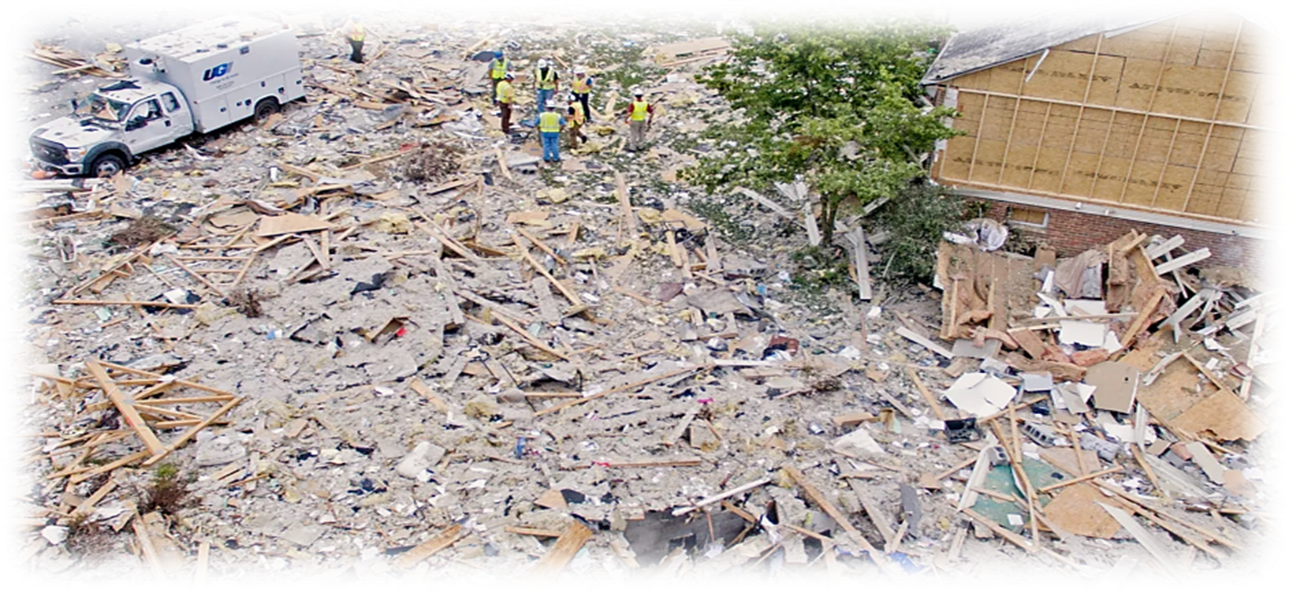
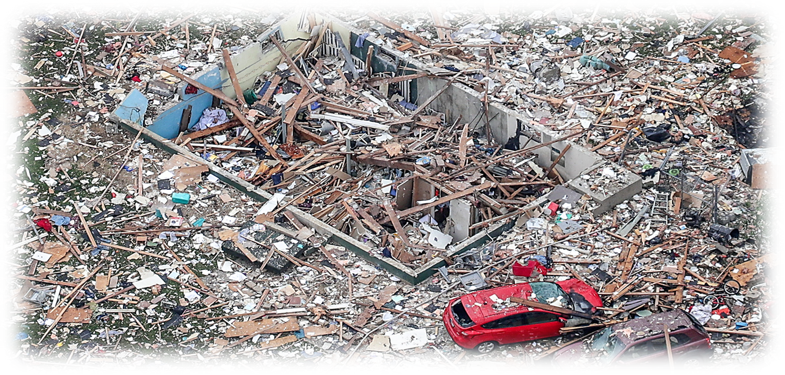
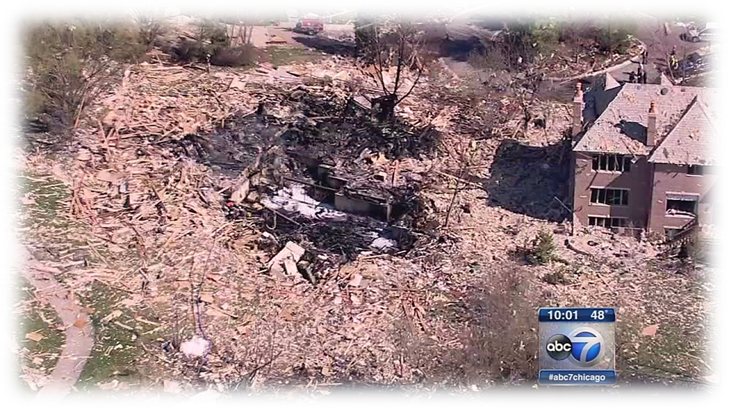
KY Underground Facilities Damage Prevention Act

Slide 6
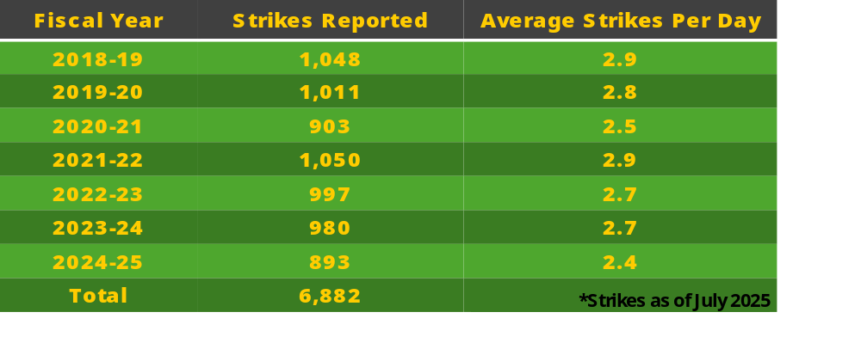
KY Underground Facilities Damage Prevention Act
Pipeline Strikes Per Fiscal Year

Slide 7
KY Underground Facilities Damage Prevention Act
* as of February 2026

Slide 8
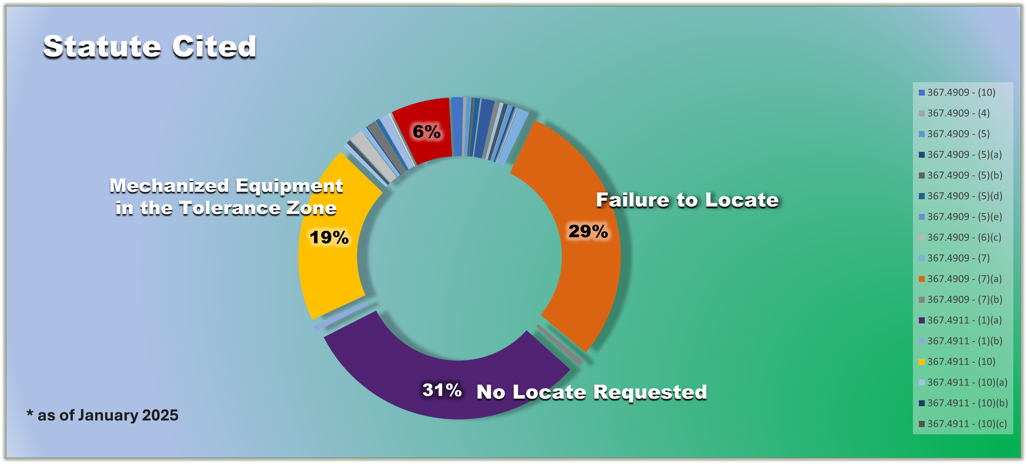
KY Underground Facilities Damage Prevention Act

Slide 9
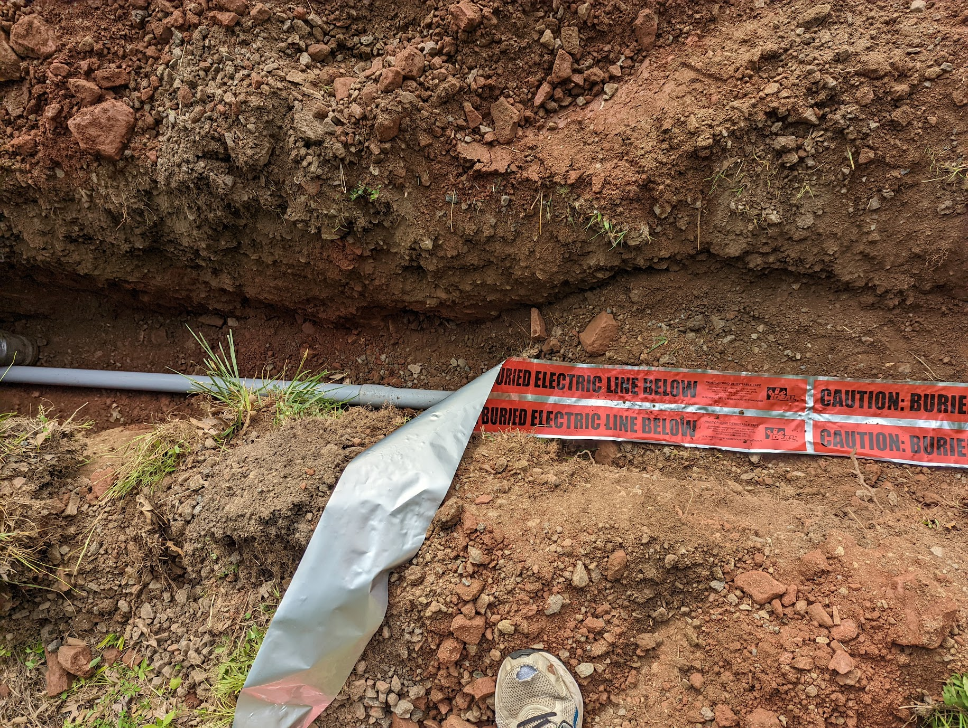
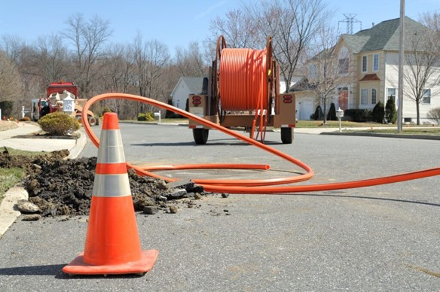
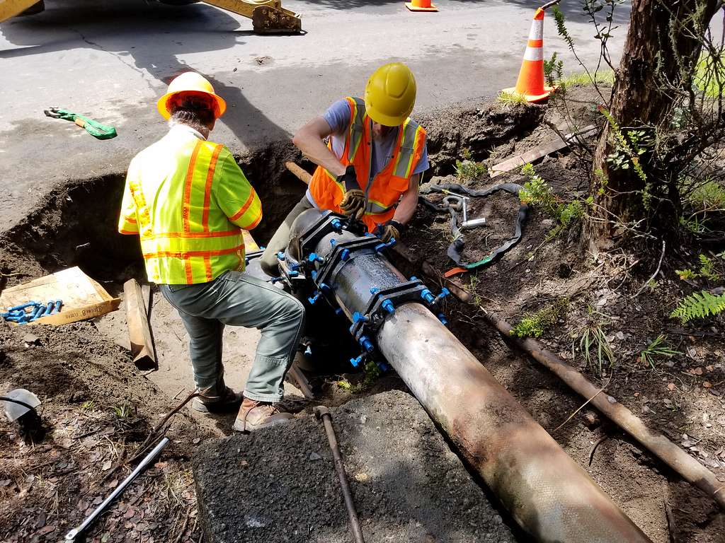
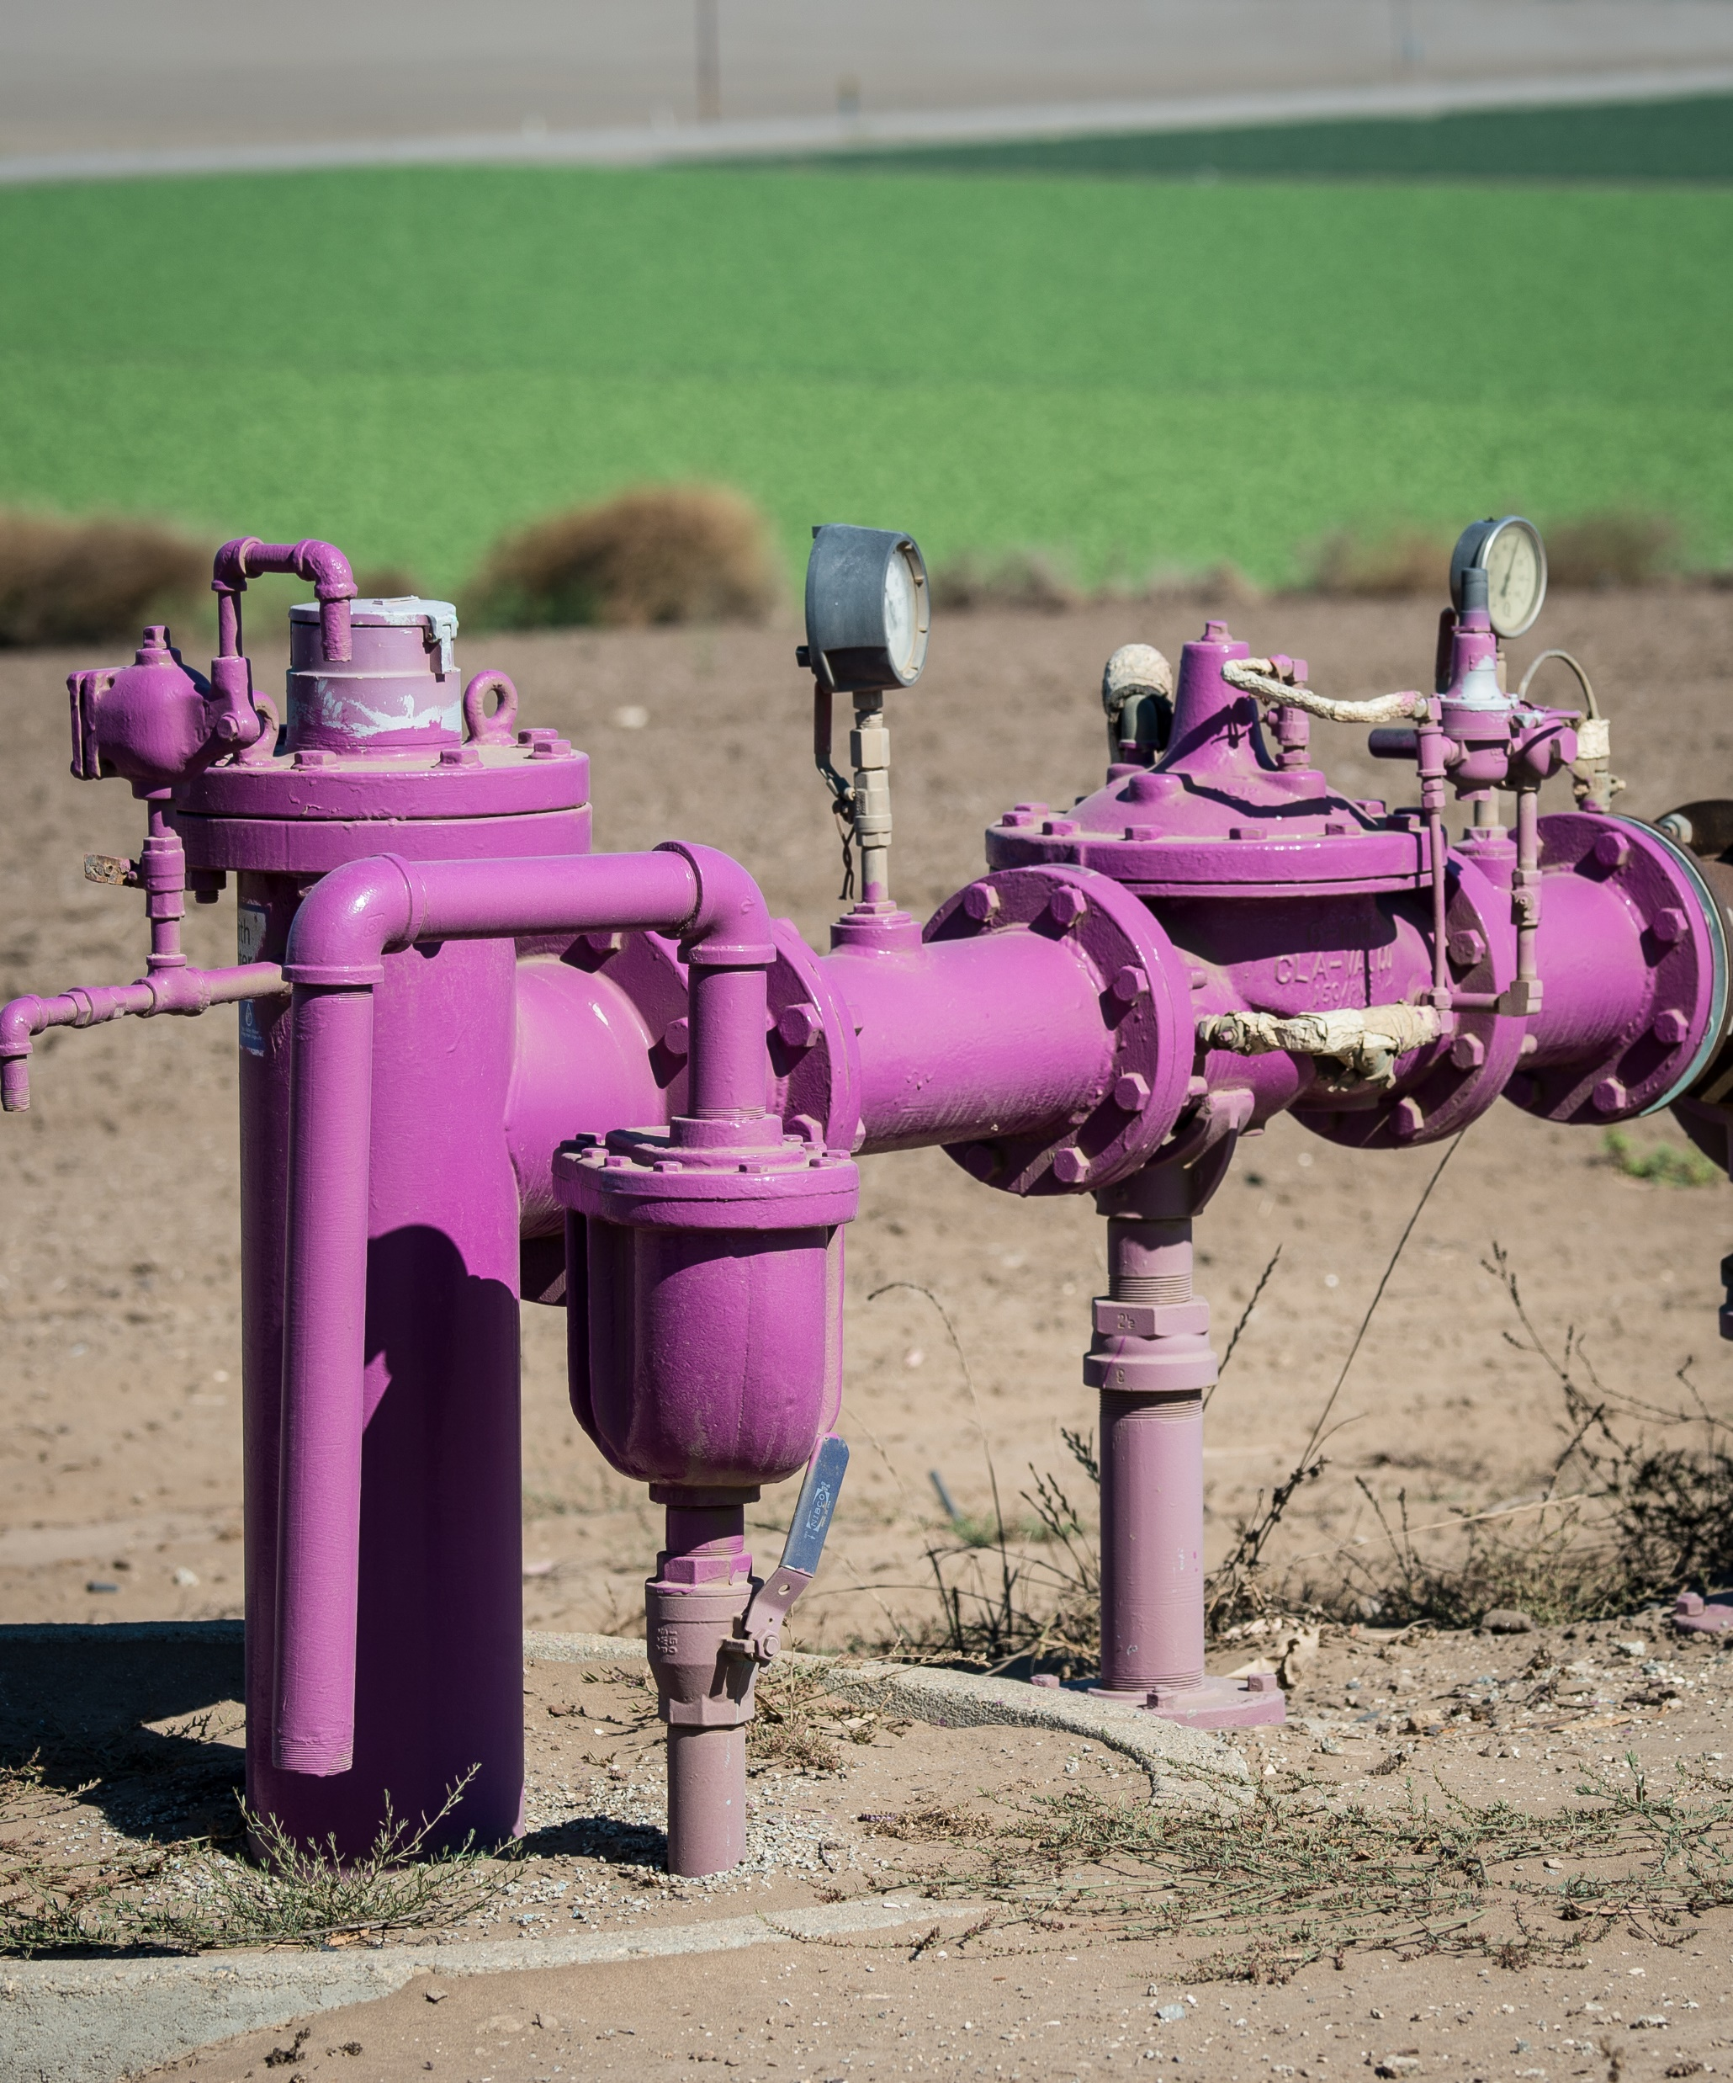
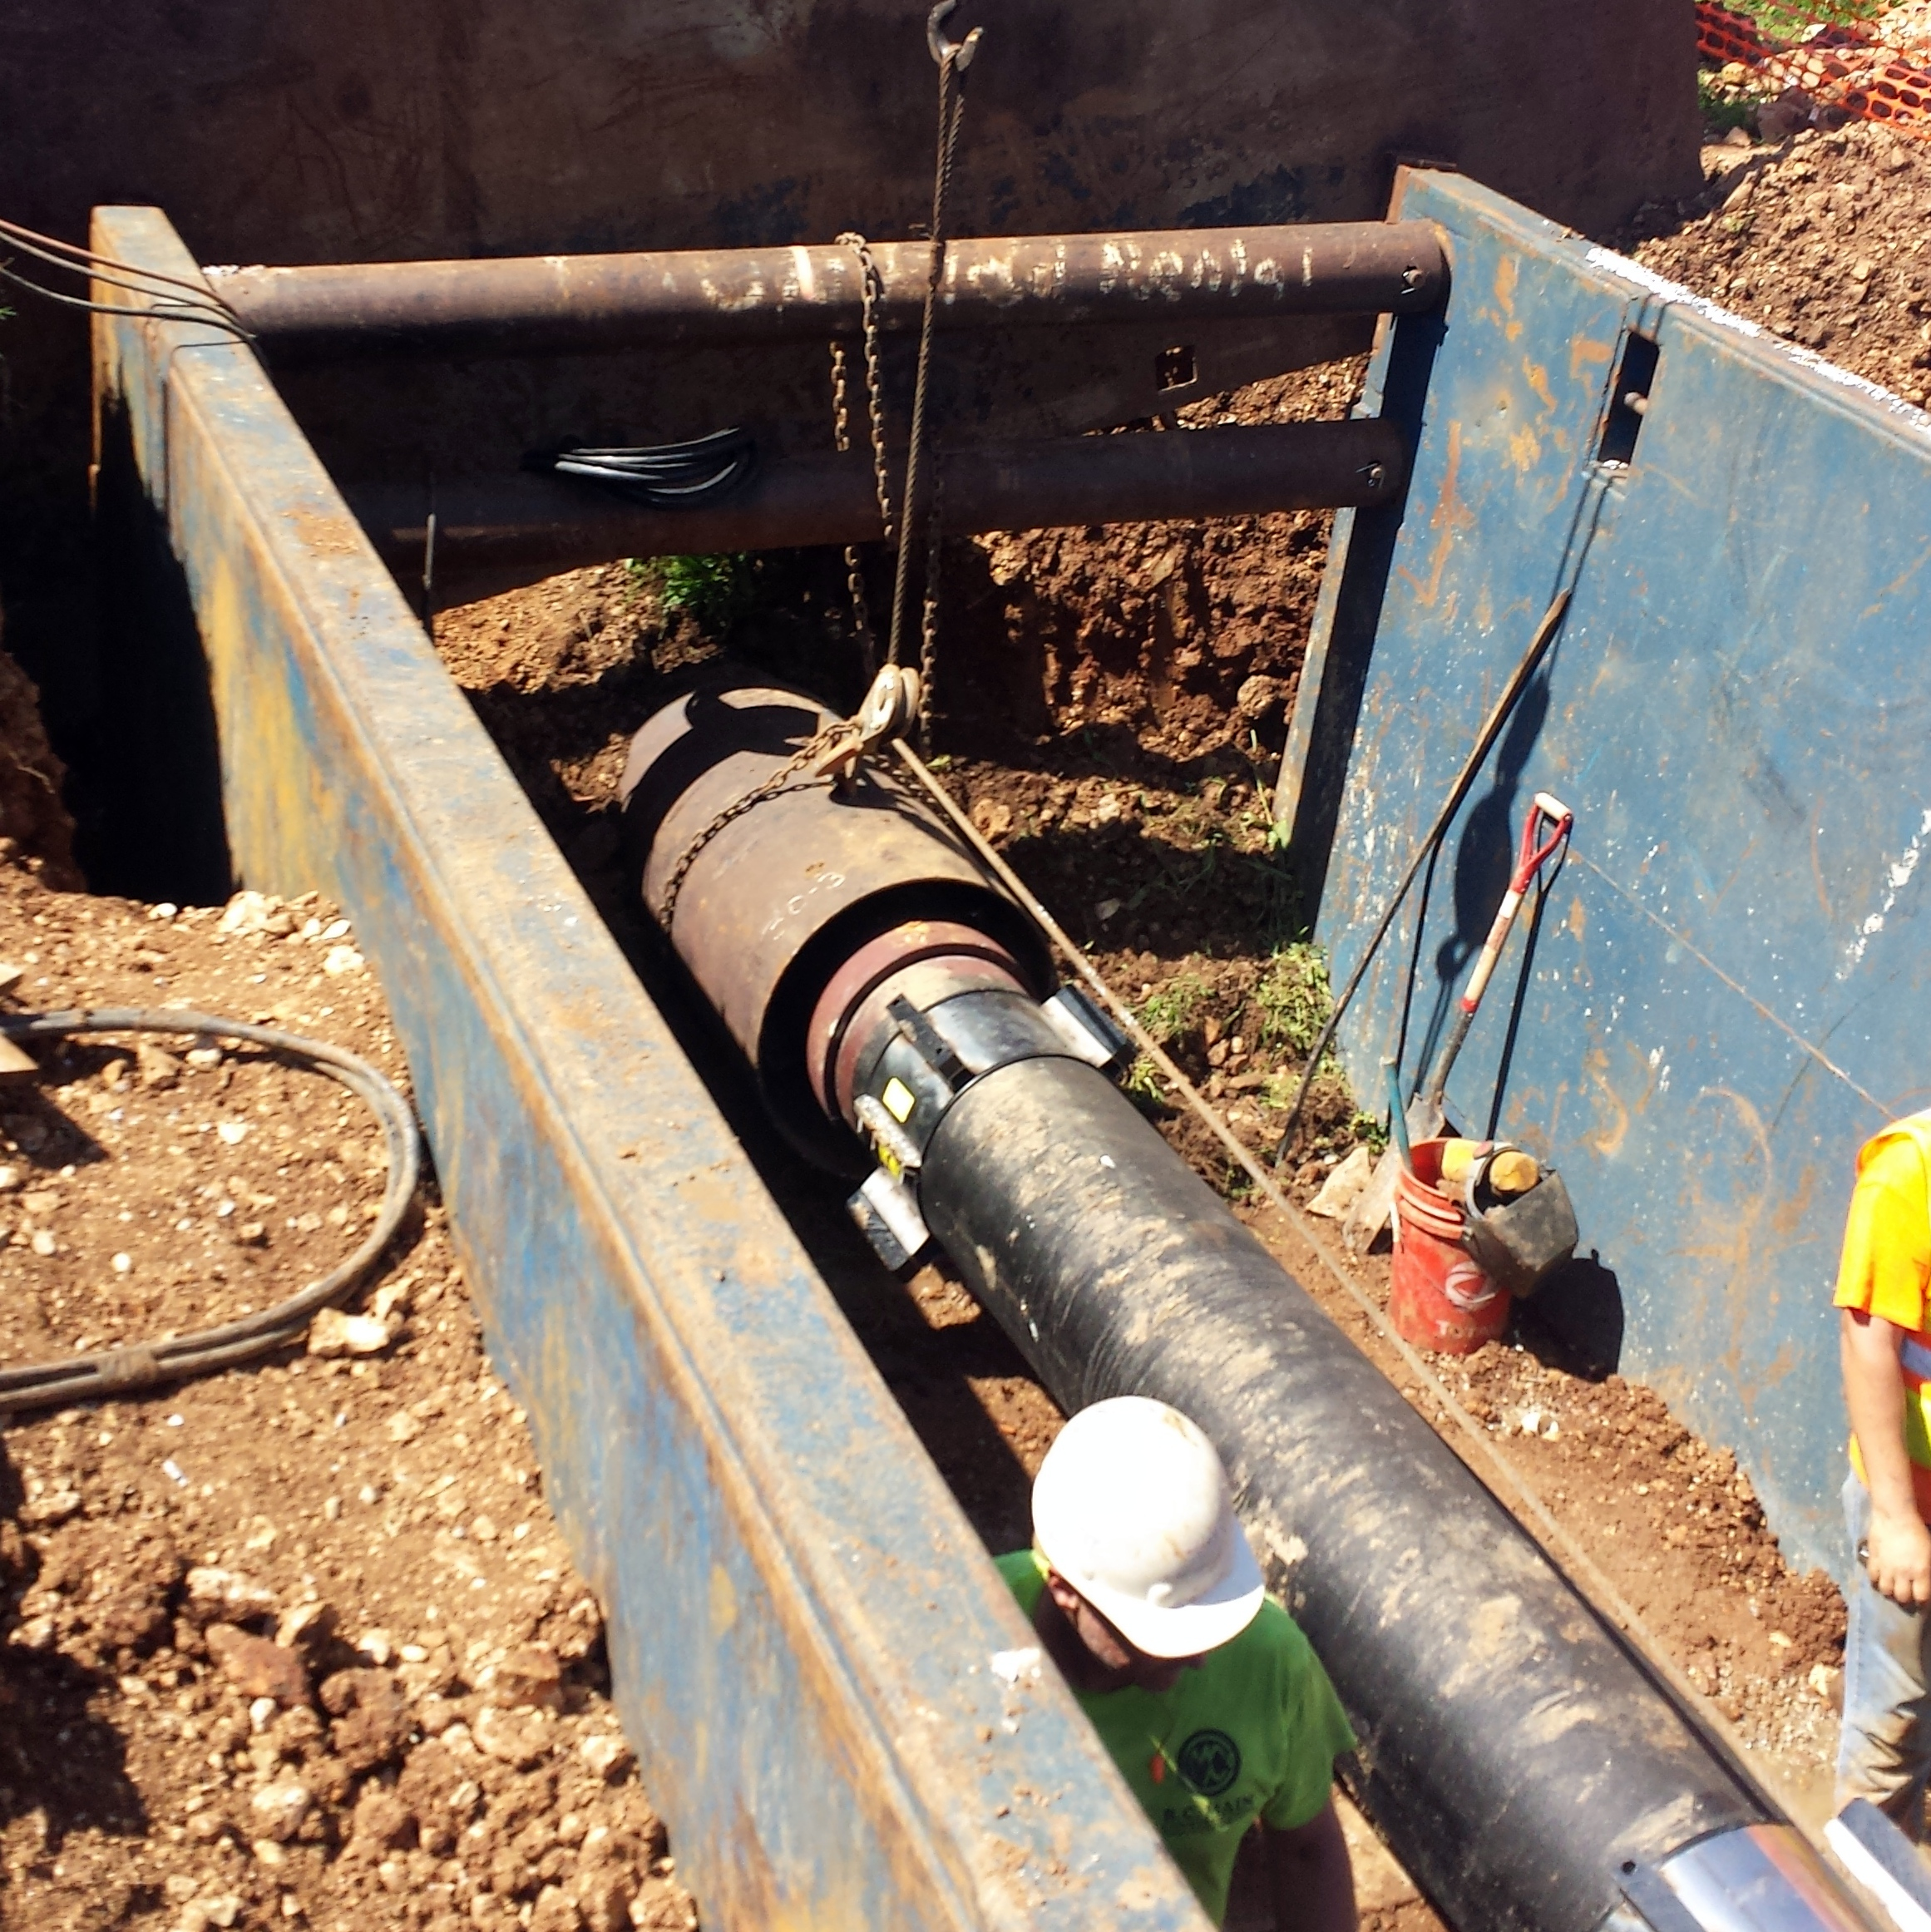
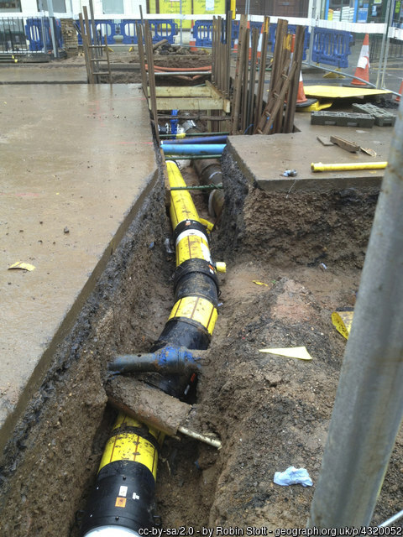
Underground facilities include:
Both lines and associated facilities: vaults, manholes, tanks, etc. for:
Electricity
Telecommunications/ Cable television
Water – including steam
Reclaimed water, slurry, irrigation
Natural gas/ Hazardous liquids/ Oil
Sewage

Slide 10
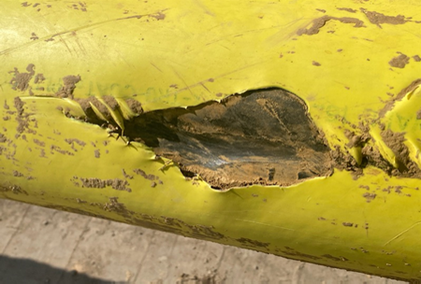
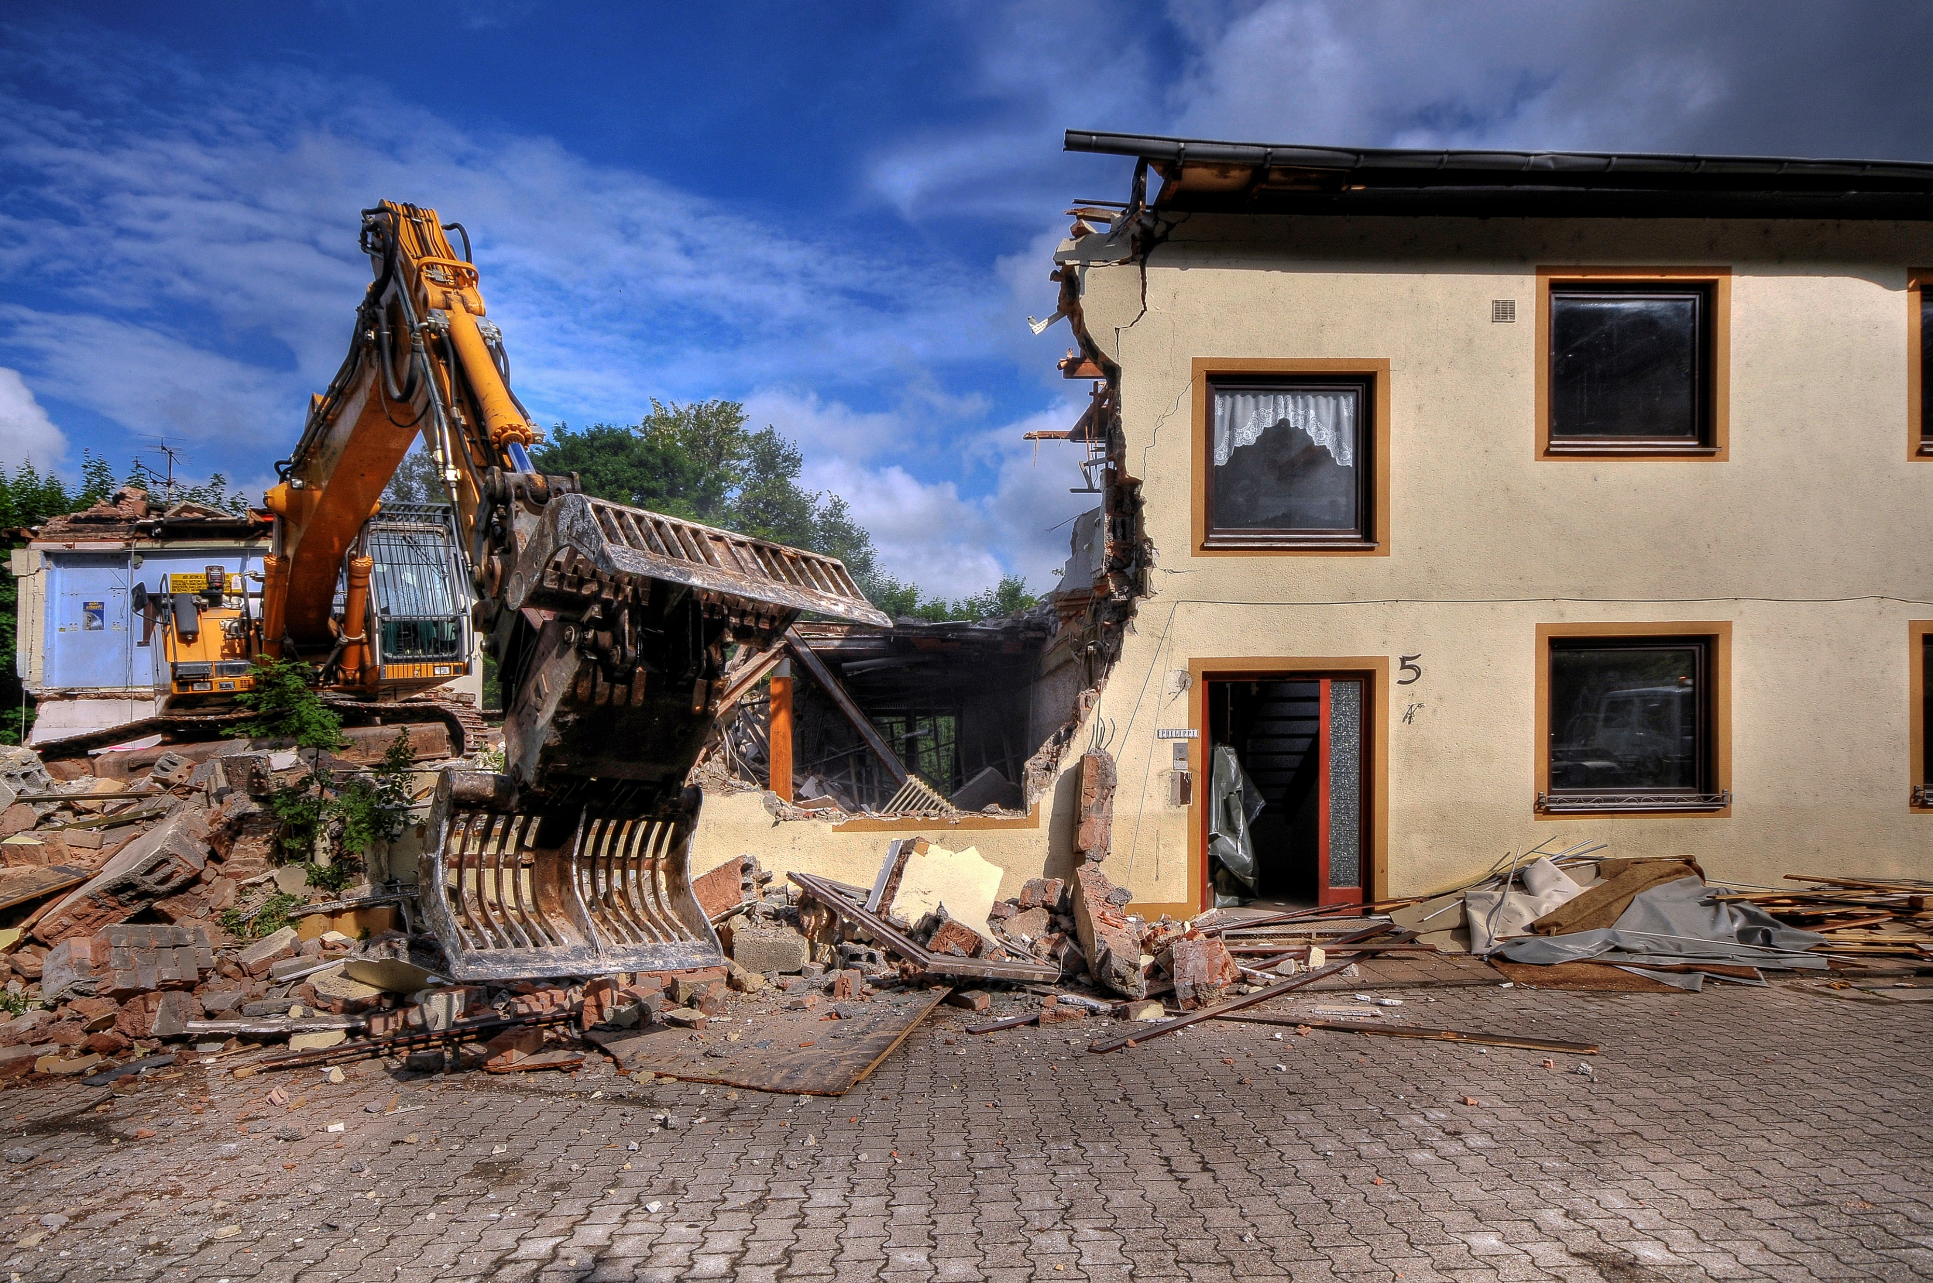
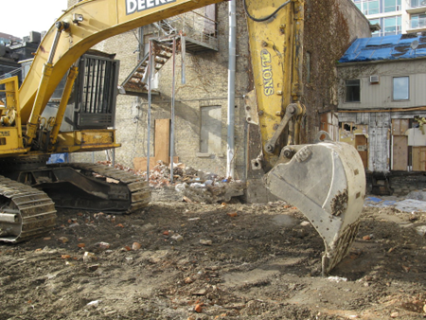
Key Definitions
Damage: Doesn’t have to be a puncture. Includes any weakening of structural or lateral support or penetration of protective coating or housing. “It’s just a scratch” may still be damage.
Demolition: any operation by which a structure or mass of material is wrecked, razed, moved, or removed by means of mechanized equipment, or discharge of explosives.
Excavator: Any entity or individual, other than those exempted by KRS 367.4915, engaged in excavation, demolition, or timber harvesting using mechanized equipment.
Operator: Anyone owning or operating underground facilities.

Slide 11
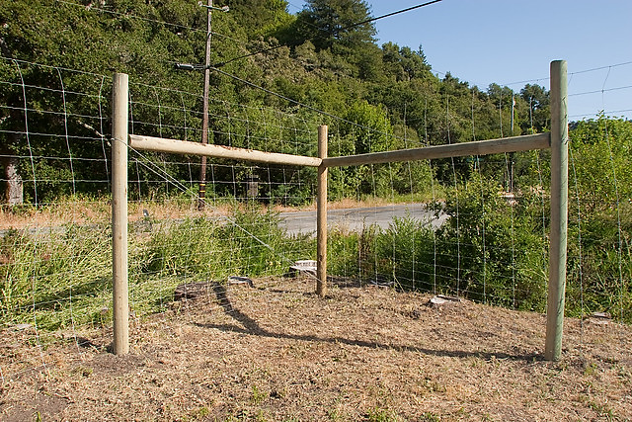
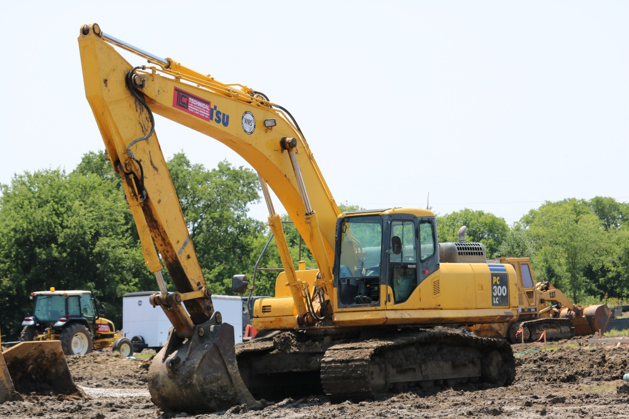
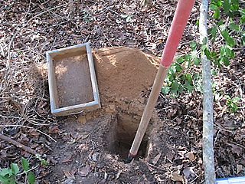

Key Definitions
Excavation: Any activity that results in the movement, placement, probing, boring, or removal of earth, rock, or other material in or on the ground by the use of any tools or equipment, by the discharge of explosives, or by the harvesting of timber using mechanized equipment.

Slide 12
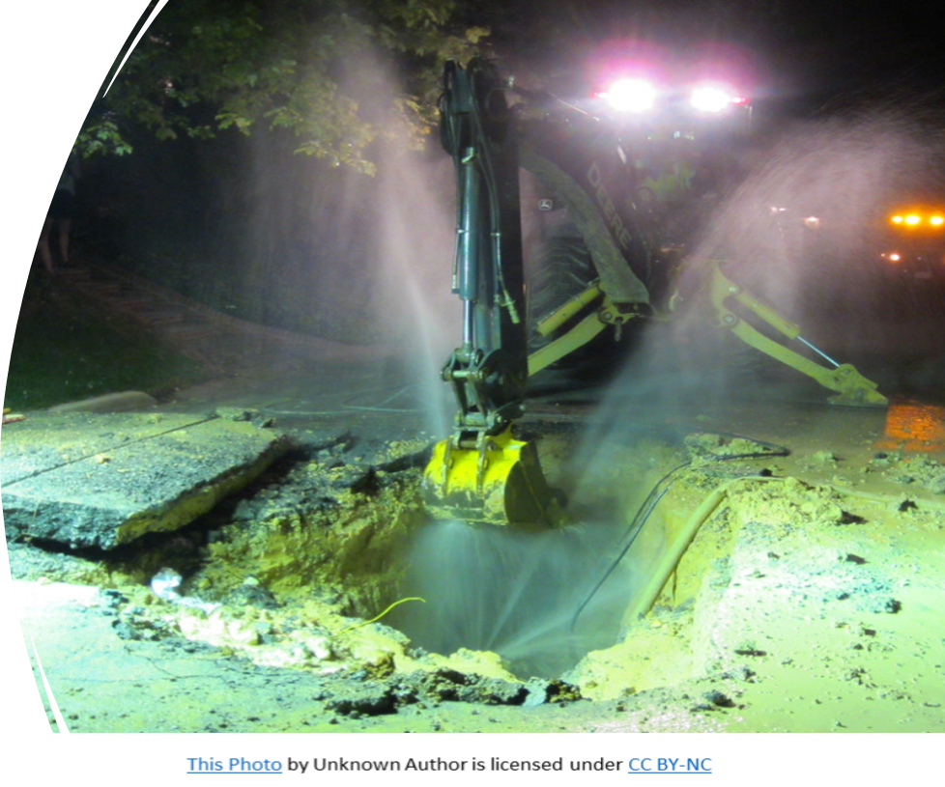
Key Definitions
Emergency: there exists substantial likelihood that loss of life or property, the inability to restore interrupted utility service, an imminent danger to health or the environment, or the blockage of public transportation facilities will result before location procedures are able to occur.

Slide 13

Key Definitions
Kentucky Contact Center:
Protection notification center: Operator-provided call center for operators who do not belong to 811. (All Natural Gas Facility operators are required to be a member of 811)

Slide 14
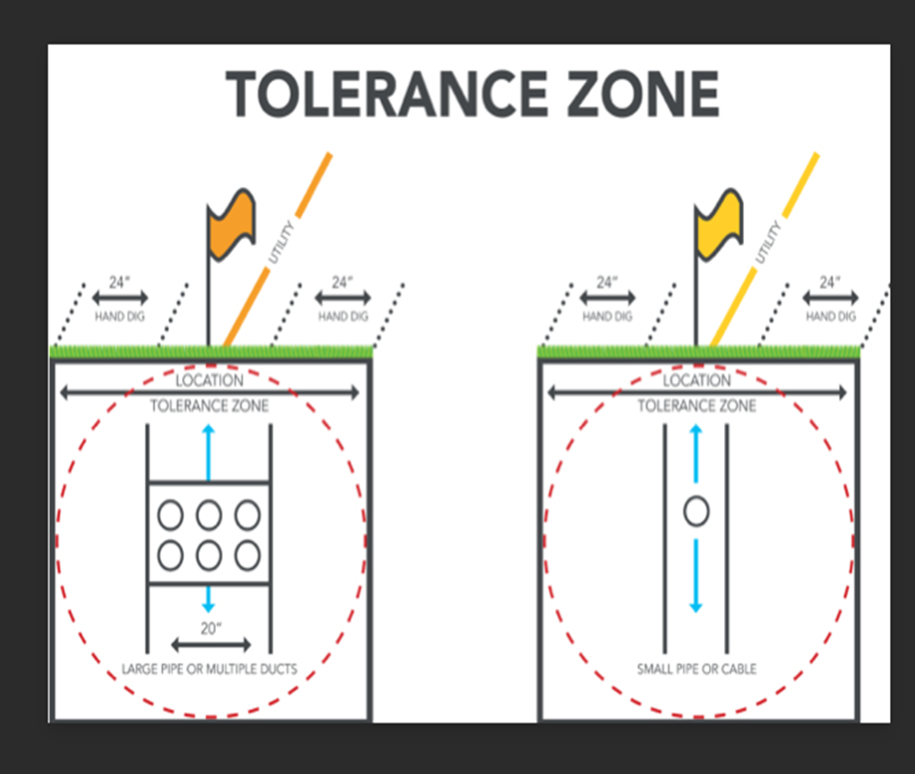
Key Definitions
Approximate location: when referring to an underground facility, means:
For underground metallic facilities and underground nonmetallic facilities with metallic tracer wire, a distance not to exceed the combined width of the underground facility plus twenty-four (24) inches measured from the outer edge of each side of the underground facility. . .
(b) For unmapped or untonable facilities, the underground facility shall be located as accurately as possible from field location records and shall require notification from the operator of the inability to accurately locate the facility.

Slide 15
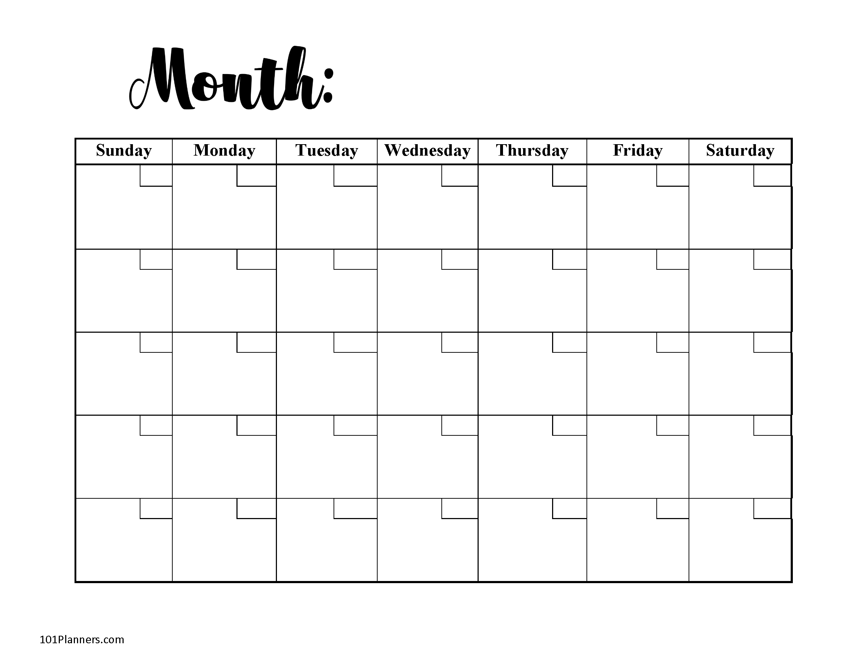



Key Definitions
Working Day: every day, except Saturday, Sunday, and holidays, as commencing at 12:01 a.m. eastern time and ending at 12:00 midnight eastern time EXCLUDING the day the locate request was made;
Positive response: means an automated or written communication system provided by each protection notification center for all locate requests the center receives that allows excavators, locators, operators, and other interested parties to determine the status of locating an underground facility and requires response and verification by operators and excavators.
Request
This Photo by Unknown Author is licensed under CC BY-SA
This Photo by Unknown Author is licensed under CC BY-NC

Slide 16
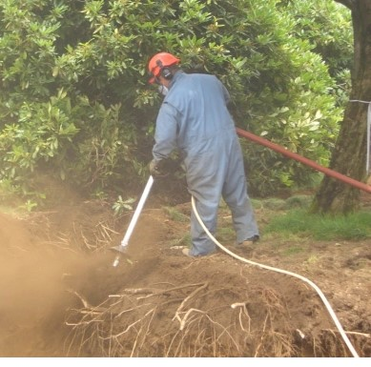
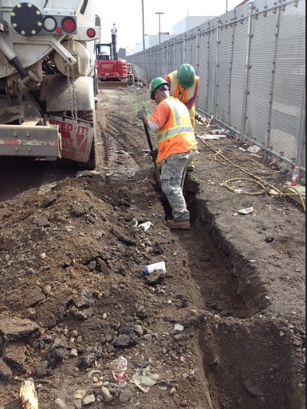
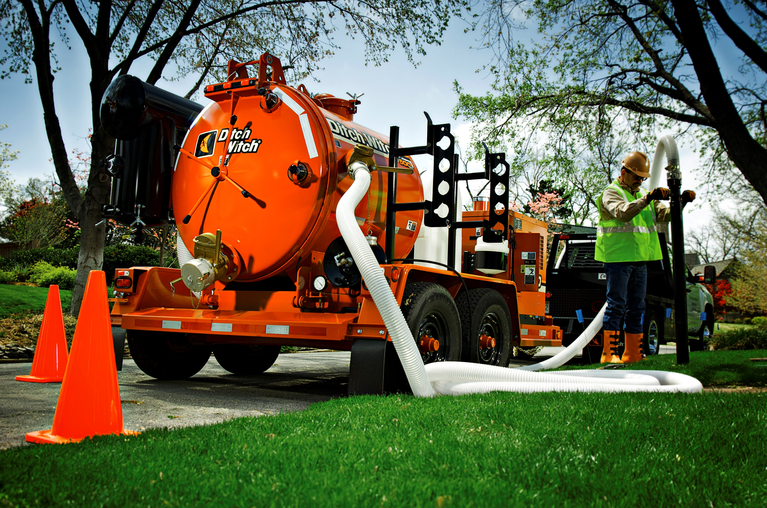
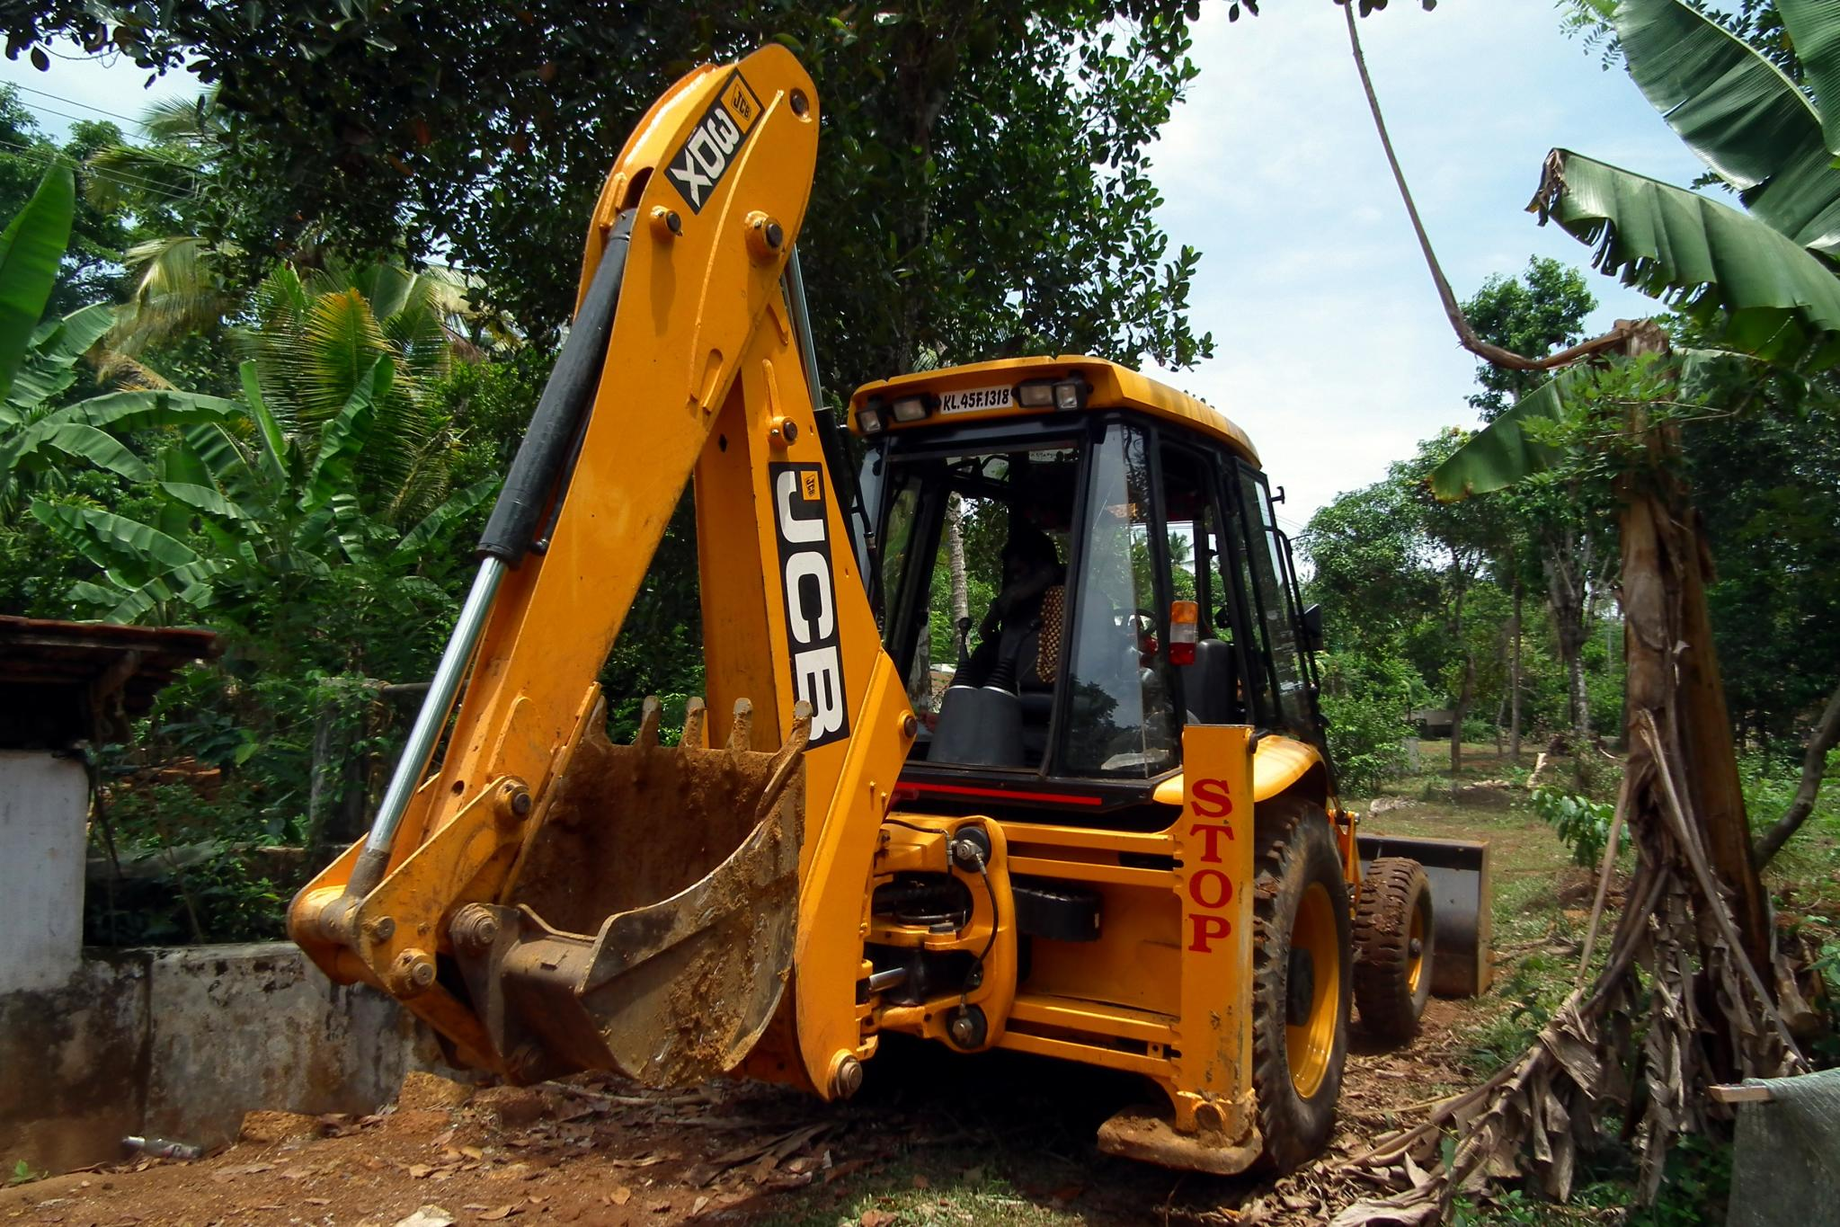
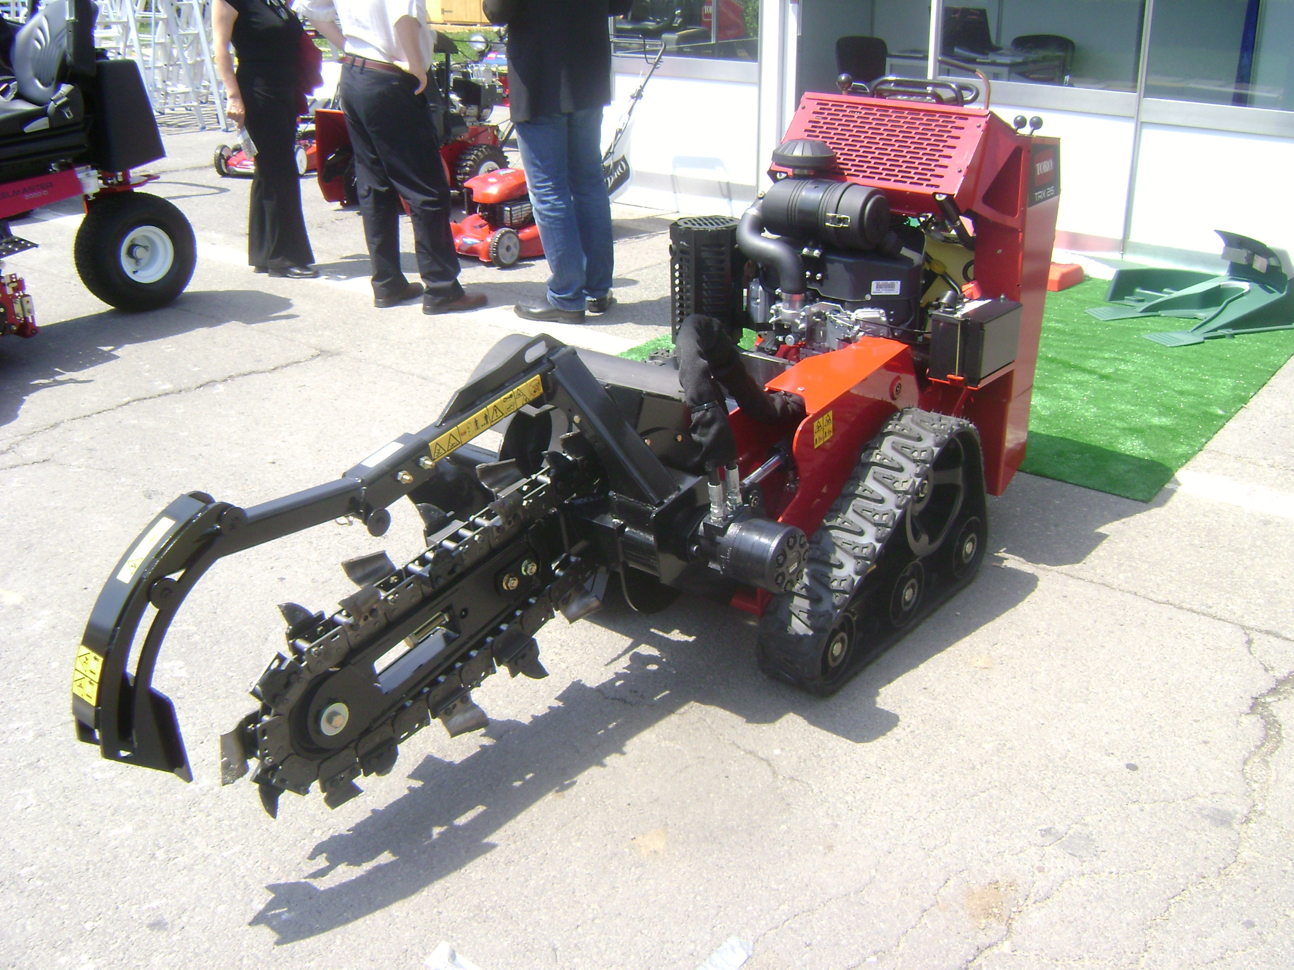
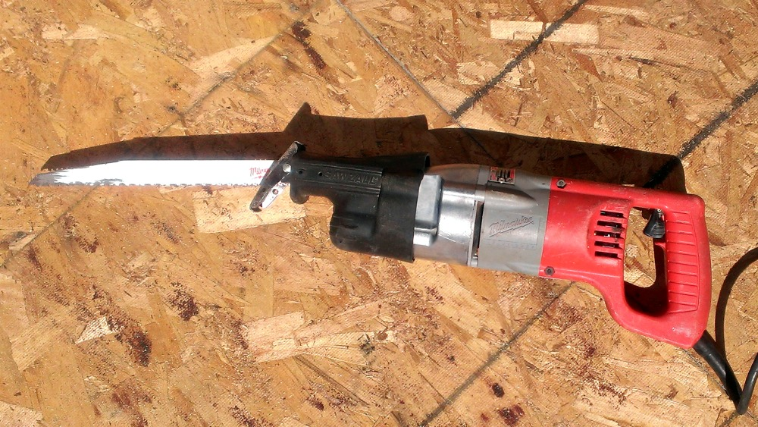
Key Definitions
Nonintrusive excavating:
  Hand Tools
  Air
  Water
Mechanized equipment:
Anything with a motor.

Slide 17
Key Definitions
Second Notice: a notice that is made by an excavator to a notification center when an operator has failed to comply with the positive response requirements.
Untonable facility: means an underground facility that cannot be located from the surface using locating methods which meet industry standards and that requires additional efforts and extended time
Work site contact: an individual that will be present at the excavation site when the excavation will occur

Slide 18
Water Districts Duties under the Act
KRS 367.4911 provides the duties of Excavators:
A water district is an excavator when it installs or repairs its own underground facilities, and when it engages in digging or probing to investigate the source of a water leak. When a water district engages in excavation, all the provisions of KRS 367.4911 apply to the water district.
2. KRS 367,4909 provides the duties of Operators:
A water district is an operator as defined by the Act because a water district operates underground facilities to serve the public. A water district transports its product to the public by use of underground facilities. All the provisions of KRS 367.4909 apply to water districts, except those designated as applicable only to operators of gas or hazardous liquid facilities, such as the requirement to report damage to the Commission.

Slide 19

Excavator Requirements KRS 367.4911

Slide 20
Excavator Requirements: The Locate Request
Request the Locate
  Make locate request 2 full workings days before scheduled start, but not more than 10 full working days prior to commencing work.
    Work may commence before the 2-day period ONLY IF ALL UTILITIES have provided a positive response that the area has been marked and locate marks are present.
  Locate valid for 21 calendar days from date of request.
  No piggybacking tickets: If more than 1 excavator will be working at the same site, each excavator must request a locate. Employees of excavator will be covered by locate ticket of the excavator they work for.
  White Lining of proposed excavation location: Must be provided if requested by the operator or their contract locator.
  Second Notice: If the 2-day locating period has passed without positive response from the operator, you must provide a second notice to the notification center. The operator will have 1 working day to complete the locate and provide positive response.

Slide 21
Excavator Requirements: The Locate Request
Required Information for Requesting the Locate:
  Name and phone number of the excavator or person requesting the underground facility locate.
  Approximate location and type of work being performed by the excavator, including if the request involves a fiber-to-the-premises broadband deployment excavation.
  Name and phone number of work site contact.
  Estimated start date and start time of excavation.
  The excavation or demolition site location or locations, each of which shall not exceed five thousand (5,000) feet in length unless the excavator and operator agree to a larger area, the city or community, county and street address, including the nearest cross street.

Slide 22
Excavator Requirements: The Worksite
All employees on the worksite must be provided:
  The underground facility location provided by each operator.
  Any related safety information provided by each operator.
  The locate request identification number assigned by each protection notification center.
Evidence of an unmarked facility at worksite after positive response has been provided:
  Immediately notify the notification center. Operator has 6 business hours to identify the facility.

Slide 23
Excavator Requirements: The Worksite
Request Remarking 2 working days in advance of ticket expiration:
  Request remarking 19 days from the day of the locate request if excavation or demolition will continue past the 21-day period.
Protect and Preserve Markings:
Excavator Must Request remarking if:
  Markings have been compromised.
  The work plan or location previously filed changes.
  Do not refresh marks on your own!

Slide 24
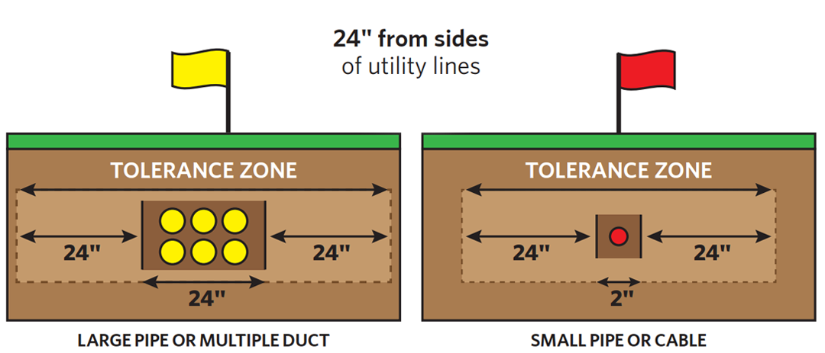
Excavator Requirements: The Worksite
The Tolerance Zone
When excavation or demolition is necessary within the tolerance zone, the excavator shall hand-dig or use nonintrusive means to avoid damage to the underground facility, except that mechanized equipment may be used:

Slide 25
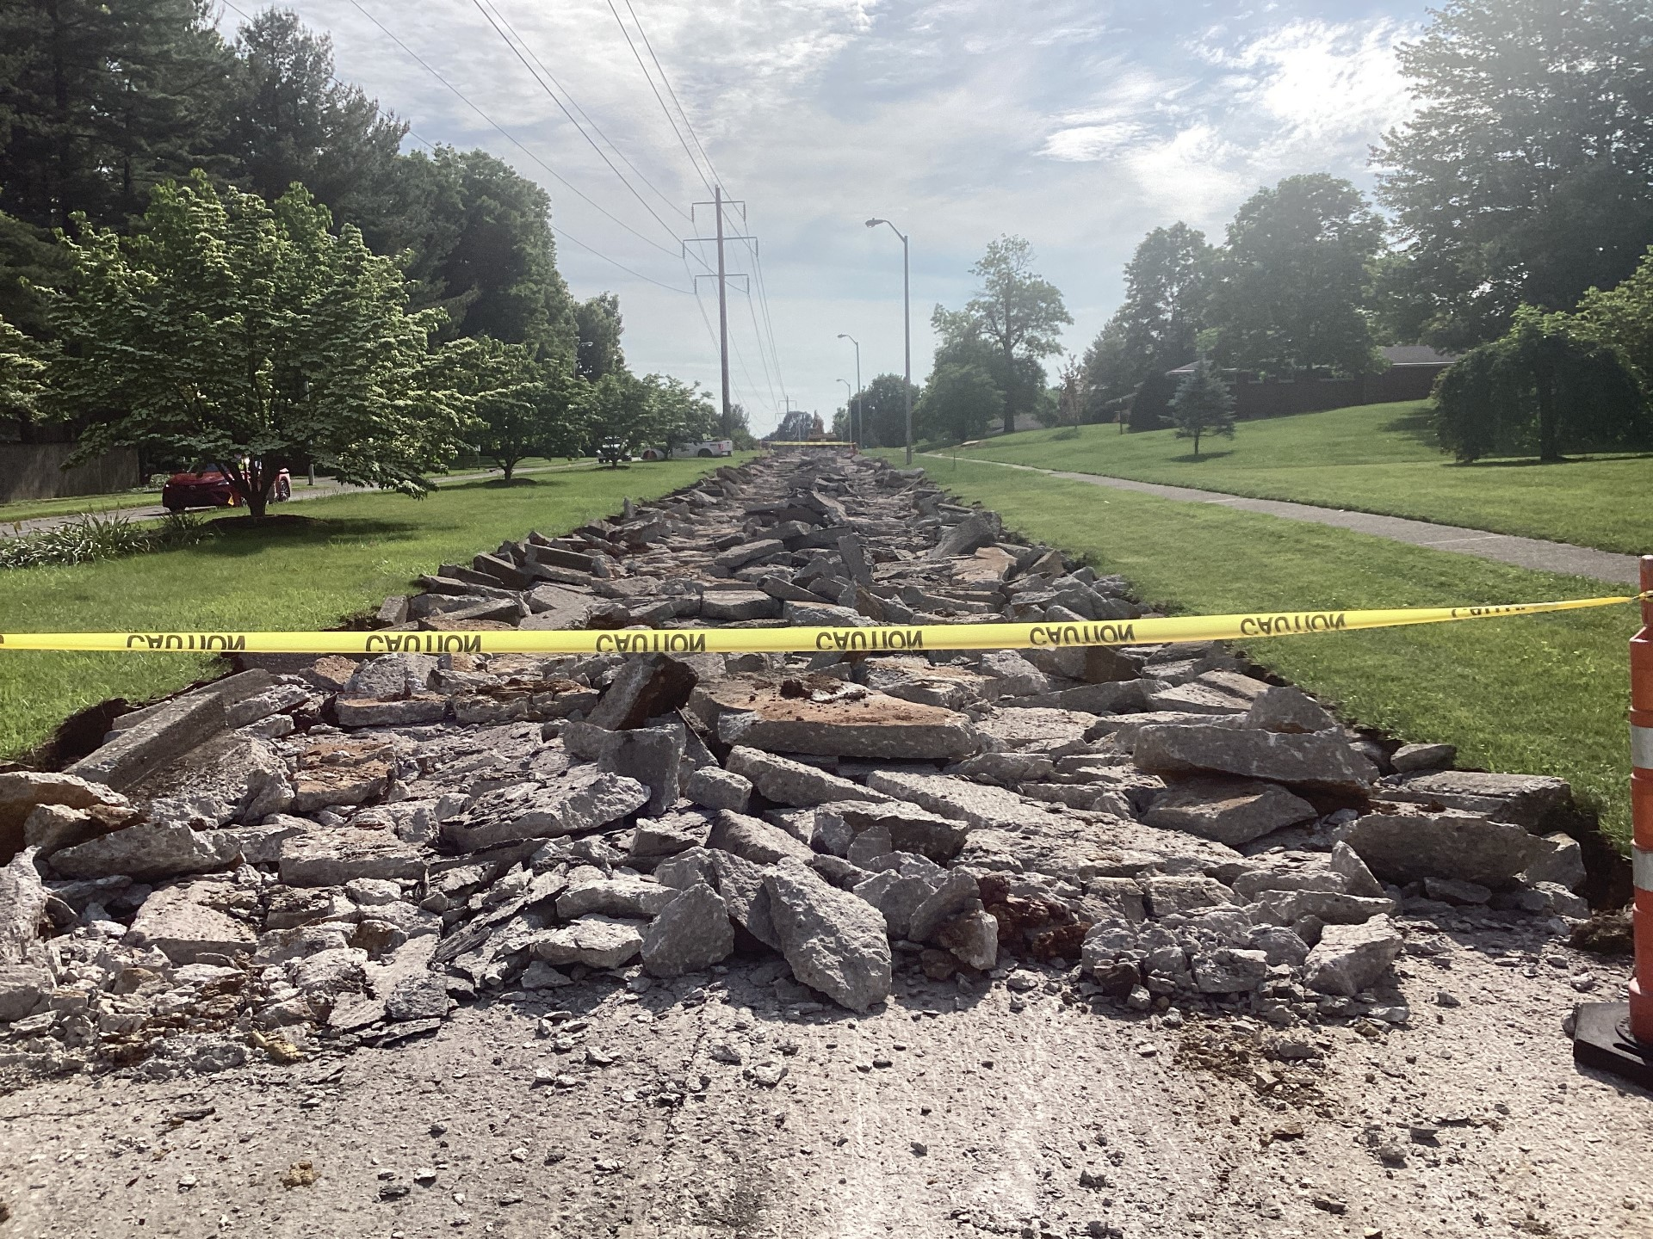
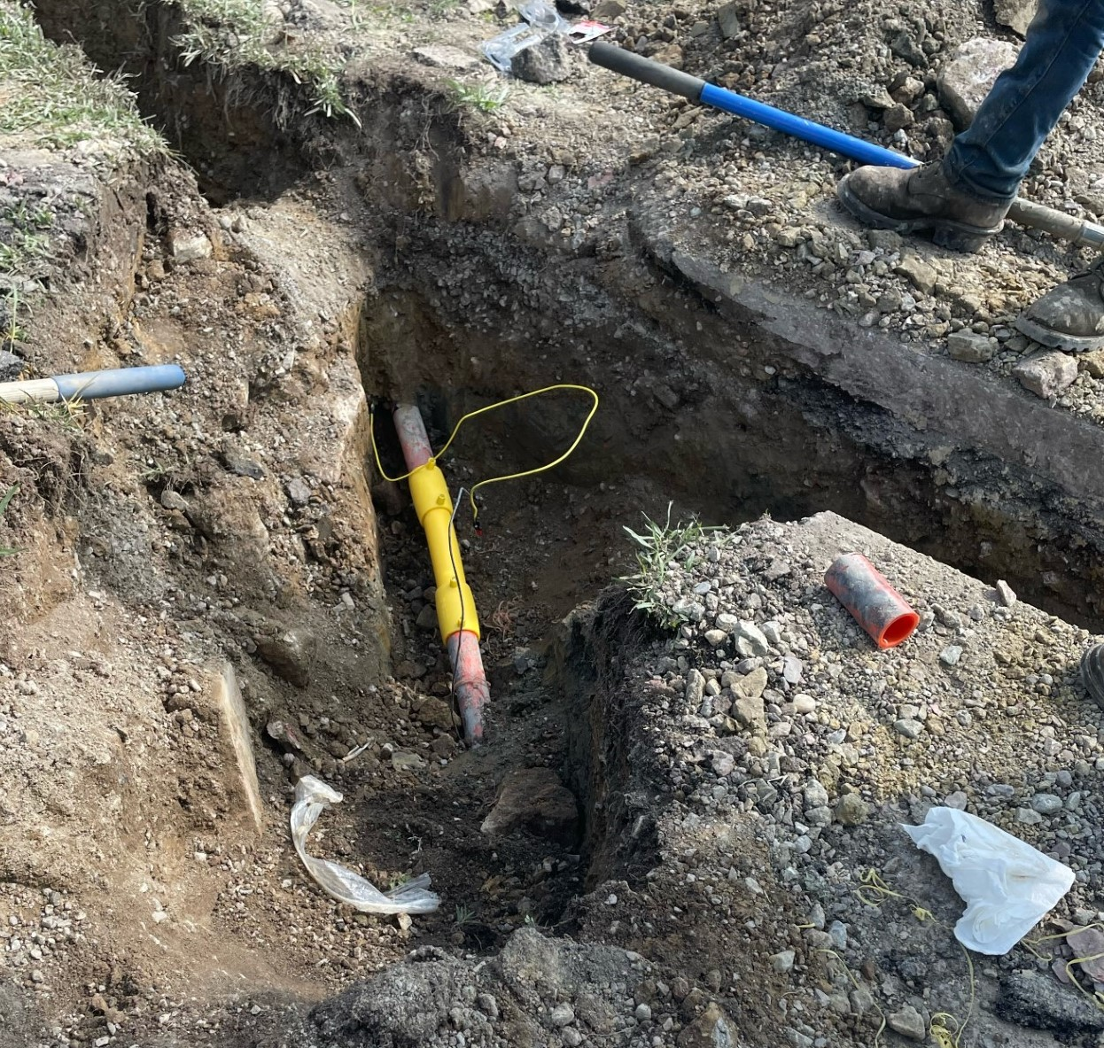
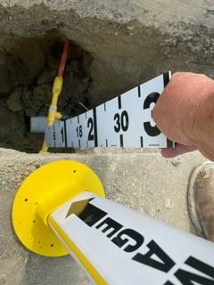
Excavator Requirements: The Worksite
When is mechanized equipment allowed in the tolerance zone?
To remove the pavement or other manmade hard surface or indigenous rock if:
  Only used to the depth necessary to remove the hard surface. Must return to hand tools once hard surface has been removed.
  An individual other than the equipment operator visually monitors the activity.
  Planned to avoid damage to underground facility
  Facility owner is notified of intent to remove indigenous rock if the line contains flammable, toxic, corrosive, or hazardous products.

Slide 26
Excavator Requirements: The Worksite
When is mechanized equipment allowed in the tolerance zone?
To remove materials that are more than twelve (12) inches in any direction from the outer edge of the located facility if:
  The excavator visually identifies the precise location of the underground facility or visually confirms that no facility is present within the depth of the excavation.
  An individual other than the equipment operator visually monitors the activity.
  Planned to avoid damage to underground facility.
  To place shores into an existing excavation or remove shores from an existing excavation.

Slide 27


Excavator Requirements: If a Damage Occurs
Excavator Responsibilities if an underground facility damage occurs:
Note: This also applies to excavators exempt from the requirements of KRS 367.4901 to 367.4917 under KRS 367.4915
  Cease excavation or demolition activities and notify all affected operators of the location and nature of the underground facility damage immediately upon discovery
  Notify appropriate public safety agencies of the location and nature of the safety concern if the damage causes concern for public or workplace safety, the excavator.
  immediately report to the appropriate authorities by calling 911 emergency telephone number if the underground facility damage results in the escape or suspected escape of any flammable, toxic, or corrosive gas or liquid.

Slide 28
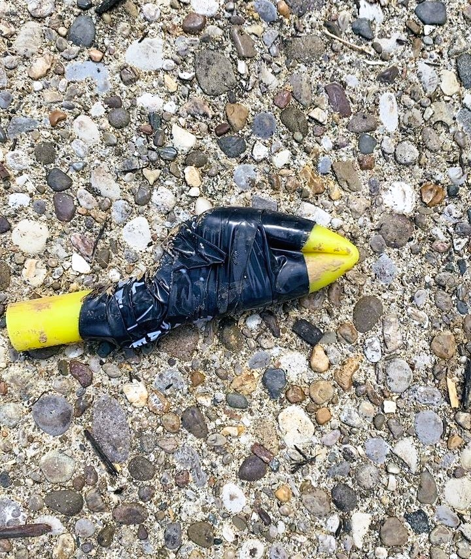
Excavator Requirements: If a Damage Occurs
DO NOT attempt to repair or stop the flow of a line containing any flammable, toxic, or corrosive gas or liquid that has been damaged.
Only Operator Qualified (OQ) personnel can perform the repairs.

Slide 29
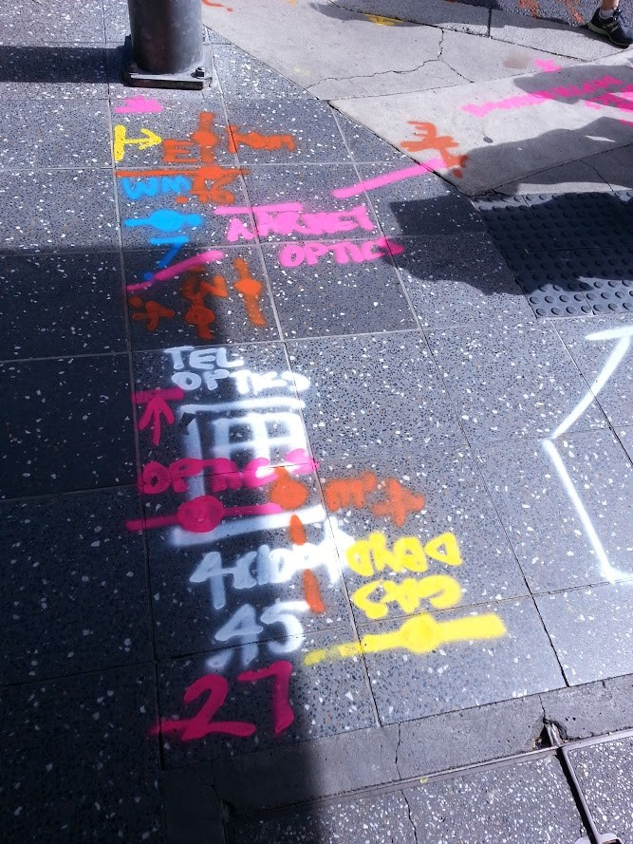
Operator Requirements: KRS 367.4909

Slide 30
Operator Requirements: KRS 367.4909
  A place to request a locate:
    Each operator shall provide protection notification center access to excavators.
      This includes all utilities.
      Voluntary operator membership in the Kentucky Contact Center satisfies the above requirement.
        Gas and hazardous liquid operators are required to be members of their state one-call system per federal regulation CFR 192.614(b)
      Updates to the Kentucky contact Center:
        Operator members of the Kentucky Contact Center must provide and update as needed to the Kentucky Contact Center:
          the general location of its underground facilities
          the operator identity and business address
          emergency notification telephone numbers.

Slide 31
Operator Requirements: KRS 367.4909
  Damage Reporting Requirements (Gas and Hazardous Liquid Operators Only):
    Operator shall report to the commission excavation damage to an underground facility used in the transportation of gas or hazardous liquid within thirty (30) calendar days of being informed of the damage.
    Damage caused by a communications service provider and no attempt to locate underground facilities was made, the operator shall include in its damage report to the commission the distance from the communications terminal that the damage occurred.

Slide 32
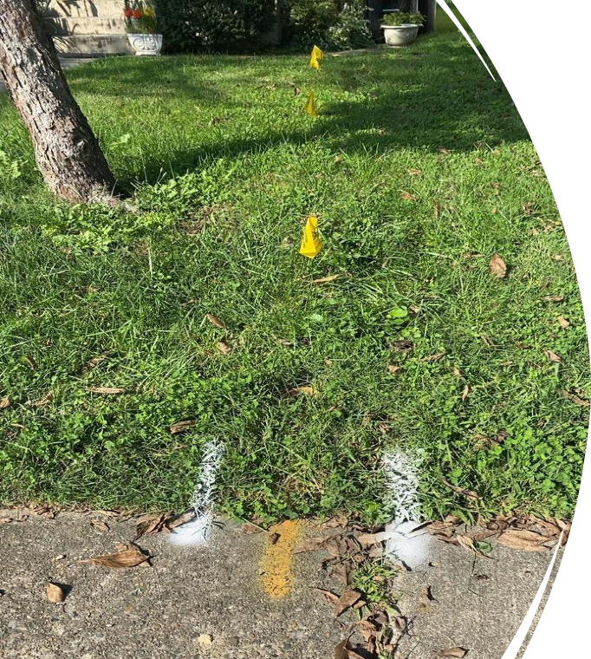
Operator Requirements: Locate Timelines
  Operators shall respond to facility locate requests and provide a positive response as follows:

Slide 33
Operator Requirements: Locate Timelines
  Normal Excavation Locate Request:
  a notification made to a protection notification center where a request for locating utility facilities is processed.
Two (2) working days after receiving notification from an excavator or any time prior to the scheduled excavation start date if agreed upon as provided in KRS 367.4917(7).
  KRS 367.4917(7) The commission shall make available on its Web site a written agreement form for an operator and an excavator to agree to a date or series of dates by which time the locate request must be completed if different from those dates established in KRS 367.4909. The form shall contain but is not limited to the parties' names, the locate request number, the date requested, and the location. The parties shall make the executed agreement form available upon request of the commission.
  Form available at: https://psc.ky.gov/agencies/psc/industry/gas/Facility%20Locate%20Agreement%20Form.pdf

Slide 34
Operator Requirements: Locate Timelines
Emergency Locate Request:
a notification made to a protection notification center by an excavator to alert facility owners or operators of the need to begin immediate excavation in response to an emergency.
As quickly as possible but not to exceed forty-eight (48) hours after receiving notification from an excavator
Note: KRS 367.4907 Compliance…shall not be required of authorized persons responding to emergency situations. However, these persons shall take every reasonable precaution to protect the public safety and underground facilities of others.
KRS 367.4917(3) A person that knowingly provides false notice to a utility notification center of an emergency as defined in KRS 367.4903 shall be subject to a civil penalty of one thousand dollars ($1,000) for each violation.

Slide 35
Operator Requirements: Locate Timelines
Design Information Request:
a notification made to a protection notification center by a person providing professional services and making a request in preparation for bidding, preconstruction engineering, or other advance planning efforts. A design information request may not be used for excavation purposes
within ten (10) working days after receiving notification from the person making the request.

Slide 36
Operator Requirements:
When Responding to a Design Information Request:
KRS 367.4909 (8) The operator shall:
  (a) Designate with temporary underground facility markers the location of all underground facilities owned by the operator within the area of the design information request as defined in KRS 367.4903;
  (b) Provide to the person making the design information request a description of all underground facilities owned by the operator in the area of the design information request and the location of the facilities, which may include drawings marked with a scale, dimensions, and reference points for underground utilities already built in the area or other facility records that are maintained by the operator; or
  (c) Allow the person making the design information request or an authorized person to inspect the drawings or other records for all underground facilities with the proposed area of excavation at a location that is acceptable to the operator.
  Note: KRS 367.4909 (9) An operator may reject a design information request and not be held in violation of subsection (6) of this section based upon security considerations or if producing the information will place the operator at a competitive disadvantage, pending the operator obtaining additional information confirming the legitimacy of the notice. The operator shall notify the person making the design information request and may
  request additional information.

Slide 37
Operator Requirements: Locate Timelines
Large Project Request:
An area of excavation occurring on or after July 1, 2016, measuring more than two thousand (2,000) feet in length. Multiple excavation notifications in an area may be considered together in determining if the excavations are part of a large project.
within two (2) working days the operator shall notify the excavator that an excavation area has been determined to be a large project, and the operator shall respond to the request within five (5) working days from the later of receiving notification from an excavator or prior to the scheduled excavation start date for that location if agreed upon as provided in KRS 367.4917(7)

Slide 38
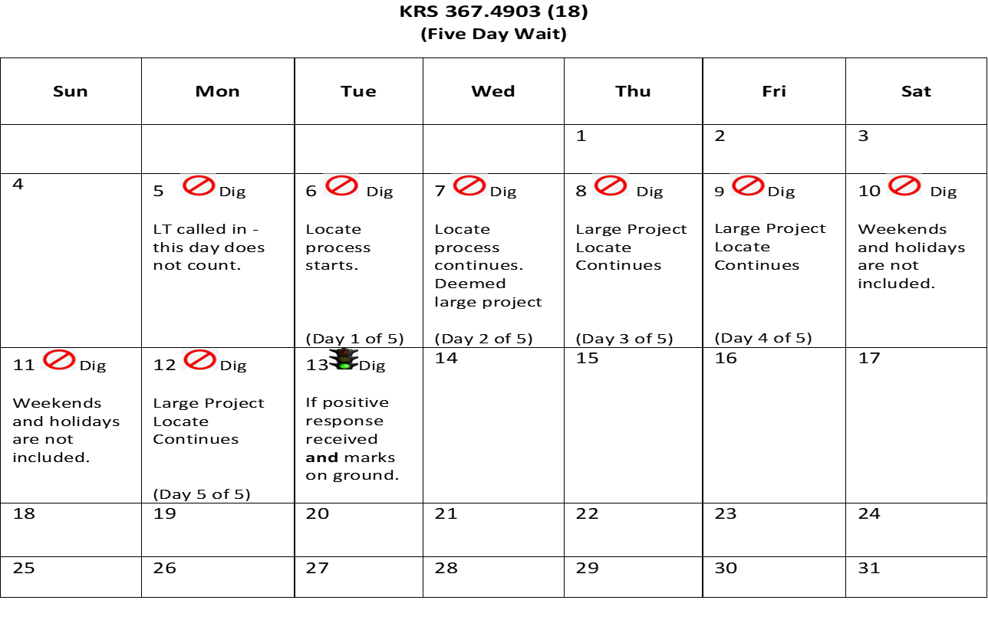
Operator Requirements:
  Large Project Timeline

Slide 39
Operator Requirements: Locate Timelines
Unmapped or Untonable Facility Request:
an underground facility that cannot be located from the surface using locating methods which meet industry standards and that requires additional efforts and extended time
Within two (2) working days the operator shall notify the excavator that an excavation area has been determined to be an unmapped or untonable project, and the operator shall respond to the request within five (5) working days for a normal locate request or eight (8) working days for a large project request from the later of receiving notification from an excavator or prior to the scheduled excavation start date if agreed upon as provided in KRS 367.4917(7)

Slide 40
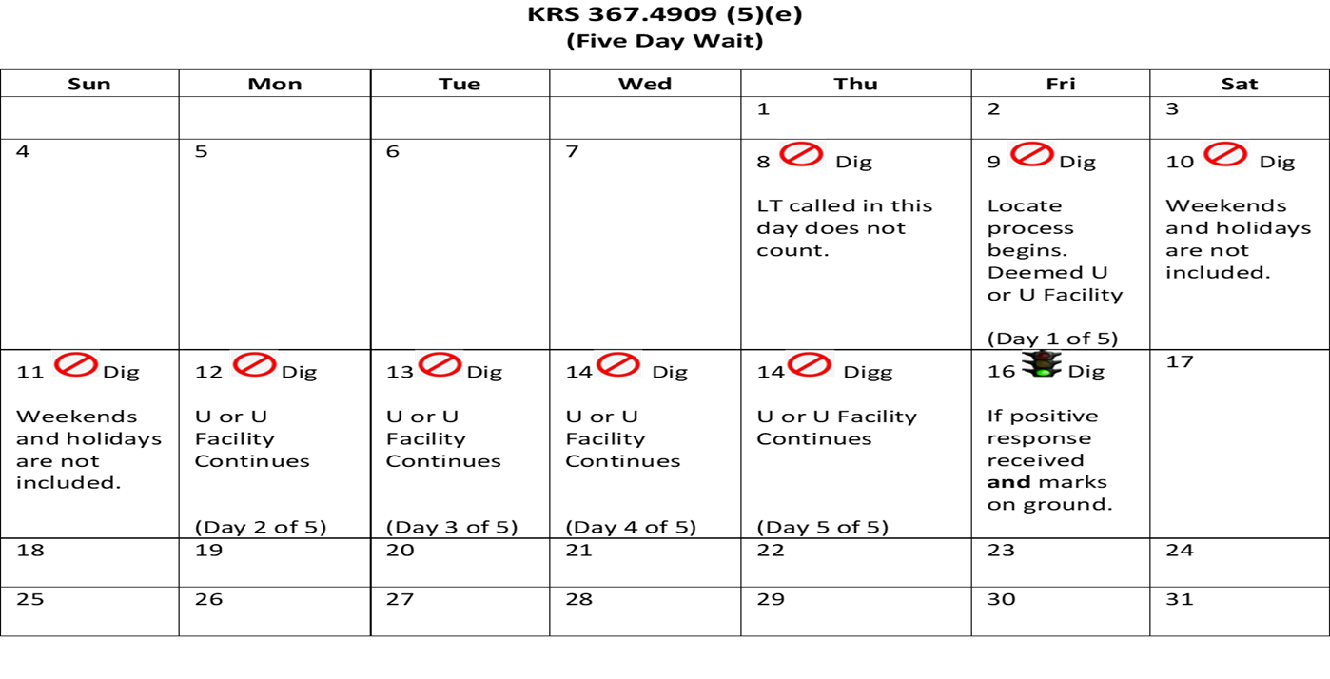
Operator Requirements:
  Unmapped or Untonable Locate Timeline

Slide 41
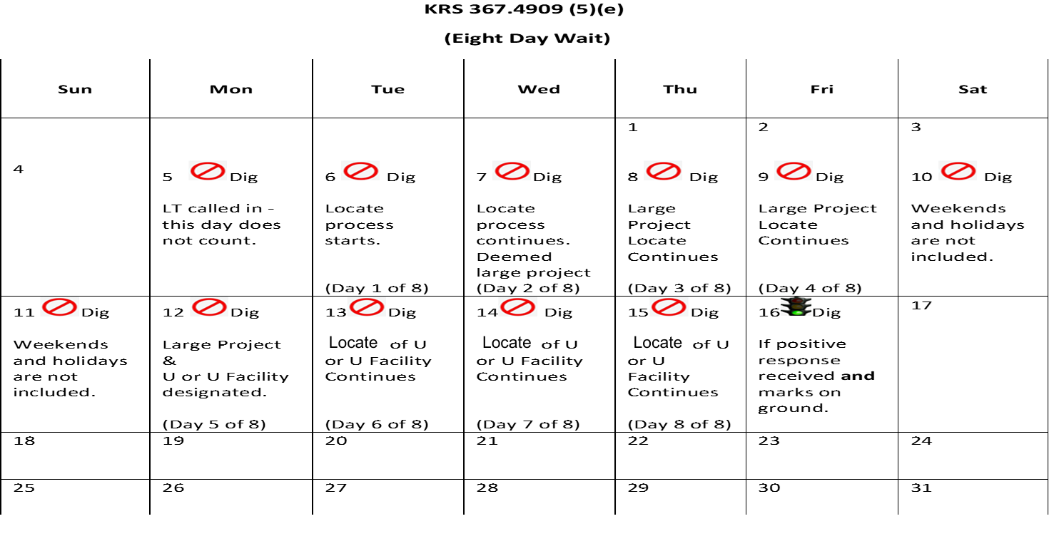
Operator Requirements:
  Unmapped or Untonable Large Project Locate Timeline

Slide 42
Operator Requirements: Locate Timelines
Fiber-to-the-Premises Broadband Deployment Excavation Request:
a service that provides network connectivity between a location and a subscriber using fiber
in locations not already served by fiber-to-the-premises, within four (4) working days.

Slide 43
Operator Requirements: Locate Timelines
Second Notice Request:
a notice that is made by an excavator to a notification center when an operator has failed to comply with the positive response requirements
Within one (1) working day after receiving a second notice request from an excavator pursuant to KRS 367.4911(12), an operator shall locate its facility and update the positive response system.

Slide 44
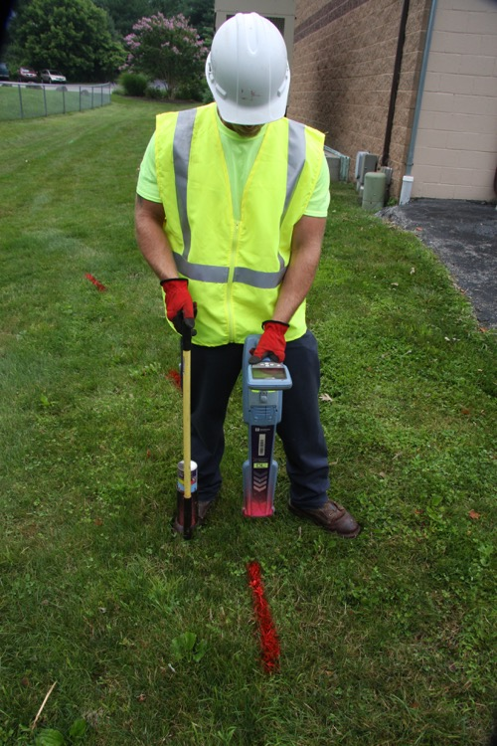
Operator Requirements:
After receiving a locate request:
KRS 367.4909 (7) The operator shall:
  (a) Inform the excavator of the approximate location and description of any of the operator's underground facilities that may be damaged or pose a safety concern because of excavation or demolition;
  (b) Unless permanent facility markers are provided, provide temporary markings to inform the excavator of the ownership and approximate location of the underground facility; and
  (c) Provide a positive response to the requesting party.

Slide 45
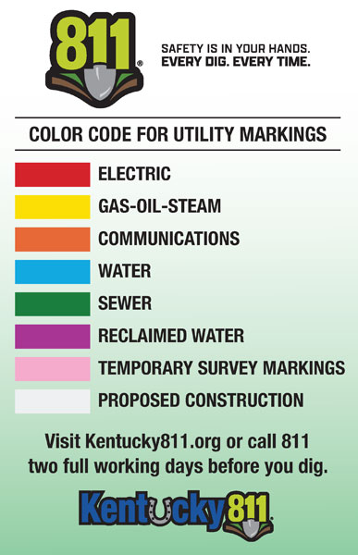
Operator Requirements: Marking Requirements
Temporary underground facility markers shall consist of paint, chalk, flags, stakes, or any combination thereof…

Slide 46
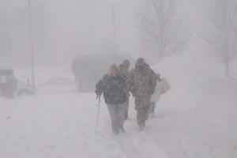
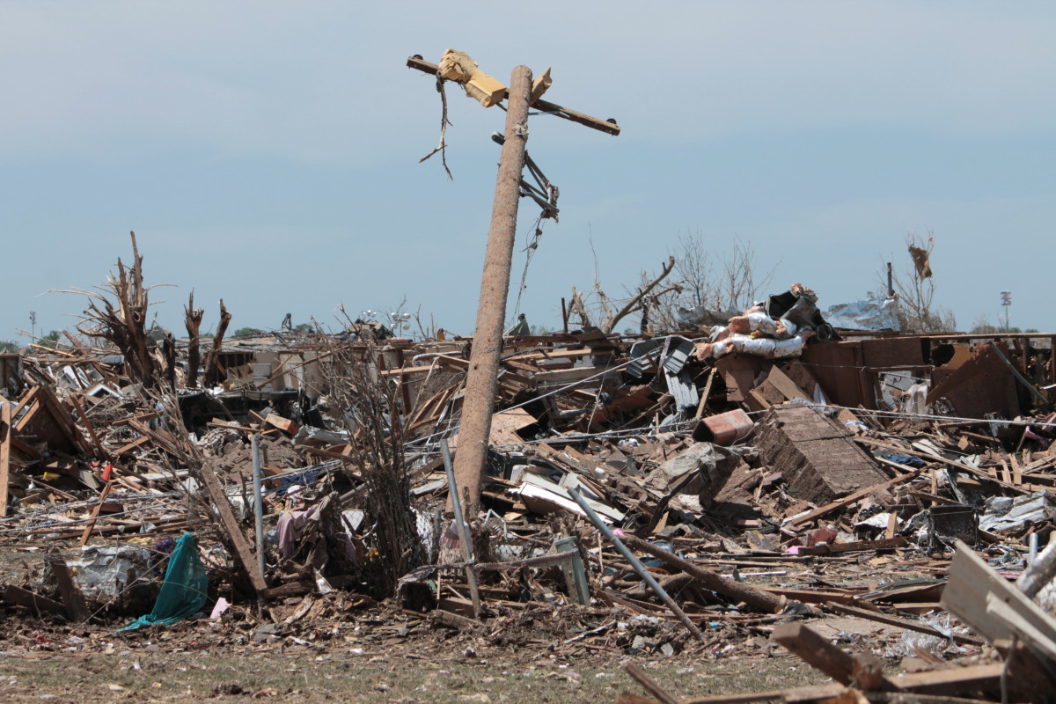
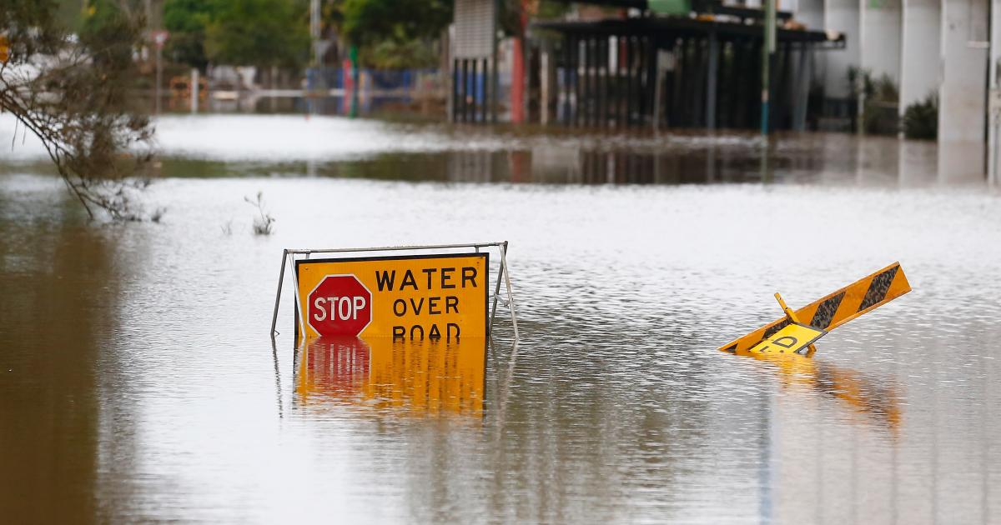
Operator Requirements:
Marking Requirements
Extraordinary Circumstances
If extraordinary circumstances exist, an operator shall notify the excavator of the operator's inability to comply with this section. Notification under this subsection shall temporarily relieve the operator of complying with subsections (5) and (6) of this section until the operator can recover from the extraordinary circumstances. Extraordinary circumstances include weather that makes it impossible for any combination of facility markers identified in subsection (10) of this section to be used, extreme weather conditions, force majeure, disasters, or civil unrest that make timely response difficult or impossible.

Slide 47
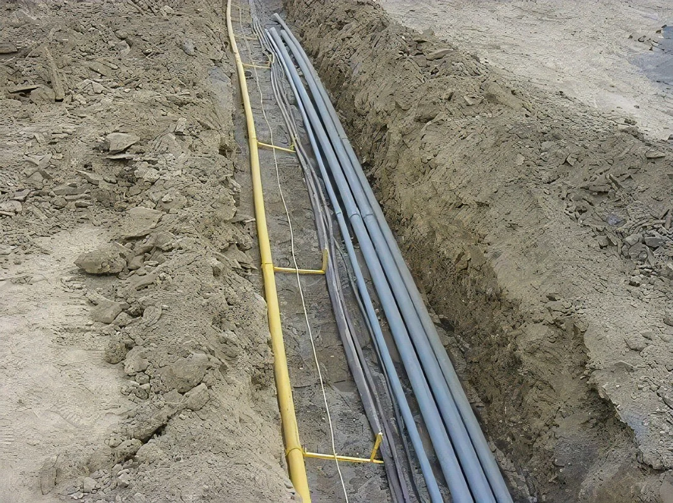
Operator Requirements: Installation Requirements
All underground facilities installed after January 1, 2013, shall include a means to accurately identify and locate the underground facilities from the surface. This subsection does not apply to the repair of existing facilities.

Slide 48
Protection Notification Center and Kentucky Contact Center Requirements: KRS 367.4913
Requirements for ALL Protection Notification Centers including KY 811:
(a) Provide locate request services during working days and provide an emergency contact number for incidents occurring outside the working day.
(b) Provide a positive response system…to determine the status of locating an underground facility.
(c) Provide any excavation request with an identification number and the names of the facility owners or operators who will be notified for each locate request.
(d) Promptly after receiving an excavation or demolition work notification…provide to each of its affected operator members the excavator information…
(e) Maintain a list of all its operator members, their business addresses and their business and emergency telephone numbers and provide this information…with the county clerk of each county where the operator member has underground facilities…
(f) Make the operator members information list available to any person for inspection at its place of business without charge or provide a copy of the list to any person for any county upon request for a fee not to exceed the actual cost of providing a copy
(g) Define and adopt policies and procedures for processing design information requests.
(h) Provide the person making a design information request a list of identified operators that will receive notification and notify those operators.
(i) Maintain the following information provided by excavators for all requests to locate facilities for at least five (5) years from the date of the request: Name and phone number of the excavator or person requesting the underground facility locate, Location and type of work being performed by the excavator, Name and phone number of work site contact, Name, address, and phone number of underground facility operators, and Estimated start date and start time of excavation.
(j) Provide contact information for the protection notification center on its Web site or pursuant to paragraph (e) of this subsection .
(k) Provide public awareness education and damage prevention programs in the manner and amount determined by each protection notification center.

Slide 49
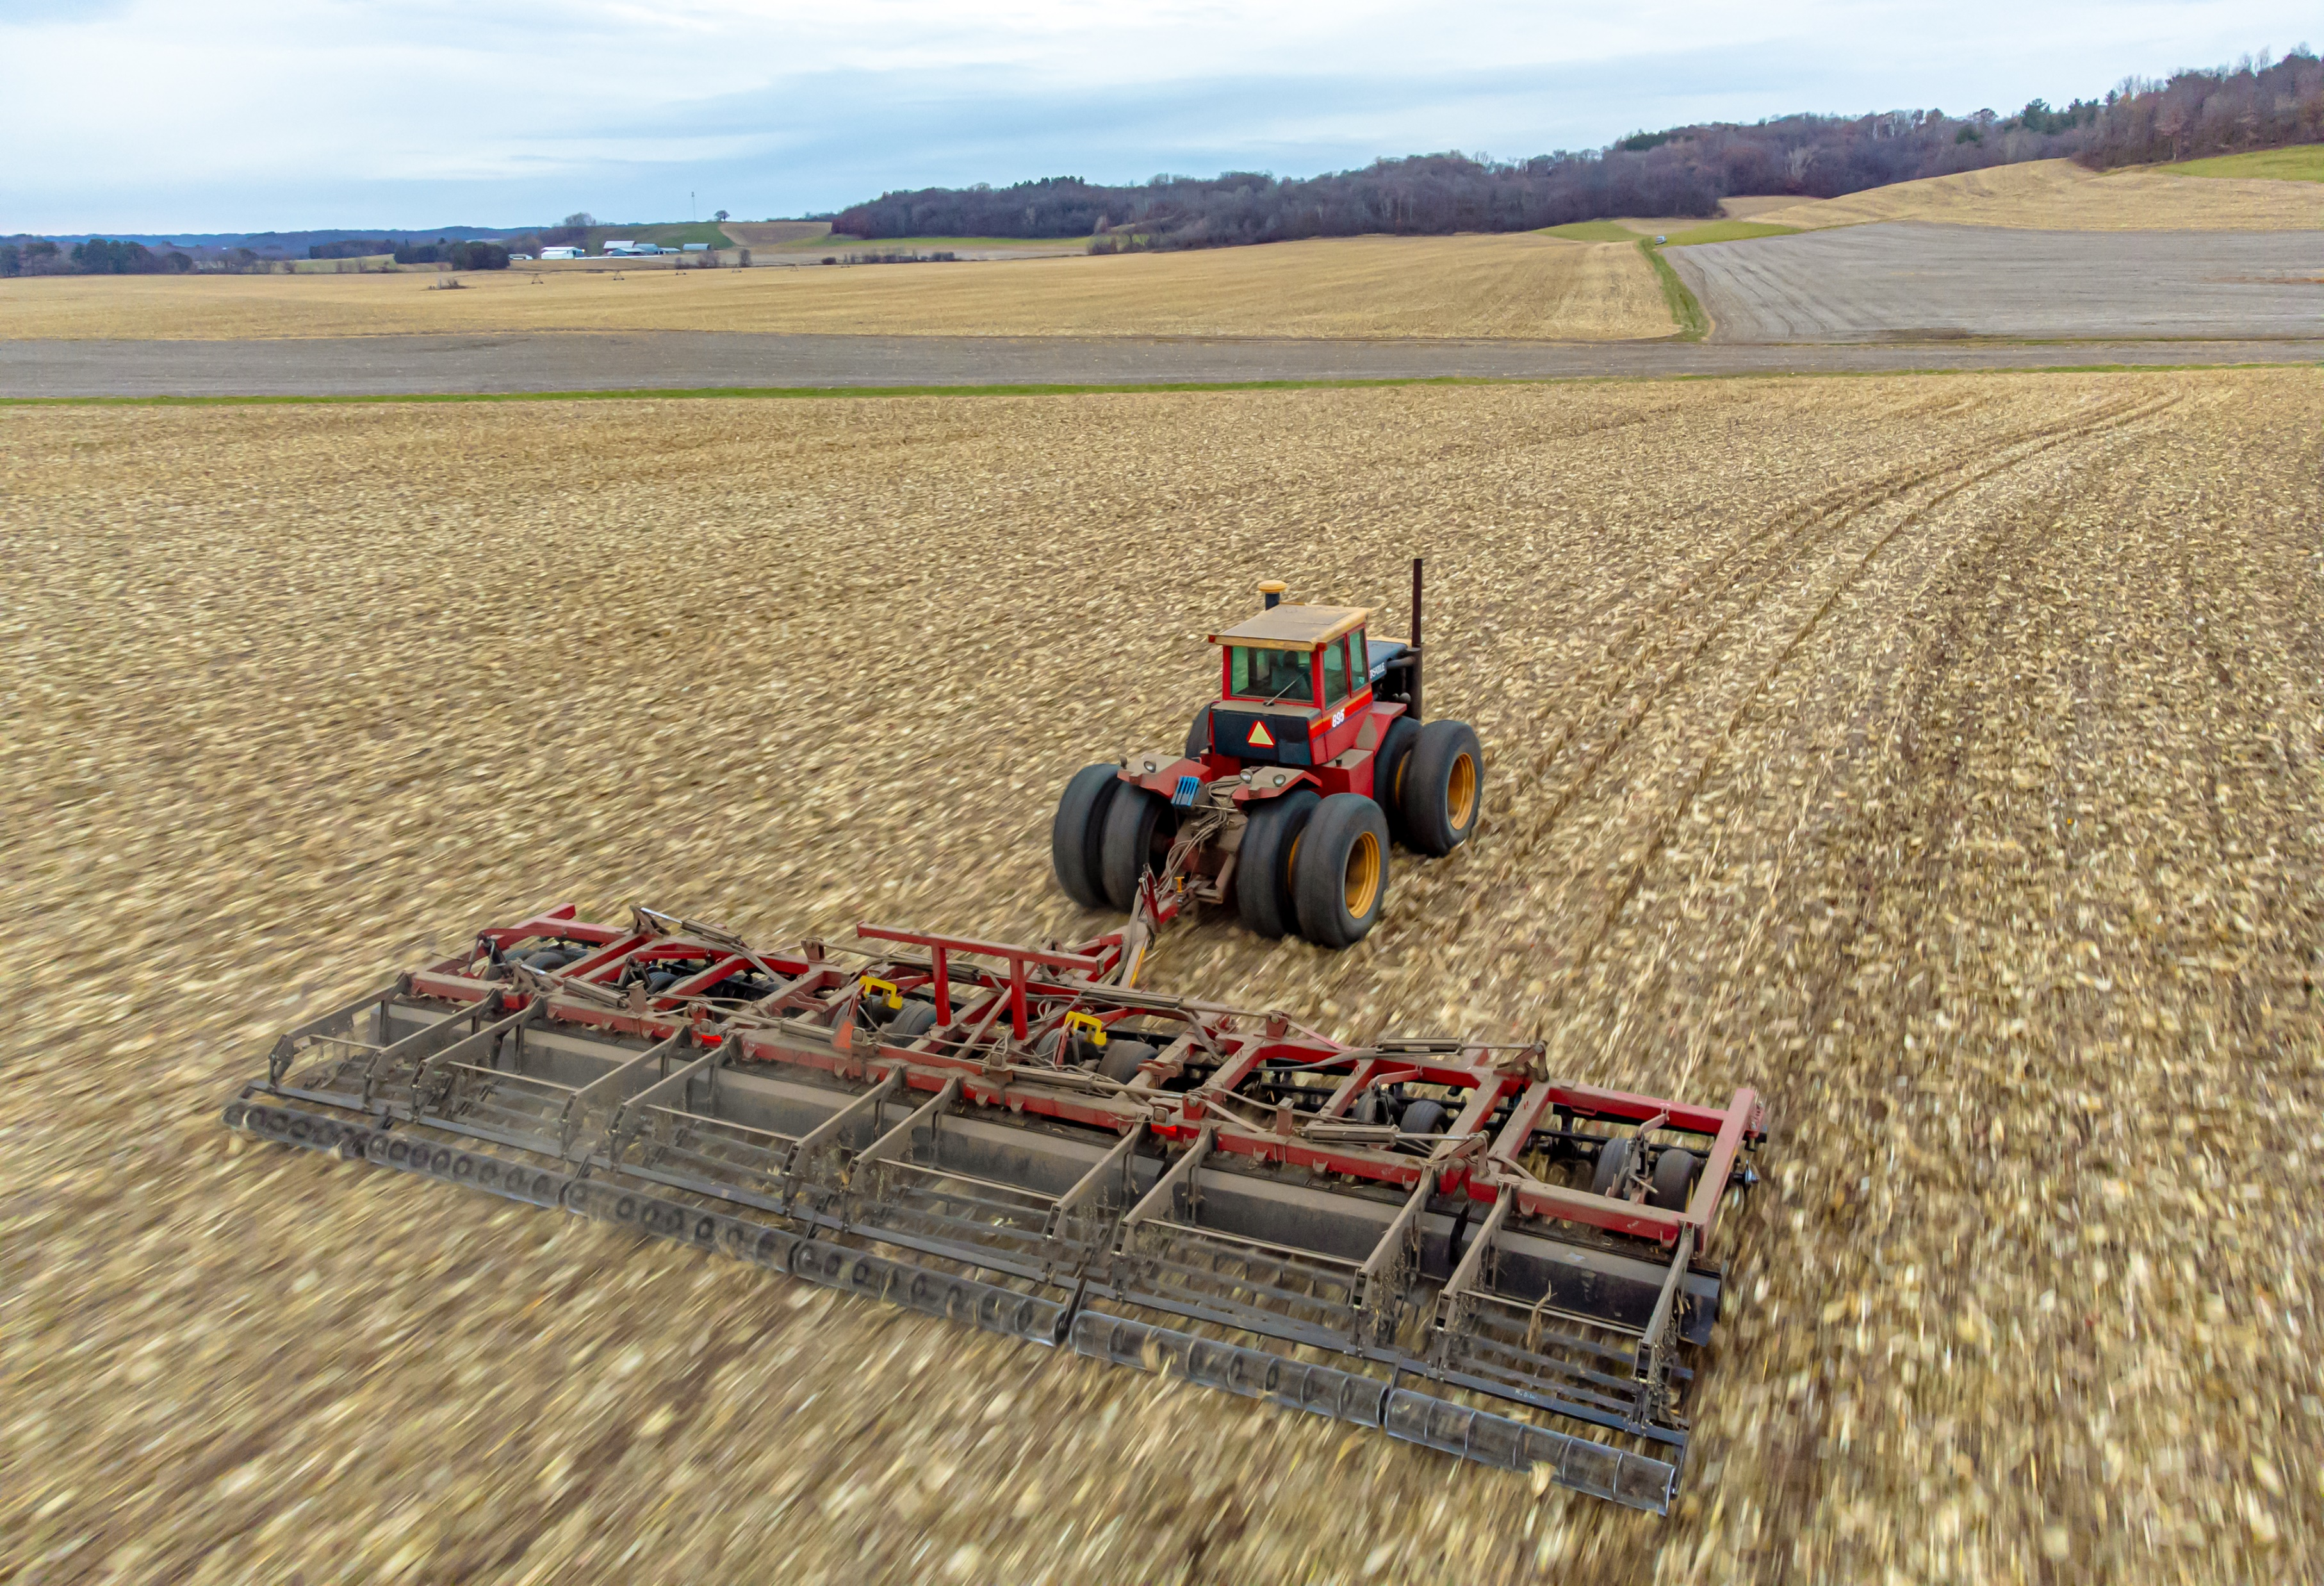
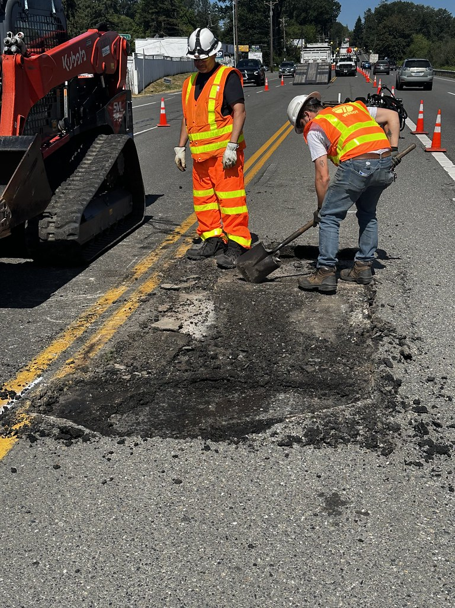
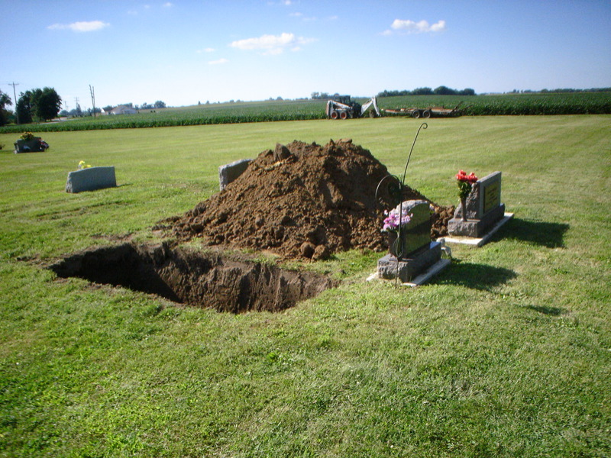
Exemptions: 367.4915
Except as provided in KRS 367.4911(9), the requirements of KRS 367.4905 to 367.4917 shall not apply to the following:
Excavation by an operator on its own easement except where that easement is crossed by another operator's facilities
Routine road maintenance or railroad maintenance or repairs.
Tilling of soil for agricultural purposes.
Excavators excavating on private property, using nonmechanized. equipment, if there is no encroachment on any operator's right-of-way or easement.
The opening of a grave in a cemetery.

Slide 50
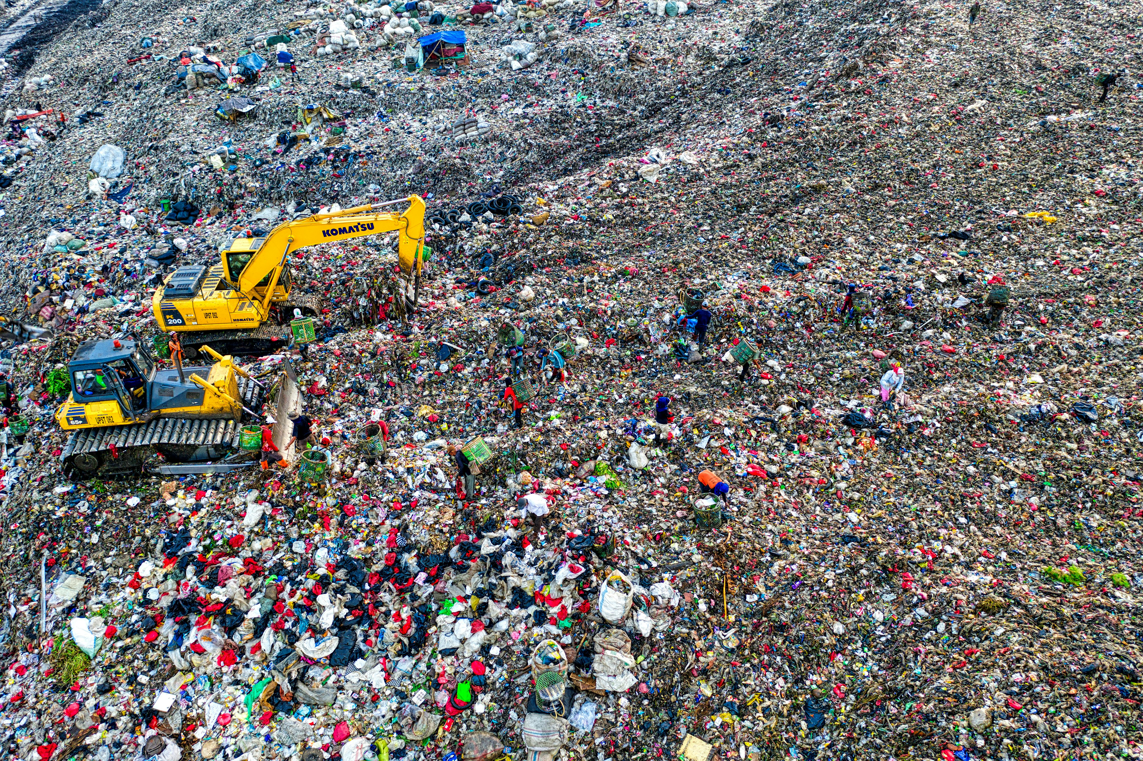
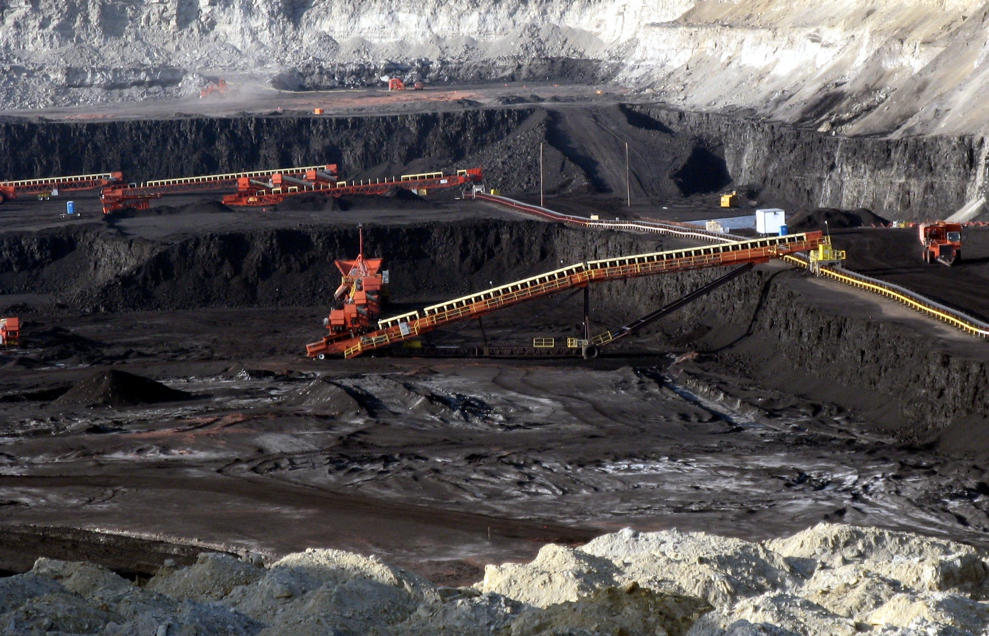
Exemptions: 367.4915
Except as provided in KRS 367.4911(9), the requirements of KRS 367.4905 to 367.4917 shall not apply to the following:
A solid waste disposal site which is properly permitted.
Coal mining operations which are currently regulated under KRS Chapter 350.
A utility operator or utility operator subcontractor performing emergency work as defined in KRS 367.4903.
Leak migration testing using metal probes inserted by hand by an authorized representative of the operator.

Slide 51
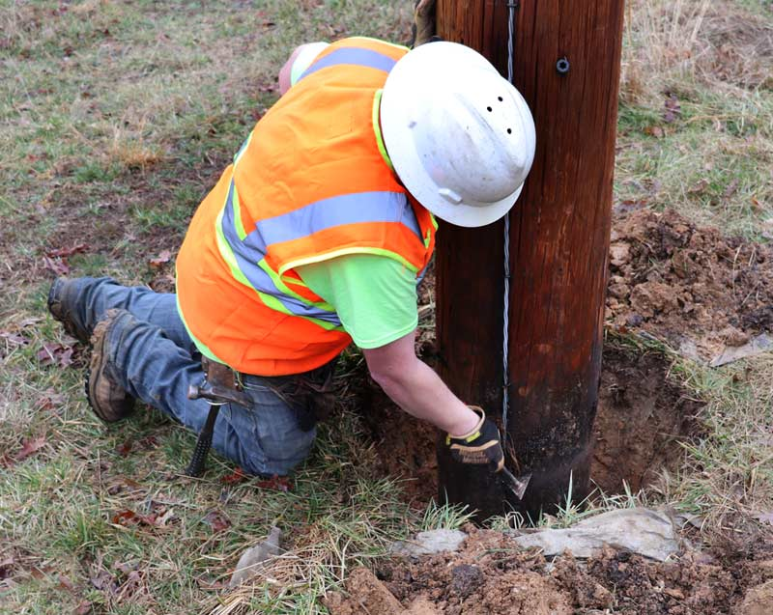
Exemptions: 367.4915
Except as provided in KRS 367.4911(9), the requirements of KRS 367.4905 to 367.4917 shall not apply to the following:
Any nonintrusive excavating performed by an operator or his or her subcontractor to locate the operator's underground facilities in response to a notice of excavation from the notification center, if all reasonable precautions have been taken to protect the underground facilities.
Nonintrusive excavating to inspect or perform maintenance for an existing utility pole.

Slide 52
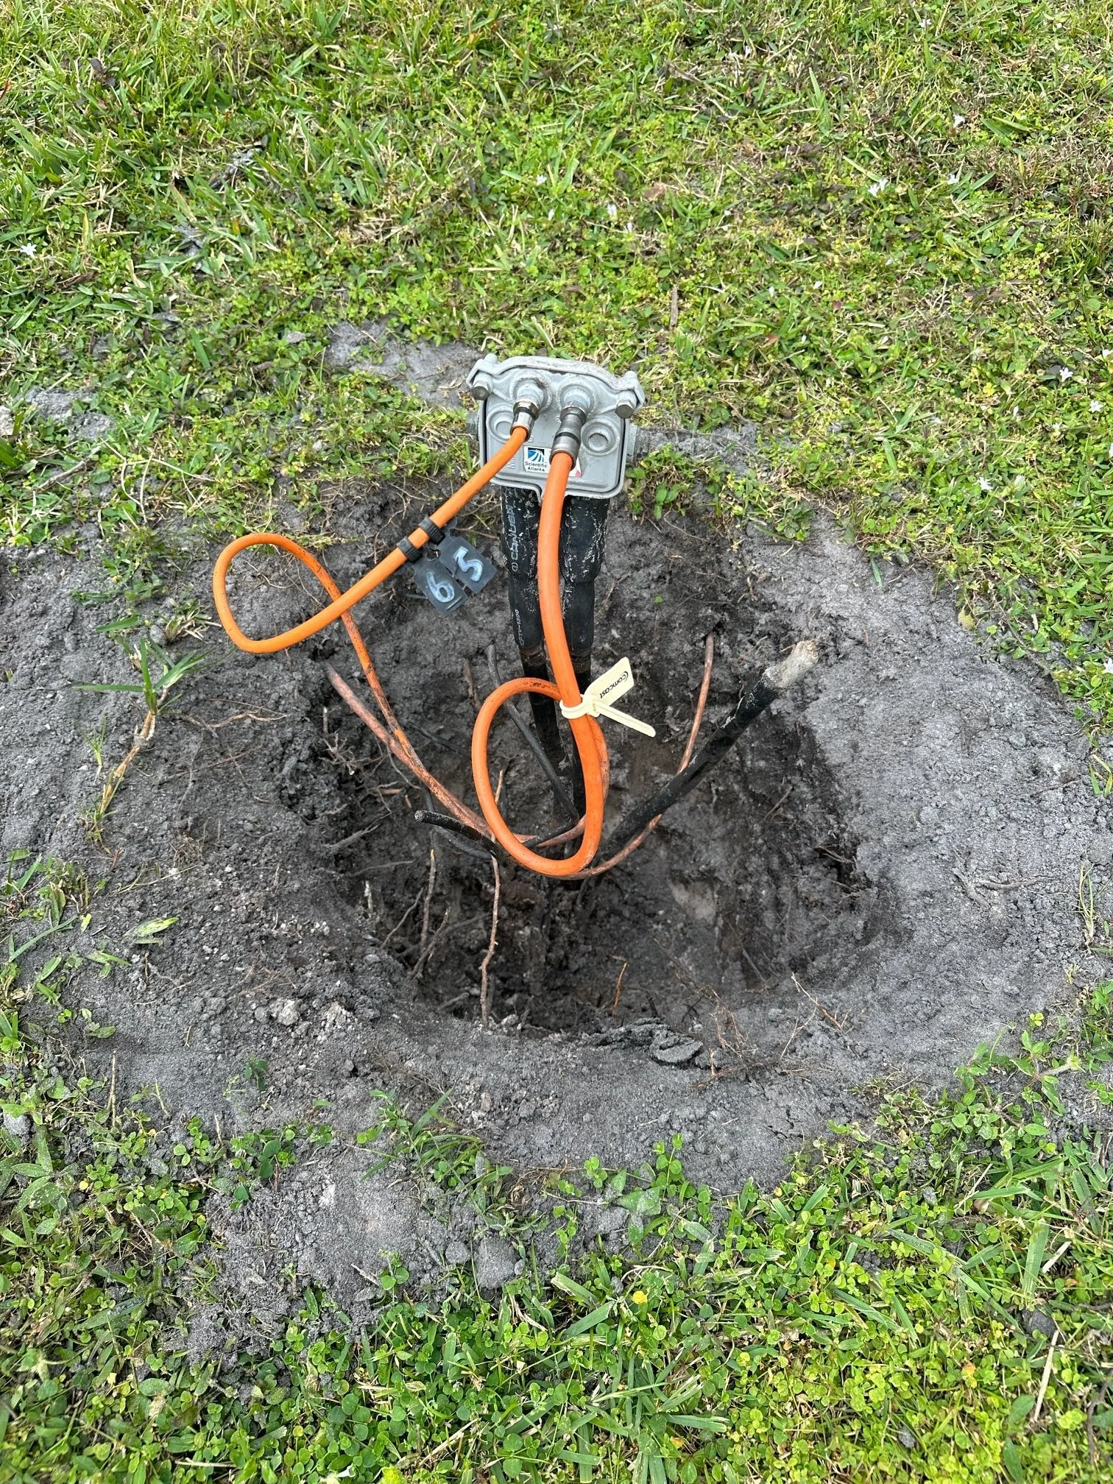
Exemptions: 367.4915
Except as provided in KRS 367.4911(9), the requirements of KRS 367.4905 to 367.4917 shall not apply to the following:
(12) Connection or disconnection of communications lines within a private or public easement or right-of-way by means of nonintrusive excavating when the depth of the excavations is not greater than twelve (12) inches and is completed within twelve (12) inches of a communications service provider's own communications network.

Slide 53
Penalties: 367.4917
Excavators & Operators:
1st Violation:
$250.00
2nd Violation:
$1000.00
3rd or Subsequent Violation:
$3000.00
A violation shall be considered a first violation…if more than three hundred sixty-five (365) days have elapsed since the last incident attributable to a person in violation.
Any violation that involves damage to a facility containing any flammable, toxic, corrosive, or hazardous material or results in the release of any flammable, toxic, corrosive, or hazardous material:
Additional $1000.00

Slide 54
Penalties: 367.4917
Protection Notifications Centers:
$1000.00 per violation
False Emergency Locate:
$1000.00 per violation
The Commission shall have statewide authority to enforce and assess civil penalties…for any violation that results in damage to an underground facility use to transport gas or hazardous liquid.

Slide 55
Penalties: Water Districts as Operators
Penalties under KRS 367.4917 do not apply to water districts in their role as operators but will apply in their role as Excavators.
HOWEVER:
KRS 278.040 grants the Commission jurisdiction over the service utilities provide to the public.
KRS 278.250 grants the Commission authority to investigate the condition of a utility subject to its jurisdiction.
The penalties set forth in KRS 278. 990 are applicable to the conduct of Water Districts as operators of underground facilities. ($2,500 individual and $10,000 utility).

Slide 56
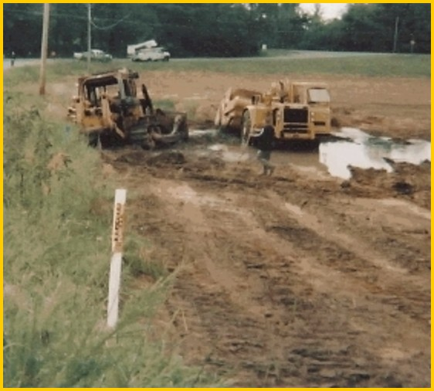
INVESTIGATIONS
APPLY THE LAW AND PROTECT YOURSELF
Application of the Law and the Department of Inspections Investigation Process

Slide 57
INVESTIGATIONS
WAS THERE A DIG TICKET?
Was a Damage Report completed?
Damage Reports should include:
Written Reports from staff at the site of damage when it occurred.
Photographs
Diagrams / Drawings
Written agreements. No Verbal agreements.
Any other evidence relevant to the damage.

Slide 58
INVESTIGATIONS
Was a timely request made?
  When was the request made and when did the damage occur?
Did excavation being in the absence of location marks?
  This is where pre-excavation pictures can help.
  Are there other facility marks (water, sewer, etc.)
  Is there a gas meter on the house

Slide 59
INVESTIGATIONS
Were the facilities properly and accurately located?
  Again pre-excavation pictures help.
  Did the damage occur w/in 24 inches of the locate mark?
  Post-damage pictures help. Try to show locate marks and damage location.

Slide 60
INVESTIGATIONS
Were the appropriate excavation methods used in close proximity to the pipeline that was damaged?
Use of non-mechanized equipment within 24 inches of the locate marks.

Slide 61

INVESTIGATIONS
Do any of the statutory exemptions apply?

Slide 62


INVESTIGATIONS
What do these
photos tell us?

Slide 63

INVESTIGATIONS
Is this damage within the
tolerance zone?

Slide 64


INVESTIGATIONS

Slide 65

INVESTIGATIONS

Slide 66

INVESTIGATIONS
Connect the dots

Slide 67

INVESTIGATIONS
The statute does
not specify depth.
It was stated that
the line was only 2
inches deep.

Slide 68

INVESTIGATIONS
Did a shovel or
posthole digger
cause this damage?
Non-mechanized
equipment?

Slide 69

INVESTIGATIONS
Where did this
damage occur?
Photos should
show address and
landmarks.

Slide 70

INVESTIGATIONS

Slide 71

INVESTIGATIONS
Diagrams
enhance your
photographs
and report.

Slide 72


INVESTIGATIONS
Locate 7828
and 7827
Fairmeadows
Lane

Slide 73


INVESTIGATIONS

Slide 74


INVESTIGATIONS

Slide 75


INVESTIGATIONS

Slide 76
INVESTIGATIONS
Some helpful hints for excavators:
Don’t assume all pipes or lines are straight.
Don’t assume facility depths are uniform.
Don’t remark or improve markings on your own.
Don’t assume everything has been marked just because some things have.
Don’t assume permanent pipeline markers are exactly above the pipe.

Slide 77

INVESTIGATIONS

Slide 78

Contact Us
  Eric Tout
  Consumer Complaints Analyst-Damage Prevention
  Ericv.tout@ky.gov
  502-782-2622
  Ashley Rhodes
  Consumer Complaints Analyst-Damage Prevention
  Ashleyb.Rhodes@ky.gov
  502-782-2578
  Jessica Norris-Canfield
  Staff Attorney
  jnorriscanfield@ky.gov
  502-782-8508

