Slide 1
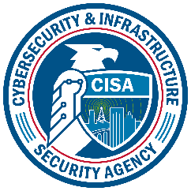
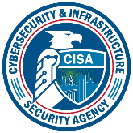
CYBERSECURITY AWARENESS TRAINING
C I S A | CY B E RS E CURI T Y A ND I NF RA S T RUCT URE S E CURI T Y A G E NCY

Slide 2
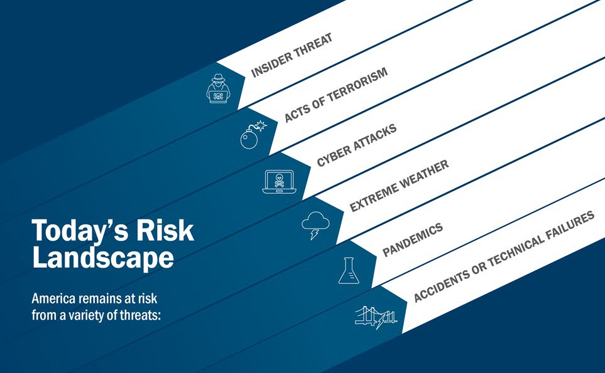
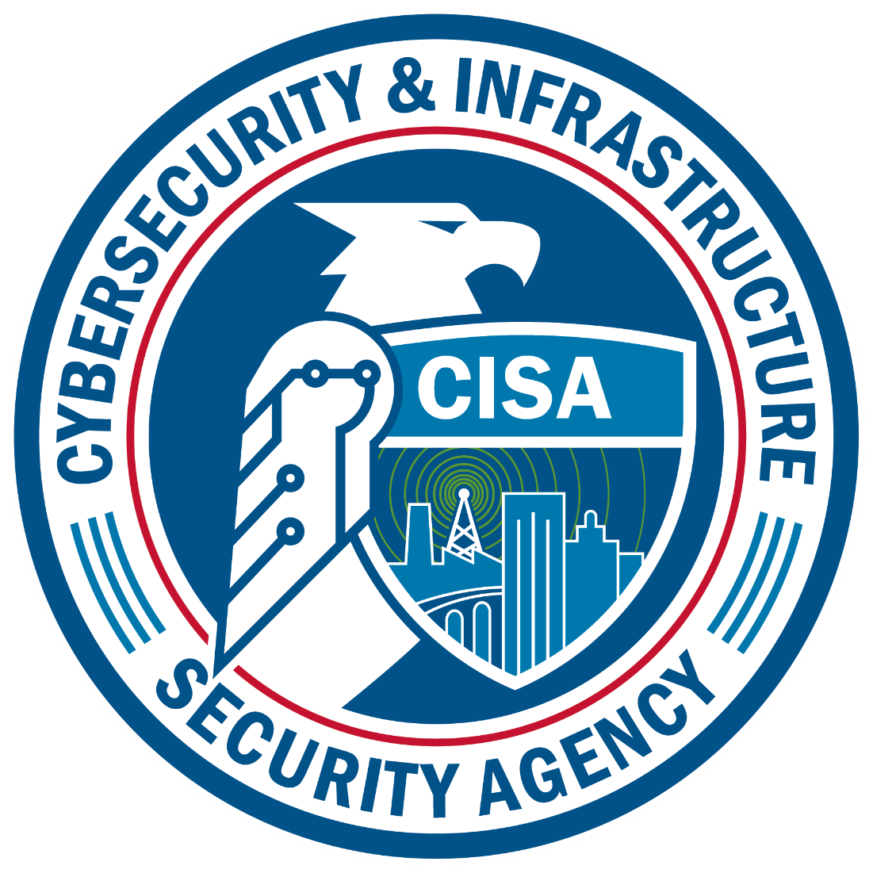

Slide 3
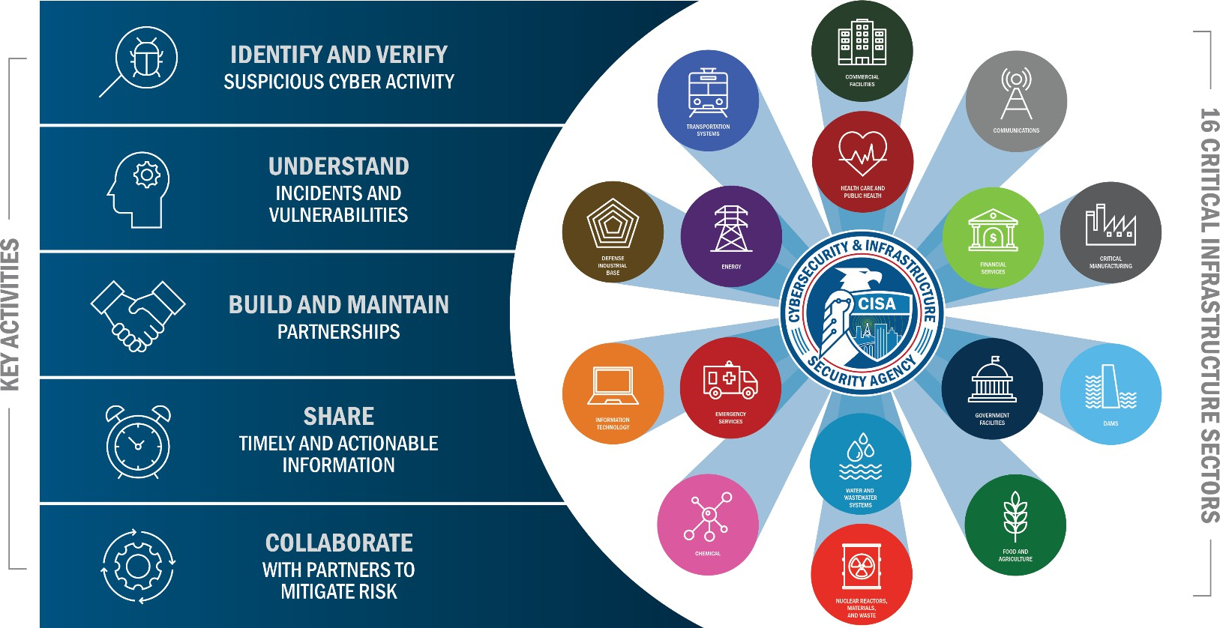
Serving Critical Infrastructure
TLP:WHITE

Slide 4
Phishing
TLP:WHITE
Phishing - online messages designed to look like they’re from a trusted source and/or hijack legitimate accounts intended to lure target to: click a link, open an attachment, or take an action.
Common Red Flags:
  Urgent/ Emotionally Charged
  Requests to Send or Change Personal/ Finance Info
  Unexpected/ Suspicious Attachments (uncommon naming/ file types)
  Untrusted/Suspicious Links (URL mismatches)
  Email Addresses Do Not Match Sender
  Official Emails Originating from Outside Company
  Too Good To Be True
Mitigation:
  Resist and Report
    Spam – Organization
    Blocks Current Sender
  Delete
    Avoid Unsubscribe Link
      Could Be Malicious

Slide 5
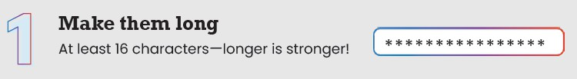
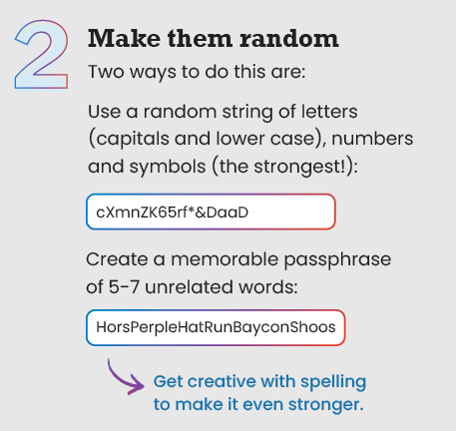
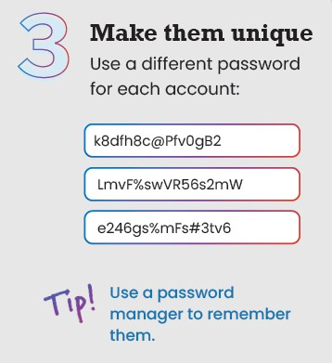
Password Defense
TLP:WHITE
8 character (numbers, upper and lowercase letters, symbols) = 39 minutes 16 character (numbers only) = 5 hours
16 character (numbers, upper and lowercase letters, symbols) = 92bn years

Slide 6
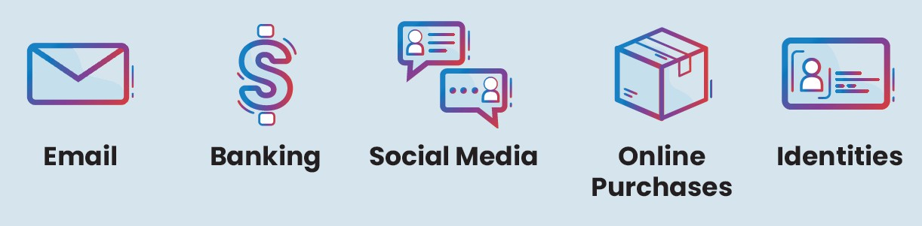

Multifactor Authentication (MFA)
TLP:WHITE
MFA (two-factor): Confirms Our Identities.
Highly Impactful Defense Against Cyber Attacks.
Enable on EVERY account and Device pssible.

Slide 7

Software Updates
TLP:WHITE
Install Updates to fix Security Risks.
  Mobile Phones, Computers/ Tablets, Operating Systems, Software, Web Browsers, Watches, Network and Security Equipment, IoT
Time is Critical once Vulnerabilities are known.
Turn on Automatic Updates
Watch for Notifiers – Not every update can be automatically installed

Slide 8
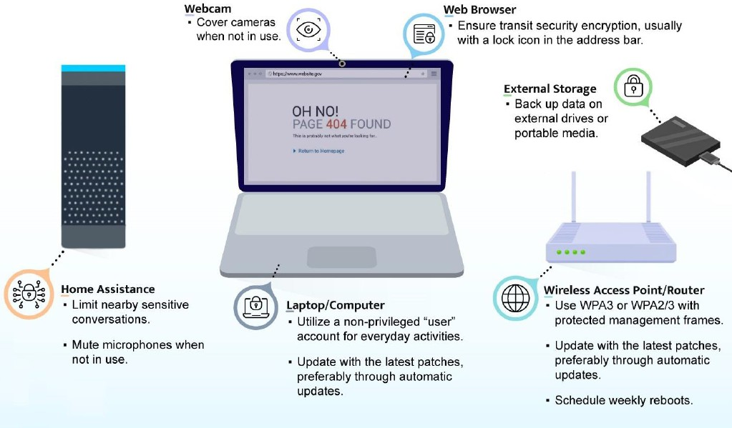
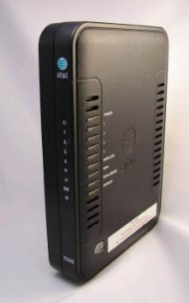


Home Network Security
TLP:WHITE
ISP Router Management
Change Default Password
Enable Firewall
Enable Network Address Translation (NAT
NSA-Best Practices For Securing Your Home Network
Change Default Password - - - Restart Often
EA/SED/IOD
March 18, 2026

Slide 9
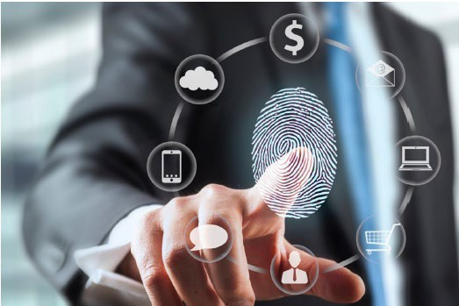
Mobile Device Security
TLP:WHITE
Enable User Authentication (Passcode)
Install Updates
Restart Phone Often (Memory Dump)
Create backups
Reinstall From backups Occasionally (After Foreign Travel or Loss of Control)
Only Download Apps from Legitimate Sources
Limit Remote Sharing
Limit Public Exposure/ Change Device Name
EA/SED/IOD
March 18, 2026

Slide 10
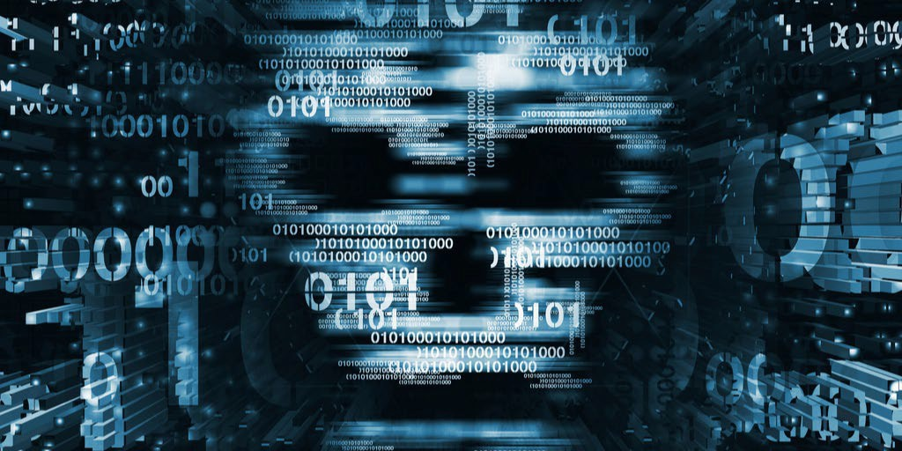
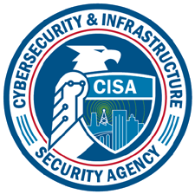
CYBER THREATS
TLP:WHITE
Joe Parker
October 22, 2024
EA/SED/IO
March 18, 202
16
D
6

Slide 11
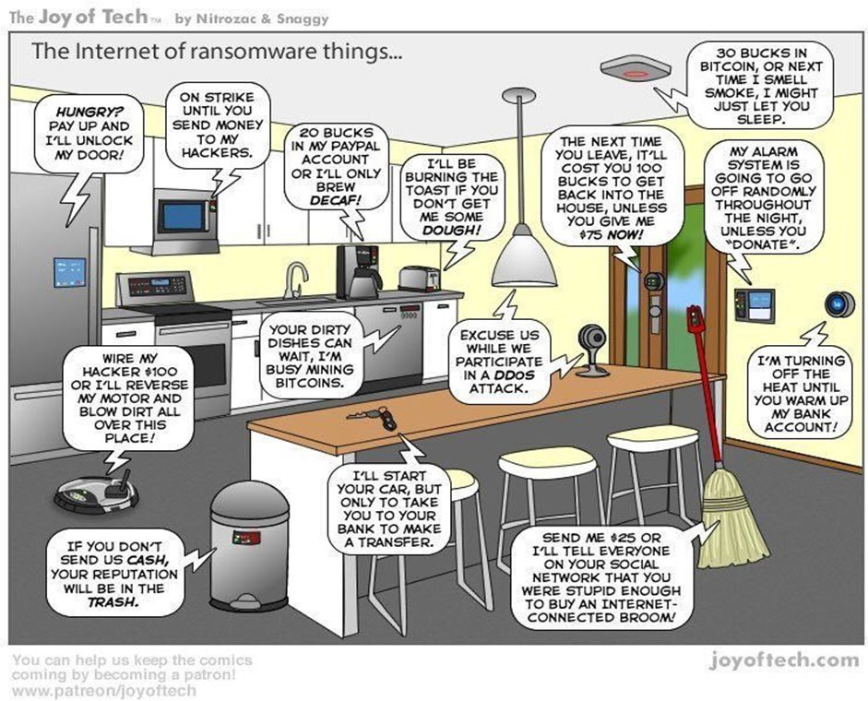
Ransomware Internet of Things
TLP:WHITE
Infects…Encrypts…Extorts

Slide 12
Operational Technology (OT) Vulnerabilities
TLP:WHITE
Building Automation Systems (BAS) BACNet Field Panels (BFP)
  HVAC Systems Control- elevators, lighting, emergency services, sensors, access control, etc.
Utility PLCs (programable logic controllers) and Human Machine Interface (HMI)
Camera Systems
Specialty Equipment (Vender Maintained)
Compromised OT network resulting in IT network ransomware or vice versa
Industrial Control Systems | Cybersecurity and Infrastructure Security Agency CISA

Slide 13
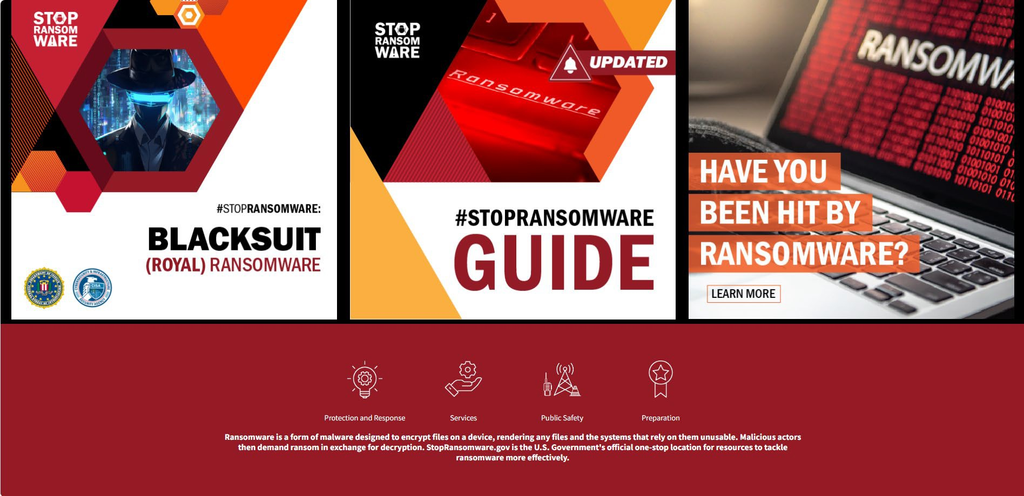
#Stop Ransomware - Resources
TLP:WHITE
Stop Ransomware | CISA

Slide 14
CyberAv3ngers
TLP:WHITE
Iranian Government’s Islamic Revolutionary Guard Corps (IRGC)-Affiliated Cyber Actor
Exploited PLCs in Multiple U.S. Critical Infrastructure Sectors
  Water/Wastewater, Health, Food, Energy, Manufacturing
  Water/Wastewater primary target with 60 percent of activity
Targeted Israeli-made Unitronics Vision Series PLCs/ Human-Machine-Interfaces (HMI)
  However, likely pivot to other venders
Most exploitations took advantage of “Default” passwords (1111) and direct
  exposure to the internet.
IRGC-Affiliated Cyber Actors Exploit PLCs in Multiple Sectors, Including U.S. Water and Wastewater Systems Facilities | CISA
14

Slide 15
Georgia Tech Attack Simulation
TLP:WHITE
The attack simulation shows how an attacker with access to the PLCs can close valves, display false information to the operator, and increase the amount of chlorine added to the water.
“We were able to simulate a hacker who had gained access to this part of the system and is holding it hostage by threatening to dump large amounts of chlorine into the water unless the operator pays a ransom,” Formby said. “In the right amount, chlorine disinfects the water and makes it safe to drink. But too much chlorine can create a bad reaction that would make the water unsafe.” https://www.youtube.com/watch?v=t4u3nJDXwes

Slide 16
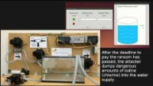
TLP:WHITE

Slide 17
Pro-Russian Hacktivist Targeting
TLP:WHITE
Threat actors can exploit exposed HMIs at WWS Sector utilities to view the contents of the HMI, make unauthorized changes, and potentially disrupt the facility’s water and/or wastewater treatment process.
Physical disruptions from attacker remotely manipulating HMIs.
Caused water pumps and blower equipment to exceed their normal operating parameters.
Maxed out set points, altered other settings (Ladder Diagram Logic), turned off alarm mechanisms, and changed administrative passwords to lock out the WWS operators.
Some victims experienced minor tank overflow events; however, most victims reverted to manual controls in the immediate aftermath and quickly restored operations.
Internet-Exposed HMIs Pose Cybersecurity Risks to Water and Wastewater Systems | CISA Defending OT Operations Against Ongoing Pro-Russian Threats

Slide 18
PRC Hackers: The Typhoons
TLP:WHITE
The U.S. Intelligence Community (IC) assesses that the People’s Republic of China(PRC) is “the most active and persistent cyber threat” to U.S. institutions. The Office of the National Cyber Director has highlighted China’s ambitions “to hold at risk U.S. and allied critical infrastructure, shape U.S. decision-making in a time of crisis, and use cyber capabilities to augment PRC geopolitical objectives.”
Observed behavior suggests that the threat actor goal to maintain access without being detected for as long as possible using Living off the Land techniques
Affected Sectors Include:
Communications
Construction
Maritime
Government
Education
Transportation
Information technology
Utility
CISA and Partners Release Advisory on PRC-sponsored Volt Typhoon Activity and Supplemental Living Off the Land Guidance | CISA Volt Typhoon: Hiding in Plain Sight - Critical Start
Volt Typhoon targets US critical infrastructure with living-off-the-land techniques | Microsoft Security Blog

Slide 19
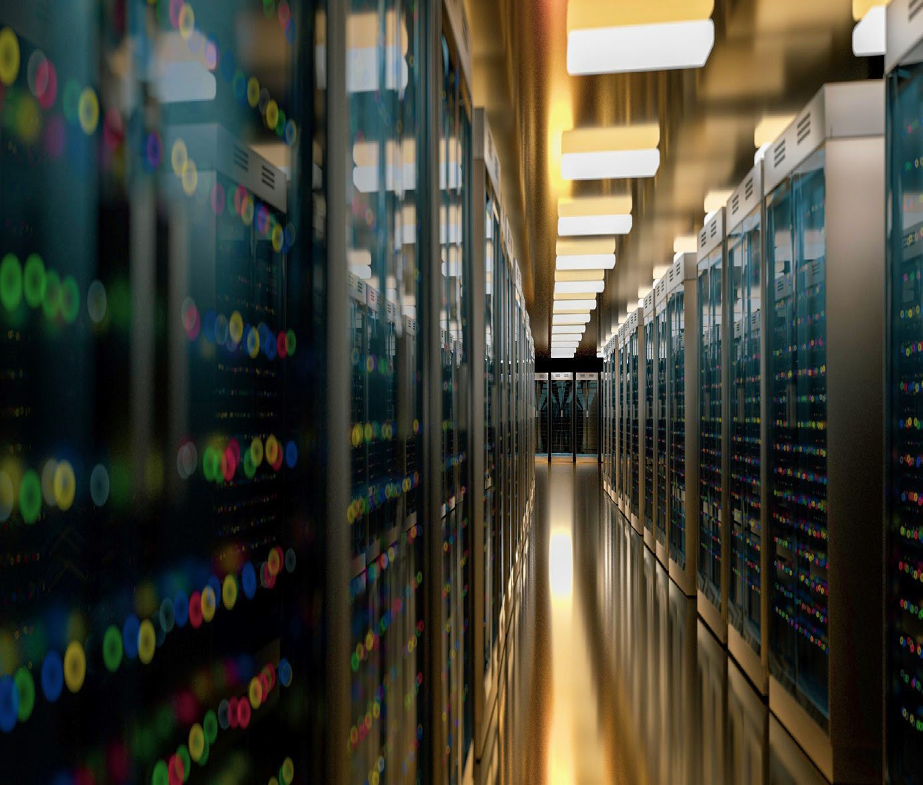
Living Off the Land
Sophisticated cyberattack technique that leverages legitimate tools already present within a victim’s system to execute and sustain an attack
  Bypasses traditional signature-based defenses (Behavioral Vs. Signature Analysis is key)
  Windows Management Instrumentation
  PowerShell
  Scheduled Tasks Actions
  C2- Home User Networks
  FTP, SMB, and SSH
  Log Deletion (Event 1102)
Living Off the Land (LOTL): The Invisible Cyber Threat Lurking in Your System (socradar.io)
19

Slide 20

Best Practice Detection
LOTL detection requires organizations undertake contextual analyses of multiple data/log sources to identify command executions, file interactions, privilege escalations, and other network activities that differ from normal administrative actions.
Establishing and maintaining an infrastructure that collects and organizes logs for defenders is essential for detecting LOTL techniques.

Slide 21
Logging Made Easy
CISA's Logging Made Easy (LME) is a no-cost log management solution for small to medium-sized organizations with limited resources that would otherwise have little to no functionality to detect attacks. LME offers centralized logging, proactive threat detection and enhanced security by allowing organizations to monitor their network, identify users, and actively analyze Sysmon data to quickly identify potential malicious activity. As a locally run application, CISA cannot access LME data, ensuring the privacy and security of organizations' information.
LME is dedicated to evolving with the cybersecurity needs of its community. Available to the public, LME serves organizations across private, public and non-profit sectors, especially those operating Windows-based, on-premises networks.
To get started with LME, download it directly from CISA’s GitHub page. For any questions, please contact CyberSharedServices@cisa.dhs.gov

Slide 22
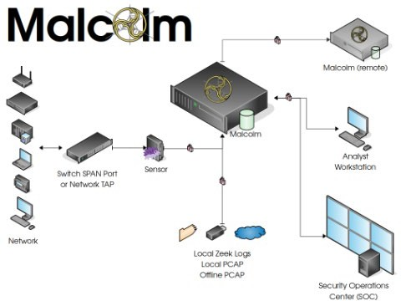
Malcolm
What is Malcom? A threat detection and network traffic analysis toolset that provides a centralized logging, monitoring and investigation platform.
Centralized network logging, monitoring, threat detection and network traffic analysis tools
Runs on Linux, MacOS, Windows 10 and above, and in cloud environments via Kubernetes
Does not require internet access at runtime, expanding the service’s usefulness to sandboxed OT environment applications
What are Malcolm’s Benefits? Malcolm’s network analysis toolkit offers multiple benefits, including threat detection, secure operation, and powerful analysis.
GitHub - cisagov/Malcolm: Malcolm is a powerful, easily deployable network traffic analysis tool suite for full packet capture artifacts (PCAP files), Zeek logs and Suricata alerts.
22
EA/SED/IOD
March 18, 2026

Slide 23
Insider Threats
Tower Gateway Basestations (TGBs) are used to collect data from smart meters installed at people's homes and relay the information to the water provider's main systems, where it is logged, monitored for incidents, and processed for billing.
Engineer fired for undisclosed reasons hacks TGB systems.
Disabled comms between TGBs and water facility- shutting off monitoring for incidents and billing
Changed passwords to offensive words
Six incidents in five cities across Maine, New Jersey and Pennsylvania
Water Utility could not collect readings remotely
Sent an employee to each customer residence
Engineer faced a max sentence of 90 years and $3 million fine
Fired Employee Hacks and Shuts Down Smart Water Readers in Five US Cities
EA/SED/IOD
23
March 18, 2026

Slide 24
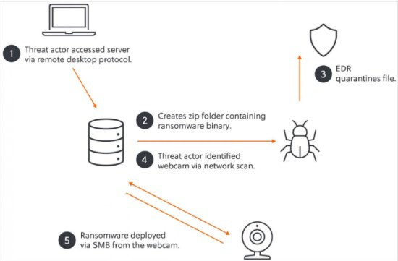
Camera Threats
The Akira ransomware gang used an unsecured webcam to launch encryption attacks on a victim's network, effectively circumventing Endpoint Detection and Response (EDR), which was blocking the encryptor in Windows.
Scanned network found a webcam and fingerprint scanner
Selected the webcam because it was vulnerable to remote shell access and unauthorized video feed viewing
Used webcam to encrypt the network effectively circumventing the EDR software on the network
Webcam was not being monitored, malicious traffic undetected
Patches were available for the webcam meaning this attack vector was avoidable
Monitor ALL network traffic
Internet of Things (IoT) devices should be isolated Regularly patch ALL network devices
Ransomware gang encrypted network from a webcam to bypass EDR

Slide 25
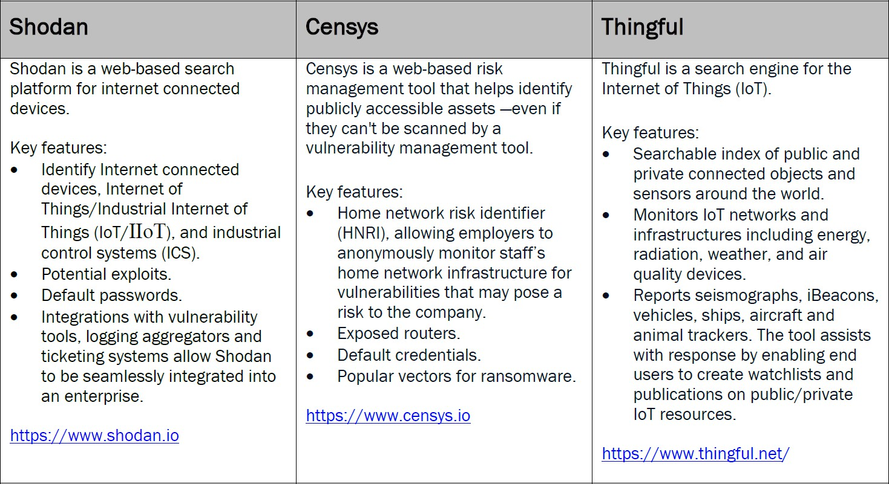
Stuff Off Search
TLP:WHITE
Get your Stuff Off Search - S.O.S. - and reduce Internet attack surfaces that are visible to anyone on web-based search platforms.
Web: Stuff Off Search | CISA

Slide 26
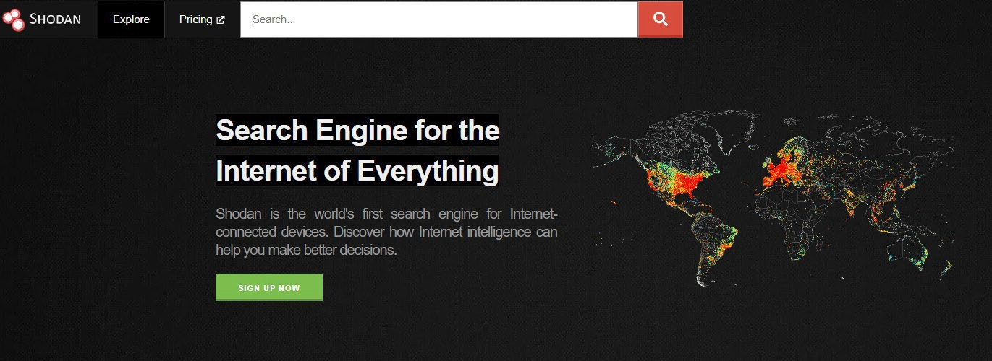
TLP:WHITE
Shodan (www.shodan.io) is a web-based search platform for Internet connected devices. This tool can be used not only to identify Internet connected computers and Internet of Things/Industrial Internet of Things (IoT/IIoT), but also Internet connected Industrial Control Systems (ICS) and platforms.

Slide 27
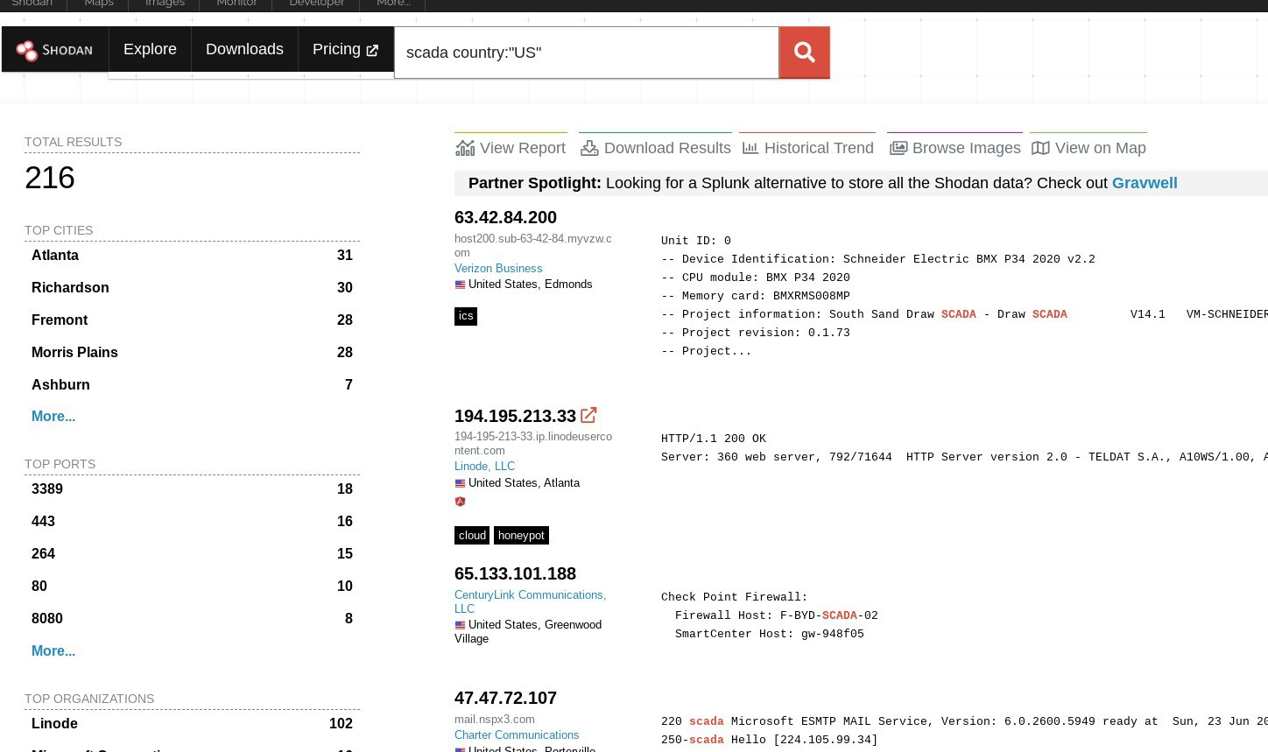
SCADA Search: US
TLP:WHITE

Slide 28
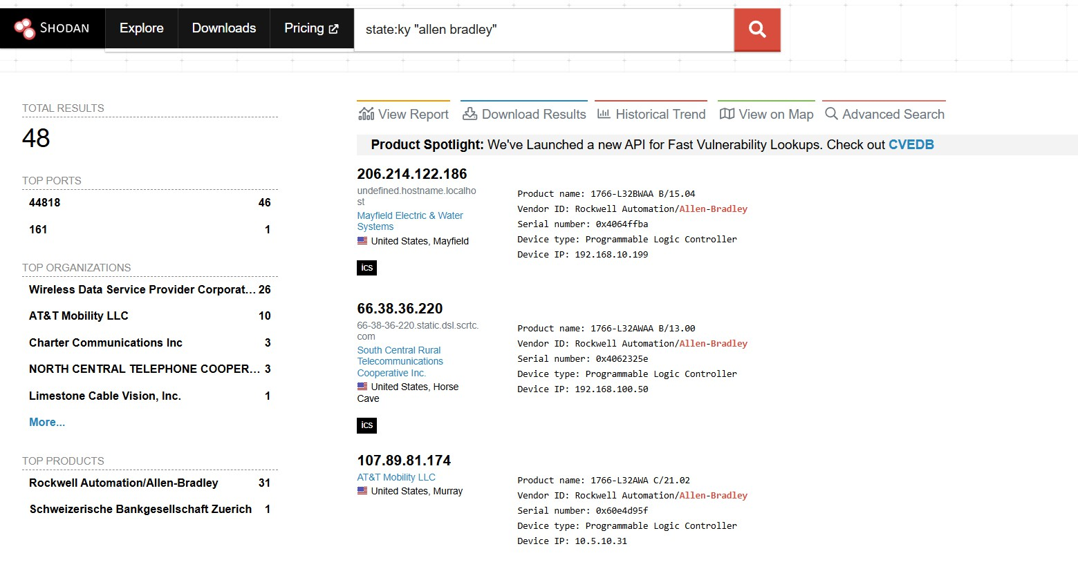
PLC Search: Kentucky
TLP:WHITE

Slide 29
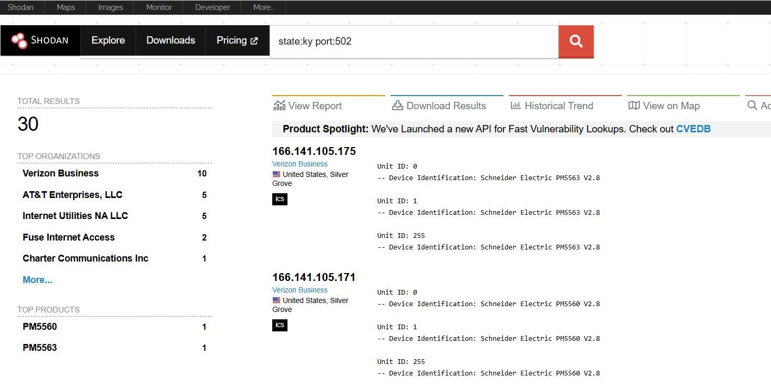
PLC Modbus Search
TLP:WHITE

Slide 30
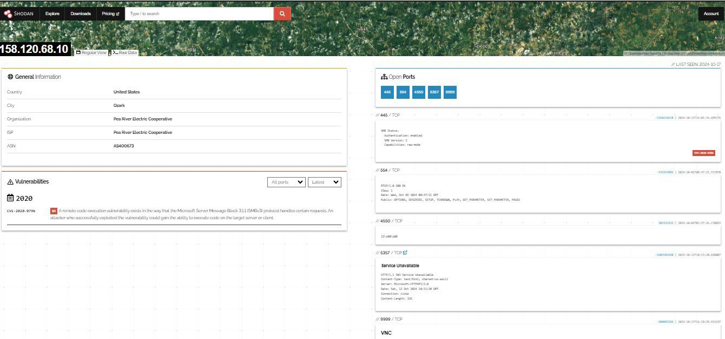
Open Vulnerabilities
TLP:WHITE

Slide 31
Censys Reporting
TLP:WHITE
In October 2024, Censys researchers discovered nearly 400 web-based HMIs for U.S. water facilities exposed online. These were identified via TLS certificate analysis and confirmed through screenshot extraction.
All systems used the same browser-based HMI/SCADA software and were found in one of three states:
  Authenticated (credentials required)
  Read-only (viewable without control)
  Unauthenticated (full access without credentials)
40 systems were fully unauthenticated and controllable by anyone with a browser.
Censys shared these findings with the EPA and the vendor in question for coordinated remediation. Within nine days, 24% of the systems had been secured, and a few weeks later, this rose to 58%. As of May 2025, fewer than 6% of systems remain online in a read-
only or unauthenticated state.
EA/SED/IOD
31
Turning Off the (Information) Flow: Working With the EPA to Secure Hundreds of ^{M}Eªx^{rc}p^{h 1}o^{8,}s²e⁰²d⁶ Water
HMIs - Censys

Slide 32
Commercially Available “Pen-Testing” tools
TLP:WHITE

Slide 33
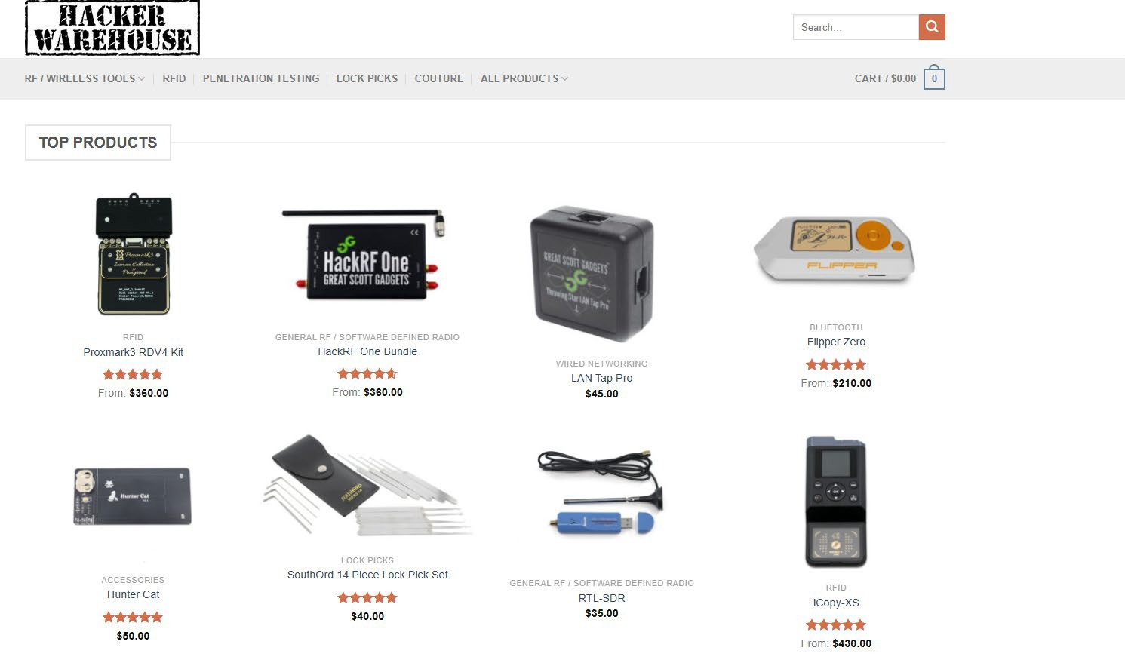
TLP:WHITE

Slide 34
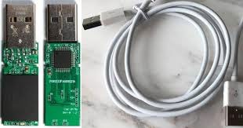
USB Ninja / O.MG Cable
TLP:WHITE
TSA warned that USB ports, commonly used to charge cellphones, laptops and other portable devices, can present serious risks, making your sensitive information more vulnerable to hackers and scammers. Passengers are urged to be aware of the risks involved when using the airport's public USB charging ports.

Slide 35
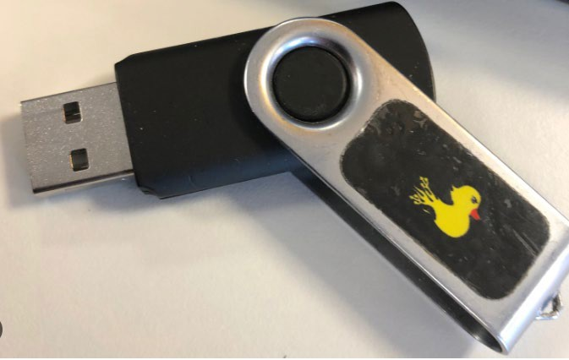
Rubber Ducky
TLP:WHITE
To a human it's a flash drive. To a computer it's a keyboard, typing at superhuman speeds. Pull off the most creative and complex hotplug attacks

Slide 36


WiFi Pineapple
TLP:WHITE

Slide 37
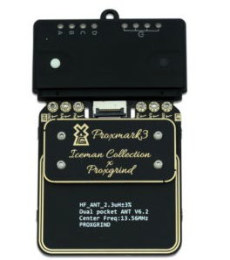
Proxmark
TLP:WHITE
The Proxmark is an RFID swiss-army tool, allowing for both high and low level interactions with the vast majority of RFID tags and systems world-wide

Slide 38
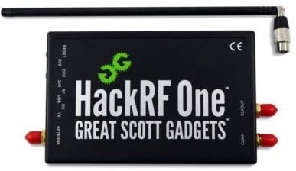
HackRF One
TLP:WHITE
HackRF One from Great Scott Gadgets is a Software Defined Radio
peripheral capable of transmission or reception of radio signals from 1 MHz to 6 GHz.

Slide 39
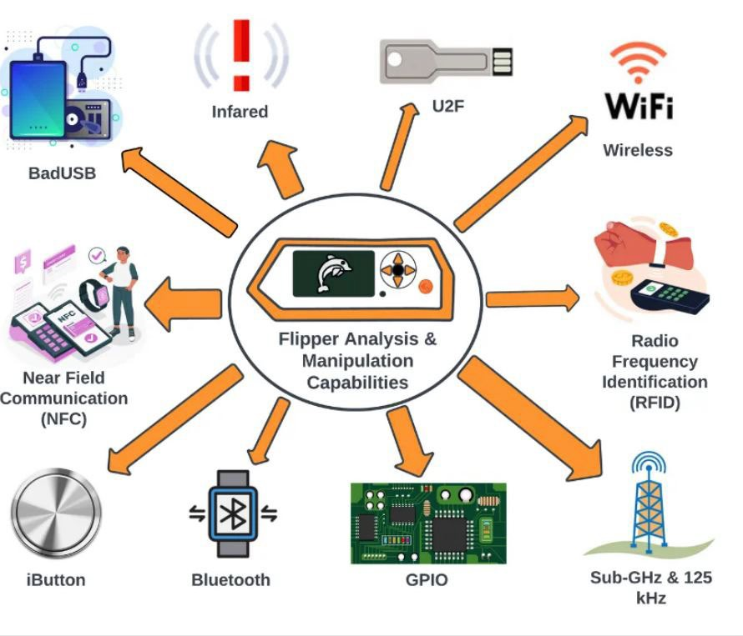

The Flipper Zero
TLP:WHITE
39

Slide 40
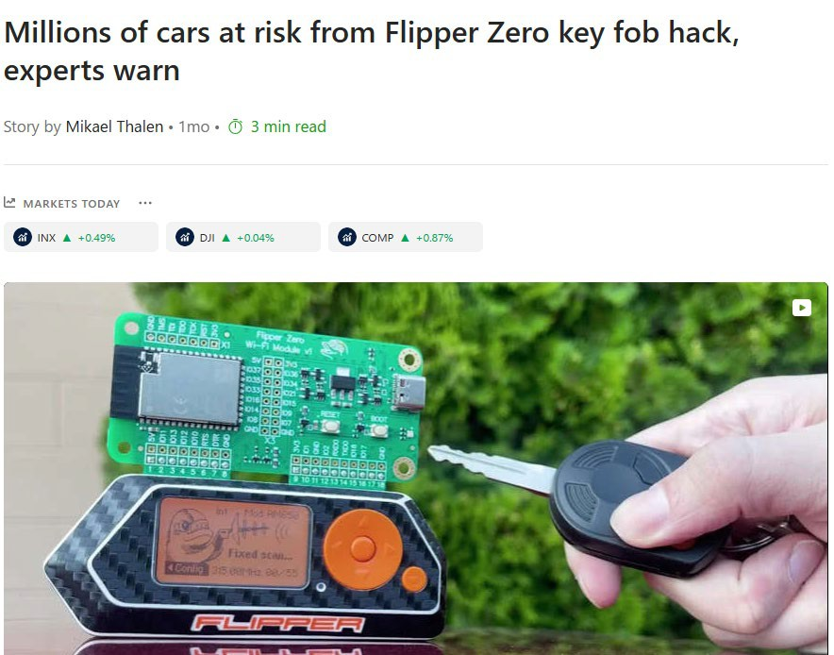
Recent Reporting
TLP:WHITE
From MSN August 205 - It bypasses a security mechanism known as rolling codes, designed to prevent thieves from reusing captured key fob signals to unlock a car. Each time the key fob is pressed, an internal algorithm generates a new, one-time-use code, leading the vehicle to unlock only if the code is confirmed to be valid.
But the new hack sidesteps these protections by exploiting the rolling code algorithm to calculate valid key fob commands based on a single intercepted signal.
40

Slide 41
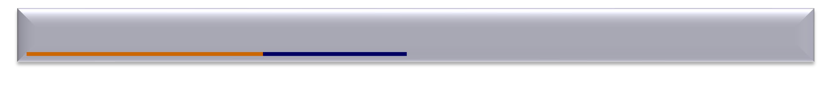
Water-Wastewater Sector
TLP:WHITE
Water and Wastewater Cybersecurity | CISA
  Specific Alerts and Advisories for Water/Wastewater Sector
  EPA Resources
  Incident Response Guide
  Funding Resources
  CISA Live Events on Water/Wastewater
https://homelandsecurity.ky.gov/Pages/Grants.aspx

Slide 42
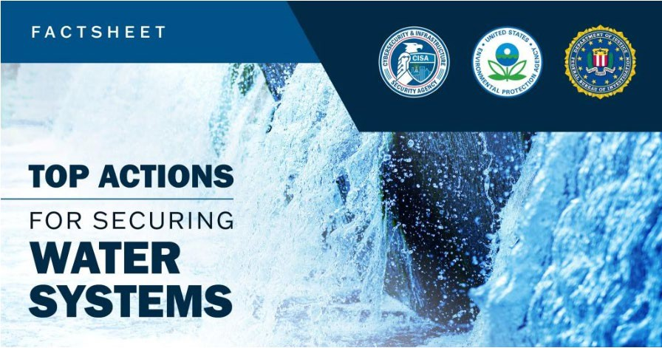
Water Systems Cybersecurity
TLP:WHITE
Water and Wastewater Cybersecurity | CISA

Slide 43
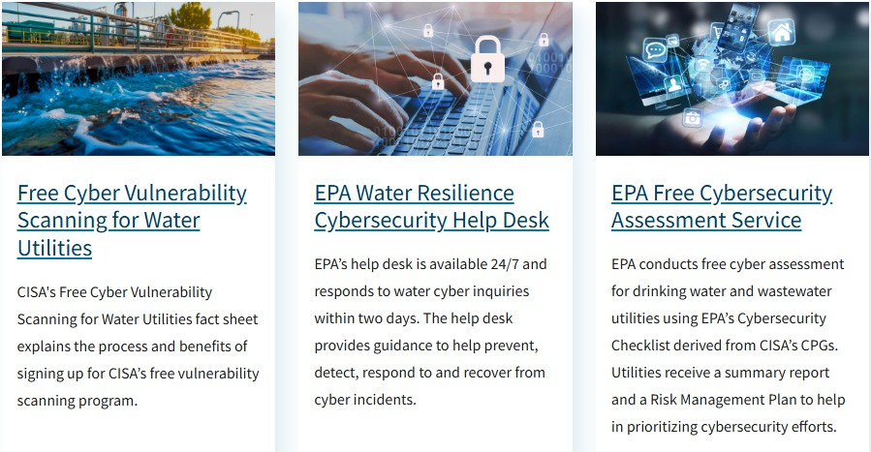
Water Systems Cybersecurity
TLP:WHITE
Water and Wastewater Cybersecurity | CISA

Slide 44
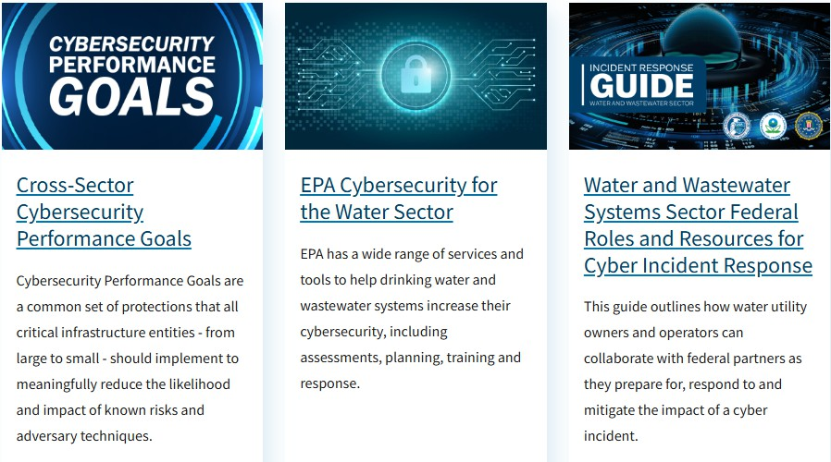
Water Systems Cybersecurity
TLP:WHITE
Water and Wastewater Cybersecurity | CISA

Slide 45
CISA ICS No-Cost Virtual Training
TLP:WHITE
Operational Security (OPSEC) for Control Systems (100W) - 1 hour
Differences in Deployments of ICS (210W-1) – 1.5 hours
Influence of Common IT Components on ICS (210W-2) – 1.5 hours
Common ICS Components (210W-3) – 1.5 hours
Cybersecurity within IT & ICS Domains (210W-4) – 1.5 hours
Cybersecurity Risk (210W-5) – 1.5 hours
Current Trends (Threat) (210W-6) – 1.5 hours
Current Trends (Vulnerabilities) (210W-7) – 1.5 hours
Determining the Impacts of a Cybersecurity Incident (210W-8) – 1.5 hours
Attack Methodologies in IT & ICS (210W-9) – 1.5 hours
Mapping IT Defense-in-Depth Security Solutions to ICS - Part 1 (210W-10) – 1.5 hours
Mapping IT Defense-in-Depth Security Solutions to ICS - Part 2 (210W-11) – 1.5 hours
Industrial Control Systems Cybersecurity Landscape for Managers (FRE2115) - 1 hour
https://www.cisa.gov/ics-training-available-through-cisa

Slide 46
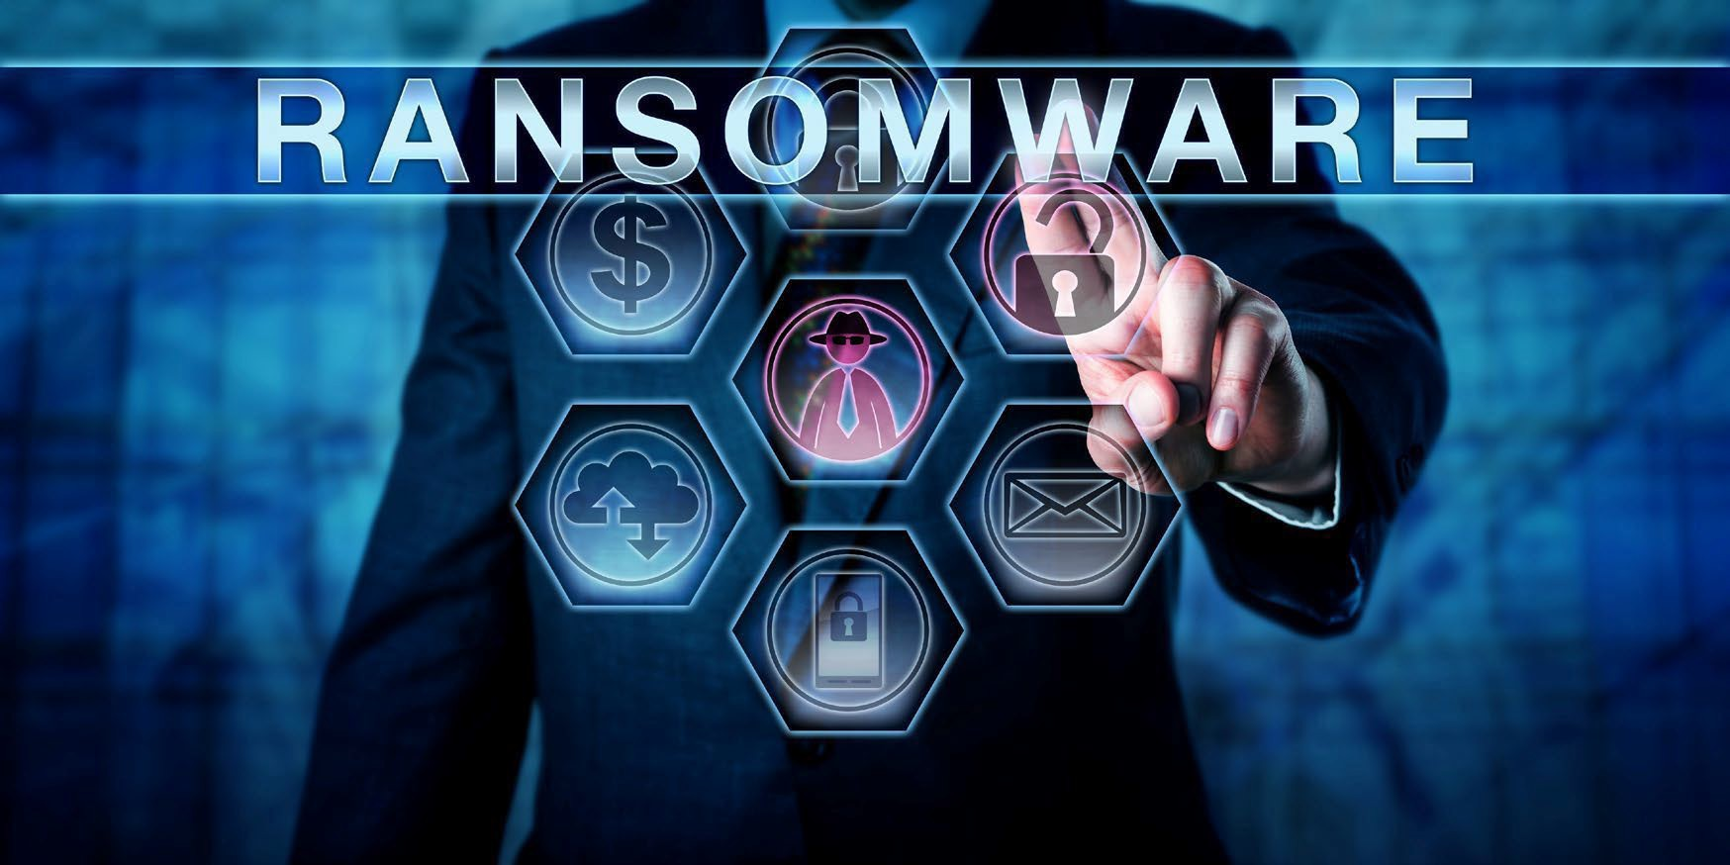
Ransomware Vulnerability Warning
TLP:WHITE
Ransomware Vulnerability Warning Pilot (RVWP)
A new effort to warn critical infrastructure entities that their systems have exposed vulnerabilities that may be exploited by ransomware threat actors.
Leverages existing authorities and technology to proactively identify information systems that contain security vulnerabilities commonly associated with ransomware attacks.
  CISA’s Cyber Hygiene Vulnerability Scanning
  Known threat vectors
  Administrative Subpoena Authority
  Homeland Security Act of 2002

Slide 47
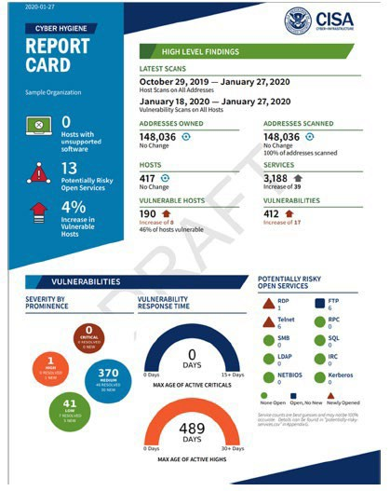
Vulnerability Scanning Report
TLP:WHITE
High Level Findings
Latest Scans
Addresses Owned
Addresses Scanned
Hosts
Services
Vulnerable Hosts
Vulnerabilities
Vulnerabilities
Severity by Prominence
Vulnerability Response Time
Potentially Risky Open Services
Oct

Slide 48
Request Vulnerability Scanning
TLP:WHITE
Simply send an email to requesting enrollment to…
email address: vulnerability@cisa.dhs.gov
Subject Line: Requesting Enrollment in CyHy Vulnerability Scanning and/ or Web Application Scanning (WAS)

Slide 49
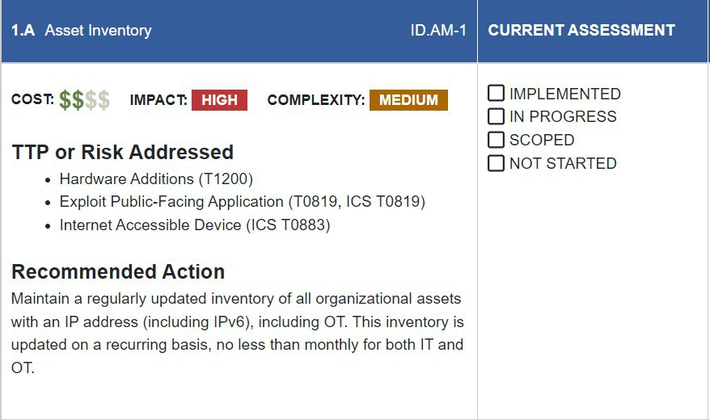
Cyber Performance Goals (CPG)
TLP:WHITE
A common baseline of cybersecurity practices that all critical infrastructure entities should implement to meaningfully reduce the likelihood and impact of known risks and adversary techniques.
IT and operational technology (OT) cybersecurity practices that meaningfully reduce the likelihood and impact of known risks and adversary techniques
Informed by real-world threats and adversary tactics, techniques, and procedures (TTPs)
Aids in identifying areas for potential future investment

Slide 50
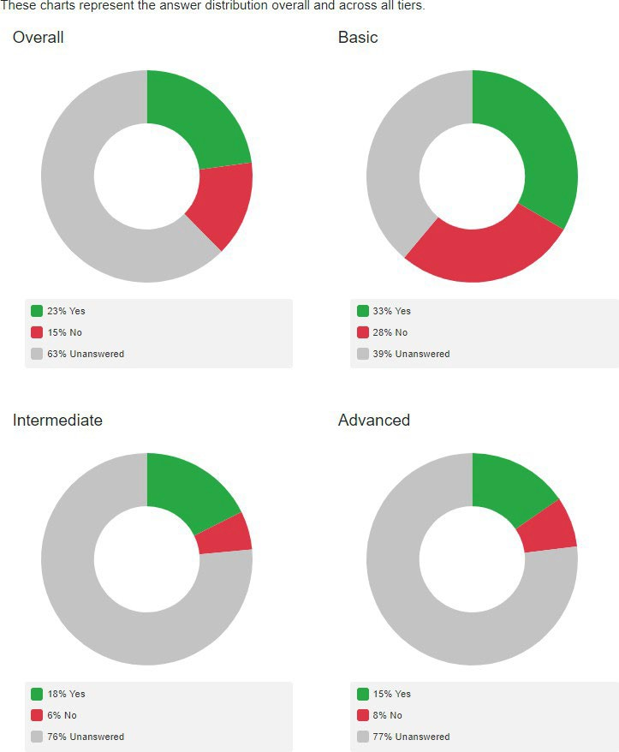
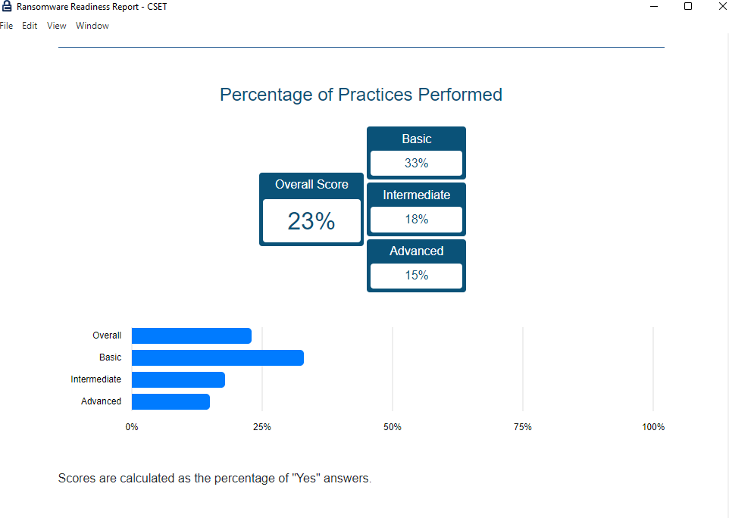
Ransomware Readiness
TLP:WHITE
To understand your cybersecurity posture and assess how well your
organization is equipped to defend and recover from a ransomware
incident, take the Ransomware Readiness Assessment (RRA).

Slide 51
Report an Incident
TLP:WHITE
CISA: cisa.gov/report ; report@cisa.gov, (888) 282-0870
FBI/ Internet Crime Complaint Center (IC3): ic3.gov

Slide 52
Actions To Take Now
TLP:WHITE
Reduce exposure to public-facing internet
Conduct regular cybersecurity assessments
Change default passwords immediately
Conduct an inventory of OT/IT assets
Develop and exercise cybersecurity incident response and recovery plans
Backup OT/IT systems
Reduce exposure to vulnerabilities
Conduct cybersecurity awareness training
FREE HELP to IMPLEMENT CHANGES:
  CISA Regions | CISA
  Email CISA Cyber Hygiene Services: vulnerability@cisa.dhs.gov with subject line: Requesting Cyber Hygiene Services
  Contact EPA through its Cybersecurity Technical Assistance Form
EA/SED/IOD
March 18, 2026
Top Cyber Actions for Securing Water Systems | CISA

Slide 53

Colin Glover Cybersecurity State Coordinator
colin.glover@cisa.dhs.gov
Ryan Lewis Cybersecurity Advisor ryan.lewis@cisa.dhs.gov 202-894-4869
Presenter’s Name
March 18, 2026

