Slide 1



Customer Relations:
Ratepayer Rights and Responsibilities
Utility Obligations
the PSC Complaint Process
Kentucky Public Service Commission
Water Training Seminar
Any views expressed in this presentation are those of the presenter and do not reflect official positions of the PSC

Slide 2
THE Customer Bill of Rights
Purpose:
  To educate customers of their rights and of the utility’s basic service obligations under Kentucky law and Commission’s Administrative Regulations.

Slide 3
Customer Bill of Rights
Residential customers in Kentucky are guaranteed rights subject to Kentucky Revised Statutes and the provisions of the Kentucky Public Service Commission Administrative Regulations.
Customer Rights ARE LISTED in 807 KAR 5:006 Sections 14 AND 16. (SEE HAND-OUT)

Slide 4
Customer Bill of Rights
RIGHT TO SERVICE (IF YOU DON’T OWE THE UTILITY MONEY)
right to be present at any routine utility inspection of your PREMISES
separate, distinct disconnect notice
right to dispute the termination of your service
right to negotiate a partial payment plan
right to maintain your utility service for up to thirty (30) days upon presentation of a medical certificate issued by a health official.
You have the right to prompt (within 24 hours OR CLOSE OF NEXT BUSINESS DAY) restoration of your service
right to contact the Public Service Commission regarding any dispute that you have been unable to resolve with your utility.

Slide 5

TARIFFS

Slide 6
TARIFFS – WHAT IS A TARIFF?
Schedule(s) showing all LEGALLY BINDING rates and conditions of service established AND ENFORCED by a utility and APPROVED BY THE PSC

Slide 7
TARIFFS – PURPOSE
Ensures PSC review of a utility’s rates, rules, conditions of service, and any other policies.
Prevents discrimination by mandating uniform treatment to similarly situated customers.

Slide 8
TARIFFS – EFFECT
Utility’s tariff has the status of law.
Utility may file new tariffs to change its rates, but the utility lacks the legal authority to deviate from its filed tariff without PSC approval.

Slide 9
TARIFFS – SUMMARY
If a fee is not in your tariff, you cannot charge it.
If a requirement is not in your tariff, you cannot impose it.
If a rule is not in your tariff, you cannot enforce it.
If it is in your tariff, you must do it.

Slide 10
TARIFFS – REMINDERS
Every Commissioner and Employee should review the Tariff at a minimum of each and every year.
Check with all staff to make sure that every rate, rule, policy, and condition of service is included in your tariff.

Slide 11

DEPOSIT
POLICY

Slide 12
DEPOSITS – TARIFF REQUIREMENTS
Method of deposit -- Flat or Calculated
Criteria for when a deposit will be required or waived
Deposit amount for each customer class if it is flat
Policy on refunding the deposit; when and what conditions
Policy on interest; accrued and refunded or credit to bill

Slide 13
DEPOSITS – MAXIMUM AMOUNTS
Monthly 2/12
Bimonthly 3/12
Quarterly 4/12
Of the Customer’s Actual or Estimated Average Annual Bill

Slide 14

DISCONNECTION/
TERMINATION OF SERVICE

Slide 15
CUSTOMER REQUESTED TERMINATION OF SERVICE
customer desiring termination of service or address CHANGE MUST GIVE 3 DAYS NOTICE, SUBJECT TO OTHER contractual obligations or tariff provisions.
The customer is not responsible for charges for service beyond the three-day notice period if the customer provides reasonable access to the meter during the notice period.

Slide 16
Termination of Utility Service
Utility service may be terminated under some conditions.
Non-Payment of Bill
  Disconnect cannot occur for water or sewer service before 20 days after the original mailing date of the unpaid bill.
  The disconnect notice 5 days prior to disconnection of water or sewer service.
  Payment plans may be negotiated to keep service from termination.

Slide 17
Termination of Utility Service
Violation of Rules
  Disconnection is permitted only after written notice of problem and after a grace period to correct situation.
Dangerous Situation
  Immediate disconnection is permitted with a follow-up of a written explanation. Action is required by customer before reconnection.

Slide 18

LEAK
ADJUSTMENT
POLICY

Slide 19
LEAK ADJUSTMENTS
A utility may choose to offer a leak adjustment.
Leak Adjustments are not required by the PSC.
Absolutely no leak adjustment may be made without a written policy in the tariff.
Everyone must be treated equally in accordance to the tariffed policy

Slide 20
LEAK ADJUSTMENTS
For Line Loss considerations, the amount of gallons flowing through the meter should never be adjusted.
Instead, adjustments should be done on the monetary side.
The adjustment must cover the cost of the water.

Slide 21
LEAK ADJUSTMENTS
SUGGESTED INCLUSIONS
The customer should make the request in writing.
The bill should be the average monthly bill plus the additional water that flowed thru the meter charged at a reduced rate.
The number of adjustments over a period of time should be limited.

Slide 22

MONITORING
CUSTOMER
USAGE

Slide 23
MONITORING USAGE
807 KAR 5:006 Sec 11 (3)
Each utility must include procedure in its tariff for monitoring customers usage at least annually.
The procedures must be designed to draw the utility’s attention to unusual deviations in a customer’s usage and provide for reasonable means by which the utility can determine the reasons for the unusual deviation.

Slide 24
MONITORING USAGE
807 KAR 5:006 Sec 11 (3)
If the usage is unduly high and cannot be explained, the utility must test the meter to determine whether the meter shows an average error greater than two (2) percent fast or slow

Slide 25
BILL
ADJUSTMENTS

Slide 26
807 KAR 5:006 General Rules Section 11
Bill Adjustment for Water Utilities
ADDRESSES THE ISSUE OF METERS THAT ARE FOUND TO BE RUNNING EITHER FAST OR SLOW AND SETS THE RULES FOR DETERMINING THE SIZE OF THE ERROR
ADDRESSES SITUATIONS IN WHICH A METER ERROR HAS LED TO OVERBILLING OR UNDERCOLLECTION – INCLUDING TERMS FOR REPAYMENT OR REFUND
SETS THE RULES FOR FURTHER TESTING OF METERS BY THE PSC

Slide 27
CONSUMER
RELATIONS

Slide 28
Customer sERVICE
Customer Service Representatives are the first contact (and sometimes the only contact) the customer has with the utility.
HOW YOU DEAL WITH Customers SHAPES THE PUBLIC IMAGE OF YOUR UTILITY.
Service Representatives SHOULD always:
1. Listen attentively.
2. Maintain a positive attitude.
3. Speak clearly.
4. Avoid technical terms or fancy words.
5. Make every customer feel important.

Slide 29
Customer sERVICE
Utility representatives should receive the complaint with care and courtesy, research the complaint with diligence, and resolve the complaint with efficient customer service skills.
Benefits of a complaint to the utility are:
1. The opportunity to gain the customer’s trust and loyalty.
2. The opportunity to turn an angry customer into a loyal customer.

Slide 30
WHEN A CUSTOMER CALLS
Issues to address upon receipt of a customer’s call:
1. Who is calling?
2. Why are they calling?
3. What do they expect the utility to do?
4. When will customer be contacted?
High bill complaints require more research, documentation, and explanation to the customer and the PSC. The utility personnel should provide the necessary information to the customer so the customer (as well as the utility personnel) can understand and calculate the bill.

Slide 31
WHAT TO TELL A CUSTOMER
Customer should be provided with a billing and payment history that is very simple. (See example.) If the customer is of the opinion the high bill is due to a meter change, customer should be provided with the meter history.
If the utility representative has provided the customer with all the appropriate information and the customer is still not satisfied, give them the PSC’s toll-free number, 1-800-772-4636. Call a Consumer Services staff member or me and give a “heads up” on the possible complaint. This provides all of our staff the opportunity to ask the correct questions.

Slide 32
IF A CUSTOMER CONTACTS THE PSC
If the customer does contact the PSC, the utility will already have all the necessary information available for the PSC Staff. On high bill complaints, Consumer Services will request the billing, payment, and meter history along with information about any premise visits that have been made to the customer’s location.

Slide 33
SAMPLE BILLING AND PAYMENT HISTORY
John Doe
123 Smith Street
Elizabethtown, KY 42701
Meter #JA #02468
Date Service Established: 01-05-06
Date | Beginning Meter Reading | Ending Meter Reading | Actual or Estimate | Total Gallons Billed | Total $ Amount Billed | Late Penalty Charge | Payments Received | Balance
Jan --
Feb --
Mar --
April --
May --
June --
July --
Aug --
Sep --
Oct --
Nov --
Dec --
Totals

Slide 34
PSC CONSUMER SERVICES
PSC COMPLAINT PROCESS

Slide 35
Consumer Services
Becky Bingham
Branch Manager
Stacey Varney
Complaint Investigator
Amy Gray
Complaint Investigator

Slide 36
Consumer Services
Investigators routinely answer more than 1,500 telephone calls each month. Most callers are requesting information regarding regulations, tariffs, and utility company practices.
Refunds, savings, and credits to consumers ARE tracked. In 2021, CONSUMER SERVICES helped consumers receive $92,213.04.

Slide 37
Complaint Activity
Reports are created in-house on a monthly basis. If you are interested in monthly complaint activity, you can contact Consumer Services.
Utilities can view quarterly reports related to complaint activity by visiting the following web site: http://psc.ky.gov/Home/Consumer_Intra

Slide 38
Water Utility Complaints
                2025
Investor-owned Utilities: 53
Water Districts: 156
Water Associations: 23
Top reasons:
Billing
Service quality/repairs
Disconnection
Rates/Policies

Slide 39
Water Utility Complaints
2025
Water Districts:
Billing
Service quality/repair
Disconnection
Rates/Policies
Refusal to provide service
Line extension/upgrade charge
Safety
Water Associations:
Billing
Disconnection
Rates/Policies
Service quality/repair
Line Extension/Upgrade Charge

Slide 40
TOP 5 COMPLAINT REASONS
Billing
Service Quality/Outage
Disconnection
Rates/Policies
Refusal to provide service

Slide 41
TOOLS
Customer’s Bill of Rights
Utilities’ Filed Tariff
PSC Rules and Regulations
Kentucky State Statutes
Past Commission Decisions

Slide 42
Informal Complaints
Customer first talks to the utility and attempts to resolve the dispute.
If unresolved, the utility advises the customer of the opportunity to contact the PSC for review of the dispute.
Customer may contact the PSC by telephone, fax, e-mail, letter, or in person. Use of the toll-free number or e-mail allows the complaint to be handled with the greatest speed and efficiency. Most complaints are handled over the telephone.
Commission staff acts as a mediator, using information from the customer, the utility, tariffs, laws, Orders, etc. when attempting to resolve the dispute.

Slide 43
COMPLAINT PROCESS
Complaint received by phone,
fax, mail, e-mail, or walk-in
Investigator reviews
utility’s tariff,
applicable regulations,
and state statutes
Investigator enters
complaint into CIS system
and identifies problem
Investigator forwards complaint
to utility and requests account
information and documentation
Investigator confirms utility’s
response with customer. If customer
is not satisfied, we inform him
that he can file a formal complaint
Utility contacts
Complainant, resolves complaint, and sends response to PSC

Slide 44
Formal Complaints
Customers have the right to file a formal complaint. This does not necessarily mean that the complaint was not resolved at the informal process. It may mean that the consumer refused to accept the mediation results.

Slide 45
Formal Complaints
Customer request for a formal investigation of a complaint must be made in writing. A business filing a formal complaint MUST BE REPRESENTED BY AN ATTORNEY.
The complaint is assigned a case number and made part of the Commission’s docket of cases.
THE Commission STAFF REVIEWS THE COMPLAINT TO DETERMINE WHETHER IT STATES A PRIMA FACIE CASE (WHETHER THERE IS ENOUGH EVIDENCE TO ALLOW THE COMPLAINT TO GO FORWARD)

Slide 46
Formal Complaints
IF THE COMPLAINT DOES NOT STATE A PRIMA FACIE CASE, THE COMPLAINING PARTY IS GIVEN AN OPPORTUNITY TO PROVIDE ADDITIONAL EVIDENCE. IF NO ADDITIONAL EVIDENCE IS PROVIDED, OR IF THE ADDITIONAL EVIDENCE IS INSUFFICIENT TO MAKE A PRIMA FACIE CASE, THE COMPLAINT IS DISMISSED.
IF A PRIMA FACIE CASE IS MADE BY THE COMPLAINTANT, THE Commission issues an Order to the utility to satisfy the complainant’s request or to file an answer to the complaint.

Slide 47
Formal Complaints
Utility and customer may negotiate a settlement to resolve the dispute.
Settlement Proposal must be submitted to the Commission for review and approval.

Slide 48
Formal Complaints
Without a Commission-approved Settlement, the commission holds a hearing at which the utility and complainant present their positions.
Commission issues an Order with its decision on the case.

Slide 49
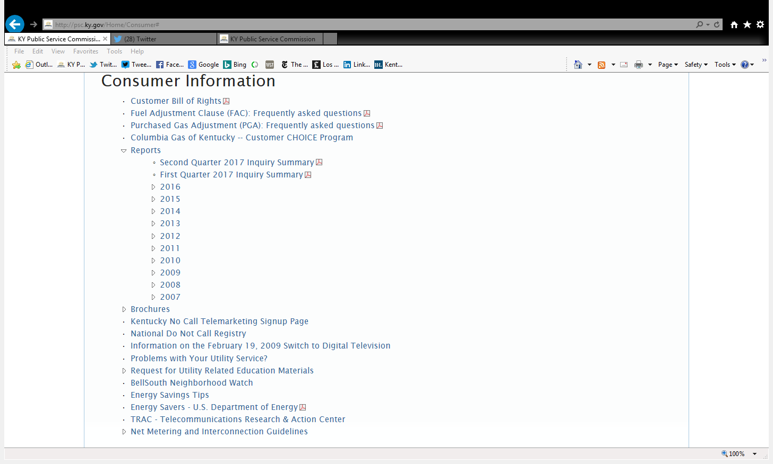

Slide 50
FINAL POINTS
The best advice to take from these seminars is to always call the PSC when you have questions.

Slide 51
CONSUMER SERVICES
1-800-PSC-INFO
(1-800-772-4636)
211 Sower Boulevard
Frankfort, KY 40601
http://psc.ky.gov
psc.consumer.inquiries@ky.gov
psc.info@ky.gov
Reports: psc.ky.gov/Home/Consumer_Intra

