Slide 1


Accounting Controls and Internal Auditing
Any views expressed in this presentation are those of the presenter and do not reflect official positions of the PSC

Slide 2
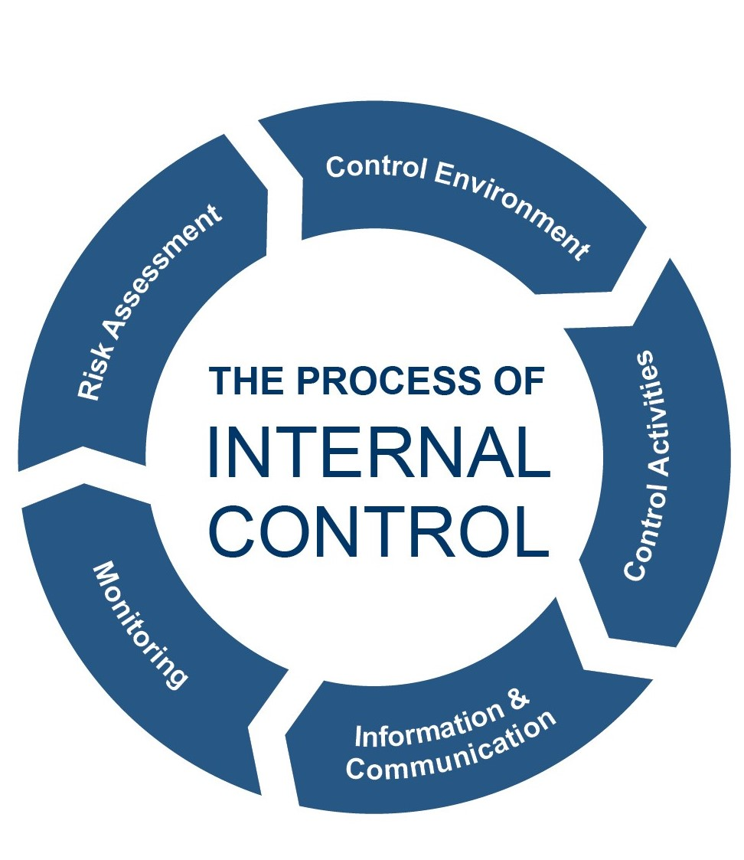
Today’s Agenda
Common procedures in the proper management of internal controls applicable to small water districts and associations
Personnel issues and limitations to internal controls
KRS 74.050 and the duties of the treasurer of a water district with respect to the statute

Slide 3

How did this happen? Real Stories in Kentucky!
“An accountant with six years of employment embezzled over $500,000”. Sentenced to 35 months in prison and ordered to pay restitution.
An employee embezzled $10,000 and was sentenced to three years probation.
An employee embezzled over $900,000 was sentenced to four years in prison.

Slide 4

Internal Controls Definition
A process designed to provide reasonable assurance about the achievement of an entity’s:
1) objectives with regard to the reliability of financial reporting,
2) effectiveness and efficiency of operations, and
3) compliance with applicable laws and regulations.

Slide 5

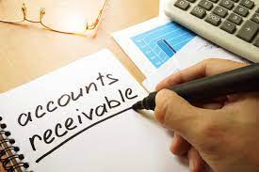


Internal Controls are:
Procedures adopted to:
  Safeguard assets
  Check the accuracy and reliability of accounting data
  Promote operational efficiency
  Encourage adherence to managerial policies

Slide 6
Association of Certified Fraud Examiners
Occupational Fraud 2024: Report to the Nations
Median duration of a fraud scheme: 12 Months
Asset misappropriation represents 89% of cases with a median loss of $120,000 or less
Highest median losses from check and payment tampering. Second highest from billing.
Tips are by far the most common initial detection method (43% reported by tips; 52% of tips from employees)
2024-report-to-the-nations.pdf

Slide 7
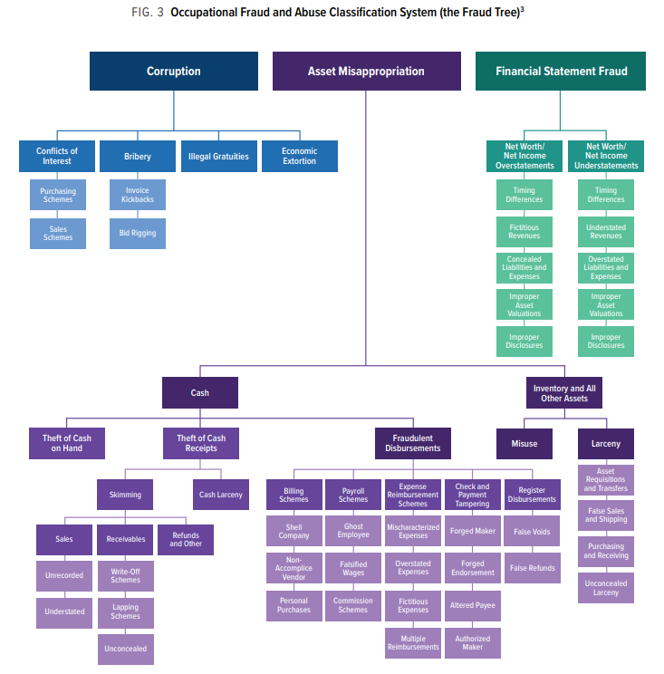
Types of Business Fraud

Slide 8
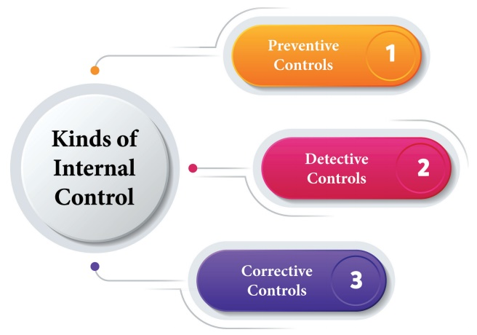
INTERNAL CONTROL examples
Training
Firewalls
Computer backups
Internal audits
Reviews
Reconciliations
Physical inventories
Software modifications
New policies
Disciplinary action

Slide 9

5 Keys to Internal Control Standards
1. Establish a Control Environment
  Promote ethical standards
  Establish accountability policies
  Establish a chain of command
  Emphasis on compliance
  Hold individuals accountable for their actions

Slide 10
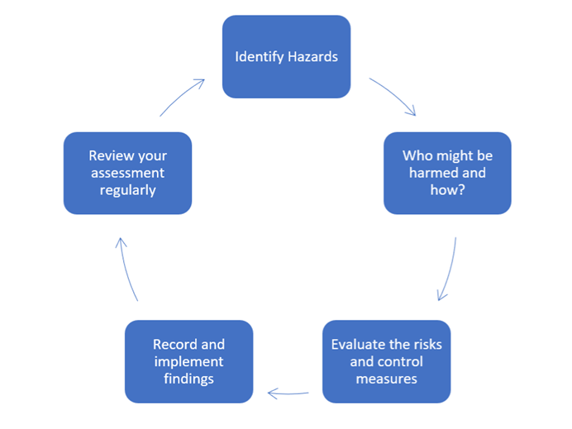
5 Keys to Internal Control Standards
2. Conduct Periodic Risk Assessments
  Periodically identify risks to operations and performance
  Brainstorm with staff to determine risks and rank them
  Discuss controls or other actions needed to eliminate or reduce the risks
  Develop corrective
  actions

Slide 11
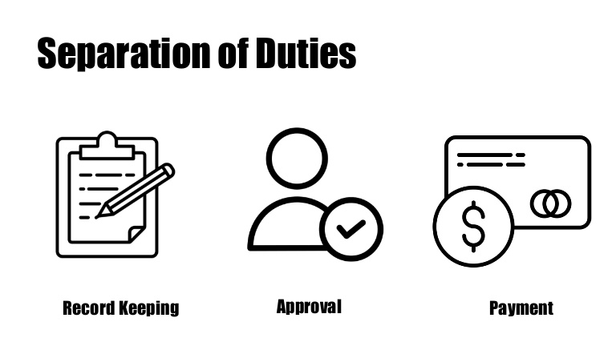

5 Keys to Internal Control Standards
3. Implement Control Activities
  Establish responsibility through organizational structure, and assign each task to only one person
  Establish recordkeeping
    Document all expenditures
  Create policies and procedures
    Written instructions with directives to follow them. Review annually.
  Implement segregation of duties
    Do not make any single employee responsible for all parts of the process
    Compensating controls, such as secondary signoffs can be utilized when separation is not possible

Slide 12

5 Keys to Internal Control Standards
4. Information and Communication Systems
  Relevant and reliable information throughout the organization to track operations and compliance
  Establish separate lines of communication both externally and internally such as fraud and ethics hotlines for confidential information.
  Inform employees how reports of unethical behavior are handled
  and how the chain of
  command operates

Slide 13
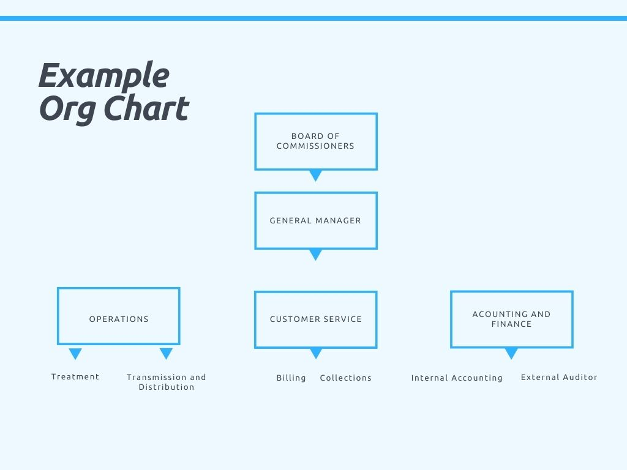

Slide 14
5 Keys to Internal Control Standards
5. Monitoring
  Routine reviews of actual performance compared to goals and budgets (work with external auditor)
  Management reviews to determine whether system of controls is working as intended
  Track corrective actions and ensure they are being implemented and working as intended.
  Watch for signs of control problems and correct accordingly

Slide 15
Duties of the Board - KRS 74.070
The commission shall be a body corporate for all purposes, and may make contracts for the water district with municipalities and other persons.
All corporate powers of the water district shall be exercised by, or under the authority of, its commission. The business and affairs of the water district shall be managed under the direction and oversight of its commission.
The commission may prosecute and defend suits, hire the chief executive officer and do all acts necessary to carry on the work of the water district.
The commission may adopt bylaws not inconsistent with the provisions of this chapter.
The commission shall comply with the provisions of KRS 65A.010 to 65A.090.
Kentucky Revised Statutes - Chapter 74

Slide 16
Duties of the Treasurer - KRS 74.050
The treasurer of the commission shall be the lawful custodian of the funds of the water district and shall cause the funds to be disbursed according to procedures adopted by the commission.
The procedures shall include a requirement for approval of disbursements by a commissioner in addition to the treasurer.
The treasurer shall cause to be maintained a proper record of the receipts and disbursements of the water district in accordance with the Uniform System of Accounts for utilities.

Slide 17
Compensation of the Treasurer - KRS 74.050
In addition to the compensation for commissioners as set out in KRS 74.020, as compensation for his or her services the treasurer shall receive an amount fixed by the commission, not to exceed two hundred dollars ($200) per year. The treasurer shall execute bond to the commission in an amount and with such surety as determined by the commission.

Slide 18
Control Cash Receipts
Have someone other than bookkeeper open mail and list all cash receipts
Have all checks endorsed “for deposit only” with a company stamp when mail is opened
Keep cash handling and recordkeeping separate

Slide 19
Control Cash Receipts (continued)
Compare listing of cash receipts with the cash receipts journal and deposit slips
Deposit cash receipts daily
Post cash receipts to accounts receivable ledgers promptly

Slide 20
Control Cash Disbursements
Make all disbursements by check (other than petty cash)
Prohibit checks payable to cash
Make sure all checks are prenumbered and accounted for
Require adequate documentation before signing checks
Never sign blank checks

Slide 21
Control Cash Disbursements (continued)
Prepare monthly bank reconciliations
Person preparing bank reconciliation should be different than one handling cash
Chairman or secretary should receive unopened bank statements and review prior to submitting to utility
Keep blank checks locked up

Slide 22
Simple Example for Small Utility

Slide 23
Segregation of Duties for Money Received
Person 1 - receives money (mail and walk-in) and records who payment was from, what it was for, and whether cash or check.
Person 2 - gets money and list from person 1, makes sure money and list match, prepares deposit slip and takes it to the bank.

Slide 24
Segregation of Duties for Money Received
Person 3 - records the money into the accounting system and verifies that deposit matches payment information
Person 4 - receives the bank statement and prepares reconciliation, matching bank deposits actually made with what was supposed to have been made.

Slide 25
Segregation of Duties for Money Spent
Person 1 - purchases/orders items needed to operate and maintain the system (the person that spends the money)
Person 2 - writes the check, making sure funds are available and invoice approval procedures have been followed

Slide 26
Segregation of Duties for Money Spent
Person 3 - signs the checks, double-checking to be sure money is available and that disbursement approval procedures have been followed
Person 4 - receives the bank statement and prepares reconciliation, checking signatures and comparing statement with information in accounting system

Slide 27
Other Internal Controls
Prescreen employee applicants, thorough background checks
Educate employees
Make sure employees take regular vacations
Rotate job duties occasionally

Slide 28
Other Internal Controls
Give employees a way to report fraud
Provide active oversight
Have a written code of ethics
Obtain fidelity bonding, governed by KRS 65.067 for water districts which requires that the bond amount be based on the maximum amount of public funds the individual handles at any given time during a fiscal year cycle. Amount of bond left up to Commissioners?

Slide 29
Office Procedure Manual
Document recordkeeping procedures for handling receipts, processing invoices, etc.
Document procedures such as processing applications for service, discontinuance of service, disconnection procedures, etc.

Slide 30
Personnel Issues
Develop job descriptions, get help from auditor or other CPA to develop proper segregation of duties
Conduct annual performance evaluations
Maintain employee handbook

Slide 31
Oversight - Things to Review During Monthly Meetings
Receipts and disbursements for the preceding period
Monthly bank reconciliation for each account
Aged accounts receivable listing
Adjustments to customers’ accounts
Cash disbursement pre-approval documents should be reconciled with each entry to the cash disbursement journal, KRS 74.050

Slide 32
More Things to Review Each Month
Uncollectible accounts to be written off as bad debts. For an annual period, a water utility’s bad debts when using the allowance method should be between .5 to 1 percent of retail water sales revenue if employing effective customer deposit and shut-off policies
Gallons of water purchased/produced and gallons of water sold
Manager’s expenses
Unpaid invoices to approve for payment
Compare monthly budget to actual

Slide 33
Annual Oversight Tasks
Conduct annual performance evaluation of general manager
Prepare budget
Meet with external auditors prior to start of audit and after audit report is prepared
Review year-end financial statements including audit and annual report
Evaluate financial position and consider whether any changes are required

Slide 34
Internal Control Limitations
System design - No such thing as a perfect control system
Implementation - Human error, misunderstandings, fatigue and stress
Things change - Need to re-evaluate procedures periodically

Slide 35
QUESTIONS?

Slide 36
Thank You!

